Slide 1
Oxford Nanopore sequencing data analysis
Tiezheng Yuan
March 10th, 2020

Slide 2
Pipelines of Nanopore mRNA-seq data analysis
Transfer fast5 to fastq
Align genome references
Retrieve results such read counts, and assembled transcripts
Statistics

Slide 3
Functional analysis of miRNA-seq data
Identify new transcripts
Discover transcriptional splicing

Slide 4
Statistics of nanopore mRNA-seq data
Evaluate sequencing quality control: QC of single reads
Study expression profiles: RNA distribution
Pairwise analysis: differential expression analysis

Slide 5
Bioinformatics tools
Convert FAST5: albacore, https://omictools.com/albacore-tool
Sequence aligner: minimap2, https://www.ncbi.nlm.nih.gov/pubmed/29750242
Identify transcripts: pinfish, https://github.com/nanoporetech/pipeline-pinfish-analysis
Demultiplexing: guppy, https://omictools.com/guppy-tool
Quantity transcripts: salmon, https://www.ncbi.nlm.nih.gov/pmc/articles/PMC5600148/
Build transcripts: gffcompare, https://ccb.jhu.edu/software/stringtie/gffcompare.shtml
Notes:
Here, I listed three tools that I used before. All the three are Perl tools.

Slide 6
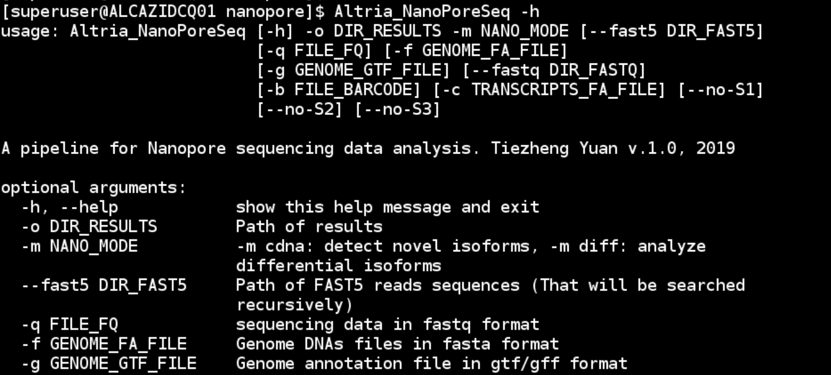
Python pipeline for Nanopore sequencing data
Source code: https://github.com/Tiezhengyuan/python_bioinformatics

Slide 7
Workflow of cDNAs identification

Slide 8
Workflow of qualification of transcripts

