Slide 1
Bioinformatics Workflow Engine: NextFlow
Tiezheng Yuan
Jan 23th, 2020

Slide 2
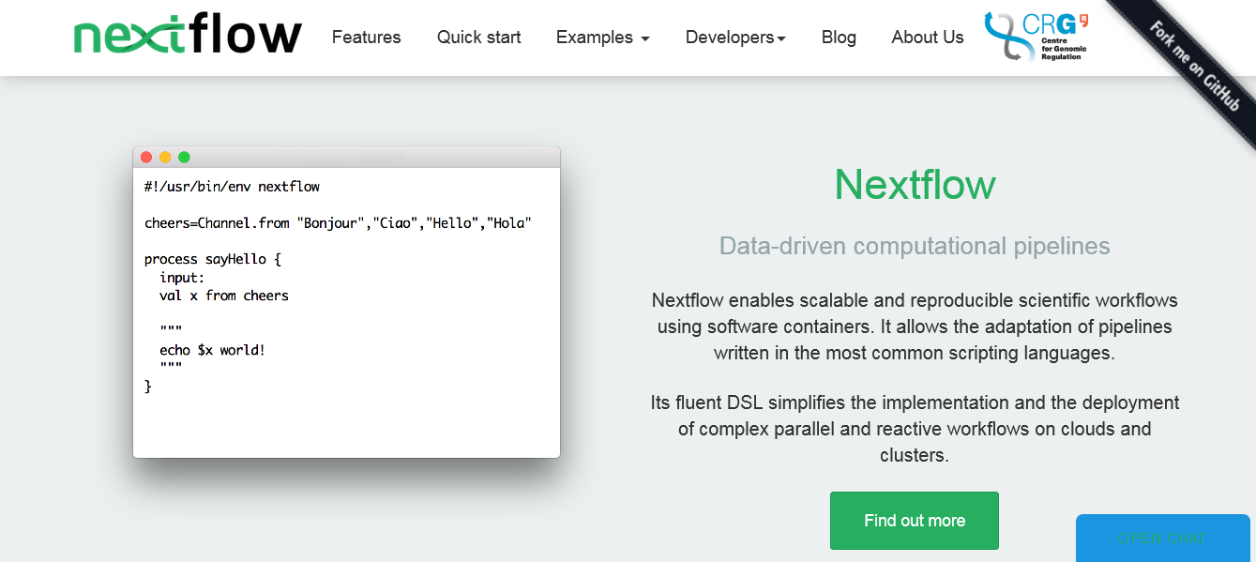
What is NextFlow?
https://www.nextflow.io/
Notes:
The workflow engine NextFlow rules some minimal syntax to allow you develop pipeline for bioinformatics data analysis. NextFlow is like Linux/Unix-style bash script programming, but its programming pattern is routine for fast development and easy deployment.

Slide 3
Use NextFlow: Single day learning
Linux knowledge: install binary packages and run tools
Bash scripting knowledge: write simple bash scripts
NextFlow syntax and format: write a NextFlow script
Deployment: start with an example

Slide 4
What do a NextFlow script look like?
#!/usr/bin/bash
Hello = ( “A” “B” “C” “D” “E” “F” )
for x in “${Hello[@]}”
echo “$x” is printed!
done
#!/usr/bin/env nextflow
Hello = channel.from “A” “B” “C” “D” “E” “F”
Process sayHello{
input:
val x from Hello
“””
echo $x is printed!
“””
}
Bash script NextFlow script

