Slide 1
NextFlow: Pipeline Topology
Tiezheng Yuan
March 21th, 2020

Slide 2
Why we talk about “topology”
Split data -> handle data concurrently-> determined by “Channel” block
Decompose tasks -> Handle processes concurrently or sequentially -> determined by “process” block

Slide 3
NextFlow Process
Process is basic component of a nextflow pipeline.
Channel determines parallel status of a process
Input and output blocks determine the workflow of processes execution in a pipeline.
Process topology reveals relationship of processes and their execution order in analytic process.
Clarification of process topology will facilitate coding work of nextflow pipeline development.

Slide 4
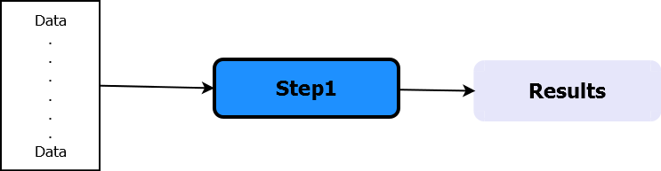
A single-process pipeline
#!/usr/bin/env nextflow
echo true
x = Channel.from('a', 'b', 'c')
process print2{
input:
val e from x
script:
"""
echo 'process $e'
"""
}
Data handling: concurrent
Process: N/A
NextFlow script NextFlow topology
Notes:
This a simple script. Only one process is defined. Data is array like.

Slide 5
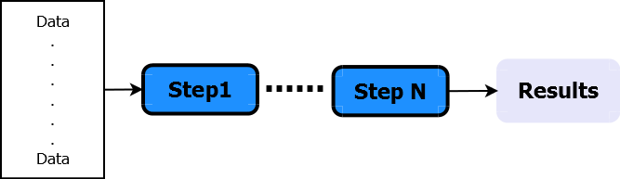
Sequential Processes
s1_ch = Channel.from(1,2,3)
process step1{
input:
val x from s1_ch
output:
val x into s2_ch
"""
echo "step1: $x"
"""
}
process step2{
input:
val x from s2_ch
"""
echo "step2: $x"
"""
}
Data handling: concurrent
Process: sequential
NextFlow script NextFlow topology
Notes:
Two processes are defined. Data is array like. In real world two or more processes could be defined.
In nextflow, input and output will define the order of different processes. The order of writing doesn’t determine the execution order.

Slide 6
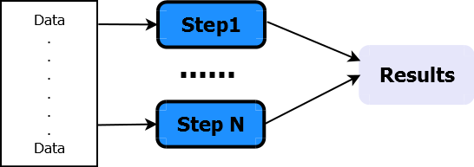
Concurrent Processes
ch1 = Channel.create()
ch2 = Channel.create()
Channel.from(1,2,3).separate (ch1, ch2) { it -> [it, it] }
process step1{
input:
val x from ch1
"""
echo "step1: $x"
"""
}
process step2{
input:
val x from ch2
"""
echo "step2: $x"
"""
}
Data handling: parallel
Process: concurrent
NextFlow script NextFlow topology
Notes:
Here, two channels are defined, which could be different. And two processes are concurrent launched.

Slide 7
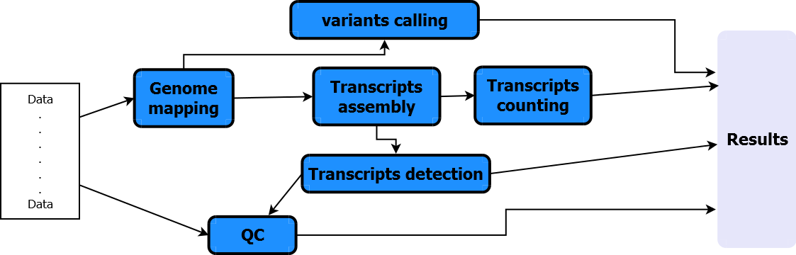
Hybrid Processes: mRNA-seq analytic pipeline
NextFlow script NextFlow topology
Notes:
There is usually a critical path in the pipeline. And there are some optional branches. Some processes could be concurrent. Some should be sequential.

Slide 8
Steps of determining pipeline topology
Requirement analysis
Define tasks and decompose tasks if necessary
Identify critical path and determine branches.
Identify input and output.
Determine execution: bioinformatics tools or scripts
Notes:
The key steps here are the 2-3 steps.

