Slide 1
NextFlow: Build Blast Pipeline
Tiezheng Yuan
March 23th, 2020

Slide 2
Outline
Blast introduction
Steps of building blast nextflow pipeline
Details of all steps
Notes:
I employ the blast nextflow pipeline to show how to build a nextflow pipeline.

Slide 3
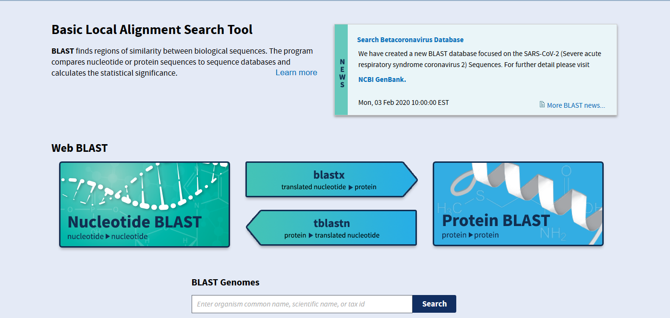
Blast: a sequence aligner
https://blast.ncbi.nlm.nih.gov/Blast.cgi
Notes:
NCBI provide web app of blast. Here I talked about how to use blast locally.

Slide 4
Steps of developing NextFlow pipeline
Requirement analysis and understand biological background
Pipeline topology analysis and design: Define tasks and decompose tasks if necessary Identify critical path and determine branches. Identify input and output.
Development preparation: prepare example data (query fasta) and references (*fasta) Install and test bioinformatics tools (blast) Execution of the whole analytic process at command lines.
Coding work -> unit testing -> integral testing -> documentation
System testing and deployment

Slide 5
Requirement analysis
Needs or expectations from biologists: I would like to conduct sequence alignment using Blast. Or Can you help to to detect similarity of some certain sequences against a given references.
High-level functional requirements specifications: The pipeline shall do nucleotide sequence alignment using blastn. The pipeline shall do amino acid sequence alignment using blastp. The pipeline shall automatically recognize nucleotide or protein sequences based on nextflow.config. The pipeline shall automatically build reference database based on reference in fasta format.

Slide 6
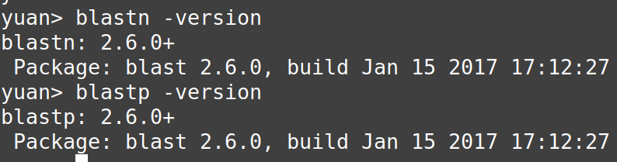
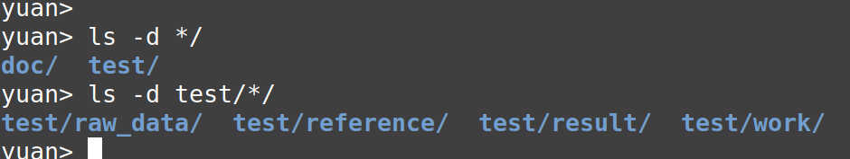
Create a repository as a starting point
That could be used as coding template, which standardize development process.

Slide 7
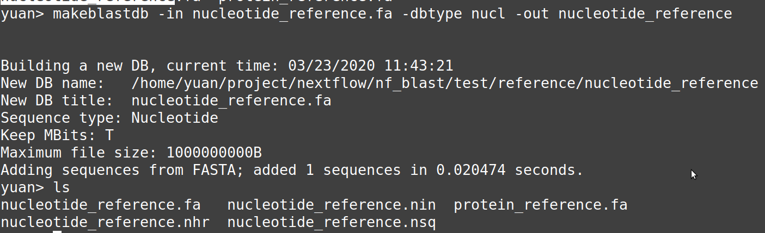
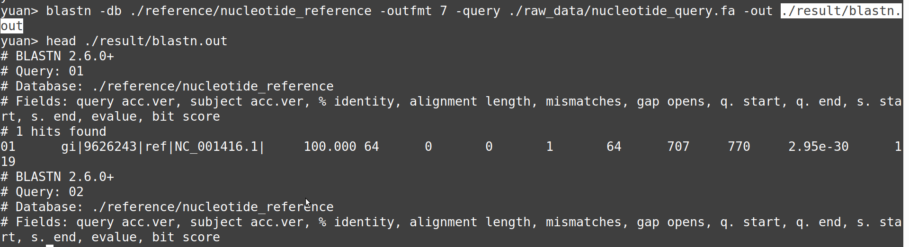
Launch blastn at commandline

Slide 8
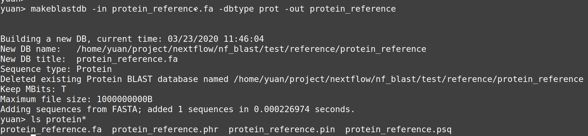
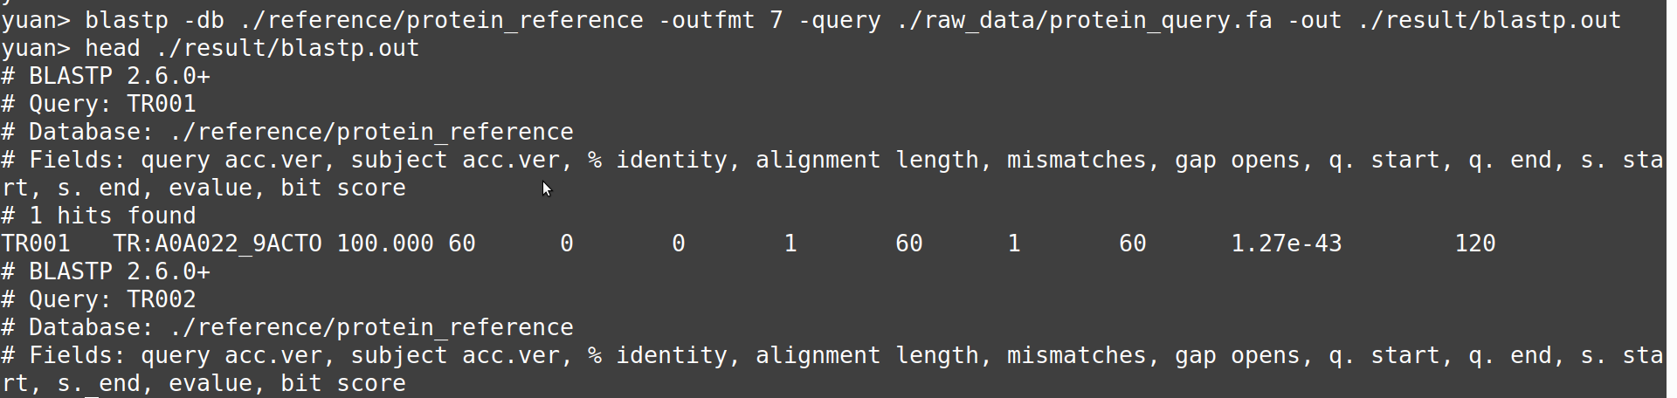
Launch blastp at command line

Slide 9
White-box testing
Unit testing: Isolate functions and codes at unit testing test all small blocks: channels, and processes
Integral testing: Combine channels or process once unit testing is done.
System testing: test pipeline use real data at real running environments

Slide 10
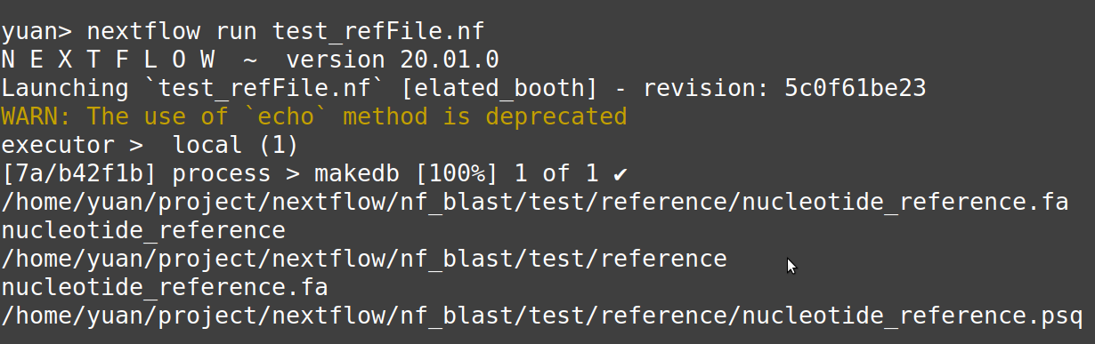
Unit testing: test file data type
params.reference = './reference/nucleotide_reference.fa'
ref_fa = file(params.reference)
db_psq = file("${ref_fa.parent}/${ref_fa.baseName}.psq")
process makedb{
"""
echo $ref_fa
echo $ref_fa.baseName
echo $ref_fa.parent
echo $ref_fa.name
echo $db_psq
"""
}
NextFlow script test exports

Slide 11
Unit testing: test pass parameters from nextflow.config
#!/usr/bin/env nextflow
echo true
process test{
"""
echo $baseDir
echo $params.outfmt
echo $params.chunkSize
"""
}
NextFlow script test exports

Slide 12
Unit testing: test fromPath
Channel
.fromPath("$params.query")
.splitFasta(by:params.chunkSize, file:true)
.set {query_ch}
process test{
input:
file 'query_file' from query_ch
"""
echo $query_file
"""
}
NextFlow script test exports

Slide 13
Unit testing: test make db process
//
process makedb{
script:
if ( db_index.isFile() ){
"""
echo "The index files of $ref_fa exist. skip makeblastdb"
"""
}
else{
"""
echo "Build blast index file based on $ref_fa."
makeblastdb -in $ref_fa -dbtype $params.dbtype -out $db
"""
}
}
params.reference = './reference/nucleotide_reference.fa'
params.dbtype = 'nucl'
ref_fa = file(params.reference)
db = file("${ref_fa.parent}/${ref_fa.baseName}")
if (params.dbtype == 'nucl'){
db_index = file("${ref_fa.parent}/${ref_fa.baseName}.nsq")
}else{
db_index = file("${ref_fa.parent}/${ref_fa.baseName}.psq")
}
NextFlow script

Slide 14
Unit testing: test alignment process
process blast{
input:
file 'query_file' from query_ch
output:
file 'blast_hits' into hit_ch
script:
if (params.dbtype == 'nucl'){
"""
blastn -db $db -outfmt $params.outfmt -query query_file -out blast_hits
"""
}
else if (params.dbtype == 'prot'){
"""
blastp -db $db -outfmt $params.outfmt -query query_file -out blast_hits
"""
}
}
hit_ch.collectFile(name: "$params.out", newLine:true)
.subscribe { println "Export blast results to $it"}

Slide 15
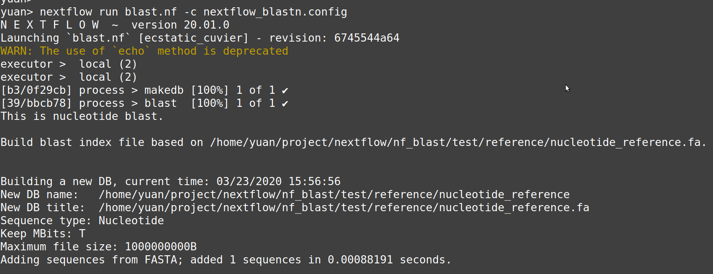
Integral Testing: blast.nf on blastn

Slide 16
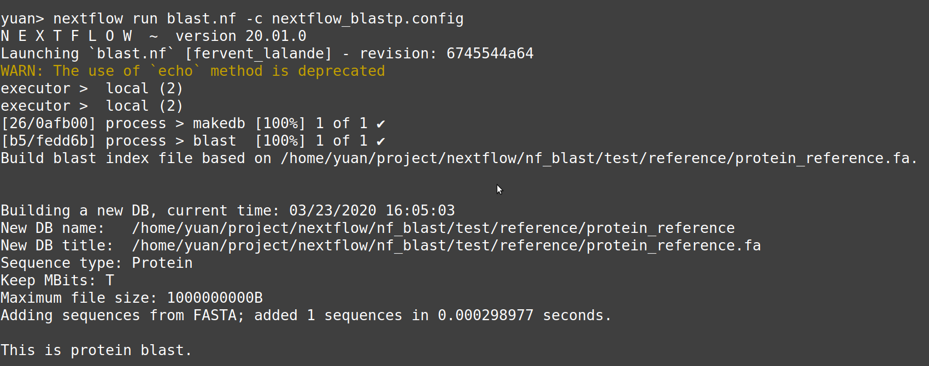
Integral Testing: blast.nf on blastp

Slide 17
Source code
https://github.com/Tiezhengyuan/nextflow/tree/master/nf_blast

