Slide 1
Bioinformatics NextFlow: Build Bowtie pipeline
Tiezheng Yuan
March 24, 2020

Slide 2
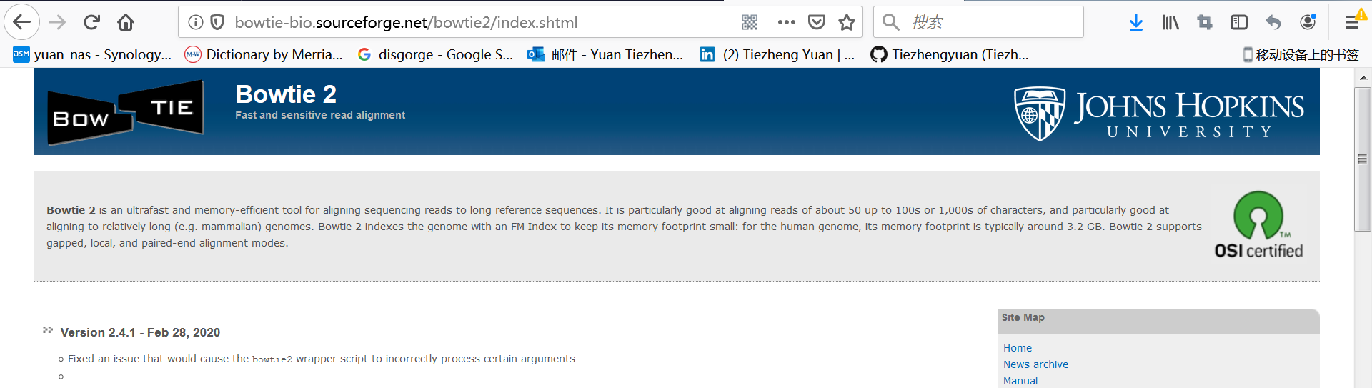
Sequence aligner: Bowtie
Bowtie2 is widely used for short reads sequence alignment

Slide 3
Steps of sequence alignment
Build index using reference in fasta format
Conduct sequence alignment
Analyze *.sam file

Slide 4
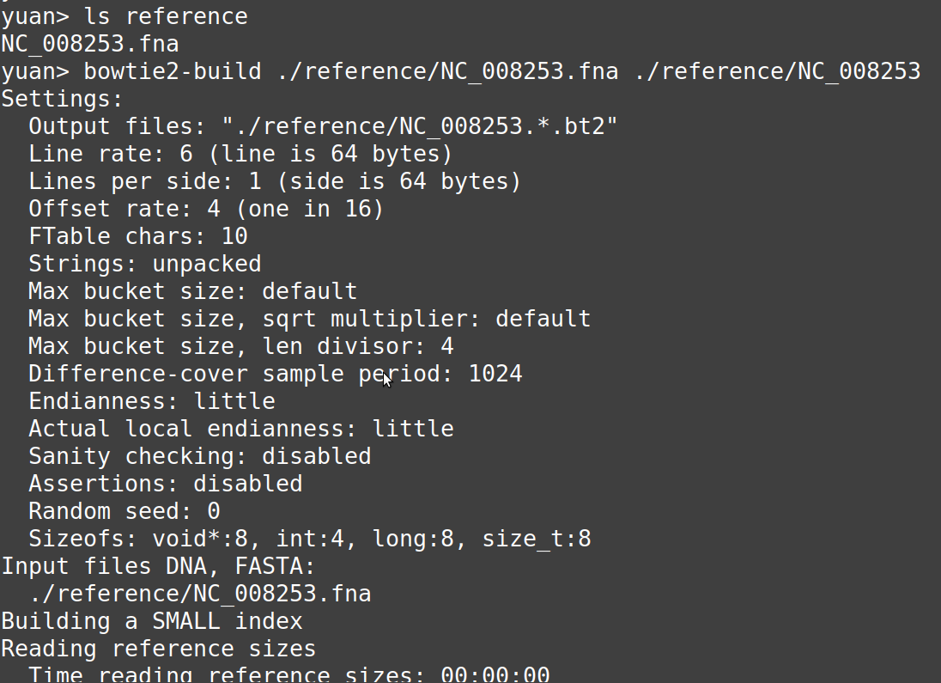
Build index

Slide 5
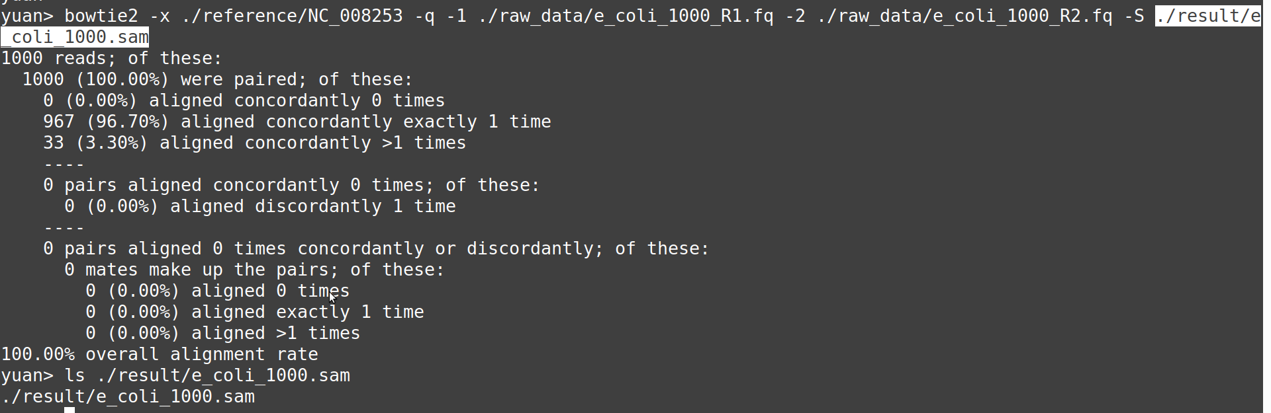
Sequence alignment

Slide 6
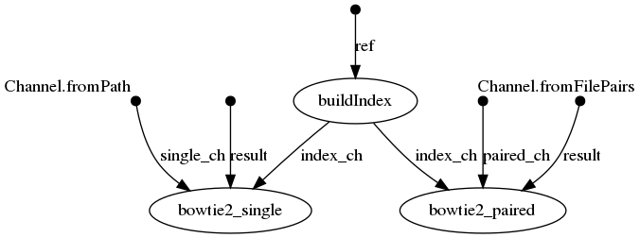
Topology of nextflow pipeline

Slide 7
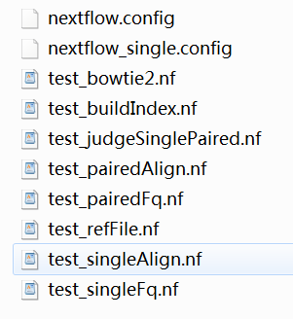
Unit Testing
Test all nextflow blocks

Slide 8
Test functions of picking files
//pick up fastq files
rawData = file(params.rawData)
fqType = params.fqType
Channel
.fromFilePairs("${rawData}/*R{1,2}*.fq")
.set {paired_ch}
Channel
.fromPath("${rawData}/*R1*.fq")
.set {single_ch}
//reference
ref_fa = file(params.reference)
//result
result_path = file("${params.result}")
Files needed: reference in fasta DNA query file in fastq with single- or paired-end

Slide 9
Nextflow process for building index
process buildIndex{
input:
file ref from ref_fa
output:
val index into index_ch
script:
index = file("${ref_fa.parent}/${ref_fa.baseName}")
index_file = file ("${ref_fa.parent}/${ref_fa.baseName}.1.bt2")
if ( index_file.isFile() ){
"""
echo "The index files of $ref exist. skip index building"
"""
}
else{
"""
echo "Build blast index file based on $ref."
bowtie2-build ${ref} ${index}
"""
}
}
The process recognizes index file, and automatically decides whether to build a new one or skip this process

Slide 10
Sequence alignment
process bowtie2_paired{
input:
set sampleID, pair from paired_ch
val index from index_ch
val result from result_path
when:
fqType == 'paired'
"""
bowtie2 -x ${index} -S $result/${sampleID}.sam -1 ${pair[0]} -2 ${pair[1]}
"""
}
process bowtie2_single{
input:
file R1 from single_ch
val index from index_ch
val result from result_path
when:
fqType == 'single'
"""
bowtie2 -x ${index} -S $result/${R1.baseName}.sam -q ${R1}
"""
}
Automatically decide either of the two processes can be launched.

Slide 11
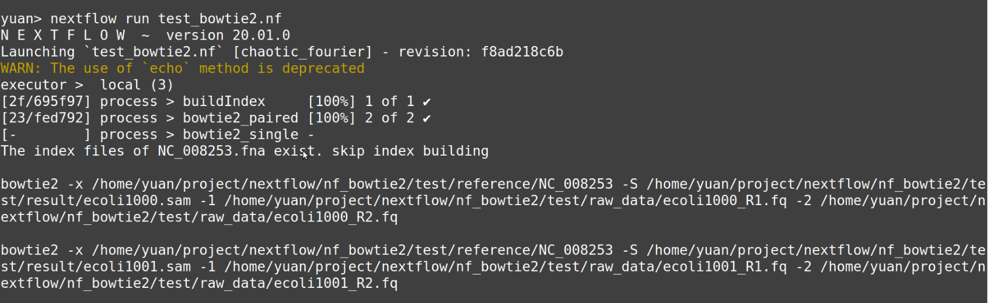
Integral testing on all pipeline

