Slide 1
Bioinformatics NextFlow: Variants Calling Pipeline
Tiezheng Yuan
March 24, 2020

Slide 2
Variants calling
Variants: SNPs, copy number variation (CNV), deletion, insertion
Variants calling: mostly SNPs
Data source: DNA level: whole genome sequencing, exome sequencing RNA level: mRNA-seq
Bioinformatics tools: bowtie2, samtools, bcftools

Slide 3
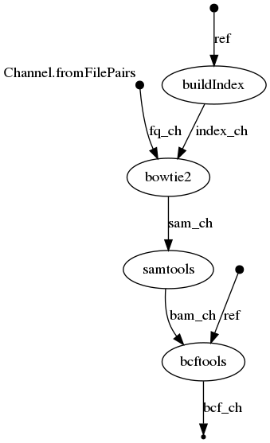
Topology of the VC pipeline

Slide 4
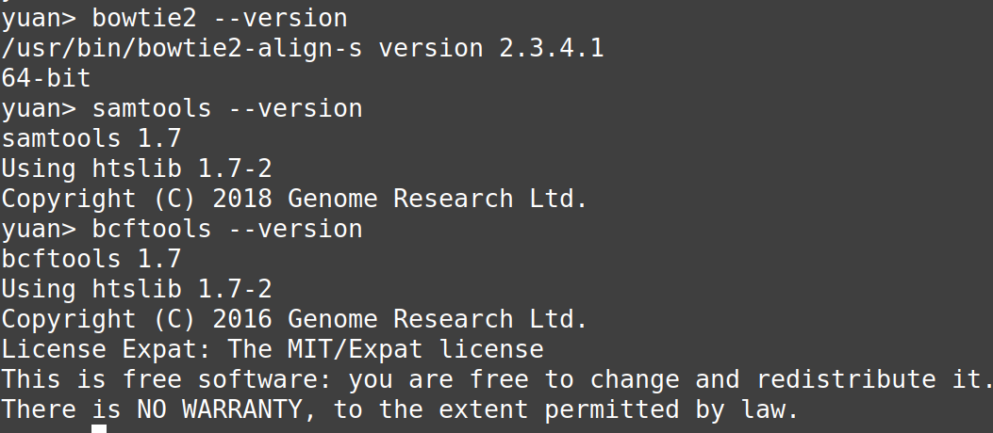

Bowtie2 -> samtools -> bcftools

Slide 5
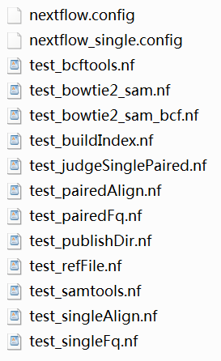
Unit Testing

Slide 6
Pick up input files
//pick up fastq files
rawData = file(params.rawData)
fqType = params.fqType
if(fqType == 'paired'){
Channel
.fromFilePairs("${rawData}/*R{1,2}*.fq")
.set {fq_ch}
}else{
Channel
.fromPath("${rawData}/*R1*.fq")
.map {it -> [it.baseName, it]}
.set {fq_ch}
}
//reference
ref_fa = file(params.reference)
//result
out = file("${params.result}")

Slide 7
Samtools convert sam file to bam file
process samtools{
publishDir "${out}"
input:
file sam from sam_ch
output:
file "${sam.baseName}.bam" into bam_ch
"""
echo "samtools sort -T ${sam.baseName}.tmp -o ${sam.baseName}.bam ${sam}"
samtools sort -T ${sam.baseName}.tmp -o ${sam.baseName}.bam ${sam}
"""
}

Slide 8
bcftools conduct variants calling
process bcftools{
publishDir "${out}"
input:
file ref from ref_fa
file bam from bam_ch
output:
file "${bam.baseName}.bcf" into bcf_ch
"""
echo "bcftools mpileup -f ${ref} ${bam} | bcftools call -mv -Ob -o ${bam.baseName}.bcf"
bcftools mpileup -f ${ref} ${bam} | bcftools call -mv -Ob -o ${bam.baseName}.bcf
"""
}

Slide 9
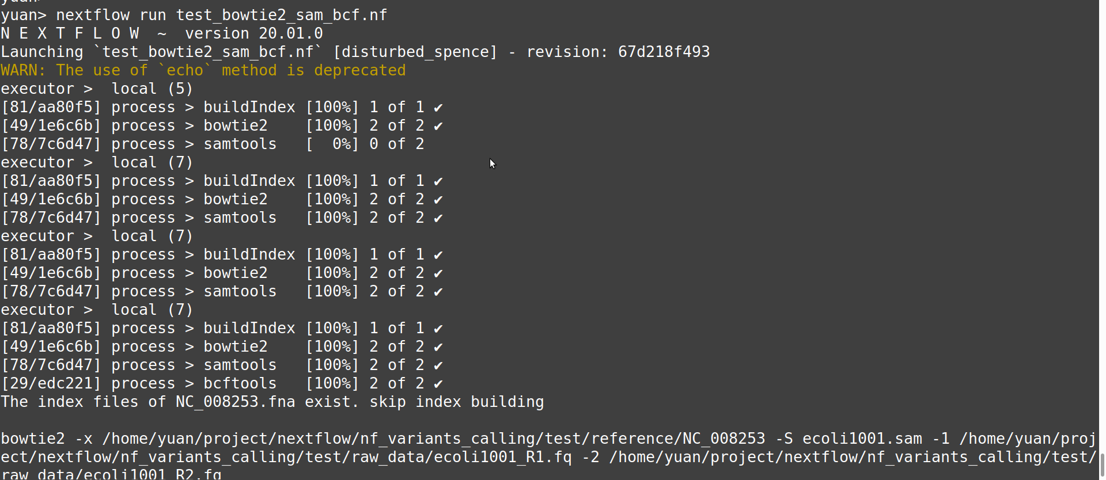
Integral testing

