Slide 1
Develop Python pipeline:
Constructor and Destructor
Tiezheng Yuan
Feb 01, 2020
Notes:
Hello. Today I am going to introduce what is inheritance in Python.

Slide 2
Constructor and Destructor
Constructor is special method in a class that are automatically executed when an object of the class is created.
Destructor is special method in a class that are automatically executed when an object of the class is destroyed.
Both of them have no returns. The program can’t call them directly.
Notes:
What are constructor and destructor

Slide 3
Basic example of constructor and destructor
class test:
#constructor
def __init__ (self):
print (“This is constructor”)
#destructor
def __ del__(self):
print(“This is destructor”)
#other static methods
def other(self):
pass
Notes:
Here are the example of constructor and destructor

Slide 4
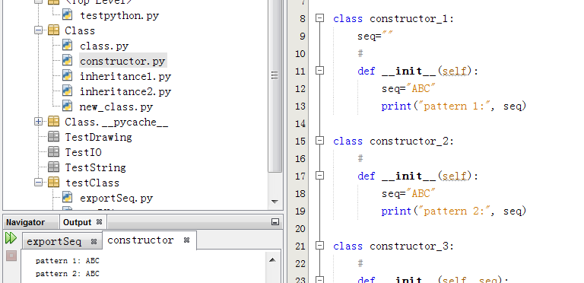
Initiate variables
Notes:
The classes constructor1 and constructor 2 show two patterns of variable initiation. Both of them are equal.

Slide 5
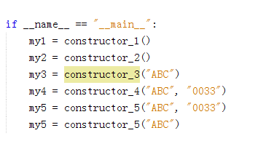
Pass one parameter
#pass one parameter
class constructor_3:
def __init__(self, seq):
self.seq=seq
print("pattern 3:", self.seq)
Notes:
Here is the example of one parameter passing.

Slide 6
Pass mulstiple parameters
#pass multiple parameters
class constructor_4:
def __init__(self, seq, seqID):
self.seq=seq
self.seqID=seqID
print("pattern 4:", self.seq, self.seqID)
#pass multiple parameters but one can be default
class constructor_5:
def __init__(self, seq, seqID="NA"):
self.seq=seq
self.seqID=seqID
print("pattern 4:", self.seq, self.seqID)
Notes:
Here is the example of multiple parameters passing.

