Slide 1
Develop Python pipeline:
Generator
Tiezheng Yuan
March 26, 2020
Notes:
Hello. Today I am going to introduce python generator

Slide 2
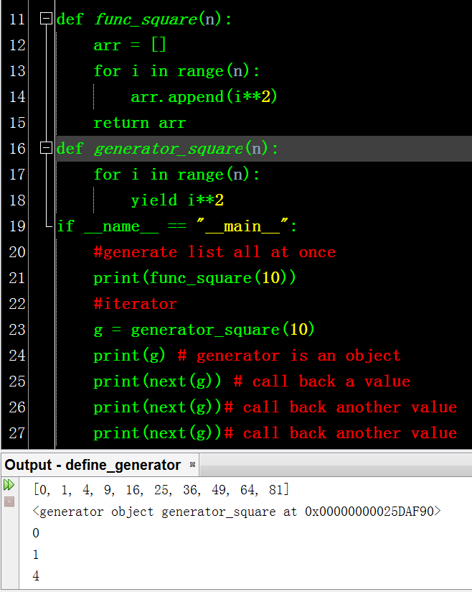
Create a generator
Generator is an iterator. Replace return with yield once it is defined.
It works as a call-back function. It suspend in memory without creating all list. Once it is called using __next__(), it return only one value at a time; and then the process could be iterative through the end.

Slide 3
List vs. generator
Return list items all at once.
Loaded into memory. It could be reused.
Fast if the list is small
Huge memory required if the list is huge
Return an iterable, which suspend in memory.
Call back and return only one value at a call back.
It canot be reused or go back if the generator has been iterated.
RAM-consuming saved

Slide 4
Significance of generator
Save memory when huge list or dat stream is handled.
Generator is often used in list loop.
Application:
huge list: g = ( x**2 for x in range(10000) )
huge file: with open(‘/home/big_file.txt’) as f
Built-in generator:
range() in python 3, xrange() in python2.7
file handler
enumerate()

Slide 5
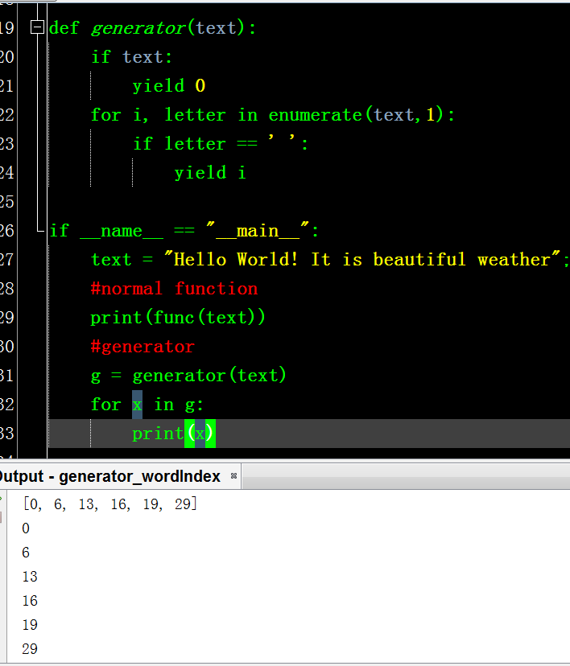
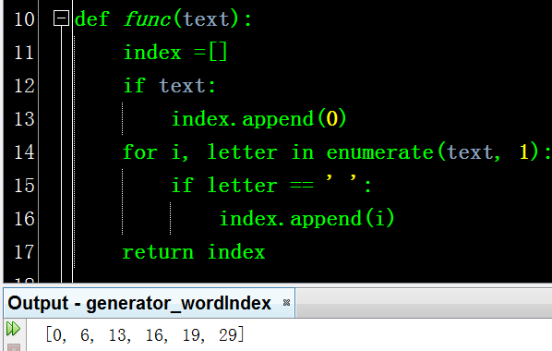
Generator coding is more concise

Slide 6
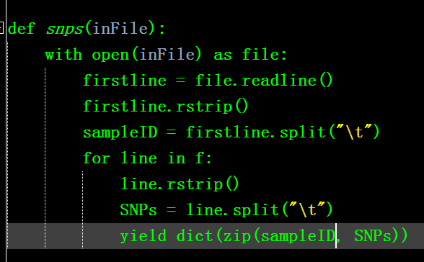
Handle huge file
Here is a 14GB text file storing SNPs.
A total of 12,000 SNP identifications are in rows, and 2,045 samples are in columns.
Bioinformatician would like to use some SNPs data one more times in a Python script.
Notes:
Typical, we need to go through the file and store data at memory.

Slide 7
Handle huge dynamic text files
A huge text file storing living stock market trade data. It is huge and accumulated with the time. Let’s say it is updated per 5s.
The goal is to extract and organize data.
Typical, data could be read as data frame (pd.DataFrame). That is slow and high memory load.
Use pandas.DataFrame.iterrows to return a generators. Use next() method to get latest data, which keep synchronization with latest market.

