Slide 1
Develop Python pipeline:
Class modeling
Tiezheng Yuan
Feb 05, 2020
Notes:
Hello. Today I am going to introduce what is inheritance in Python.

Slide 2
Class modeling or object modeling
Object modelling is a process that represent a pipeline/software in terms of objects and O-O concepts.
In OOP, all things in real world are called objects, which are identified by particular attributes and methods.
UML (unified modeling language) is used for visualizing and documenting object modeling.
Visual tools:
use case modeling
class diagram

Slide 3
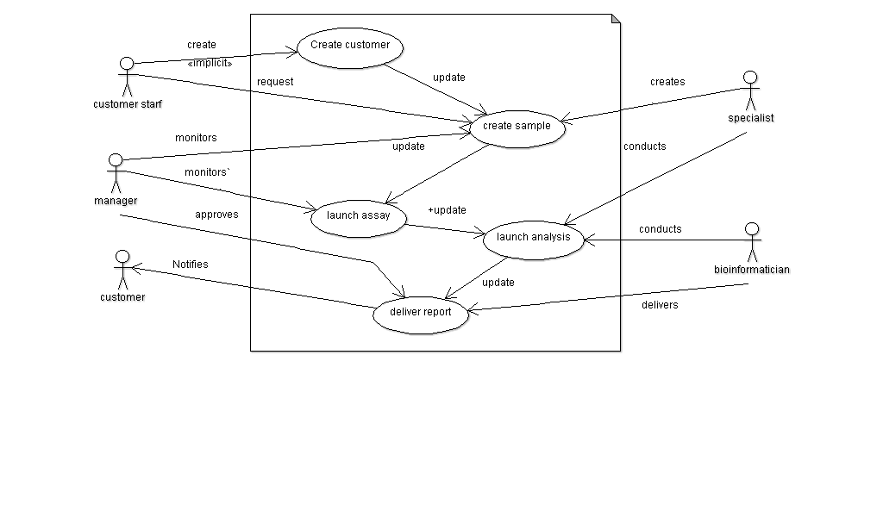
Use case modeling
A use case represents the steps of a particular business function or process.
Notes:
A use case represents the steps of a particular business function or process. This use case diagram shows how a process of sample assay is finished from creating sample through delivering reports.

Slide 4
Class diagram (CD)
CD shows all objects and classes and their relationships involved in a user case.
CD should also include other objects such as data type or error exception and so on.
CD helps developers to conduct coding work, testing engineers to understand internal logic, business analysts to model the software from business perspective.
Notes:
Class diagram is so crucial for OO analysis. Drawing class diagram should predate of coding work.

Slide 5
A good class diagram
Involve all components:
class/objects
attributes and methods
Show relationship:
inheritance
aggregation
composition
association
dependency

Slide 6
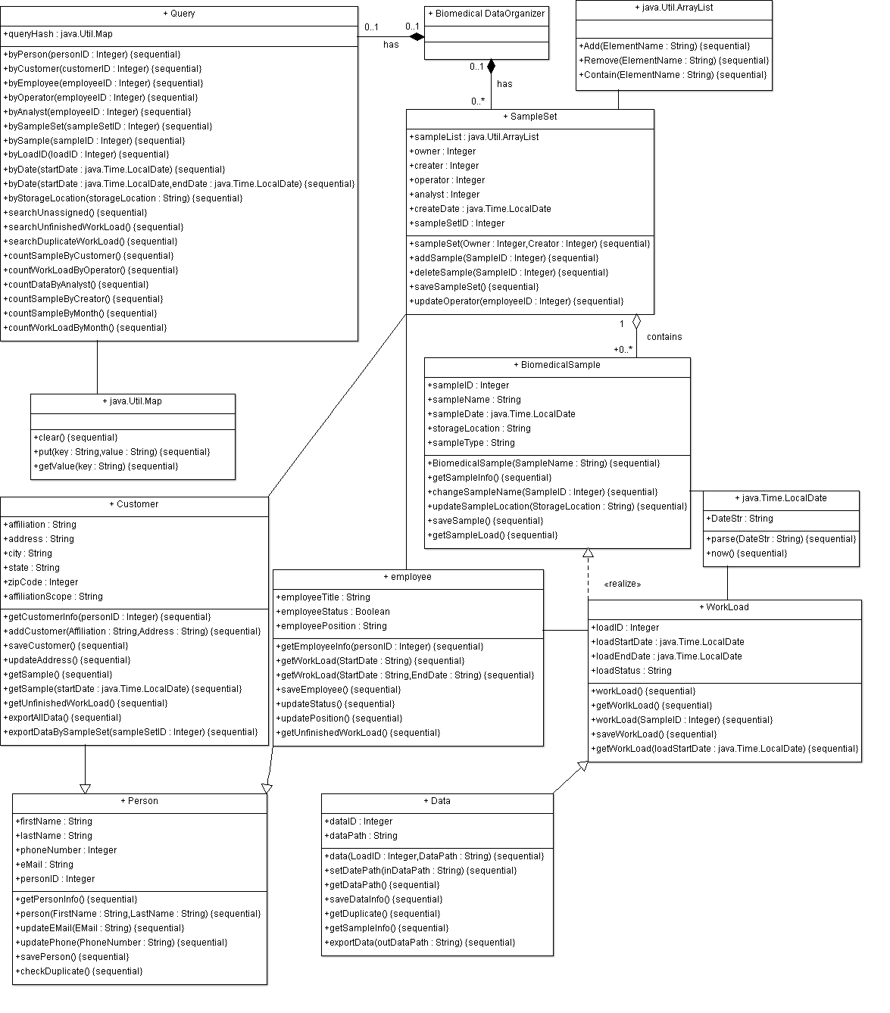
Summarization
and monitoring
Biomedical
sample
organization
Resource
allocation
Notes:
Continue the same example. This class diagram shows all classes and objects involved in source code. There are three main functional modules. One is biomedical sample module, which organize samples and data. This one is human resource module, which relocate work load and control and monitor status. The last one is statistics modules, which carry out some summarization of relevant information. All functional modules work together for data integration and make the process of controlling and monitoring through sample life cycle.

Slide 7
Weakness of class diagram
Some rough description of class/object modeling for more complicated class architecture because it is hard to squeeze all classes into one page.
Class diagram could be out of date in a long-term Agile because some requirements may not be clarified at the beginning.
Sterling class diagram depends on experience of analyst. Incomplete class diagram may confuse later coding work.
It is a typical Object-Oriented tool. A class diagram might not fit well with the functionalities of a Python pipeline.

