Slide 1
Develop Python pipeline:
Unit Testing
Tiezheng Yuan
Feb 08, 2020
Notes:
Hello. Today I am going to introduce what is unit testing in developing Python pipelines.

Slide 2
Unit testing
Unit testing is the process of testing individual units of source code.
In large project, developers and testers are different roles. In terms of development of python pipeline, developers often work as testers.
White-box testing and Black-box testing.
White-box testing considers internal mechanism of source code.
Goals of unit testing:
Verify the correctness of source code.
Validate the robustness and functionality.
Notes:
Unit testing is the process of testing individual units of source code. Unit testing is so important that it is a starting point for all other kinds of testing approach such as integration test, system test or acceptance test. You can’t release python pipeline without testing, and can’t do code work only without unit testing. In large project, developers and testers are different roles. In terms of development of python pipeline, developers often work as testers. Here, I am going combine unit testing with White-box testing.
White-box testing considers internal mechanism of source code. What are goals of unit testing: Verify the correctness of source code. Validate the robustness and functionality.

Slide 3
Prepare white-box unit testing
Design basic testing path and prepare data for testing
Prepare testing plan
Build testing repository
Create separate Python scripts for testing
Version control: The version of testing unit should keep up with the version of the source code that is subject to testing.
Notes:
Design basic testing path and prepare data for testing. Prepare testing plan
Build testing repository and Create separate Python scripts for testing
Version control: The version of testing unit should keep up with the version of the source code that is subject to testing.

Slide 4
Build test cases: Test a function for reversing DNA sequence
a short DNA sequence: ATCTG
a long DNA sequence: ATCTG….
a numeric sequence: “3434”
a null string: “”
an amino acid sequence: “ATGUL”
a RNA sequence: “AGUC”
a DNA sequence with illegal (none A/T/G/C) characters: ”ATG3C”
a DNA sequence with unreadable characters: ”ATG^C”

Slide 5
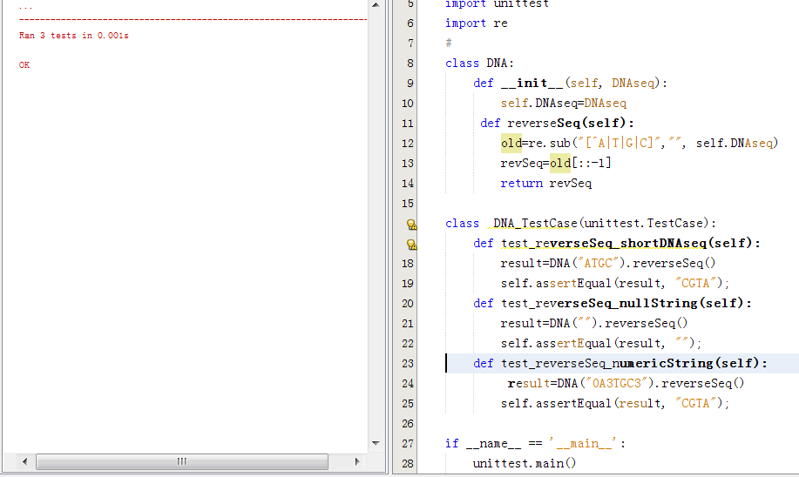
Unit testing tools in Python
Notes:
Python provide the module unitest for unit testing. Which is close to Java unit testing – JUnit. Here are three testing cases using the module unitest in python.

Slide 6
Practices of unit testing
Correctness: This is a basic requirement. No bug
Robustness: Consider to test extreme conditions.
Coverage: Cover all methods and all functionalities of a method.
Build separate repository for testing even if the developer and tester are the same person
Specificity: One method, and one test case. Keep notes of version control.
Isolation: Only test the unit itself. Consider mock-up approach if it is required.

