Slide 1
Develop Python pipeline:
Objects and Classes
Tiezheng Yuan
Jan 31, 2020
Notes:
Hello. Today I am going to introduce how are objects and classes defined in Python.

Slide 2
Objects
In real world, objects are the physical entities of which the world is comprised. We could observe those objects.
For object-oriented programming (OOP) thinking, objects are units or pieces of which a software system is comprised. We use objects to create abstract models.
In Python, objects could be variables such as list or dictionary. Objects could be functions, too.
Notes:
What is objects.

Slide 3
Classes
In real world, classes are units of entities with similar attributes. For example cars are categorized into sedan, SUV and pickup.
In OOP thinking, a class is an abstract description of units of objects.
In Python, a class is a bundle of data and functionalities.
Notes:
What is class

Slide 4
A basic example of class and object
class DNA:
DNASeq="ATTCGG"
def getDNA(self):
print("The DNA sequence is", self.DNASeq)
return self.DNASeq
Class: There is a class known as DNA
Objects:
The string variable DNASeq, which is created in the class.
The function getDNA, which is claimed by the prefix def
Notes:
Here is a basic example of class and object in Python. In this

Slide 5
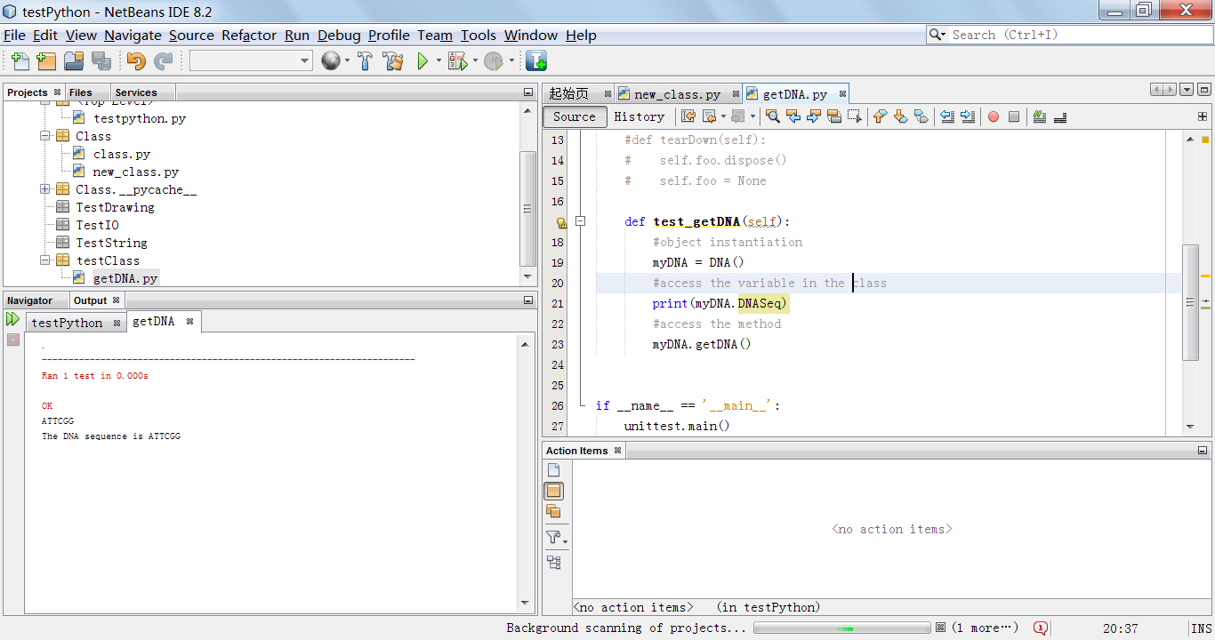
Instantiate a class and access objects
The class is “DNA”. The variable is “DNASeq”. The method is “getDNA”.
Notes:
Lets show how to use class in Python. Showed in the right side is the python code about instantiation of classes. And the results displayed in the left side.

Slide 6
Python could be functional programming except OOP
Data:
In Java, data should not be involved into an object. Data is assigned after an object is instantiated.
In Python, data could be part of an object when a variable object is claimed.
Variable:
A variable can not hold an object, but a reference to an object in Java.
A variable can be an object in Python.
Notes:
Java is rigid object-oriented. Python is much more flexible than Java. In terms of classes and objects, defining and using classes and objects is much easier in Python than other languages such as C++ and Java.
Data: In Java, data should not be involved into an object. Data is assigned after an object is instantiated. In Python, data could be part of an object when a variable object is claimed.
Variable: A variable can not hold an object, but a reference to an object in Java. A variable can be an object in Python.

