Slide 1
Develop Python pipeline:
Inheritance
Tiezheng Yuan
Feb 01, 2020
Notes:
Hello. Today I am going to introduce what is inheritance in Python.

Slide 2
Inheritance
There is a biological phenomenon: Parents give birth to their children. The Children usually inherit some features from their parents.
In object-oriented programming (OOP) thinking, a new class is a modified version of an existing class. This is inheritance. The existing class is called parent class, and the new class is called children class.
Notes:
What is inheritance

Slide 3
Inheritance in real world
Car
Sedan car
Sports car
A good way to extend current class without modifying it.
Notes:
Here is example of inheritance. The class car is parent class. And two children classes inherited attributes and methods from the parent class Car, and both of them own their specific attributes and methods.

Slide 4
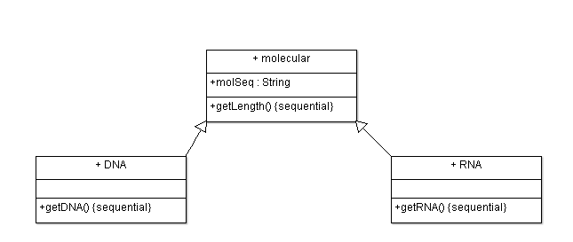
A basic example of inheritance
A good way to extend current class without modifying it.
Notes:
Here is a basic example of inheritance. The class molecular is parent class. And two children classes DNA and RNA. They inherited attributes and methods from the parent class.

Slide 5
A basic example of inheritance in Python
#parent class
class molecular:
def __init__ (self, molSeq):
self.molSeq=molSeq
#method of the parent class
def getLength(self):
seqLen=len(self.molSeq)
print("The length of the sequence is", seqLen)
return seqLen
Notes:
Here is a basic example of inheritance usage in Python. This is parent class known as molecular. One attribute is molecular sequence known as molSeq. And one method is used for calculating the length of the sequence.

Slide 6
A basic example of inheritance in Python
class DNA (molecular):
#method of the children class
def getDNA(self):
print("The DNA sequence is", self.molSeq)
return self.molSeq
class RNA (molecular):
#method of the children class
def getRNA(self):
print("The RNA sequence is", self.molSeq)
return self.molSeq
Notes:
The next is two children classes known as DNA and RNA, respectively.
The syntax is class prefix + class_name followed by parent class name encompass by brackets
Both of the children classes inherited all attributes and methods of their parent class.

Slide 7
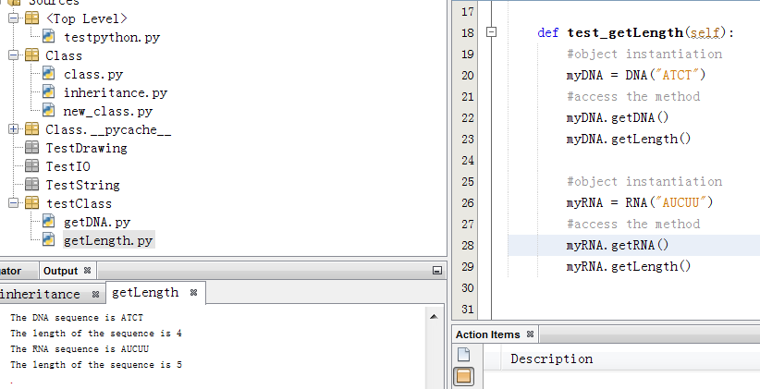
Use inheritance
Notes:
Here is the usage of inheritance. In these example, instantiate two classes DNA and RNA. They call the same variable from their specific method. They claim the same parent method inherited from the parent class. And the results are showed on the left side panel.

Slide 8
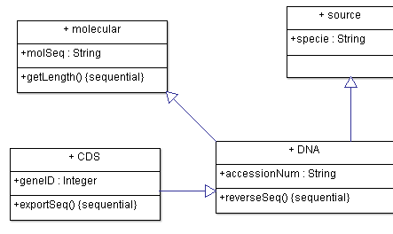
Hierarchical inheritance
Notes:
The next I am going to show more complicated example of inheritance.
Both the class molecular and source are the parent class of the child class DNA. And the class DNA is the parent class of the child class CDS. The class CDS inherited attributes and methods from the 3 parent classes.

Slide 9
#parent class 1
class molecular:
def __init__ (self, molSeq):
self.molSeq=molSeq
#method of the parent class
def getLength(self):
seqLen=len(self.molSeq)
print("The length of the sequence is", seqLen)
return seqLen
#parent class 2
class source:
def __init__ (self, specie):
self.specie=specie

Slide 10
#children class
class DNA (molecular, source):
def __init__ (self, molSeq, specie, accessionNum):
molecular.__init__(self, molSeq)
source.__init__(self, specie)
self.accessionNum=accessionNum
#method of the children class
def reverseSeq(self):
revSeq = self.molSeq[::-1]
return revSeq

Slide 11
class CDS (DNA):
def __init__ (self, molSeq, specie, accessionNum, geneID):
DNA.__init__(self, molSeq, specie, accessionNum)
self.geneID=geneID
#method of the children class
def exportSeq(self):
print("\nFASTA format:")
seqRecord = ">" + self.geneID + "|" + self.accessionNum + " " + self.specie + "\n" + self.molSeq
print(seqRecord)
return seqRecord

Slide 12
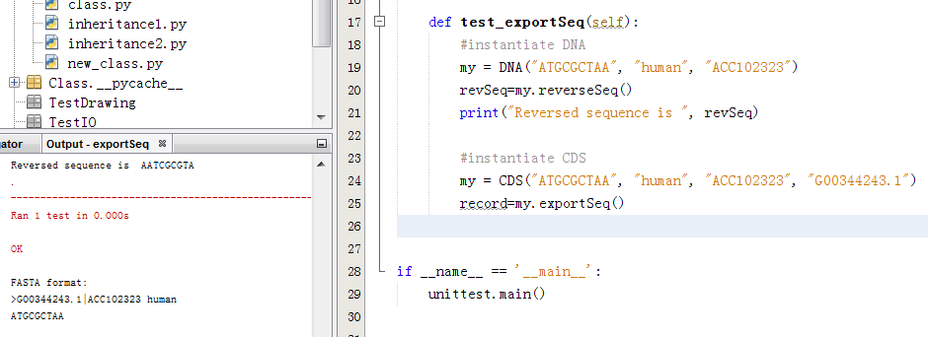
Notes:
Here is the execution status of this example. I instantiated two classes passing three or four parameters, repectively. The results are displayed on the left side.

