Slide 1
Develop Python pipeline:
Decorator
Tiezheng Yuan
Feb 04, 2020
Notes:
Hello. Today I am going to introduce what is inheritance in Python.

Slide 2
Decorator
Decorator is a specific change to the function of an object.
Decorator is used for functional extension
Decorators alter the functionality of the function, method or class without having to directly use subclasses or change the source code of the function being decorated.
Decorators could be used before or after an object.
Decorators in Python reflect functional programming, a little differing from object-oriented programming.
Notes:
What are constructor and destructor

Slide 3
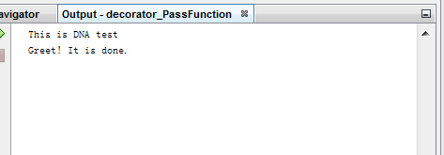
Usage 1: Pass an object as an argument to another function
class test:
def printDone(self):
return ("Greet! It is done.")
class DNA(test):
def printTest(self, func):
print("This is DNA test")
print(func())
if __name__ == "__main__":
basic = test()
my = DNA()
my.printTest(basic.printDone)
Notes:
In this example, the function printTest is a decorator of the function of printDone. printTest extends the function of the function f printDone by pass the function printDone as an argument.
Let imagine the scenario: There are multiple functions, which share some codes. Therefore, we could package the part of code as a parent function. Pass the parent function as an argument to the child function once the child function is used.

Slide 4
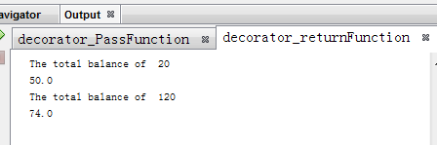
Usage 2: Return functions within a function
class rate:
def __init__(self, counts):
self.counts=counts
def GenericRate(self):
return self.counts*0.5+40
def DiscountRate(self):
return self.counts*0.45+20
#
def calcRate(counts):
print("The total balance of ", counts)
if (counts<100):
return rate(counts).GenericRate()
else:
return rate(counts).DiscountRate()
if __name__ == "__main__":
print(calcRate(20))
print(calcRate(120))
Notes:
In this example, the function calcRate is a decorator of the two functions GenericRate and DiscountRate, which are the returns of the function calcRate().
Let imagine the scenario: Various patterns for calculating rates are fixed and packaged. We don’t want script executors to change any of the functions. But allow them to determine which one could be used based on real circumstances, especially in case that the conditions vary.

Slide 5
Usage 3: Embed functions in one function
class test:
def __init__(self, counts):
self.counts=counts
def calcRate(self):
##embed a function
def convertCounts(counts):
return counts*3
#calculate rate
rate=convertCounts(self.counts)+10
return rate
if __name__ == "__main__":
print(test(30).calcRate())
Notes:
In this example, the function calcRate () include a function convertCounts. However, embedding functions is not suggested unless it is worthy to do that.

Slide 6
When decorators are used?
Decorator in Python is close to the polymorphism in OOP programming.
1. Pass additional arguments to a function: extend a function
2. Encapsulate some functionalities: developer vs. callers
3. Reuse Python code, and make code more succinct.
4. Test some tentative changes in SDLC, especially in a large Python project.
5. Optimize Python script execution for complex data structure: int, float, string.

Slide 7
Notes of decorators
Avoid decorators chain.
Too many decorators in Python may ruin OOP class architecture. Developers might be lost in decorators chain. If so, you might as well re-design the class diagram
Decorators may make code unreadable.
Developers are forced to leap among different functions in order to come up with a particular function.
Set proper checkpoint or error handling.
Code execution is transact among different python code when decorators are executed.
Notes:
Some points should be noted.

