Slide 1
Develop Python Pipeline: parallel Processing
Tiezheng Yuan
Feb 07, 2020
Notes:
Hello. Today I am going to introduce what is inheritance in Python.

Slide 2
Process and Thread
Process | Thread
An execution of a program | A part of a process
Managed by process control block of CPU | Managed by a schedule
Isolated memory usage | Share memory
Consume more system resource | Require less system resource
Not data shared | Share data
Communication needs more time | Communication needs less time
Notes:
In this table, I compare the difference between process and thread.

Slide 3
CPU- and IO-intensive task
CPU-intensive task means that the execution of a program or process is mostly limited by the rate of CPU. Most of the time is spent at execution of the code.
Examples: matrix calculation, big data processing.
IO-intensive task means such execution is constrained by the rate of IO device. The process is blocked by IO device.
Examples: the operations of read/write tremendous files are often limited by IO rate of hard drives. Web scrapping are often limited by the socket of internet.
Notes:
CPU-intensive task means that the execution of a program or process is mostly limited by the rate of CPU. Most of the time is spent at execution of the code.
Examples: matrix calculation, big data processing.
IO-intensive task means such execution is constrained by the rate of IO device. The process is blocked by IO device.
Examples: the operations of read/write tremendous files are often limited by IO rate of hard drives. Web scrapping are often limited by the socket of internet.

Slide 4
Global Interpreter Lock (GIL)
Python is a kind of interpreting programming language, written by C. The default interpreter of Python is CPython. In Cpython, GIL protects access to Python objects, allowing that only one thread execution at a time.
Due to GIL, the pattern multi-threading in Python is close to time-division multiplexing.
Notes:
Python is a kind of interpreting programming language, written by C. The default interpreter of Python is CPython. In Cpython, GIL protects access to Python objects, allowing that only one thread execution at a time.
Due to GIL, the pattern multi-threading in Python is close to time-division multiplexing. Because of GIL, execution of python scripts using multi-threading isn’t concurrent multiple threading but pseudo-multiple threads, of which a single thread is executed in one process.

Slide 5
Mutli-threading using the module thread
import thread
import time
#
def loop(tid,x):
print ("ID:%s=%s\n", tid,x)
time.sleep(100000)
#multi-threading
def multithreading():
for i in range(1,5):
print ("in:", i)
thread.start_new_thread(loop, (i,i))
Notes:
The python model thread is used in python2, and removed from standard library in Python3.

Slide 6
Mutli-threading using the module threading
import threading
import time
#
def loop(tid,x):
print ("ID:%s, input:%s\n", tid,x)
time.sleep(1)
#multi-threading
def multithreading():
for i in range(1,5):
print ("in:", i)
t=threading.Thread(target=loop, args=(i,i), name=i)
t.start()
t.join()
Notes:
The module threading displace the module thread. In this example, the script instantiate the object of threading.thread().
In this method, the method join() tells python interpreter to release resource once a children thread is done without waiting the parent thread.
All objects (variables) are shared by various threads in this pattern. So be watchful when applying multi-threading. Therefore, it is safe to lock particular variables preventing conflicts.

Slide 7
The module multiprocessing.dummy
import multiprocessing.dummy as mpd
import time
#
def loop(tid,x=5):
print ("ID:%s, input:%s\n", tid,x)
while x==1000:
x+=1
time.sleep(1000)
def multithreading():#multi-threading
pool=mpd.Pool(2) #create a threads pool with threads number
pool.map(loop, range(5)) #pass one argument at a time
pool.map(loop, zip(range(5), range(5))) #pass two arguments at a time
pool.close()
pool.join() #release resource when execution of a thread is done.
Notes:
This code represent the usage of multi-threading using the python module multiprocessing.dummy
multiprocessing.dummy replicates the API of multiprocessing but is no more than a wrapper around the threading module.

Slide 8
The module multiprocessing
import multiprocessing as mp
import time
#
def loop(tid,x=5):
print ("ID:%s, input:%s\n", tid,x)
while x==1000:
x+=1
time.sleep(1000)
def multiprocessing():#multi-processing
pool=mp.Pool(2) #create a process pool with process number
pool.map(loop, range(5)) #pass one argument at a time
pool.map(loop, zip(range(5), range(5))) #pass two arguments at a time
pool.close()
pool.join() #release resource when execution of a process is done.
Notes:
This code represent the usage of multi-processing using the python module multiprocessing

Slide 9
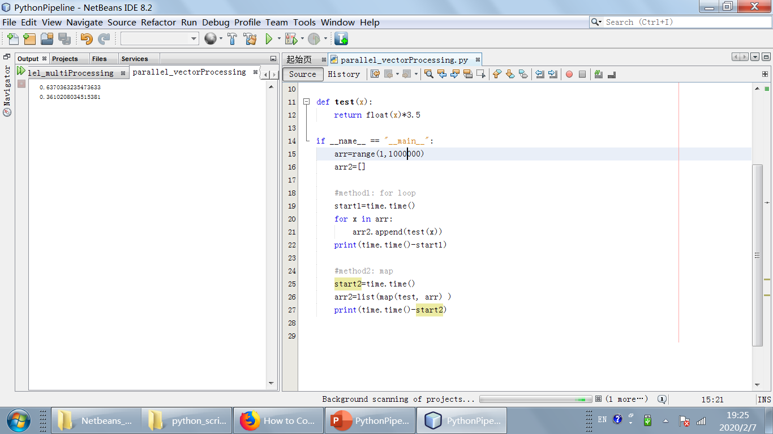
Vector processing: map()
Notes:
Vector processing is alternative for parallel processing. A vector is like an array. All elements of a vector are processed in one clock period. The python method map() is an example for speeding up execution. The execution time of map() is always shorter than for loop.

