Slide 1
Develop Python Pipeline:
Data and Process Modeling
Tiezheng Yuan
Feb 05, 2020
Notes:
Hello. Today I am going to introduce what is data and process modeling in Python programming.

Slide 2
Data and process modeling
In this context, data and process modeling shows how an pipeline convert data into useful information.
It is logistic modeling, showing what the pipeline should do, regardless of how the pipeline is implemented physically.
That uses some visual tools:
Data Flow Diagram (DFD)
Process Flow Chart
Notes:
In this context, data and process modeling shows how an pipeline convert data into useful information.
data and process modeling is a logistic modeling, showing what the pipeline should do, regardless of how the pipeline is implemented physically. In data and process modeling, some visual tools are used to aid analysis. They are Data Flow Diagram (DFD) and Process Flow Chart

Slide 3
Data Flow Diagramm (DFD)
DFD shows how data move in the pipeline, regardless of the pipeline’s logic or processing steps.
DFD defines four basic components:
processes
data flows
data storage
entities

Slide 4
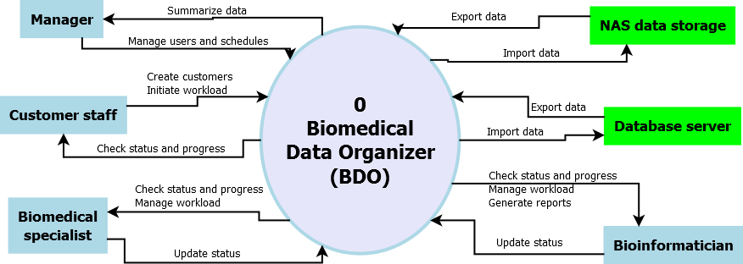
Context diagram DFD for BDO
Notes:
Here, I am going to show you an example.
This is a context diagram DFD for a software - biomedical data organizer. Scientists and managers employ the software to schedule tasks, manage data, and track progress. Four physical entities are identified: manager, customer staff, biomedical specialist, and bioinformatician. Two logical entities are used for data stores. Major processes are defined showed as arrow lines.

Slide 5
Why DFD is useful?
DFD helps us to identify all entities and processes involved in the pipelines.
DFD is summarized based on the achievement of requirement analysis.
DFD helps the next stage: The entities could be converted to classes in OOP, and processes could be defined as methods or functions.
Notes:
DFD is very useful for pipeline development. DFD helps us to identify all entities and processes involved in the pipelines. The contents of DFD is summarized based on the achievement of previous requirement analysis. DFD helps us to conduct the next stage work in pipeline life cycle. The entities defined in DFD could be converted to classes in OOP, and processes could be translated into methods or functions.

Slide 6
Describe processes
Process description shows logistic steps of the pipeline operations, which correspond with operations in real world.
Notes:
Process description shows logistic steps of the pipeline operations, which correspond with operations in real world.
This is an example- a pipeline used for analyzing RNA-seq. This sequence structure shows process structure. All steps required for RNA-seq analysis: prepare data: fastq files and genome references and annotation files, verify parameters for bioinformatic tools, conduct genome mapping and transcripts assembly, and finally gather read counts for further statistical analysis.

Slide 7
Why process description (PD) is useful?
PD helps us to understand business logics in real world, which should be translated into pipeline design.
PD helps us to identify critical path and milestones, which are useful for project management in pipeline life cycle.
PD and DFD combined depict a blue picture of object modeling.
PD is readable for those stakeholders without too much technical background.
Notes:
PD helps us to understand business logics in real world, which should be translated into pipeline design.
PD helps us to identify critical path and milestones in pipeline development life cycle.
PD and DFD combined depict a blue picture of object modeling.
PD is readable for those stakeholders without too much technical background.

