Slide 1
Develop Python Pipeline:
Functional Programming
Tiezheng Yuan
March 26yh, 2020
Notes:
Hello. Today I am going to introduce arguments passing in Python.

Slide 2
Features of Functional Programming: one function, one task
Self-contained: Each function focus on a specific task.
Rigid call: A function only receive data at top of the function through inputs.
Rigid leave: All execution start from the top, and leave the function at the end of function code.
Allow to pass a function or return a function.

Slide 3
Steps to Writing a Function
Understand the purpose of the function.
Define the inputs that comes into the function.
Define the outputs that export from the function.
Design the algorithm, and decide the steps that the program will use to accomplish this purpose.
Create the function…..

Slide 4
Iterable object
Iterable object produce a result at a time in the context of an iteration tool like a for loop.
Iterable object:
List: iter([1,2, 3])
for loop: for x in range(10): print (x**3)
file handler: f = open(“/home/text.txt”)
Use __next__() method to retrieve a value at a time

Slide 5
Functional programming in Python
Lambda function
filter()
map()
Reduce()

Slide 6
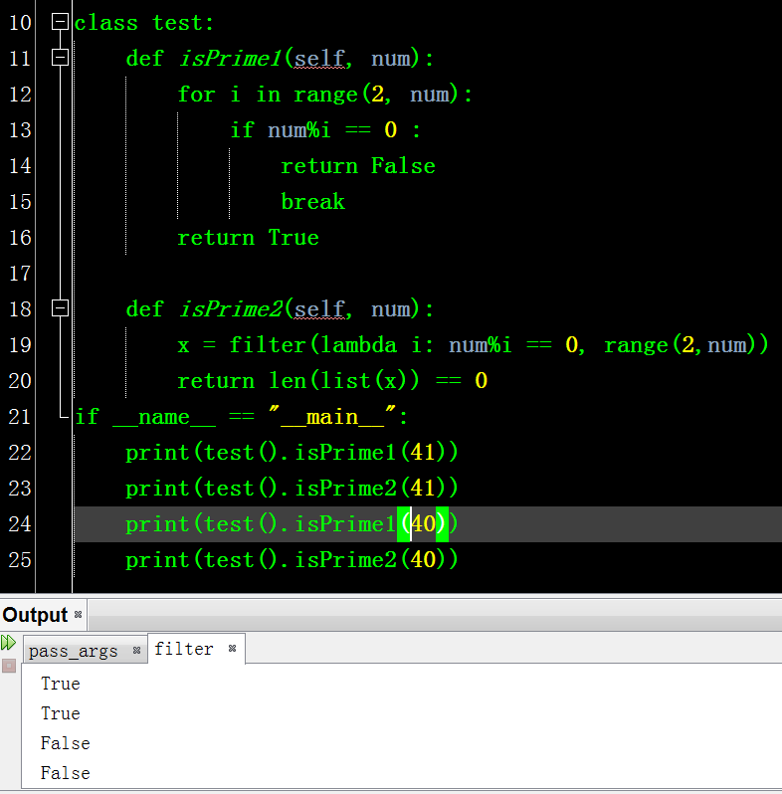
Filter()
Return boolean iterator

Slide 7
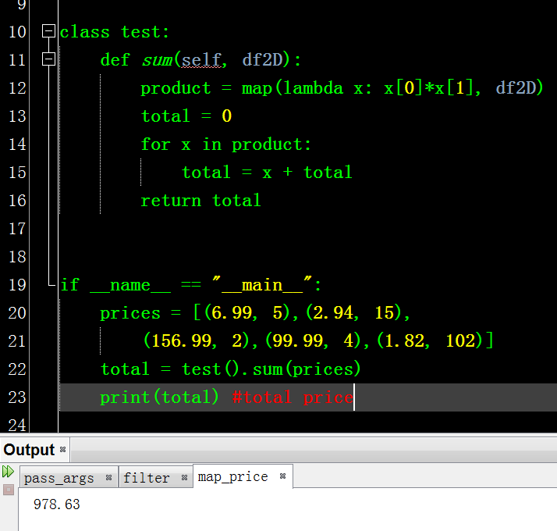
Map()

