Slide 1
Develop Python pipeline:
Task Management
Tiezheng Yuan
Feb 05, 2020
Notes:
Hello. Today I am going to introduce what is inheritance in Python.

Slide 2
Features of bioinformatics pipeline using Python
Hybrid of object-oriented and process-oriented
Hybrid of computing programming and statistics
Integrate and organize data
Use modules or embed external tools
Fast delivery
Linux-based environment
Notes:
I summarized some features of design and implementation of bioinformatics pipeline. The summarization might not cover all stuffs.
1. Hybrid of object-oriented and process-oriented: Python programming support object-oriented, but process-oriented programming is often used because some bioinformatics steps should be executed in order.
2. Hybrid of computing programming and statistics: sometimes statistical models need to be integrated into pipeline.
3. Integrate and organize data means you may figure out how to handle raw data, or how to extract annotation data. Sometimes some particular scripts are required.
4. Use modules or embed external tools
5. Fast delivery: In my experience , the Agile practise is more used than the waterfall method. One advantage of the Agile is that requirements could not be clarified in details at the beginning.
6.Linux-based environment

Slide 3
What are bioinformatics relevant tasks?
Install and implement an bioinformatics environments
Create and implement docker containers
Design and manage a bioinformatics data database
Design a biomedical software
Develop a bioinformatics pipeline
Employ external tools to conduct data analysis
Integrate a statistical model into pipeline process.
……
Notes:
Here I listed some case of bioinformatics relevant tasks. Some of them focus on system administration. Some of them concentrate on coding work. Some of them are close to data analysis.
Anyway, once a task is proposed, the technical problems should be solved and the final product should be delivered on time.

Slide 4
Practices involved Task Management
Create task lists
Decompose tasks into small parts
Direct tasks into the phases of design, analysis, testing, implementation, etc.
Schedule, assign, or delegate tasks.
Evaluate progress
Respond to changes of tasks
Notes:
Task management is so important. Good task management will facilitate the process of pipeline development. This significance is no less than that applied in other area. Here, I listed some practices involved in task management. The next, I am going to introduce the practice of task decomposition and task scheduling.

Slide 5
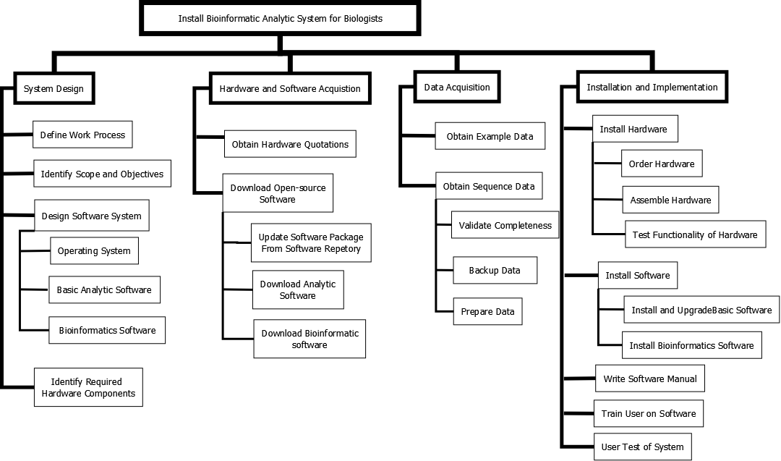
Work breakdown structure (WBS)
Notes:
Tasks decomposition means a complicated or long-term task is decomposed into small and short-term tasks.
The work breakdown structure focuses on installation and implementation of bioinformatics system for biologists. A total of three levels tasks are identified. This system is deployed in Azure cloud computing platform. Theoretically, installing a bioinformatic system is not a big deal for a computer specialist. It is unreasonable to spread them in details. Actually, I did spend almost two months in real world. Correct task decomposition allows you to understand the whole things in advance, and schedule task and allocate resources.

Slide 6
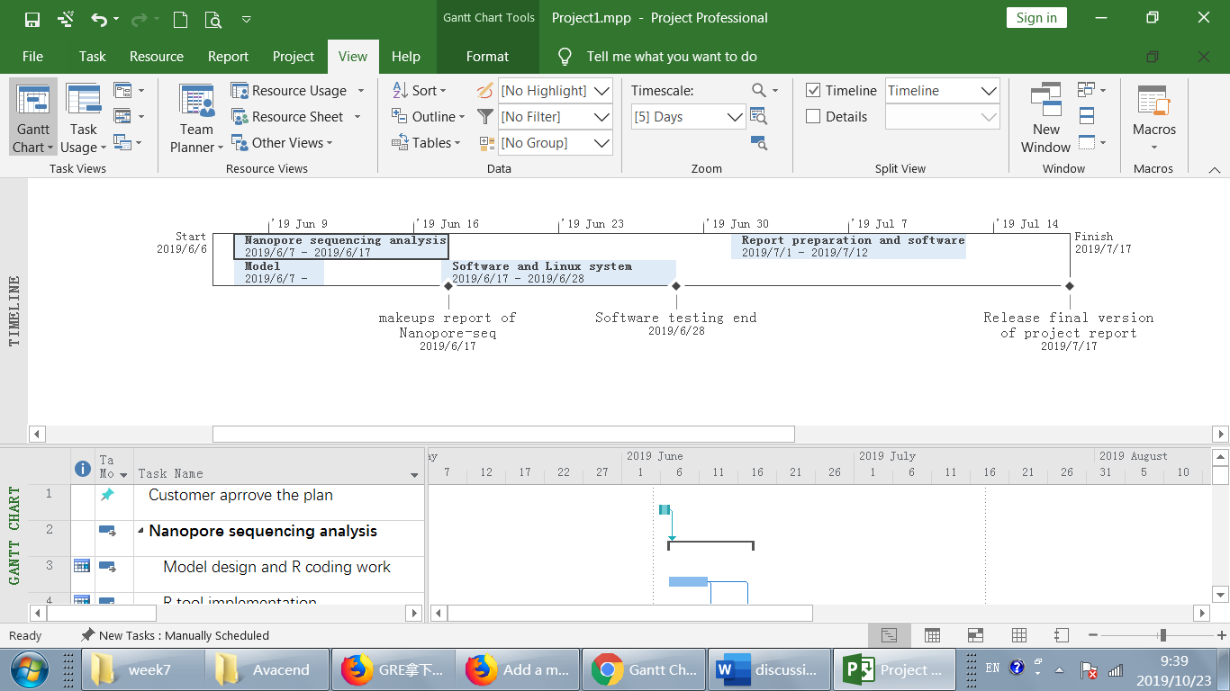
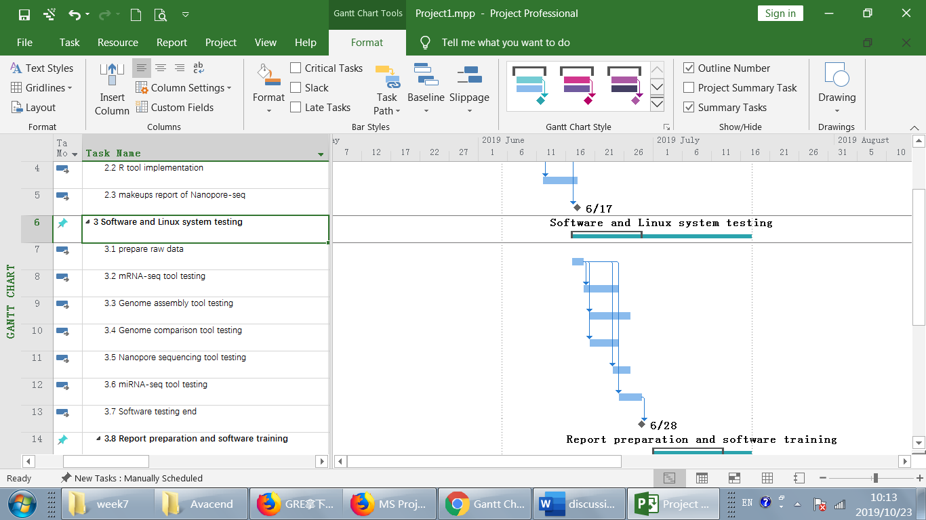
Use GANTT Charts to manage tasks
Notes:
GANTT charts is a good tool to schedule tasks. This is a real case: I developed some pipeline for a team. The time is so tight and the deadline is fixed. I share this charts with other team member. For me, this GANTT chart shows what I should do in the last month, which help me to schedule my time. For other members, that relieve their anxiety and indicate them that everything is under control.

