Slide 1
Develop Python pipeline:
Version Control
Tiezheng Yuan
Feb 07, 2020
Notes:
Hello. Today I am going to introduce what is inheritance in Python.

Slide 2
Version Control
Version control is the process of tracking information system releases or software versions.
Deploy software: Implement the latest version of a pipeline, and archive the prior version. Deploy a certain old version.
Track development process: Who change the code. When new functionality is imported. When bugs are aroused.
Enhance cooperation: Keep one single correct version at a specific time point. Share codes among team members.
Backup software: Some pipelines are under fast pace updating, or have specific life cycles.

Slide 3
Release maintenance
Version control is based on various system releases or software versions.
The initial release is 1.0. A change from v1.1 against v1.0 indicates minor enhancement; and a change from v2.0 against v1.0 indicates a significant upgrade.

Slide 4
Version control system (VCS)
Simple software
draw a table tracking versions
Complication information system: VCS
Serena: commercial VCS
git: free and open-source VCS

Slide 5
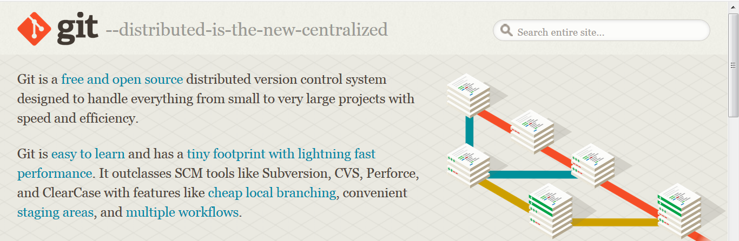
git
Notes:
Here, I am going to introduce a free and open-source version control system –git.

Slide 6
Git: manage source code
Git tracks any changes to the source code.
Git allows to go back to any of old versions.
Git prevents loss of work or conflicts when multiple contributors work together.
Notes:
Here, I am going to introduce how to manage source code using Git.
Git tracks any changes to the source code.
Git allows to go back to any of old versions.
Git prevents loss of work or conflicts when multiple contributors work together.

Slide 7
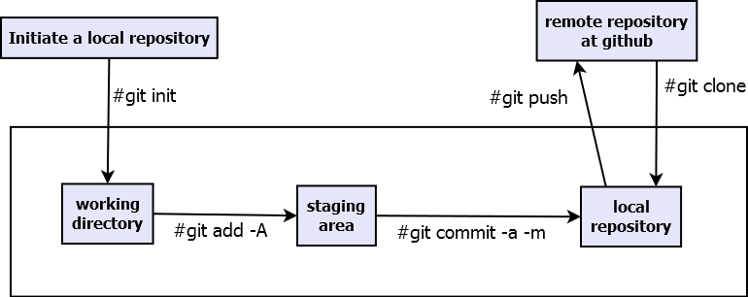
Basic workflow using Git
Notes:
Let’s suppose a scenario: a developer is working on a project at local computer using git, and maintain a remote copy at github, which could be shared with other developers. To fulfill this work, The developer has to create a local git repository using the command git init, add the changes of his code work to the staging area using the command git add, and then submit the changes to the local repository using the command git commit. The developer spends most of his time at local project. It is ok for him to push local project to the github.

Slide 8
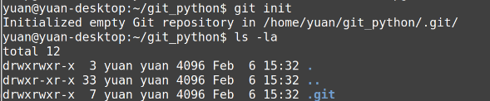
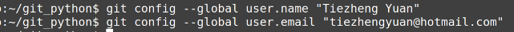
Initiate a local repository
1. Initiate a repository
2. Add user
3. Configure untracked files: create a file .gitignore
Notes:
Three steps should be done for creating a local git repository. First, initiate a local reposity using git init. A hidden directory known as .git will be created, which tracks all versions of the project. Then, add user name and user email, which will be involved in the committed message. Finally, create a file named as .gitignore. This file tells git which files or directory is out of tracking.

Slide 9
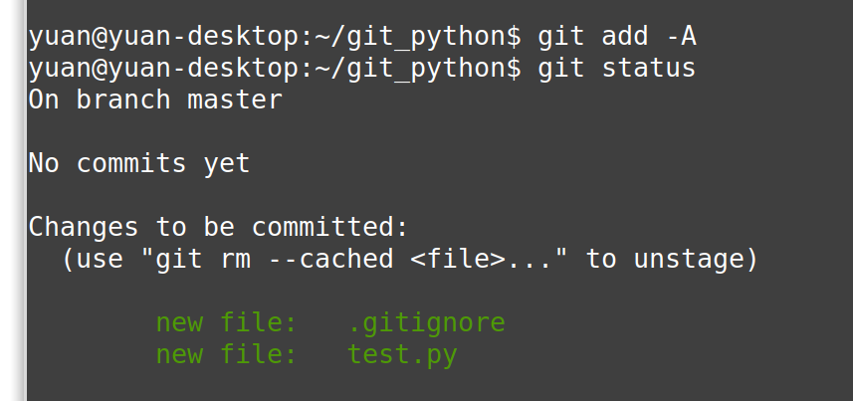
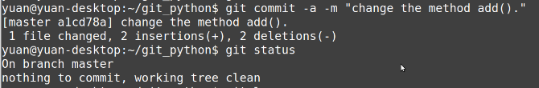
Conduct coding work and save changes
Notes:
In this process, we often employ the git commands: git add, git status, git commit. Git add add changes to the staging area, git status displays the status of the working directory and staging area. Git commit saves changes to the local repository. It is up to a developer to decide where and when a tracking point could be set.

Slide 10
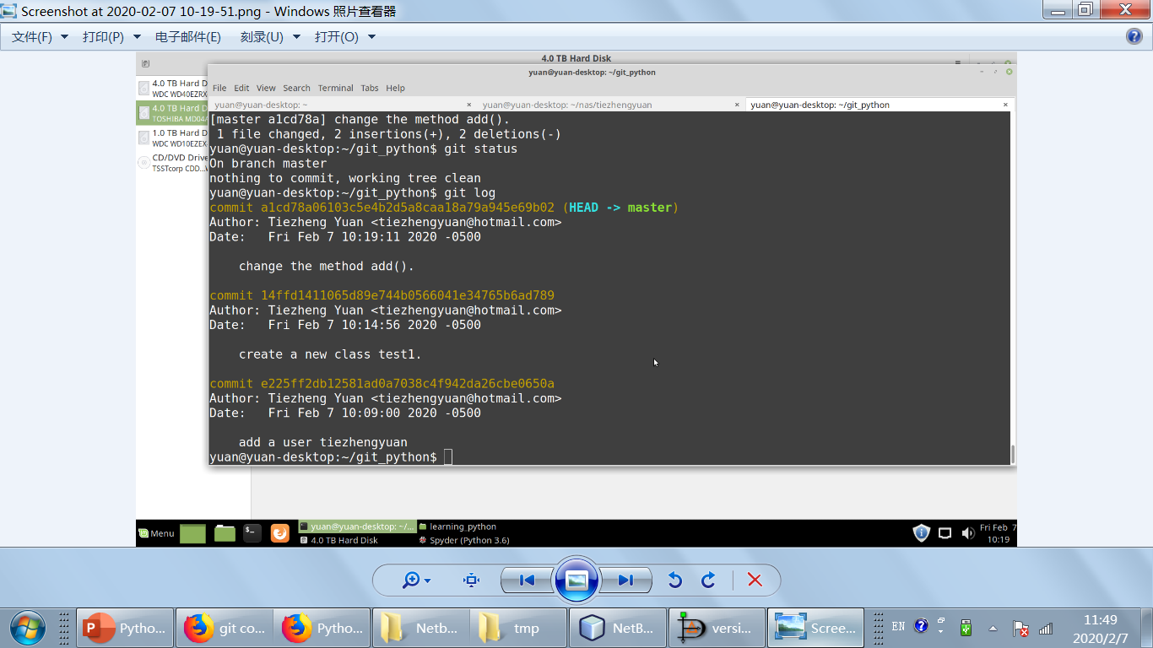
Track changes
Notes:
The command git log displays all changes saved in the local repository. There are three changes saved. One user was created, and two parts of code were changed.

Slide 11
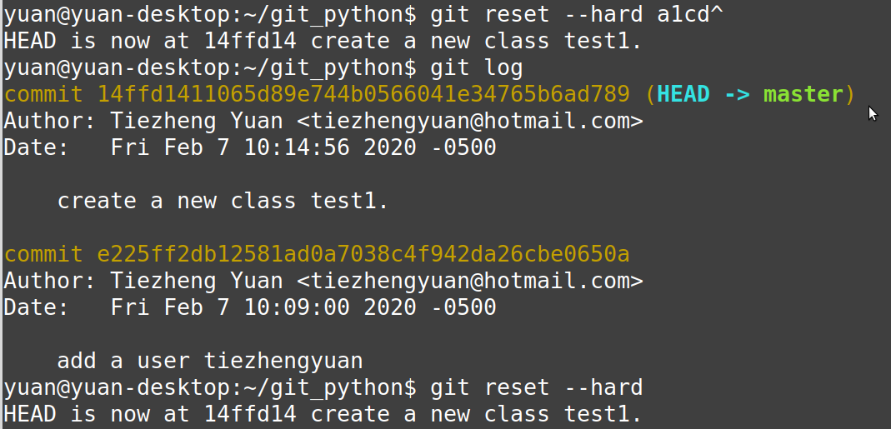
Go back the old version
Notes:
The command git reset used for setting back an old version. Showed in the red box, the option –hard followed by index code, indicating which one of the points the project should go back to.

Slide 12
Notes of Git
Commit a correct, precise and small change rather than an uncomplete and large change.
Keep commit message explicit.
Use git branch in a large project.
Reach an agreement on workflow and version control.
Notes:
1. Commit a correct, precise and small change rather than an uncomplete and large change. Don’t commit it if a change is untested or uncompleted. Setting small commits other than a big commits will facilitate version controls.
2. Keeping commit message precise help you and other team members to locate it and understand it.
3. The default commit is master. However, a large project may be categorized into multiple parts. So the function of git branch is a good approach to manage various commits.
4. Reach an agreement on workflow and version control or other stuffs.

Slide 13
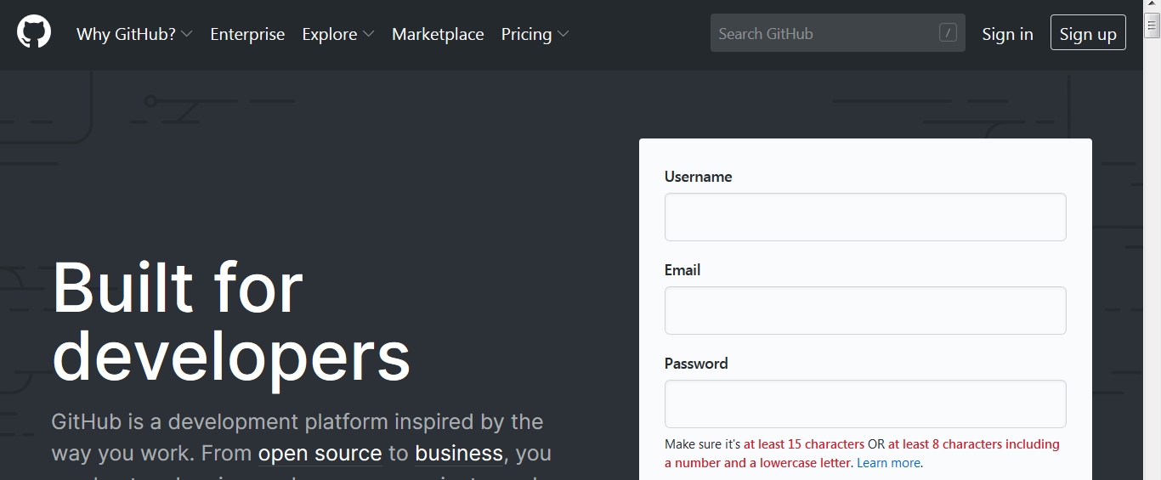
Github

Slide 14
What is Github used for?
Remote repository host
Cooperate and integrate development
Source code repertoire
Project management
Notes:
Here I listed 4 points though there are more applications for github. First, github could be used as remote repository host. Developers could keep a copy at local. Second, multiple developers could work together to conduct a big project at github without the worry of geographical limitations. Third, github is appealing to many talent developers all over the world. It is open-source and free. Feel free to get sterling project fitting well with one’s goals. Finally, github is a tool for project management. Github enhance coding cooperation and handle conflicts. Github focuses on source code management. Github combined with other free tools namely google doc allows conducting project management.

