Slide 1
Develop Python Pipeline:
Pass arguments
Tiezheng Yuan
March 26yh, 2020
Notes:
Hello. Today I am going to introduce arguments passing in Python.

Slide 2
arguments
Pass arguments to objects: class or method
Pass arguments to script at command line

Slide 3
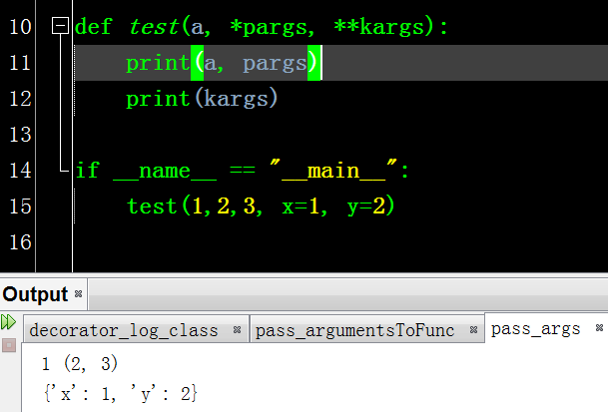
Pass arguments to function
def func(a, b) #pass two variables a and b
def func(*args) # pass variadic arguments as tuple
def func(*kwargs) # pass keywords variadic arguments as dictionary
def func(a, *args, *kwargs)
Note: args and kwargs could be any words. * and ** shows tuple and dict, respectively

Slide 4
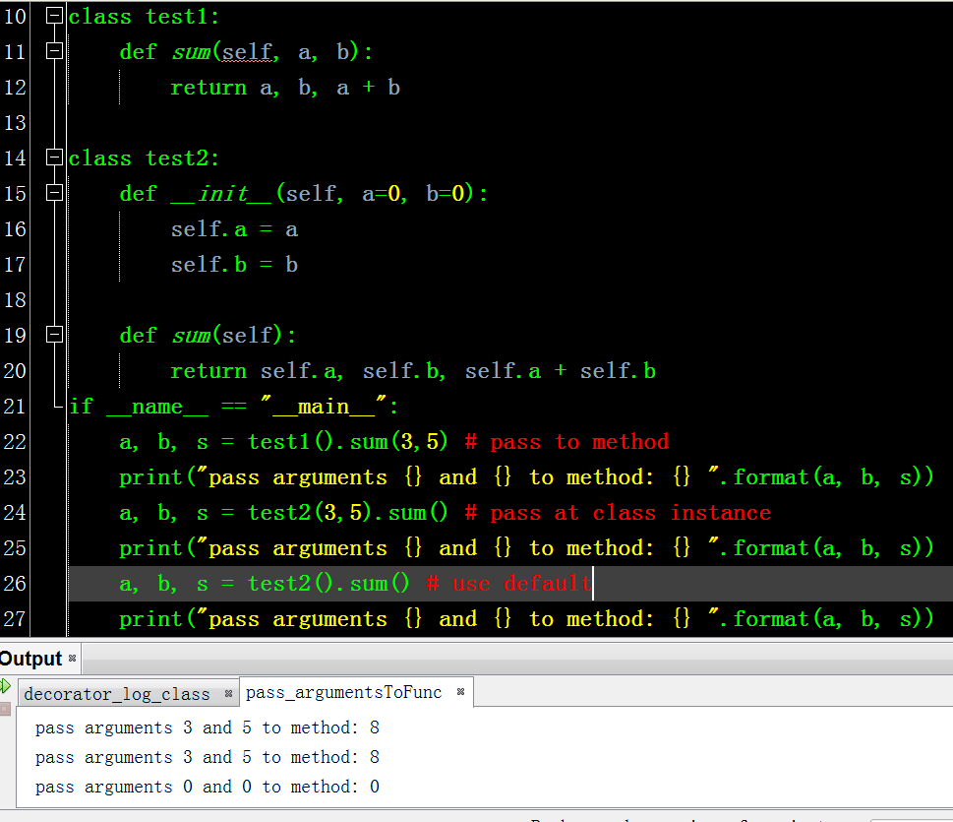
Pass arugments to class and methods
Default options

Slide 5
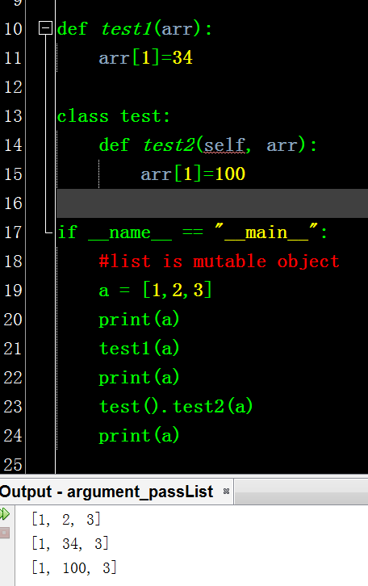
Pass list as object by reference
Any changes in the List that has been passed into a function will present.

Slide 6
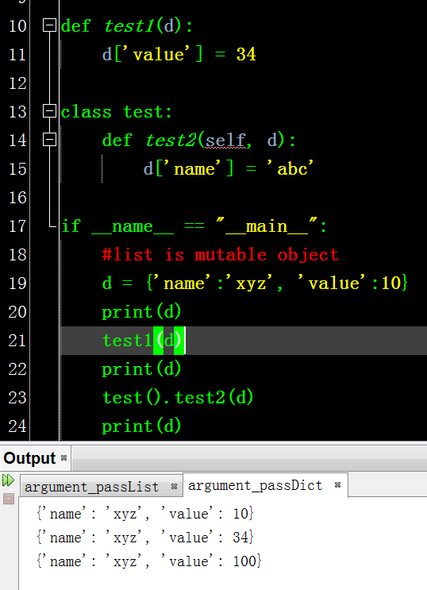
Pass dictionary as object by reference
Any changes in the dict that has been passed into a function will present.

