Slide 1
LOS ANGELES CRIME ANALYSIS FOR YEAR 2020-2023

Slide 2
TABLE OF CONTENTS
Problem Statement
Analysis Team
Analysis
Insights
Dashboard Overview
Recommendations
Conclusion

Slide 3
PROBLEM STATEMENT
The increasing complexity and volume of criminal activities in Los Angeles present significant challenges to law enforcement agencies, policymakers, and researchers. To enhance public safety and optimize resource allocation, it is essential to conduct a thorough exploratory data analysis of the Los Angeles crime dataset. This analysis aims to uncover patterns, trends, and characteristics of criminal activities within the region, providing critical insights that can inform and improve decision-making processes for crime prevention, policy formulation, and efficient deployment of law enforcement resources.

Slide 4

ANALYSIS TEAM
BOLUWATIFE QUADRI
BLESSING NNEDINSO

Slide 5
ANALYSIS
The analysis is grouped into three, namely:
Crime Analysis
District Analysis
Demographics Analysis

Slide 6
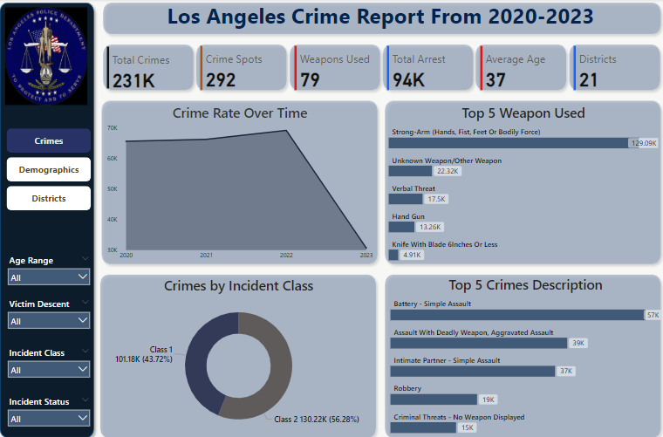
CRIME DASHBOARD

Slide 7
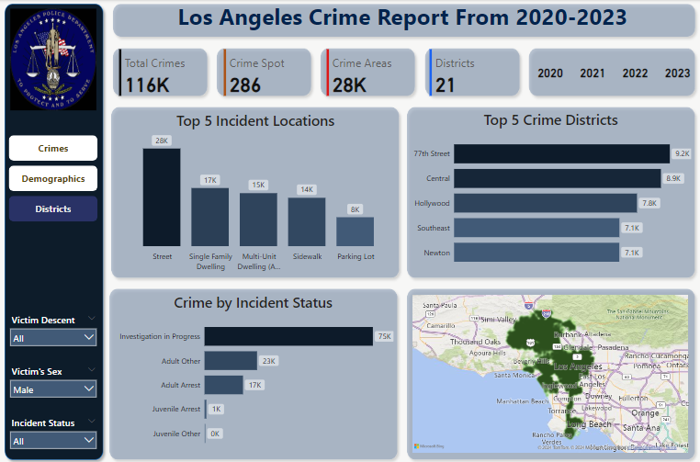
DISTRICT DASHBOARD

Slide 8
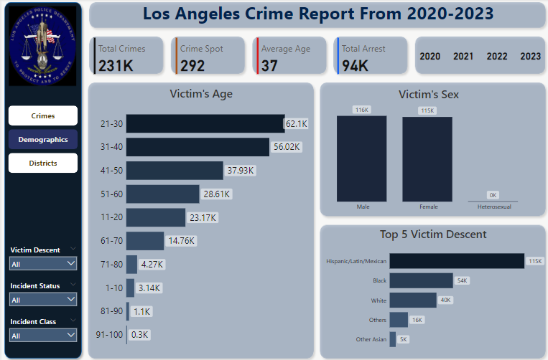
DEMOGRAPHICS DASHBOARD

Slide 9
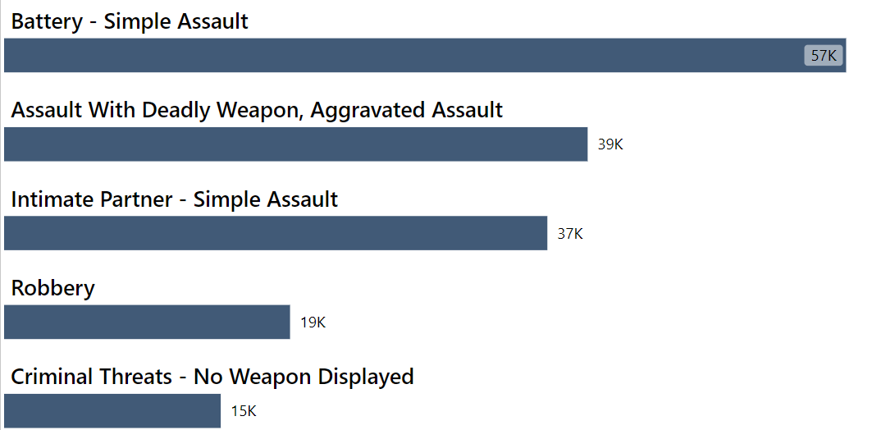
INSIGHTS
Between 2020 and 2023, a total of 231,401 crimes were committed in Los Angeles, with the most common being assaults of different kinds, robbery and criminal threats which happen mostly streets, single and multi-family dwellings, sidewalks and parking lots.
.

Slide 10
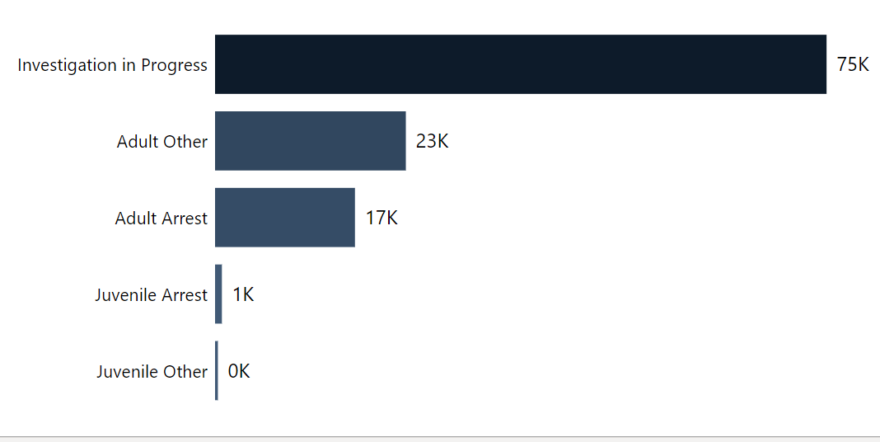
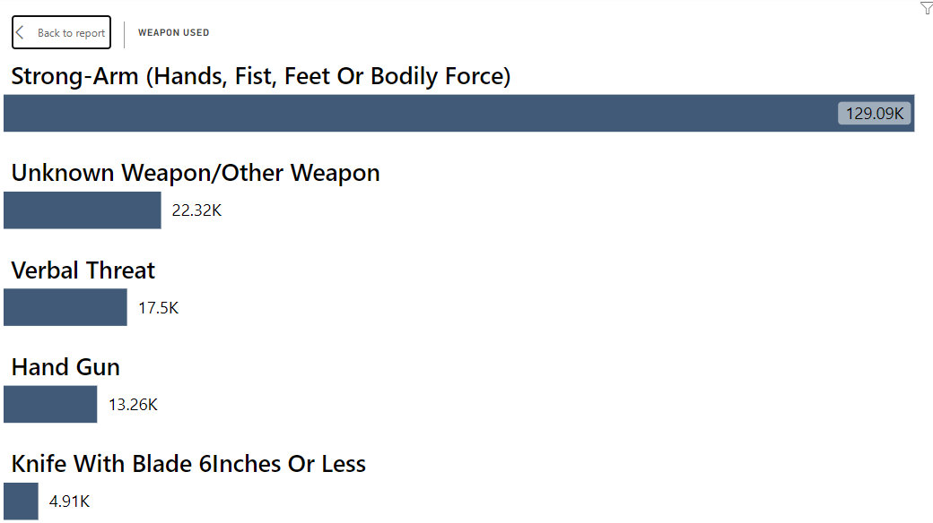
INSIGHTS
Although investigations are still pending for 74,802 crimes, analysis of the solved cases reveals that the most used weapons were bodily force, verbal threats, handguns, pistols, and knives. Specifically, bodily force was often linked to simple assaults, while guns were frequently used in dangerous assaults and robberies. In summary, it shows the solve rate of cases in Los Angeles is low.

Slide 11
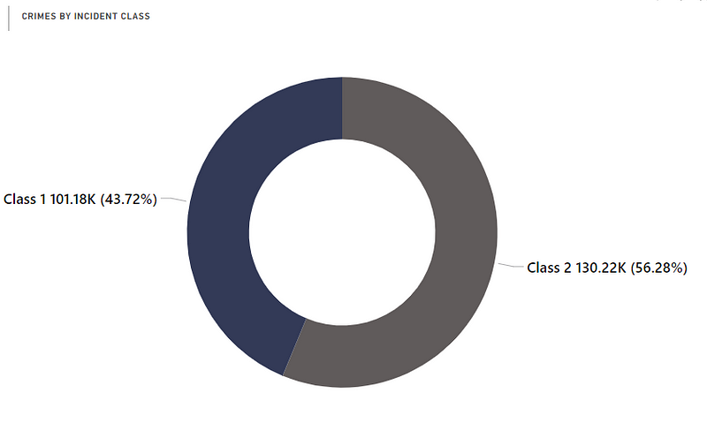
INSIGHTS
In Los Angeles, a staggering 43.72% of crimes are classified as dangerous Class 1 offenses, with a dismally low solve rate, while Class 2 crimes, making up 58.02% of cases, have a slightly higher solve rate, overall indicating a chaotic crime rate with most criminals remaining at large and likely to continue offending.

Slide 12
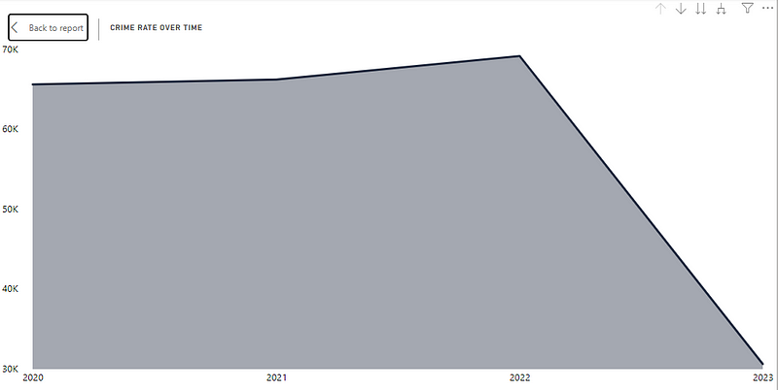
INSIGHTS
Crime rates peaked in 2022 with a total of 230,962 but dropped significantly in 2023 to 100,890. January sees the highest crime rate, fuelled by holiday shopping, tax season, and increased financial activity, creating opportunities for identity theft.

Slide 13
RECOMMENDATIONS
More security personnel, and check posts should be provided, CCTV cameras should be installed on the streets and parking lots.
More resources should be allocated to hasten investigation, and law enforcement agents should be trained to recognize crime patterns. Sensitization of victims on self-defense will help reduce vulnerability to assault.
To reduce Identity theft, cybersecurity measures should be improved like use of 2-factor authentication and use of secure websites for online shopping and transactions.

Slide 14
CONCLUSION
The crime statistics in Los Angeles from 2020 to 2023 reveal a concerning trend of high crime rates, particularly theft, assault, and burglary, with a majority remaining unsolved. The low solve rate and high percentage of dangerous crimes highlight the need for enhanced security measures, improved investigation resources, and increased awareness and training for law enforcement and citizens. By addressing these issues, Los Angeles can work towards reducing crime rates and creating a safer environment for its residents.

Slide 15
THANK YOU ANY QUESTIONS??

