Slide 1
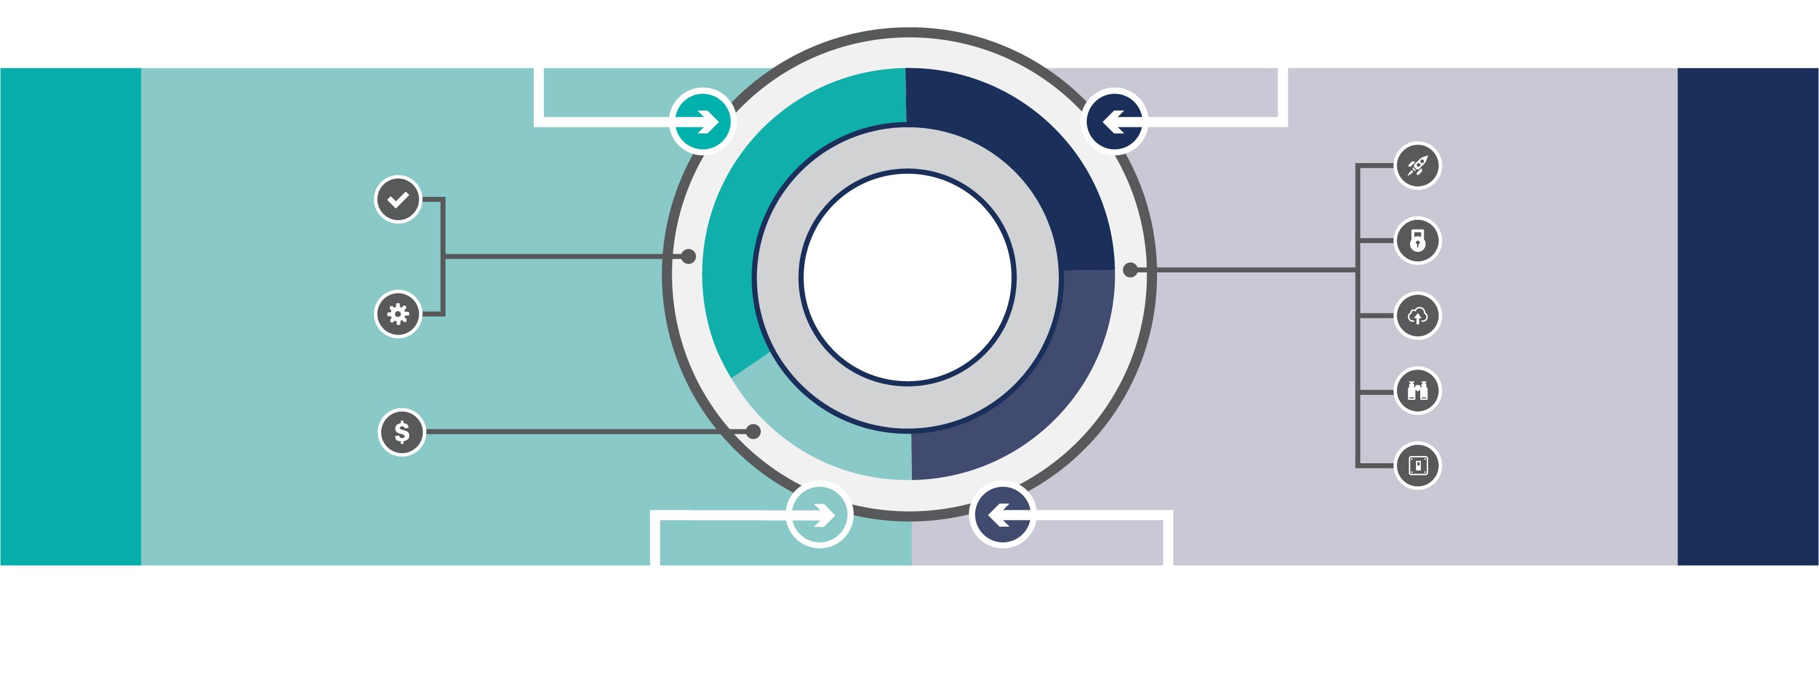

Unisys CloudForte
Accelerate
Command
Innovation
Real-time
Compliance
Accelerate Cloud Adoption Create Cloud Evangelists
Share Best Practices Centralized Knowledge Base
Transform
Consume
Security
CLOUD CENTER OF ENABLEMENT (CCOE)
Automated
Governance
Migration
SUBSCRIPTIONS
SERVICES
Discovery
Transparent,
Accurate Billing
Enablement
Consume Providing accurate and transparent billing for all AWS services
Command Go fast with confidence, securely accessing all AWS platform services.
Accelerate Migrate quickly and scale cloud adoption predictably and reliably.
Transform Become a cloud native organization.
CloudForte provides entry points at any stage in your journey to the cloud

