Slide 1

CO₂, Agriculture & Temperature: Regression Analysis
Using FAO & IPCC data to forecast agricultural temperature
Tiffany Watt

Slide 2
Project Overview
- Goal: Forecast Average_Temperature_°C using variables such as year, land use, area, etc
- Data: FAO & IPCC (1990–2020), ~7,000 records, 30+ features
- Motivation: Support sustainable agriculture & climate policy

Slide 3
Dataset Highlights
- Predictors (eg):
Emissions (fires, fertilizers, manure, processing, packaging, etc.)
Land use (forestland, net forest conversion)
Population (urban, rural, male/female splits)
- Target: Average_Temperature_°C (annual increase)
Note: Forestland can show negative emissions (carbon sinks)
Year

Slide 4
Data Cleaning
- Standardised column names
- One-hot encoding (Area)
- Missing values → median (per country, global fallback)
- Dropped redundant features (population splits)

Slide 5
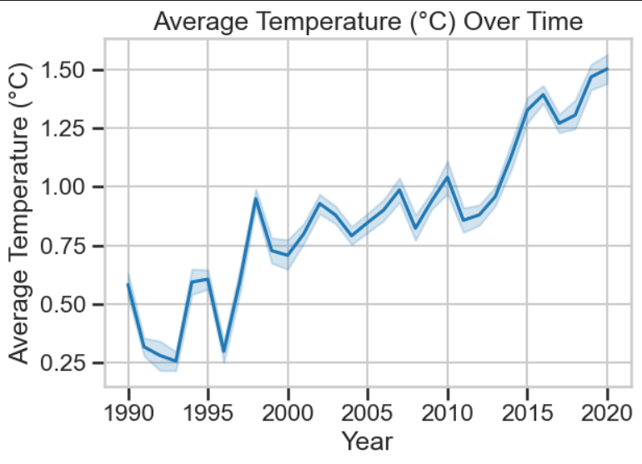
Exploratory Data Analysis (EDA)
- Temperature rising steadily (1990–2020)
- Highly skewed predictors (fertilizer, emissions)
- Strong collinearity across industrial/agri features

Slide 6
Feature Engineering
- Log transforms for skewed variables
- Interaction terms (Fertilizer × Precipitation)
- Polynomial features (Year²)
- Correlation pruning (|r| > 0.9)
- VIF pruning (>10)

Slide 7
Modeling Approaches
- Linear Regression → Baseline
- Ridge Regression → Handles multicollinearity
- Lasso Regression → Regularized baseline (underperformed)
- Random Forest → Non-linear ensemble, best performer

Slide 8
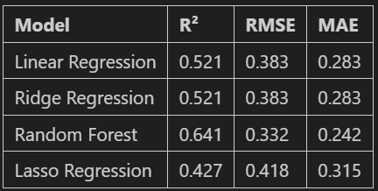
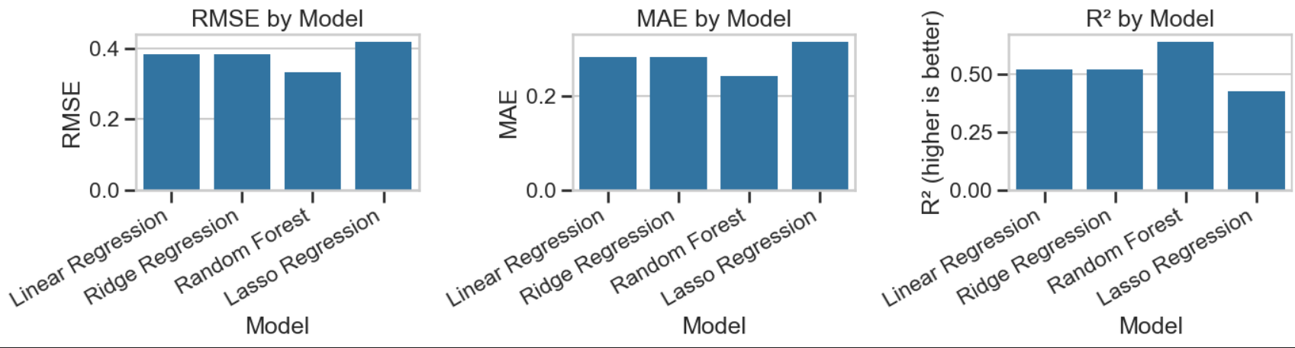
Model Comparison

Slide 9
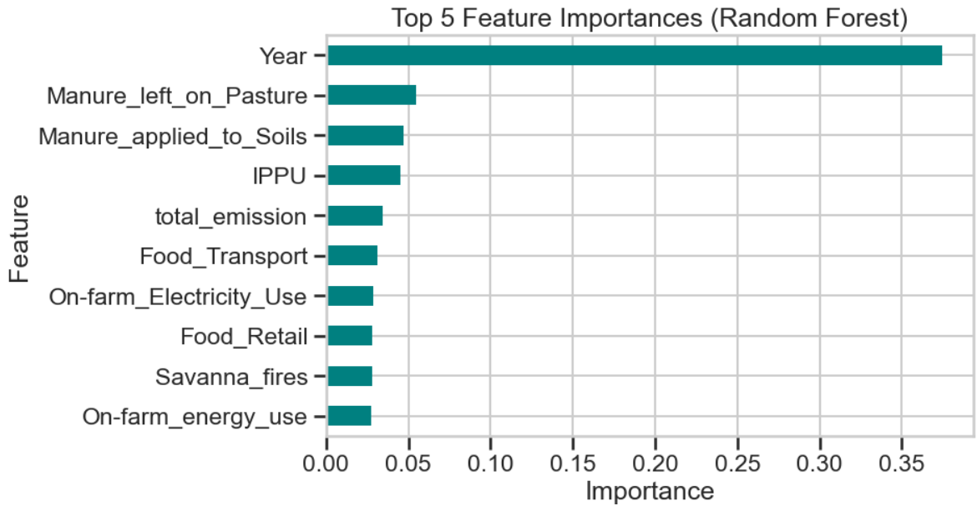

Slide 10
Conclusion
- Temperature is rising globally
- Collinearity pruning essential
- Random Forest best performer (R² ≈ 0.64)
- Key drivers: year, fertilizer, emissions, energy

Slide 11
References
- FAO: https://www.fao.org/faostat/en/
- IPCC: https://www.ipcc-data.org/
- Pedregosa et al. (2011). Scikit-learn: Machine Learning in Python
- Statsmodels, Seaborn, Matplotlib, Plotly documentation

