Slide 1
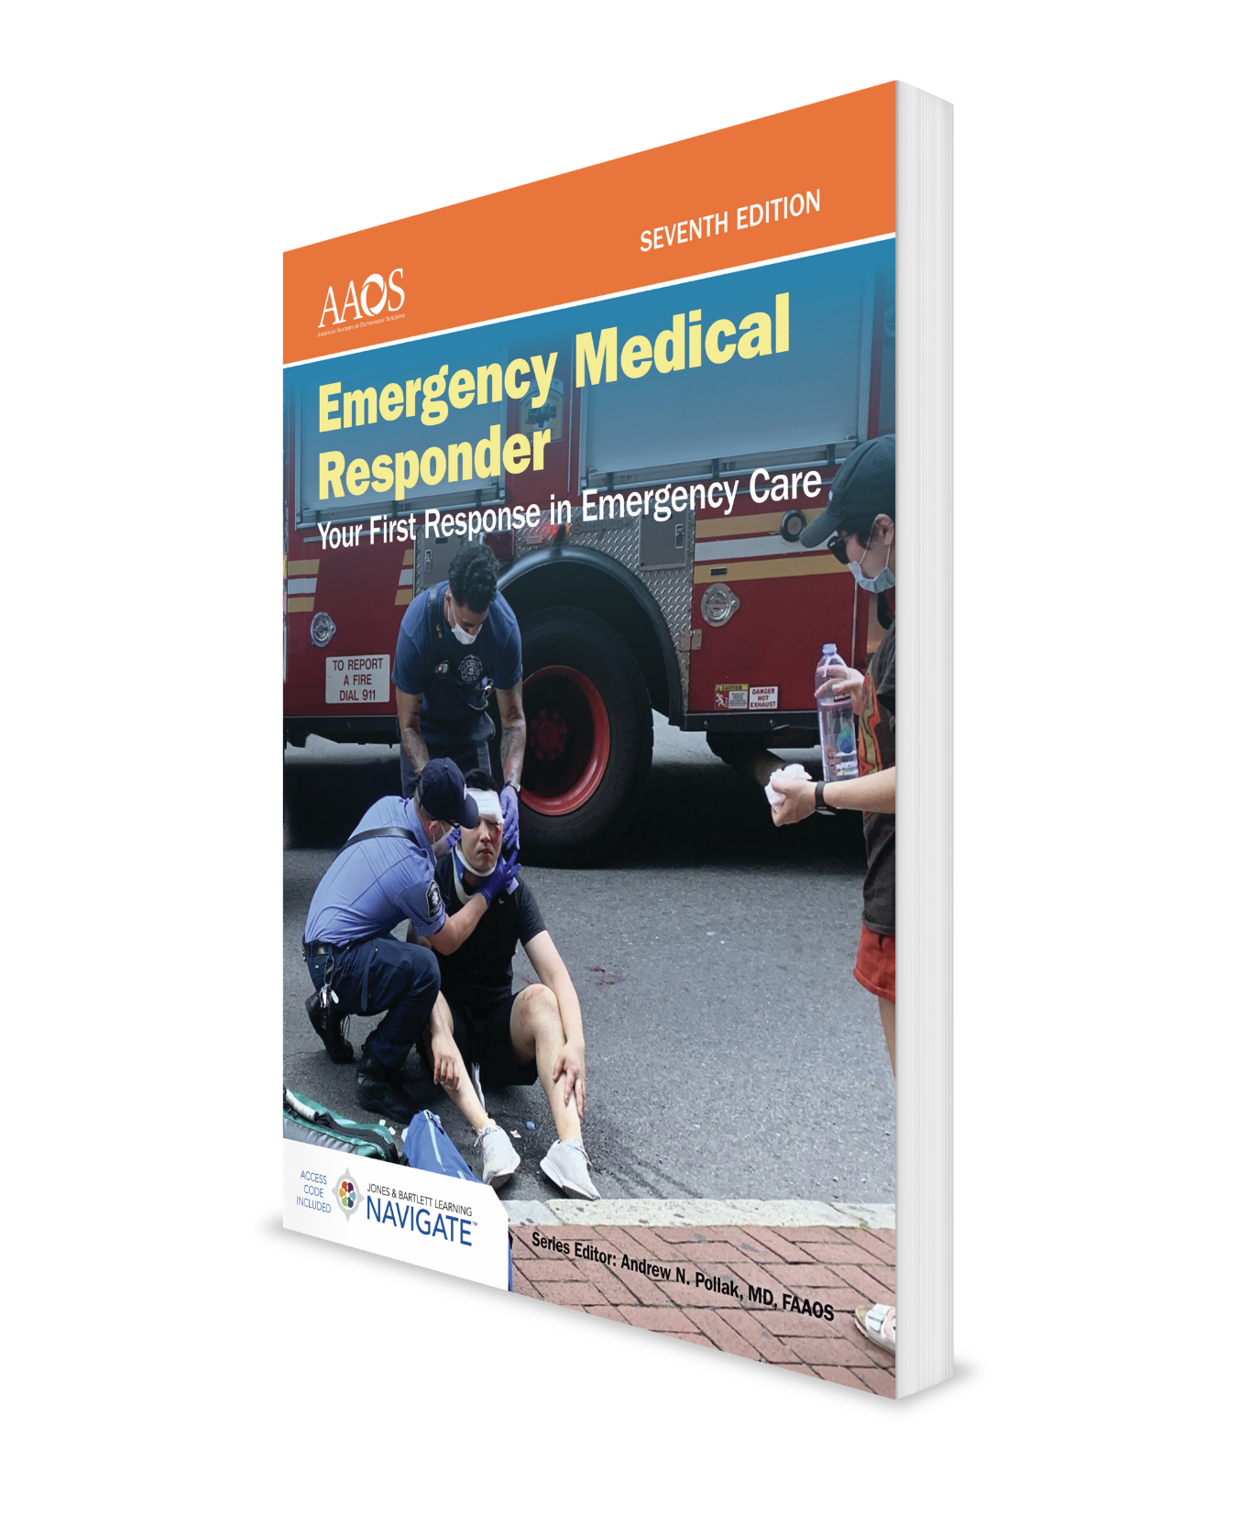
EMS Systems
CHAPTER 1

Slide 2
National EMS Education Standard Competencies (1 of 3)
Preparatory
Uses simple knowledge of the emergency medical services (EMS) system, safety/well-being of the emergency medical responder (EMR), and medical/legal issues at the scene of an emergency while awaiting a higher level of care.
Notes:
Preparatory
Uses simple knowledge of the emergency medical services (EMS) system, safety/well-being of the emergency medical responder (EMR), and medical/legal issues at the scene of an emergency while awaiting a higher level of care.

Slide 3
National EMS Education Standard Competencies (2 of 3)
EMS Systems
EMS systems
Roles/responsibilities/professionalism of EMS personnel
Quality improvement
Notes:
EMS Systems
• EMS systems (pp 3-6)
• Roles/responsibilities/professionalism of EMS personnel (p 9; p 11)
• Quality improvement (p 12)

Slide 4
National EMS Education Standard Competencies (3 of 3)
Research
Impact of research on EMR care
Data collection
Public Health
Have an awareness of local public health resources and role EMS personnel play in public health emergencies.
Notes:
Research
• Impact of research on EMR care (p 6; p 12)
• Data collection (p 12)
Public Health
Have an awareness of local public health resources and role EMS personnel play in public health emergencies.

Slide 5
Introduction
An EMR is often the first medically trained person to arrive on the scene of an emergency.
Initial care is usually followed by:
Emergency medical technicians (EMTs)
AEMTs and paramedics
Nurses and physicians
Other allied health professionals
Notes:
I. Introduction
A. An emergency medical responder (EMR) is often the first medically trained person to arrive on the scene of an emergency.
B. The initial care you give as an EMR is essential because it is provided before more advanced emergency medical care and could mean the difference between life and death.
Initial care is usually followed by care given by
1. Emergency medical technicians (EMTs)
2. AEMTs and paramedics
3. Nurses
4. Physicians
5. Other allied health professionals

Slide 6
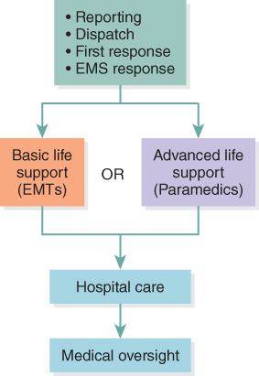
The EMS System (1 of 7)
All agencies and personnel need to share a mutual understanding of their roles for an EMS system to operate smoothly.
Figure 1-1 The EMS system.
© Jones & Bartlett Learning.
Notes:
II. The EMS System
A. All agencies and personnel need to share a mutual understanding of their roles for an EMS system to operate smoothly.
B. Close cooperation, careful planning, and continual effort are needed.
To best understand the EMS system, follow the sequence of events as an injured or ill patient moves through the system.
Figure: The EMS system.

Slide 7
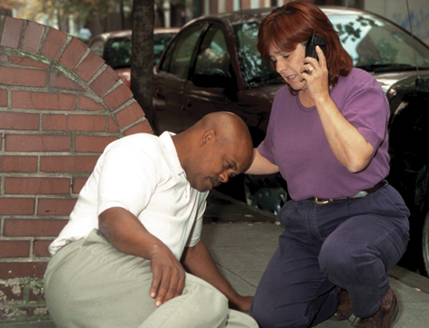
The EMS System (2 of 7)
Reporting
Report of an incident activates EMS system.
An emergency response communications center or public safety answering point (PSAP) receives call reporting an incident.
Figure 1-2 Reporting an emergency.
© Jones & Bartlett Learning. Courtesy of MIEMSS.
Notes:
1. Reporting
a. A report of an incident activates the EMS system.
b. An emergency response communications center or public safety answering point (PSAP) usually receives the telephone call reporting an incident.
Enhanced 9-1-1 centers use computers to determine the location of landline telephones.
Figure: Reporting an emergency.

Slide 8
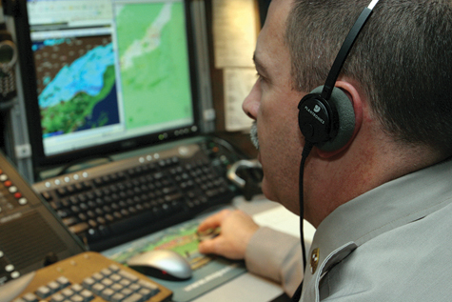
The EMS System (3 of 7)
Dispatch
Appropriate equipment and personnel are dispatched to scene.
Dispatch may occur by phone, pager, radio, computer, or other means.
Figure 1-3 An emergency response communications center receives the call.
© Jones & Bartlett Learning. Courtesy of MIEMSS.
Notes:
2. Dispatch
a. Appropriate equipment and personnel are dispatched to the scene.
b. Dispatch may occur by landline telephone, cellular phone, pager, public safety radio system, computer, or other means.
c. Agencies, personnel, and equipment that are involved in the first response vary by community.
Figure: An emergency response communications center receives the call.

Slide 9
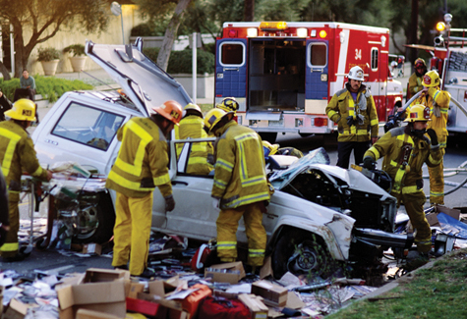
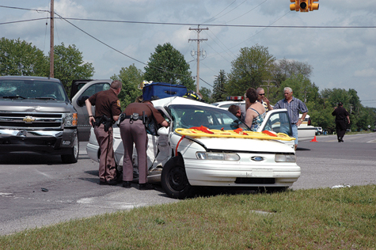
The EMS System (4 of 7)
First response
Firefighters or law enforcement personnel are likely to be first on scene.
EMR is a key element in providing emergency care.
© Corbis/Getty.
Figure 1-4 Firefighters (A) and law enforcement personnel (B) are EMRs in many emergencies.
Courtesy of Captain David Jackson, Saginaw Township Fire Department.
Notes:
3. First response
a. Firefighters or law enforcement personnel are likely to be first on the scene.
b. Most communities have many EMRs, but few EMTs and even fewer paramedics.
The EMR is a key element in providing emergency care.
Figure: Firefighters (Top) and law enforcement personnel (Bottom) are EMRs in many emergencies.

Slide 10
The EMS System (5 of 7)
EMS response
An ambulance staffed by EMTs, AEMTs, or paramedics is the patient’s second contact with EMS system.
A properly equipped vehicle and EMT staff make up a basic life support (BLS) unit.
Patients may receive advanced life support (ALS) services from AEMTs or paramedics.
Notes:
4. EMS response
a. An ambulance staffed by EMTs, AEMTs, or paramedics is the patient’s second contact with the EMS system.
i. A properly equipped vehicle and the EMT staff make up a basic life support (BLS) unit.
ii. EMTs stabilize the patient’s condition and prepare the patient for transport.
b. In addition to BLS services, patients may receive advanced life support (ALS) services from paramedics.
i. ALS personnel can administer intravenous fluids and certain medications and monitor and treat heart conditions with medications and defibrillation.
ii. Defibrillation is the administration of an electric shock to the heart of a patient who is experiencing a highly irregular heartbeat, known as ventricular fibrillation.
iii. Defibrillation may also be done by specially trained EMTs and EMRs.
iv. Paramedics are also trained to place special airway tubes (endotracheal tubes) to keep the patient’s airway open.

Slide 11
The EMS System (6 of 7)
EMS response (cont’d)
All skill levels are based on what is learned in the EMR course.
Airway maintenance
Bleeding control
Prevention, recognition, and treatment of shock
Notes:
c. All skill levels are based on what is learned in the EMR course.
i. Airway maintenance
ii. Bleeding control
iii. Prevention, recognition, and treatment of shock
d. The EMS system also involves law enforcement, fire protection, specialized rescue, and patient extrication.

Slide 12
The EMS System (7 of 7)
Hospital care
Hospital emergency department is the patient’s third contact with EMS system.
Specialized treatment facilities include
Trauma centers
Spinal cord injury centers
Hand centers
Cardiac centers
Stroke centers
Burn centers
Pediatric centers
Poison control centers
Perinatal centers
Notes:
5. Hospital care
a. The hospital emergency department is the patient’s third contact with the EMS system.
b. It may be necessary for the patient to be transported to the closest appropriate medical facility first for stabilization, and then to a hospital that provides specialized treatment.
c. Specialized treatment facilities include
i. Trauma centers
ii. Spinal cord injury centers
iii. Hand centers
iv. Cardiac centers
v. Stroke centers
vi. Burn centers
vii. Pediatric centers
viii. Poison control centers
ix. Perinatal centers
d. Follow your local patient transportation protocols.

Slide 13
Public Health and EMS (1 of 2)
Responsibilities of public health departments include:
Monitoring restaurant cleanliness
Conducting immunization programs
Determining incidence of contagious diseases
Preventing incident or progression of diseases
Notes:
6. Public health and EMS
a. It is important for EMRs to understand the basic functions of public health agencies because EMS personnel need to interact with public health practitioners.
b. Responsibilities of public health departments include
i. Monitoring restaurant cleanliness
ii. Conducting immunization programs
iii. Determining incidence of contagious diseases such as influenza, COVID-19, tuberculosis, and hepatitis
iv. Preventing incident or progression of diseases

Slide 14
Public Health and EMS (2 of 2)
Education and screening programs
Car seat installation programs
Programs to encourage seatbelt use
Alcohol awareness programs
Programs to encourage bicycle and motorcycle helmet use
Blood pressure screenings
Diabetes screenings
Notes:
c. Because prevention is better than treatment, public health and public safety departments provide education and screening programs to help prevent injuries and illness:
i. Car seat installation programs
ii. Programs to encourage seatbelt use
iii. Alcohol awareness programs
iv. Programs to encourage bicycle and motorcycle helmet use
v. Blood pressure screenings
vi. Diabetes screenings
d. Public health departments provide support to EMS in certain situations.

Slide 15
History of EMS (1 of 3)
In the United States during the 1950s and 1960s, funeral homes, hospitals, and volunteer rescue squads provided most of ambulance service.
Civilian prehospital medical care lagged behind military emergency care.
Notes:
7. The history of EMS
a. EMRs should have some understanding of the history of EMS.
b. Many advances in civilian EMS have followed progress initially made in the military medical system.
c. In the United States during the 1950s and 1960s, funeral homes, hospitals, and volunteer rescue squads provided most ambulance services.
i. The only training available for ambulance attendants was basic first aid.
d. Some physicians recognized that civilian prehospital medical care lagged behind military emergency care and urged the National Academy of Sciences to investigate.

Slide 16
History of EMS (2 of 3)
In 1966, Accidental Death and Disability: The Neglected Disease of Modern Society was published.
Paper described deficiencies of emergency medical care.
Early 1970s: US Department of Transportation developed a national standard curriculum for training EMS providers.
Notes:
e. In 1966, Accidental Death and Disability: The Neglected Disease of Modern Society was published.
i. Paper described the deficiencies in emergency medical care.
ii. It recommended the development of a national course of instruction for prehospital emergency care personnel.
iii. In the early 1970s, US Department of Transportation (DOT) developed a national standard curriculum for training EMS providers.

Slide 17
History of EMS (3 of 3)
During the 1980s, the use of advanced life support (ALS) within EMS became common.
Today, EMS providers are trained through standardized courses conducted at accredited training centers.
In January 2019 NHTSA, released the report, EMS Agenda 2050: A People-Centered Vision for the Future of EMS.
Notes:
f. During the 1980s, the use of advanced life support (ALS) within EMS became common.
g. Today, EMS providers are trained through standardized courses conducted at accredited training centers.
h. In January 2019, the National Highway Traffic Safety Administration (NHTSA) of the Department of Transportation (DOT) released the report titled: EMS Agenda 2050: A People-Centered Vision for the Future of EMS.

Slide 18
Ten Standard Components of an EMS System (1 of 2)
Regulation and policy
Resource management
Human resources and training
Transportation equipment and systems
Medical and support facilities
Communications system
Notes:
8. Ten standard components of an EMS system
a. NHTSA evaluates EMS systems based on 10 criteria:
i. Regulation and policy
ii. Resource management
iii. Human resources and training
iv. Transportation equipment and systems
v. Medical and support facilities
vi. Communications system

Slide 19
Ten Standard Components of an EMS System (2 of 2)
Public information and education
Medical direction
Trauma system and development
Evaluation
Notes:
vii. Public information and education
viii. Medical direction
ix. Trauma system and development
x. Evaluation

Slide 20
A Word About Transportation (1 of 2)
Transport
A patient’s condition requires care by medical professionals, but speed in getting the patient to a medical facility is not most important.
Prompt transport
A patient’s condition is serious enough that the patient needs to be taken to an appropriate medical facility in a fairly short period of time.
Notes:
III. A Word About Transportation
A. EMRs assist more highly trained EMS personnel in treating and preparing the patient for transportation.
B. Three terms are used to describe proper patient transportation to an appropriate medical facility.
1. Transport: A patient’s condition requires care by medical professionals, but speed in getting the patient to a medical facility is not the most important factor.
2. Prompt transport: A patient’s condition is serious enough that the patient needs to be taken to an appropriate medical facility in a fairly short period of time.

Slide 21
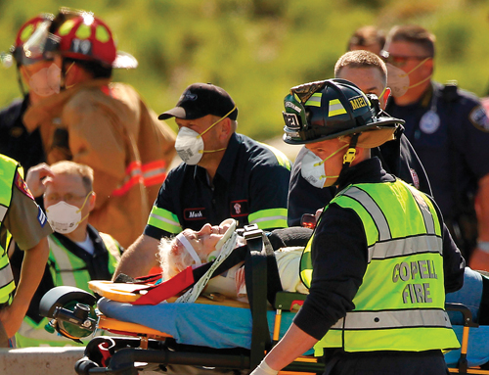
A Word About Transportation (2 of 2)
Rapid transport
When EMS personnel are unable to give the patient adequate life-saving care in field
An appropriate medical facility may be a hospital, trauma center, or medical clinic.
Figure 1-8 Ambulance transport to a hospital or medical facility.
© Tribune Content Agency LLC / Alamy Stock Photo
Notes:
3. Rapid transport: This phrase is used for the few cases when EMS personnel are unable to give the patient adequate life-saving care in field.
4. An appropriate medical facility may be a hospital, trauma center, or medical clinic.
EMS personnel must work closely with their medical director to establish transportation protocols that ensure patients are transported to the closest medical facility capable of providing adequate care.
Figure: Ambulance transport to a hospital or medical facility.

Slide 22
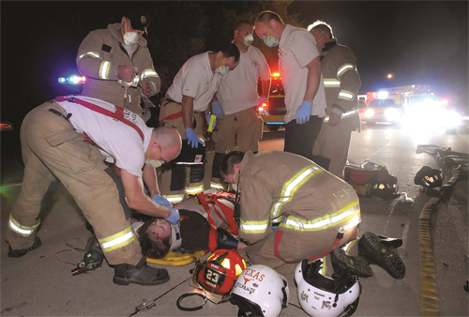
EMR Training (1 of 3)
Skills and knowledge learned in EMR course provide the foundation for entire EMS system.
Figure 1-9 A typical emergency scene with injured patients.
© Glen E. Ellman
Notes:
IV. EMR Training
A. An EMR course will teach you how to examine patients and how to use basic emergency medical skills.
The skills and knowledge learned in this course provide the foundation for the entire EMS system.
Figure: A typical emergency scene with injured patients.

Slide 23
EMR Training (2 of 3)
Skills are divided into two main groups:
Skills needed to treat injured trauma patients:
Controlling airway, breathing, and circulation
Controlling external bleeding (hemorrhage)
Treating shock
Treating wounds
Splinting injuries to stabilize extremities
Notes:
C. These skills are divided into two main groups:
1. Skills needed to treat injured trauma patients:
a. Controlling airway, breathing, and circulation
b. Controlling external bleeding (hemorrhage)
c. Treating shock
d. Treating wounds
e. Splinting injuries to stabilize extremities

Slide 24
EMR Training (3 of 3)
Skills in two main groups (cont’d):
Skills needed to care for patients experiencing illness or serious medical problems:
Heart attacks
Seizures
Problems associated with excessive heat or cold
Alcohol and drug abuse
Poisonings
Bites and stings
Altered mental status
Behavioral or psychological crisis
Emergency childbirth
Notes:
2. Skills needed to care for patients experiencing illness or serious medical problems:
a. Heart attacks
b. Seizures
c. Problems associated with excessive heat or cold
d. Alcohol and drug abuse
e. Poisonings
f. Bites and stings
g. Altered mental status
h. Behavioral or psychological crises
i. Emergency childbirth

Slide 25
Goals of EMR Training (1 of 5)
Basic goals of EMR training aim to teach you how to:
Evaluate, stabilize, and treat patients using a minimum of specialized equipment.
Improvise.
Help EMTs, AEMTs and paramedics when they arrive on the scene.
Notes:
VI. Goals of EMR Training
A. Basic goals of EMR aim to teach you how to
1. Evaluate, stabilize, and treat patients using a minimum of specialized equipment.
2. Improvise.
3. Help EMTs, AEMTs and paramedics when they arrive on the scene.

Slide 26
Goals of EMR Training (2 of 5)
Know what you should not do.
It may be better to leave patient in the position in which he or she was found rather than move patient without proper equipment or personnel.
Never judge patients based on their cultural background, religion, color, gender, sexual orientation, age, or socioeconomic status.
Notes:
B. Know what you should not do.
1. It may be better to leave the patient in the position in which he or she is found rather than move the patient without proper equipment or an adequate number of trained personnel.
2. Never judge patients based on their cultural background, religion, color, gender, sexual orientation, age, or socioeconomic status.

Slide 27
Goals of EMR Training (3 of 5)
Know how to use your EMR life support kit.
An EMR life support kit should be small enough to fit in trunk of an automobile or on almost any police, fire, or rescue vehicle.
These supplies are all you need to provide immediate care for most patients you will encounter.
Notes:
C. Know how to use your EMR life support kit.
1. This course will teach you to treat patients using limited emergency medical supplies.
2. An EMR life support kit should be small enough to fit in the trunk of an automobile or on almost any police, fire, or rescue vehicle.
3. Although the contents of the kit are limited, such supplies are all you need to provide immediate care for most patients you will encounter.

Slide 28

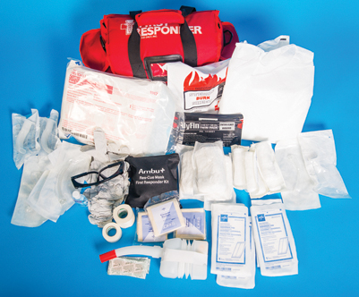
Goals of EMR Training (4 of 5)
Figure 1-10 Suggested contents of an EMR life support kit.
© Jones & Bartlett Learning
Notes:
Figure: Suggested contents of an EMR life support kit. May also include commercial tourniquet and Naloxone (if trained to administer).

Slide 29
Goals of EMR Training (5 of 5)
Know how to improvise.
You will often be in situations where little or no emergency medical equipment is available.
Know how to assist other EMS providers.
You may have to assist with certain procedures and you must know what to do in such cases.
Notes:
D. Know how to improvise.
1. You will often be in situations where little or no emergency medical equipment is available.
a. It is important to know how to improvise.
2. Examples of improvisation:
a. Use articles of clothing and handkerchiefs to stop bleeding.
b. Use wooden boards, magazines, or newspapers to immobilize injured extremities.
E. Know how to assist other EMS providers.
1. Some procedures that EMTs and paramedics use cannot be performed correctly by fewer than three people.
2. You may have to assist with these procedures and you must know what to do in such cases.

Slide 30
Additional Skills
EMRs operate in a variety of settings.
Urban areas may differ sharply from rural settings.
Regional variations in climate require you to use different skills and equipment in treating patients.
Supplemental skills may be required in your local EMS system.
Notes:
VI. Additional Skills
A. EMRs operate in a variety of settings.
1. Problems encountered in urban areas may differ sharply from those found in rural settings.
2. Regional variations in climate create conditions that affect the situations you encounter and require you to use different skills and equipment in treating patients.
B. Certain skills and equipment in this book are beyond the essential, minimum knowledge level required for an EMR course.
1. These supplemental skills and equipment may be required in your local EMS system.

Slide 31
Roles and Responsibilities of EMR (1 of 3)
Maintain your body in a healthy physical and mental condition.
Maintain equipment in a ready state.
Respond promptly and safely to the scene of an accident or sudden illness.
Ensure the scene is safe from hazards.
Protect yourself.
Protect the incident scene and patients from further harm.
Notes:
VII. Roles and Responsibilities of EMR
A. As an EMR, you have several roles and responsibilities.
1. Maintain your body in a healthy physical and mental condition.
2. Maintain equipment in a ready state.
3. Respond promptly and safely to the scene of an accident or sudden illness.
4. Ensure that the scene is safe from hazards.
5. Protect yourself.
6. Protect the incident scene and patients from further harm.

Slide 32
Roles and Responsibilities of EMR (2 of 3)
Summon appropriate assistance.
Gain access to patients.
Perform patient assessment.
Administer emergency medical care.
Provide reassurance to patients and family members.
Move patients only when necessary.
Notes:
7. Summon appropriate assistance (EMTs, fire department, rescue squad).
8. Gain access to patients.
9. Perform patient assessment.
10. Administer emergency medical care.
11. Provide reassurance to patients and family members.
12. Move patients only when necessary.

Slide 33
Roles and Responsibilities of EMR (3 of 3)
Seek and then direct help from bystanders, if necessary.
Control activities of bystanders.
Assist EMTs and paramedics, as necessary.
Maintain continuity of patient care.
Document your care.
Keep your knowledge and skills up to date.
Notes:
13. Seek and then direct help from bystanders, if necessary.
14. Control activities of bystanders.
15. Assist EMTs and paramedics, as necessary.
16. Maintain continuity of patient care.
17. Document your care.
18. Keep your knowledge and skills up-to-date.

Slide 34
Importance of Documentation (1 of 2)
Documentation should be clear, concise, accurate, and in according with accepted policies of your organization.
Provides a basis to evaluate quality of care given.
Notes:
B. Importance of documentation
1. Documentation should be clear, concise, accurate, and according to accepted policies of your organization.
2. This documentation is important because you will not be able to remember the treatment you give to all patients.
3. It also serves as a legal record of your treatment and may be required in the event of a lawsuit.
4. It provides a basis to evaluate quality of care given.

Slide 35
Importance of Documentation (2 of 2)
Documentation should include:
Condition of the patient when found
Patient’s description of injury/illness
Initial and later vital signs
Treatment you gave patient
Agency and personnel who took over patient treatment
Any other helpful facts
Notes:
5. Documentation should include:
a. Condition of the patient when found
b. Patient’s description of the injury or illness
c. Initial and later vital signs
d. Treatment you gave patient
e. Agency and personnel who took over patient treatment
f. Any other helpful facts

Slide 36
Attitude and Conduct (1 of 2)
To be a good EMR, you need to reflect certain characteristics.
Be honest and conduct yourself with integrity.
Be aware of patients’ feelings and have empathy for your patients.
Be motivated to get the job done and to understand the limits of your training/skills.
Be an advocate for your patients.
Notes:
C. Attitude and conduct
1. As an EMR, you will be judged by your attitude and conduct.
2. Professional behavior has a positive impact on your patients.
3. To be a good EMR, you need to reflect certain characteristics.
a. Be honest and conduct yourself with integrity.
b. Be aware of patients’ feelings and have empathy for your patients.
c. Be motivated to get the job done and understand the limits of your training and skills.
d. Be an advocate for your patients.
4. It is important to be calm and caring.
5. Avoid embarrassing your patients and help protect their privacy.
6. Talk with your patients and let them know what you are doing.
7. Medical information about a patient is confidential and should not be discussed with your family and friends.

Slide 37
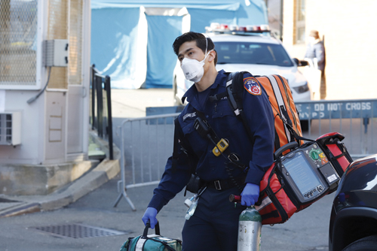
Attitude and Conduct (2 of 2)
Your appearance should be neat and professional at all times.
Figure 1-11 A professional attitude and neat appearance reassure patients.
© REUTERS/Stefan Jeremiah
Notes:
8. Your appearance should be neat and professional at all times.
Figure: A professional attitude and neat appearance reassure patients.

Slide 38
Medical Oversight (1 of 2)
Physician or medical director is overall leader of medical care team.
As indirect or off-line medical control, the physician:
Directs training courses
Helps set medical policies and procedures
Ensures quality management of EMS system
Notes:
VIII. Medical Oversight
A. Physician or medical director is the overall leader of medical care team.
B. Each EMS agency should have a physician who directs training courses, helps set medical policies and procedures, and ensures quality management of EMS system.
1. Known as indirect or off-line medical control

Slide 39
Medical Oversight (2 of 2)
Online medical control is provided by a physician who is in contact with prehospital EMS providers by two-way radio or wireless (cell) phone.
Notes:
C. A second type of medical control is known as direct or online medical control.
1. Online medical control is provided by a physician who is in contact with prehospital EMS providers, usually paramedics or EMTs, by two-way radio or wireless (cell) phone.
2. In cases where large numbers of people are injured, or in cases of prolonged entrapment, physicians may respond to the scene of the incident to provide on-scene medical control.

Slide 40
Quality Improvement (1 of 3)
Process used by medical care systems to evaluate effectiveness and safety of current treatments and procedures
Six components:
Safety: Actions of EMRs must not cause harm to patients, bystanders, or EMS providers.
Notes:
IX. Quality Improvement
A. Quality improvement is a process used by medical care systems to evaluate the effectiveness and safety of current treatments and procedures.
B. It is also used to determine the effectiveness and safety of new treatments and procedures.
C. The Institute of Medicine has identified six components of the quality improvement process.
1. Safety: Actions of EMRs must not cause harm to patients, bystanders, or EMS providers.

Slide 41
Quality Improvement (2 of 3)
Six components (cont’d):
Effectiveness: EMR care should be based on scientific knowledge and provide desired benefit to the patient.
Patient-centeredness: Be responsive to patient’s physical needs as well as his or her values, religion, and heritage.
Timeliness: Provide care in a timely manner.
Notes:
2. Effectiveness: EMS care should be based on scientific knowledge and provide the desired benefit to the patient.
3. Patient-centeredness: Be responsive to the patient’s physical needs as well as his or her values, religion, and heritage.
4. Timeliness: Provide care in a timely manner.

Slide 42
Quality Improvement (3 of 3)
Six components (cont’d):
Efficiency: Always strive to deliver care without wasting supplies, equipment, or time.
Equitability: Patient care should not vary between people of different genders, sexual orientations, ethnic backgrounds, geographic locations, or socioeconomic levels.
Notes:
5. Efficiency: Always strive to deliver care without wasting supplies, equipment, or time.
6. Equitability: Patient care should not vary between people of different genders, sexual orientations, ethnic backgrounds, geographic locations, or socioeconomic levels.

Slide 43
Your Certification
Once certified as an EMR, you must follow national and state standards for your level of certification.
Your responsibility to keep your certification current.
Maintain continuing education requirements.
Keep your skills up-to-date.
Failure to do so can result in penalties.
Notes:
X. Your Certification
A. Certification is process by which a person, institution, or program is evaluated and recognized as meeting certain standards to ensure safe and ethical patient care.
B. Once certified as an EMR, you must follow national and state standards for your level of practice.
1. Your employer may set additional requirements for your conduct and practice.
C. Your responsibility to make sure that you keep your certification current by maintaining continuing education requirements and keeping your skills up to date.
1. Failure to keep your certification current can result in penalties.

Slide 44
Summary (1 of 3)
EMR is often the first medically trained person to arrive on scene.
Typical sequence of events of EMS system is reporting, dispatch, emergency medical response, EMS vehicle response, and hospital care.
Notes:
XI. Summary
A. EMR is often the first medically trained person to arrive on the scene. The initial care provided is essential because it is available sooner than more advanced emergency medical care and could mean the difference between life and death.
B. EMRs should understand their roles in the (EMS) system. Typical sequence of events of the EMS system is reporting, dispatch, emergency medical response, EMS vehicle response, and hospital care.

Slide 45
Summary (2 of 3)
Four basic goals of EMR training are to know what not to do, how to use your EMR life support kit, how to improvise, and how to assist other EMS providers.
EMR’s primary goal is to provide immediate care for a sick or injured patient and to assist more highly trained personnel.
Documentation should be clear, concise, accurate, and in accordance with the accepted policies of your organization.
Notes:
Four basic goals of EMR training are to know what not to do, how to use your EMR life support kit, how to improvise, and how to assist other EMS providers.
D. As an EMR, your primary goal is to provide immediate care for a sick or injured patient. As more highly trained personnel (EMTs or paramedics) arrive on the scene, you will assist them in treating and preparing the patient for transportation.
E. Once your role in treating the patient is finished, you must record your observations about the scene, the patient’s condition, and the treatment you provided. Documentation should be clear, concise, accurate, and in accordance with the accepted policies of your organization.

Slide 46
Summary (3 of 3)
Medical information about a patient is confidential and should be shared only with other medical personnel involved in care of patient.
Overall leader of medical care team is physician or medical director.
Quality improvement measures care in six component areas: safety, effectiveness, patient-centeredness, timeliness, efficiency, and equitability.
Notes:
F. Medical information about a patient is confidential and should be shared only with other medical personnel who are involved in the care of that particular patient.
G. The overall leader of medical care team is physician or medical director. To ensure that the patient receives appropriate medical treatment, it is important that EMRs receive direction from a physician.
H. Quality improvement helps to determine the level of care rendered by an EMS service. It measures care in six component areas: safety, effectiveness, patient-centeredness, timeliness, efficiency, and equitability. EMS systems should have an ongoing quality improvement program.

Slide 47
Review
The EMR must possess the ability to:
treat patients using limited equipment.
perform ALS-level skills.
keep severely injured patients alive for extended periods of time.
diagnose conditions in the field.

Slide 48
Review
Answer:
A. treat patients using limited equipment.

Slide 49
Review
For a patient in cardiac arrest, which of the following interventions will you most likely be responsible for performing?
Administration of pain medication
CPR and defibrillation
Intravenous therapy
Intubation

Slide 50
Review
Answer:
B. CPR and defibrillation

Slide 51
Review
When EMTs or paramedics arrive at scene of an emergency, the EMR should:
cease all patient care.
prepare to accompany the patient to the hospital.
assist higher-level EMS providers in continuing care.
obtain signatures from all other EMS providers.

Slide 52
Review
Answer:
C. assist higher-level EMS providers in continuing care.

