Slide 1
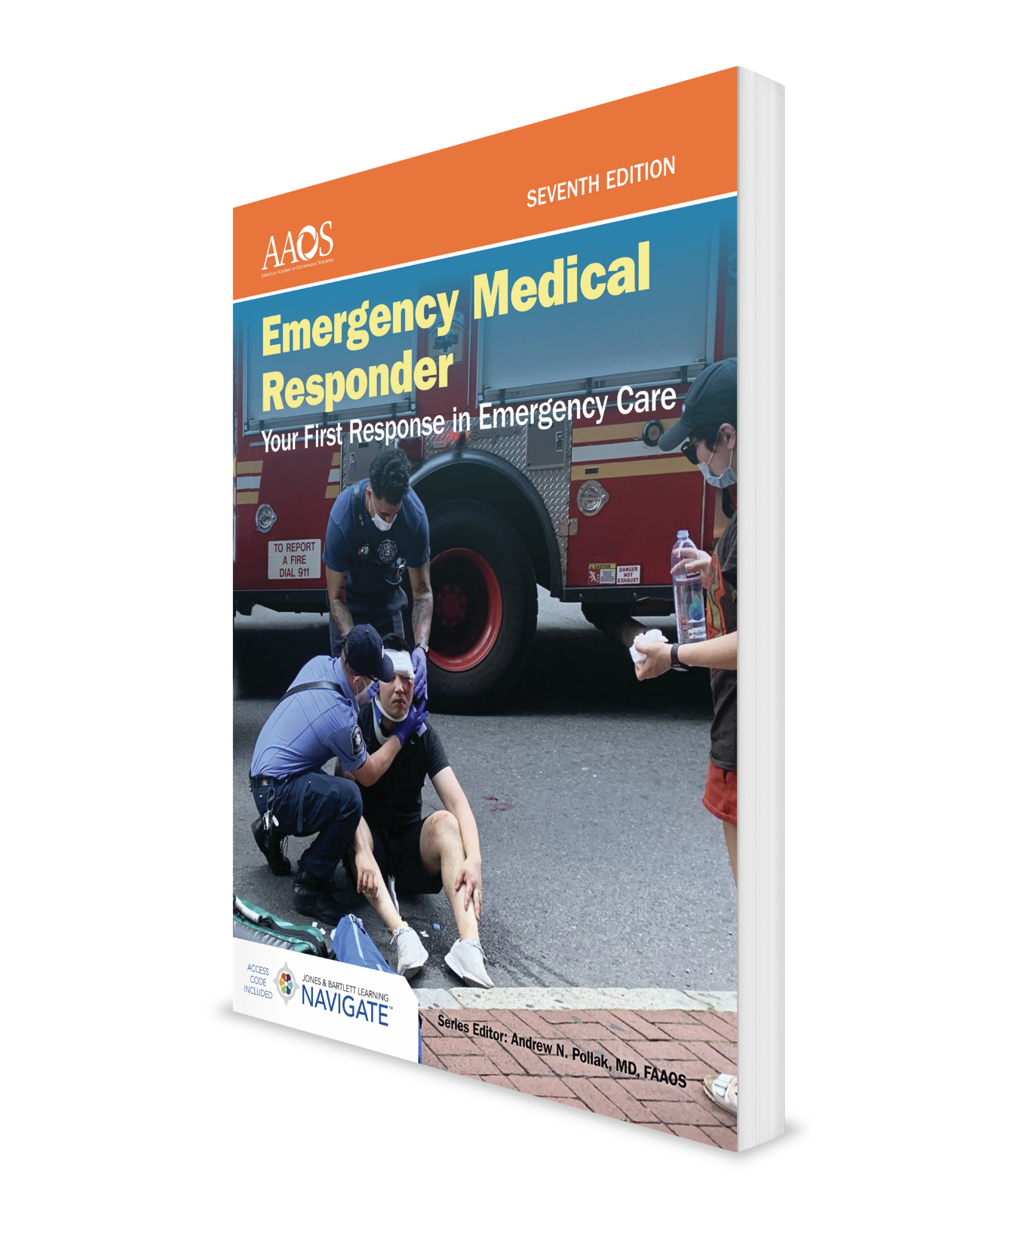
Behavioral Emergencies
CHAPTER 12

Slide 2
National EMS Education Standard Competencies (1 of 3)
Medicine:
Recognizes and manages life threats based on assessment findings of a patient with a medical emergency while awaiting additional emergency response.
Notes:
Medicine:
Recognizes and manages life threats based on assessment findings of a patient with a medical emergency while awaiting additional emergency response.

Slide 3
National EMS Education Standard Competencies (2 of 3)
Psychiatric:
Recognition of:
Behaviors that pose a risk to EMR, patient, or others.
Notes:
Psychiatric:
Recognition of:
• Behaviors that pose a risk to EMR, patient, or others. (p 244; pp 246-248)

Slide 4
National EMS Education Standard Competencies (3 of 3)
Special Patient Populations:
Recognizes and manages life threats based on simple assessment findings for a patient with special needs while awaiting additional emergency response.
Patients With Special Challenges:
Recognizing and reporting abuse and neglect.
Notes:
Special Patient Populations:
Recognizes and manages life threats based on simple assessment findings for a patient with special needs while awaiting additional emergency response.
Patients With Special Challenges:
• Recognizing and reporting abuse and neglect. (p 244; pp 248-249)

Slide 5
Introduction
EMRs need to give psychological support as well as emergency medical care.
Factors contributing to behavioral changes:
Medical conditions.
Physical trauma.
Psychiatric illnesses.
Mind-altering substances.
Situational stresses.
Notes:
I. Introduction
A. Emergency situations have emotional and psychological effects on rescuers, patients, family members and friends, and even bystanders.
B. EMRs need to give psychological support as well as necessary emergency medical care.
C. Five factors contributing to behavioral changes:
1. Medical conditions.
2. Physical trauma.
3. Psychiatric illnesses.
4. Mind-altering substances.
5. Situational stresses.

Slide 6
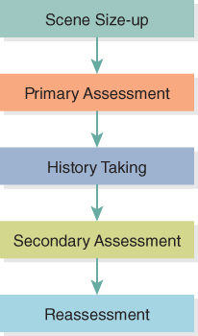
Patient Assessment in Behavioral Emergencies (1 of 3)
Figure 12-1 Patient assessment sequence.
© Jones & Bartlett Learning.
Notes:
Figure: Patient assessment sequence.

Slide 7
Patient Assessment in Behavioral Emergencies (2 of 3)
Complete a scene size-up, being especially careful to make sure that scene is safe.
If patient is oriented and responsive, complete primary assessment.
Observe patient’s responsiveness, airway, and breathing, and measure pulse.
History should follow SAMPLE format.
Notes:
II. Patient Assessment in Behavioral Emergencies
A. When you are assessing a patient who appears to be experiencing a behavioral emergency, follow steps of patient assessment sequence.
1. Complete a scene size-up, being especially careful to ensure that scene is safe both for you and for patient.
2. If patient is oriented and responsive, complete primary assessment by observing patient’s responsiveness, airway, and breathing, and measuring pulse.
3. History should follow SAMPLE format.
a. Do not neglect to ask about medical problems.
b. It is important not to overlook this part of examination.

Slide 8
Patient Assessment in Behavioral Emergencies (3 of 3)
Secondary assessment should rule out any obvious injuries and focus on signs of medical illnesses.
Take a set of vital signs.
Reassess stable patients every 15 minutes and unstable patients every 5 minutes.
If you cannot complete assessment, document reason for not completing it.
Notes:
4. Secondary assessment should rule out any obvious injuries and focus on signs of medical illnesses.
a. Take a set of vital signs.
b. Tell the patient what you are doing at each step of the way.
5. Reassess the patient every 15 minutes for a stable patient and every 5 minutes for an unstable patient.
a. In cases where you cannot complete the assessment, document the assessment findings and the reason for not completing all steps.

Slide 9
Behavioral Crises (1 of 4)
Behavioral emergencies are situations in which persons exhibit abnormal, unacceptable behavior that cannot be tolerated by patients themselves or by family, friends, or community.
Five main factors contribute to behavioral changes.
Medical conditions:
Uncontrolled diabetes.
Respiratory conditions.
Strokes.
Notes:
III. Behavioral Crises
A. Behavioral emergencies are situations in which persons exhibit abnormal, unacceptable behavior that cannot be tolerated by the patients themselves or by family, friends, or community.
B. Five main factors contribute to behavioral changes.
1. Medical conditions:
a. Uncontrolled diabetes that causes low blood glucose.
b. Respiratory conditions that prevent patient’s brain from receiving enough oxygen.
c. Strokes.

Slide 10
Behavioral Crises (2 of 4)
Medical conditions (cont'd):
Head injuries.
High fevers.
Infections.
Excessively low body temperature.
Physical trauma conditions:
Head injuries.
Injuries that result in shock and an inadequate blood supply to brain.
Notes:
d. Head injuries.
e. High fevers.
f. Infections.
g. Excessively low body temperature.
2. Physical trauma conditions:
a. Head injuries
b. Injuries that result in shock and an inadequate blood supply to brain.

Slide 11
Behavioral Crises (3 of 4)
Psychiatric illnesses:
Depression.
Panic.
Psychotic behavior.
Mind-altering substances:
Alcohol.
A wide variety of chemical substances.
Notes:
3. Psychiatric illnesses:
a. Depression.
b. Panic.
c. Psychotic behavior.
4. Mind-altering substances:
a. Alcohol.
b. A wide variety of chemical substances.

Slide 12
Behavioral Crises (4 of 4)
Situational stresses:
Death of a loved one.
Serious injury to a loved one.
Notes:
5. Situational stresses from a variety of emotional traumas:
a. Death of a loved one.
b. Serious injury to a loved one.

Slide 13
What Is a Situational Crisis?
State of emotional upset or turmoil.
Caused by a sudden and disruptive event.
Most situational crises:
Are sudden and unexpected.
Cannot be handled by person’s usual coping mechanisms.
Last only a short time.
Can cause socially unacceptable, self-destructive, or dangerous behavior.
Notes:
IV. What Is a Situational Crisis?
A. A situational crisis is a state of emotional upset or turmoil.
B. The crisis is caused by a sudden and disruptive event such as a physical illness, a traumatic injury, or death of a loved one.
C. You will often encounter this type of crisis as an EMR.
D. Most situational crises:
1. Are sudden and unexpected (such as a motor vehicle crash).
2. Cannot be handled by person’s usual coping mechanisms.
3. Last only a short time.
4. Can cause socially unacceptable, self-destructive, or dangerous behavior.

Slide 14
Phases of a Situational Crisis
There are four emotional phases to each situational crisis.
People may not experience every phase, but they will experience one or more.
Emotional phases:
High anxiety or emotional shock.
Denial.
Anger.
Remorse and grief.
Notes:
V. Phases of a Situational Crisis
A. There are four emotional phases to each situational crisis.
1. People may not experience every phase during a crisis, but they will certainly experience one or more.
2. Understanding what these phases are and why they occur will help you better treat people who are experiencing an emotional crisis.
3. Emotional phases:
a. High anxiety or emotional shock.
b. Denial.
c. Anger.
d. Remorse and grief.

Slide 15
High Anxiety or Emotional Shock (1 of 2)
High anxiety is characterized by:
Flushed (red) face.
Rapid breathing.
Rapid speech.
Increased activity.
Loud or screaming voice.
General agitation.
Notes:
B. High anxiety or emotional shock:
1. High anxiety is characterized by obvious signs and symptoms:
a. Flushed (red) face.
b. Rapid breathing.
c. Rapid speech.
d. Increased activity.
e. Loud or screaming voice.
f. General agitation.

Slide 16
High Anxiety or Emotional Shock (2 of 2)
Emotional shock is often result of a sudden illness, accident, or sudden death of a loved one.
Emotional shock is characterized by:
Cool, clammy skin.
A rapid, weak pulse.
Vomiting and nausea.
General inactivity and weakness.
Notes:
2. Emotional shock is often the result of a sudden illness, accident, or sudden death of a loved one and is characterized by:
a. Cool, clammy skin.
b. A rapid, weak pulse.
c. Vomiting and nausea.
d. General inactivity and weakness.

Slide 17
Denial
Refusal to accept fact that an event has occurred.
Your response should be as follows:
Allow patient to express denial.
Do not argue with patient.
Try to understand emotional and psychological trauma that patient is experiencing.
Notes:
C. Denial
1. Refusal to accept fact that an event has occurred
2. Your response should be as follows:
a. Allow patient to express denial.
b. Do not argue with patient.
c. Try to understand emotional and psychological trauma that patient is experiencing.

Slide 18
Anger
Normal human response to emotional overload or frustration.
May follow denial or may replace denial.
People may vent angry feelings at you.
Do not take person’s anger personally.
Frustration and a sense of helplessness can often build to anger.
Always be professional and remain calm.
Notes:
D. Anger
1. Anger is a normal human response to emotional overload or frustration.
2. Anger may follow denial or may occur instead of denial.
3. In a crisis, people may vent angry feelings at you or an authority figure.
a. Do not take person’s anger personally, but acknowledge that it is a reaction to stress.
4. Frustration and a sense of helplessness can often build to anger.
a. Always be professional and do not react to anger by becoming angry yourself.
b. Remain calm and deliberate in your actions to prevent escalation of violence.

Slide 19
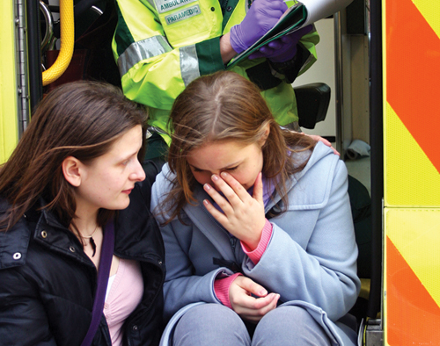
Remorse or Grief
Acceptance of situation may lead to remorse or grief.
People may feel guilty or apologetic about their behavior.
Figure 12-2 An acceptance of the situation may lead to grief.
© Jones & Bartlett Learning. Courtesy of MIEMSS.
Notes:
E. Remorse or grief:
1. An acceptance of situation may lead to remorse or grief.
2. People may feel guilty or apologetic about their behavior or actions during an incident or about incident itself.
Figure: An acceptance of situation may lead to grief.

Slide 20
Crisis Management
Role of EMR:
Follow steps of patient assessment sequence.
Perform a scene size-up.
Perform a primary assessment.
Obtain patient’s medical history (SAMPLE).
Perform a secondary assessment.
Provide ongoing reassessment.
Most important assessment skill may be your ability to communicate with patient.
Notes:
VI. Crisis Management
A. Role of EMR:
1. Follow steps of patient assessment sequence:
a. Perform a scene size-up.
b. Perform a primary assessment.
c. Obtain patient’s medical history (SAMPLE).
d. Perform a secondary assessment.
e. Provide reassessment.
2. Most important assessment skill may be your ability to communicate with patient.

Slide 21
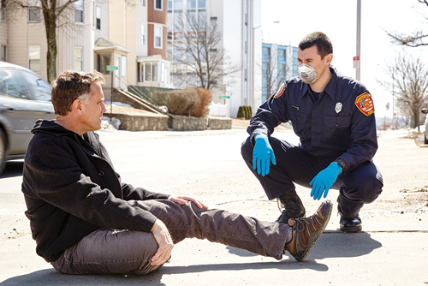
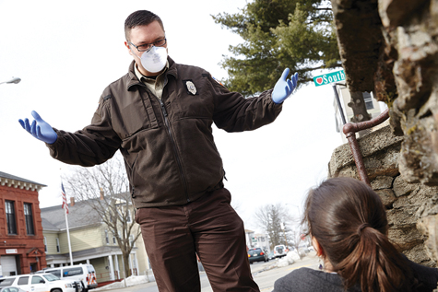
Communicating With Patient (1 of 6)
Talk with person.
Introduce yourself.
Ask patient his or her name.
Ask what you can do to help.
Be honest, warm, caring, and empathetic.
Position yourself at patient’s eye level.
Figure 12-3 Crouch or seat yourself at the same level as the patient.
© Jones & Bartlett Learning.
Figure 12-4 This body language communicates an uncaring attitude.
© Jones & Bartlett Learning.
Notes:
B. Communicating with the patient
1. First and most important step you can take in crisis management is to talk with person.
a. Introduce yourself to patient.
b. Ask patient his or her name.
c. Ask what you can do to help.
2. Be honest, warm, caring, and empathetic.
3. Position yourself at patient’s eye level.
Figure: (Top) Crouch or seat yourself at same level as patient. (Bottom) This body language communicates an uncaring attitude.

Slide 22
Communicating With Patient (2 of 6)
Establish eye contact with patient.
Use a calm, steady voice and provide honest reassurance.
Try not to let negative personal feelings interfere with your attempt to provide assistance.
Simple acts of kindness can provide comfort and reassurance.
Notes:
4. Establish eye contact with patient.
5. Use a calm, steady voice and provide honest reassurance.
6. Try not to let negative personal feelings about the person or about the person’s behavior interfere with your attempt to provide assistance.
7. Simple acts of kindness can comfort and reassure a patient in a situational crisis.

Slide 23
Communicating With Patient (3 of 6)
Restatement:
Rephrasing a person’s own words and thoughts and repeating them back.
Be honest and give patient hope, but do not give false hope.
Redirection:
Helps focus a patient’s attention on immediate situation or crisis.
Notes:
8. Restatement:
a. Rephrasing a person’s own words and thoughts and repeating them back to person.
b. It is usually not helpful to say, “I know what you mean” or “I know how you feel.”
c. Be honest and give patient hope, but do not give false hope.
9. Redirection:
a. Sometimes a patient may be embarrassed about being center of attention or may be concerned about others involved in situation.
b. Redirection helps focus a patient’s attention on immediate situation or crisis.

Slide 24
Communicating With Patient (4 of 6)
Redirection (cont'd):
Use redirection to alleviate a patient’s expressed concerns.
Move patient to a quieter and more private location.
Empathy:
Imagining yourself in another person’s situation and sharing his or her feelings or ideas.
Empathy is one of the most helpful concepts you can use.
Use a calm and caring approach.
Notes:
c. Use redirection in an attempt to alleviate a patient’s expressed concerns and draw his or her attention back to immediate situation.
d. If patient is in a public place, move him or her to a quieter and more private location.
10. Empathy:
a. Ability to empathize involves imagining yourself in another person’s situation, sharing that individual’s feelings or ideas.
b. Empathy is one of most helpful concepts you can use when caring for patients in crisis situations.
c. Use a calm and caring approach.

Slide 25
Communicating With Patient (5 of 6)
Principles for assessing patients with behavioral problems:
Identify yourself and let patient know you are there to help.
Inform patient of what you are doing.
Ask questions in a calm, reassuring voice.
Allow patient to tell you what happened—do not be judgmental.
Show you are listening by using restatement and redirection.
Acknowledge patient’s feelings.
Assess patient’s mental status.
Notes:
11. Communication skills
a. Principles for assessing patients with behavioral problems
i. Identify yourself and let patient know you are there to help.
ii. Inform the patient of what you are doing.
iii. Ask questions in a calm, reassuring voice.
iv. Allow patient to tell you what happened. Do not be judgmental.
v. Show you are listening by using restatement and redirection.
vi. Acknowledge patient’s feelings.
vii. Assess patient’s mental status, including appearance; activity; speech; orientation to person, place, and time; mood; thought process; and memory

Slide 26
Communicating With Patient (6 of 6)
Communication with patients with developmental disabilities:
CDC data indicates one in six children has a developmental disability.
Developmental disabilities range from learning disabilities and developmental delays to autism spectrum disorder.
For example, patients with autism might:
Avoid eye contact and want to be alone.
Not look at objects when another person points to them.
Have trouble expressing their needs using typical words or motions.
Appear to be unaware when people talk to them but respond to other sounds.
Have trouble adapting when their routine changes.
Prefer not to be held or touched.
Notes:
12. Communication with patients with developmental disabilities:
a. CDC data indicates one in six children has a developmental disability.
b. Developmental disabilities range from learning disabilities and developmental delays to autism spectrum disorder.
c. For example, patients with autism might:
i. Avoid eye contact and want to be alone.
ii. Not look at objects with another person points to them.
iii. Have trouble expressing their needs using typical words or motions.
iv. Appear to be unaware when people talk to them but respond to other sounds.
v. Have trouble adapting when their routine changes.
vi. Prefer not to be held or touched.

Slide 27
Crowd Control
Performing crowd control may help reduce a patient’s anxiety when there are too many people around.
During your size-up of the scene, determine whether there is a crowd that might become hostile.
It is better to ask for help early than to wait.
Notes:
C. Crowd control
1. Performing simple crowd control may help reduce a patient’s anxiety when there are too many people around.
2. Any emergency personnel who are not needed right away should leave room until patient is calm.
3. During your initial size-up of scene, determine whether there is a crowd that might become hostile.
a. It is better to ask for help with an unruly crowd early than to wait until situation is truly unsafe for you and patient.

Slide 28
Domestic Violence (1 of 6)
Common occurrence in today’s society.
It takes several different forms:
Elder abuse.
Child abuse.
Spouse and domestic partner abuse.
When responding to a domestic call: call
Maintain safety for all rescuers as well as for patient.
Notes:
D. Domestic violence
1. Domestic violence is a common occurrence in today’s society.
2. Its different forms include:
a. Elder abuse.
b. Child abuse.
c. Spouse and domestic partner abuse.
3. EMRs need to be able to recognize signs and symptoms of abuse and to understand three phases in cycle of abuse.
4. When responding to a domestic violence call, you need to:
a. Maintain safety for all rescuers as well as for patient.

Slide 29
Domestic Violence (2 of 6)
When responding to a domestic call (cont'd):
Conduct an effective assessment and treatment.
Understand requirements for reporting abuse in your state.
Physical signs and symptoms:
Broken bones.
Cuts.
Notes:
b. Conduct an effective assessment and provide treatment.
c. Understand requirements for reporting abuse in your state.
5. Signs and symptoms include physical injuries, emotional state of the victim, and personality indicators of abuser.
a. Physical injuries:
i. Broken bones.
ii. Cuts.

Slide 30
Domestic Violence (3 of 6)
Physical signs and symptoms (cont'd):
Head injuries.
Bruises.
Burns.
Scars from old injuries.
Injuries in various stages of healing.
Internal injuries.
Notes:
iii. Head injuries.
iv. Bruises.
v. Burns.
vi. Scars from old injuries.
vii. Injuries in various stages of healing.
viii. Internal injuries.

Slide 31
Domestic Violence (4 of 6)
Emotional symptoms:
Depression.
Suicide attempts.
Abuse of alcohol or drugs.
Feelings of anxiety, distress, and hopelessness.
Abusers may be paranoid, overly sensitive, obsessive, or threatening.
Notes:
b. Emotional symptoms:
i. Depression.
ii. Suicide attempts.
iii. Abuse of alcohol or drugs.
iv. Feelings of anxiety, distress, and hopelessness.
6. Abusers may be paranoid, overly sensitive, obsessive, or threatening.
a. They often abuse alcohol or drugs and have access to weapons.

Slide 32
Domestic Violence (5 of 6)
If you suspect abuse, your responsibility is to maintain safety for yourself and for patient.
Try to separate patient from abuser.
Try to keep from judging the patient.
Presence of law enforcement personnel may be helpful.
Learn requirements for reporting abuse in your state.
Notes:
7. If you suspect abuse, your responsibility is to maintain safety for yourself and for patient.
a. To diffuse a tense situation, try to separate patient from abuser.
b. As you question patient, express your concern.
c. Try to keep from judging patient.
d. If patient refuses transport, some agencies provide information about domestic abuse shelters.
e. In some cases, presence of law enforcement personnel will be helpful.
f. Learn requirements for reporting cases of suspected abuse in your state.

Slide 33
Domestic Violence (6 of 6)
Cycles of abuse:
Tension phase: Abuser becomes angry and often blames victim.
Explosive phase: Abuser becomes enraged and loses control as well as ability to think clearly.
Make-up phase: Abuser makes promises, which are seldom kept.
Notes:
8. Cycles of abuse
a. Tension phase
i. Abuser becomes angry and often blames victim.
ii. Victim may try to placate the abuser or minimize or deny abuse.
iii. Tension phase is usually the longest part of abuse cycle.
b. Explosive phase:
i. Abuser becomes enraged and loses control as well as ability to think clearly.
ii. Most injuries to victim occur during this stage.
c. Make-up phase:
i. Abuser makes promises, which are seldom kept.
ii. This phase helps keep abused person in relationship with abuser.
d. EMRs may enter a domestic scene anywhere in this cycle.
i. Understanding cycle will help you anticipate the actions of both abuser and victim.

Slide 34
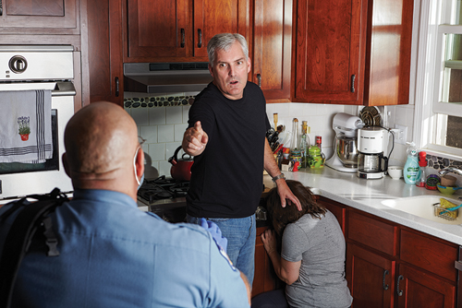
Violent Patients (1 of 3)
Immediately attempt to establish verbal and eye contact with patient.
Check with family and friends about patient’s past history of violence.
Signs of potential violence:
History of violence.
Yelling or verbal threatening.
Figure 12-5 A patient’s posture will indicate the potential for violent behavior.
© Jones & Bartlett Learning.
Notes:
E. Violent patients:
1. Immediately attempt to establish verbal and eye contact with patient.
a. This begins the process of establishing rapport.
2. Check with family members and friends about patient’s past history of violence.
3. Signs of potential violence:
a. History of violence.
b. Yelling or verbal threatening.
Figure: A patient’s posture will indicate potential for violent behavior.

Slide 35
Violent Patients (2 of 3)
Signs of potential violence (cont'd):
Loud, obscene, or bizarre speech.
Pacing, inability to sit still, and protection of personal space.
Abuse of drugs or alcohol.
Never force a potentially violent patient into a corner, and do not allow yourself to be cut off from a route of retreat.
Notes:
c. Loud, obscene, or bizarre speech.
d. Pacing, inability to sit still, or protection of personal space.
e. Abuse of drugs or alcohol.
4. Never force a potentially violent patient into a corner, and do not allow yourself to be cut off from a route of retreat.

Slide 36
Violent Patients (3 of 3)
Have only one person talk with patient.
Communicator should be rescuer with whom patient seems to have best initial rapport.
Anticipate need to summon law enforcement personnel if all else fails.
Notes:
5. Have only one person talk with patient.
a. Communicator should be rescuer with whom patient seems to have best initial rapport.
6. Anticipate need to summon law enforcement personnel if all other means of approach and intervention fail.

Slide 37
Violence Against EMRs (1 of 3)
Factors that increase risk of violence in workplace:
Working alone or in small numbers.
Working late at night or early in morning.
Working in high-crime areas.
Working in community settings.
Notes:
F. Violence against EMRs:
1. Several factors increase risk of violence in the workplace, including:
a. Working alone or in small numbers.
b. Working late at night or early in morning hours.
c. Working in high-crime areas.
d. Working in community settings.

Slide 38
Violence Against EMRs (2 of 3)
Be alert when you respond to a call that has an increased chance for violence, including following situations:
Crime scenes.
Incidents involving gangs.
Large gatherings of hostile or potentially hostile people.
Domestic disputes.
Notes:
2. Be alert when you respond to a call that has an increased chance for violence, including in following situations:
a. Crime scenes.
b. Incidents involving gangs.
c. Large gatherings of hostile or potentially hostile people.
d. Domestic disputes.

Slide 39
Violence Against EMRs (3 of 3)
Ways to minimize risk of injury:
Take steps to keep yourself and other rescuers safe at these scenes.
Always keep an escape route open between you and patient.
Prevention:
Best way to avoid violence.
Make sure you have an escape route in mind.
Notes:
3. Although EMRs are more likely to be involved in potentially violent situations than average citizens, there are ways to minimize risk of injury.
a. Take steps to keep yourself and other rescuers safe at these scenes.
b. Always keep an escape route open between you and patient.
4. Prevention:
a. Prevention is the best way to avoid violence.
b. As you arrive at scene, use your personal “antenna” to pick up any signs that you may be approaching a violent situation.
c. Make sure you have an escape route in mind.
d. Your ability to use good interpersonal communication skills will help prevent many situations from becoming violent.
e. If you think you need backup or law enforcement personnel, request it early.

Slide 40
Armed Patient
It is not your role to handle an armed patient unless you are a law enforcement officer.
Be alert and summon assistance.
Stay in your vehicle if you must wait for a law enforcement officer.
If you are confronted by an armed person, immediately attempt to withdraw.
Notes:
G. Armed patient
1. It is not your role to handle an armed patient unless you are a law enforcement officer.
2. Be alert for potentially threatening situations and summon assistance if you think person is armed.
3. Stay in your vehicle if you must wait for a law enforcement officer.
4. If, despite caution, you are confronted by an armed person, immediately attempt to withdraw.

Slide 41
Medical and Legal Considerations (1 of 3)
If an emotionally disturbed patient agrees to be treated, few legal issues should arise.
If a patient who appears to be disturbed refuses treatment, you may have to provide care against patient’s will.
You must have a reasonable belief that patient would harm self or others.
Notes:
H. Medical and legal considerations:
1. You must understand laws of your state and community that relate to dealing with emotionally disturbed patients.
2. If an emotionally disturbed patient agrees to be treated, few legal issues should arise.
3. If a patient who appears to be disturbed refuses to accept treatment, it may be necessary to provide care against patient’s will.
a. You must have a reasonable belief that patient would harm self or others.
b. As an EMR, you usually will not be responsible for transporting patient, but you should know what laws in your state permit you to do.

Slide 42
Medical and Legal Considerations (2 of 3)
If you are required to restrain a patient, consider these factors:
Patient’s size and apparent strength.
Patient’s gender.
Type of abnormal behavior.
Patient’s mental state.
Method of restraint.
Notes:
c. If you are required to restrain a patient, consider these factors:
i. Patient’s size and apparent strength.
ii. Patient’s gender.
iii. Type of abnormal behavior.
iv. Patient’s mental state.
v. Method of restraint.

Slide 43
Medical and Legal Considerations (3 of 3)
You may use reasonable force to defend yourself against an attack.
Seek assistance from law enforcement officials or from your medical director.
Document conditions present.
Whenever possible, a caregiver of same sex should take primary responsibility for care of patient.
Notes:
4. You may use reasonable force to defend yourself against an attack by an emotionally disturbed patient.
5. To prevent problems if you must restrain a patient, seek assistance from law enforcement officials or from your medical director.
6. Document conditions present in cases where you must restrain or subdue a patient.
7. Whenever possible, a caregiver of same sex should take primary responsibility for care of patient.

Slide 44
Attempted Suicide (1 of 2)
Many patients who fail at their first attempt will try to commit suicide again.
Underlying psychiatric disease is usually treatable.
Review the risk factors that make it more likely that someone will consider or attempt suicide (Table 12-1).
Management:
Protect yourself and patient from further harm.
Obtain a complete history of incident.
Determine whether patient still has a weapon or drugs on him or her.
Notes:
I. Other types of emotional crises:
1. Other types of emotional crises also require you to have good communication skills.
2. Attempted suicide:
a. Each year, thousands of people—from teenagers to elderly persons—attempt suicide (self-inflicted death).
b. Many patients who fail at their first attempt will try to commit suicide again.
c. Most people who attempt suicide have a serious psychiatric illness, such as depression or alcohol or substance abuse.
d. Patient may be under influence of drugs or alcohol.
e. The underlying psychiatric disease is usually treatable, and with proper treatment patient will no longer be suicidal.
f. Review the risk factors that make it more likely that someone will consider or attempt suicide (Table 12-1).
g. Management of an attempted suicide consists of following steps:
i. Protect yourself and patient from further harm.
ii. Obtain a complete history of incident.
iii. Determine whether patient still has a weapon or drugs on him or her.

Slide 45
Attempted Suicide (2 of 2)
Management (cont'd):
Support patient’s ABCs.
Dress any open wounds.
Treat patient for spinal injuries.
Do not judge patient.
Treat patient for injuries or conditions you discover.
Provide emotional support.
Notes:
iv. Support patient’s ABCs, as needed.
v. Dress any open wounds.
vi. Treat patient for spinal injuries, if indicated.
vii. Do not judge patient. Treat him or her for injuries or conditions you discover.
viii. Provide emotional support for patient and family.

Slide 46
Posttraumatic Stress Disorder (1 of 2)
A mental health or behavioral condition triggered by experiencing or witnessing a terrifying event.
Symptoms include:
Intrusive memories of traumatic event.
Avoidance of places, activities, or people that remind them of traumatic event.
Negative feelings.
Emotional reactions.
Notes:
3. Posttraumatic stress disorder (PTSD):
a. PTSD is a mental health or behavioral condition triggered by experiencing or witnessing a terrifying event.
b. People experiencing PTSD get worse with time, and their anxiety often interferes with their normal day-to-day activities.
c. Symptoms include:
i. Intrusive memories of traumatic event.
ii. Avoidance of places, activities, or people that remind them of traumatic event.
iii. Negative feelings.
iv. Emotional reactions.

Slide 47
Posttraumatic Stress Disorder (2 of 2)
As an EMR, your job is to:
Protect patient from harm.
Speak with patient in a positive and supportive way.
Arrange for patient to be transported to an appropriate medical facility.
Notes:
d. As an EMR, your job is to:
i. Protect patient from harm.
ii. Speak with patient in a positive and supportive way.
iii. Arrange for patient to be transported to an appropriate medical facility for evaluation and treatment.

Slide 48
Sexual Assault (1 of 2)
Psychological aspects of treatment are important.
You may have to delay all but most essential treatment until a responder of same sex as patient arrives.
Your first priority is medical well-being of patient.
Treat any injuries person may have.
Notes:
4. Sexual assault:
a. Victims of sexual assault may be men or women, old or young.
b. Psychological aspects of treatment are important.
c. You may have to delay all but most essential treatment until a responder of same sex as patient arrives.
d. Your first priority is medical well-being of patient.
i. Treat any injuries person may have.

Slide 49
Sexual Assault (2 of 2)
Sexual assault is a crime.
Do not remove clothing except to give medical care.
Try to convince patient not to bathe or use toilet.
Keep scene and any evidence as undisturbed and intact as possible.
Avoid aggressively questioning patient.
Treat patient with empathy.
Notes:
e. Sexual assault is also a crime.
i. Do not remove clothing except to give medical care.
ii. Try to convince victim not to bathe or use toilet.
iii. Keep scene and any evidence as undisturbed and intact as possible.
iv. Avoid aggressively questioning the patient about incident.
f. Treat patient with empathy.
i. Maintain patient’s privacy by covering her or him with a sheet or blanket.
ii. Do not leave patient alone.

Slide 50
Death and Dying (1 of 2)
You will encounter death and dying from natural, accidental, and intentional causes.
Do whatever you can to meet patient’s medical needs.
Most people are afraid of dying.
Work through your personal feelings about death.
Notes:
5. Death and dying:
a. You will encounter death and dying from natural, accidental, and intentional causes.
b. Do whatever you can to meet patient’s medical needs.
c. Your attempts to save or give comfort to the patient help everyone to deal emotionally with the patient’s death.
d. Most people are afraid of dying.
i. Work through your personal feelings about death so you can confront it in the field.

Slide 51
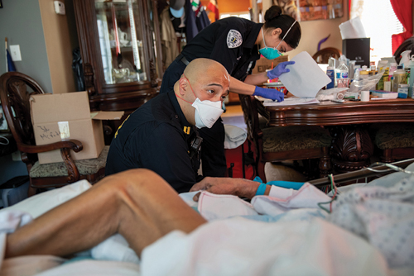
Death and Dying (2 of 2)
Consider psychological needs of patient and his or her family.
Do not be afraid to touch.
Make positive statements, but do not give false hope.
Provide comfort in any way you can.
Figure 12-6 Do not be afraid to show empathy to patients and family members.
© John Moore/Getty Images News /Getty Images
Notes:
e. Consider the psychological needs of patient and his or her family.
i. Do not be afraid to touch.
ii. Make positive statements, but do not give false hope.
iii. Provide comfort in any way you can.
Figure: Do not be afraid to show empathy to patients and family members.

Slide 52
Coping with Work-Related Stress
Providing emergency care is stressful for EMRs.
If you let stress build up without releasing it in healthy ways, it can begin to have negative effects on you and your performance.
Signs and symptoms of extreme stress:
Depression.
Inability to sleep.
Weight changes.
Increased alcohol consumption or drug abuse.
Inability to get along with family and coworkers.
Lack of interest in food or sex.
Notes:
J. Coping with work-related stress:
1. Providing emergency care is stressful for EMRs.
2. If you let stress build up without releasing it in healthy ways, it can begin to have negative effects on you and your performance.
3. Signs and symptoms of extreme stress include:
a. Depression.
b. Inability to sleep.
c. Weight changes.
d. Increased alcohol consumption or drug abuse.
e. Inability to get along with family and coworkers.
f. Lack of interest in food or sex.

Slide 53
Critical Incident Stress Debriefing and Peer Support
To help prevent excess stress and relieve stress caused by critical incidents, psychologists have developed a critical incident stress debriefing (CISD) process.
CISD brings rescuers and a trained person together to talk about the rescuer’s feelings.
CISD may help rescuers understand the signs and symptoms of stress and receive reassurance from the group leader.
CISD allows people to obtain more help from trained professionals, if needed.
Peer support is a process involving properly trained member of your department to provide confidential support to another member who is experiencing personal, emotional, or work-related problems.
Notes:
K. Critical incident stress debriefing and peer support:
1. To help prevent excess stress and relieve stress caused by critical incidents, psychologists have developed a critical incident stress debriefing (CISD) process.
a. CISD brings rescuers and a trained person together to talk about the rescuer’s feelings.
b. CISD may help rescuers understand the signs and symptoms of stress and receive reassurance from the group leader.
c. CISD allows people to obtain more help from trained professionals, if needed.
2. Peer support is a process involving properly trained member of your department to provide confidential support to another member who is experiencing personal, emotional, or work-related problems.

Slide 54
Summary (1 of 3)
Only a small percentage of patients you treat will be severely mentally disturbed, but almost every patient you care for will be experiencing some degree of mental and emotional crisis.
Behavioral emergencies are situations in which persons exhibit abnormal, unacceptable behavior that cannot be tolerated by patients themselves or by family, friends, or community.
Notes:
VII. Summary:
Only a small percentage of patients you treat will be severely mentally disturbed, but almost every patient you care for will be experiencing some degree of mental and emotional crisis. No matter which type of incident or crisis is taking place, your response must be to help patient.
Behavioral emergencies are situations in which persons exhibit abnormal, unacceptable behavior that cannot be tolerated by patients themselves or by family, friends, or community.

Slide 55
Summary (2 of 3)
Five major factors cause behavioral crises: medical conditions, physical trauma conditions, psychiatric illnesses, mind-altering substances, and situational stresses.
Four emotional phases to each crisis are high anxiety or emotional shock, denial, anger, and remorse or grief.
Notes:
C. Five major factors cause behavioral crises: medical conditions, physical trauma conditions, psychiatric illnesses, mind-altering substances, and situational stresses.
D. Four emotional phases to crisis are high anxiety or emotional shock, denial, anger, and remorse or grief. Although a person may not experience every phase during a crisis, he or she will certainly experience one or more of phases.

Slide 56
Summary (3 of 3)
Your role as an EMR consists of assessing patient and providing physical and emotional care. Your most important assessment skill may be your ability to communicate with patient.
If a patient who appears to be disturbed refuses to accept treatment, you may have to provide care against patient’s will.
Notes:
E. Your role as an EMR consists of assessing patient and providing physical and emotional care. Your most important assessment skill may be your ability to communicate with patient.
F. You must understand laws of your state and community that relate to caring for emotionally disturbed patients. If an emotionally disturbed patient agrees to be treated, few legal issues should arise. However, if a patient who appears to be disturbed refuses to accept treatment, it may be necessary to provide care against patient’s will. To do so, you must have a reasonable belief that patient would harm self or others. Usually, if patients are a threat to self or to others, it is possible to treat and transport them without their consent.
G. Even when you have thoroughly mastered processes and tools for managing behavioral crises, it is important to remember that sometimes the best approach is to ask yourself, “How would I like to be treated if I were in this situation?”

Slide 57
Review
Behavioral emergencies are situations in which a person exhibits:
abnormal behavior that is deemed unacceptable by others.
mild to moderate depression over a long period of time.
anger that is justified by the situation.
strange behavior, but is otherwise mentally stable.
Notes:
57

Slide 58
Review
Answer:
A. abnormal behavior that is deemed unacceptable by others.

Slide 59
Review
Which of the following is not considered an emotional phase in a situational crisis?
Anger
Denial
Grief
Violence
Notes:
59

Slide 60
Review
Answer:
D. Violence

Slide 61
Review
When treating a patient with PSTD, one of your responsibilities is to:
protect the patient from harm.
speak with the patient in an authoritative, forceful way.
convince the patient to take care of the problem himself or herself.
contact law enforcement immediately.
Notes:
61

Slide 62
Review
Answer:
A. protect the patient from harm.

