Slide 1
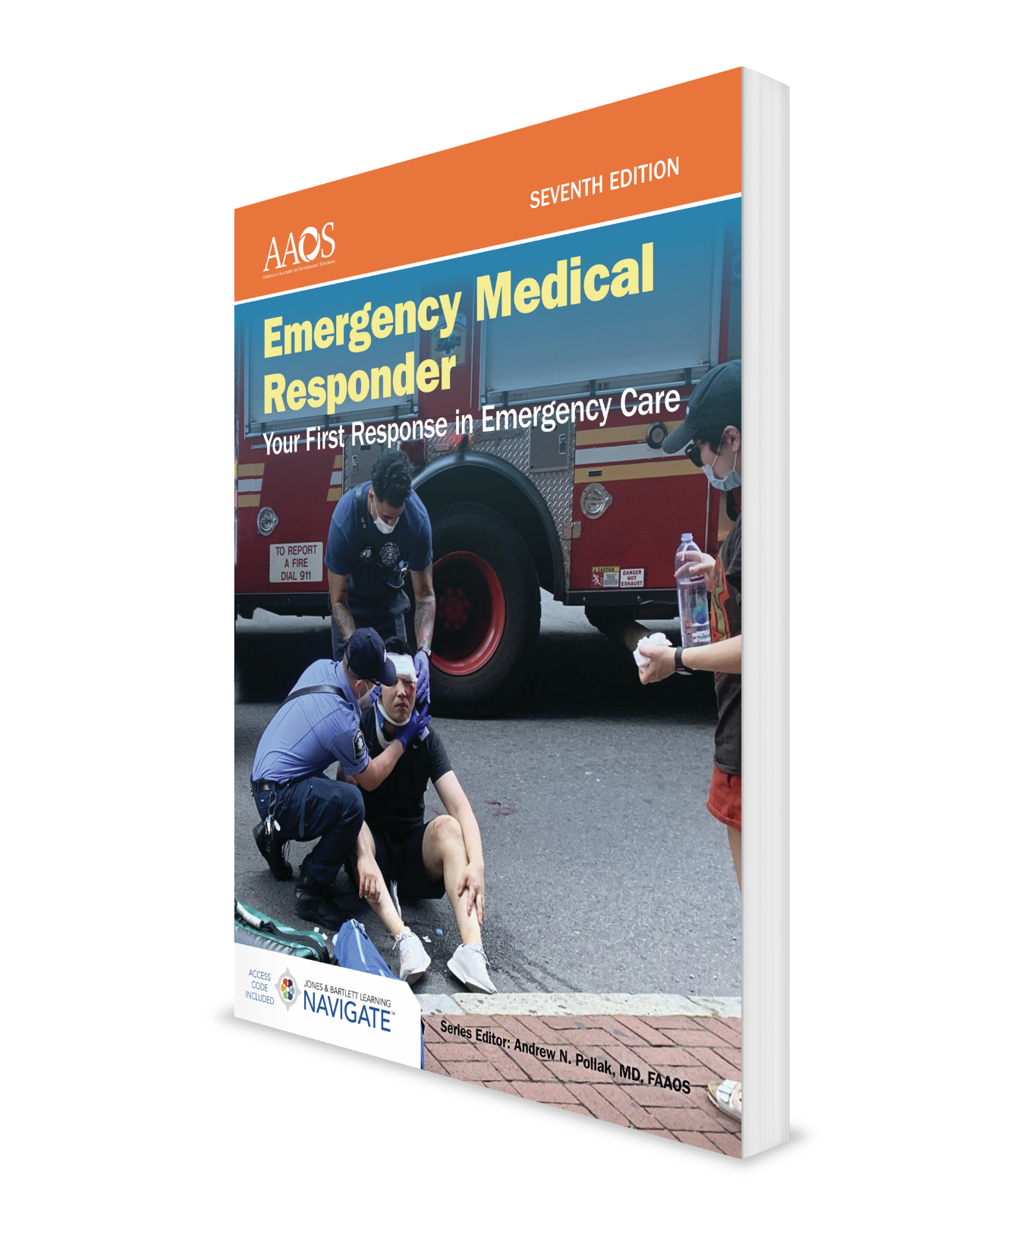
Environmental Emergencies
CHAPTER 13

Slide 2
National EMS Education Standard Competencies (1 of 2)
Trauma:
Uses simple knowledge to recognize and manage life threats based on assessment findings for an acutely injured patient while awaiting additional emergency medical response.
Notes:
Trauma:
Uses simple knowledge to recognize and manage life threats based on assessment findings for an acutely injured patient while awaiting additional emergency medical response.

Slide 3
National EMS Education Standard Competencies (2 of 2)
Environmental Emergencies:
Recognition and management of:
Submersion incidents.
Temperature-related illness.
Notes:
Environmental Emergencies:
Recognition and management of:
• Submersion incidents. (pp 261-262)
• Temperature-related illness. (pp 256-259)

Slide 4
Introduction
When a person is exposed to excess heat, the body’s mechanisms for regulating temperature can be overwhelmed, resulting in:
Heat cramps.
Heat exhaustion.
Heatstroke.
Exposure to cold environments may result in conditions such as frostbite or hypothermia.
Unintentional exposure to water can lead to submersion injuries and drowning.
Notes:
I. Introduction:
A. When a person is exposed to excess heat, body’s mechanisms for regulating temperature can be overwhelmed, resulting in:
1. Heat cramps.
2. Heat exhaustion.
3. Heatstroke.
B. Exposure to cold environments may result in conditions such as frostbite or hypothermia.
C. Unintentional exposure to water can lead to submersion injuries and drowning.

Slide 5
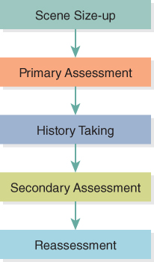
Patient Assessment for Environmental Emergencies (1 of 3)
Figure 13-1 Patient assessment sequence.
© Jones & Bartlett Learning.
Notes:
II. Patient Assessment for Environmental Emergencies:
A. Your approach to a patient who has signs and symptoms of an environmental emergency should follow patient assessment sequence.
Figure: Patient assessment sequence.

Slide 6
Patient Assessment for Environmental Emergencies (2 of 3)
Review dispatch information.
Assess scene for safety issues.
As you perform primary assessment:
Try to form an impression of patient’s condition.
Determine patient’s level of responsiveness.
Introduce yourself.
Check patient’s ABCs.
Acknowledge patient’s chief complaint.
Notes:
1. Review dispatch information to help you decide on possibilities for patient’s problem.
2. Asses scene to determine safety issues for you and patient.
3. As you perform primary assessment:
a. Try to form an impression of patient’s condition.
b. Determine patient’s level of responsiveness.
c. Introduce yourself.
d. Check patient’s ABCs.
e. Acknowledge patient’s chief complaint.

Slide 7
Patient Assessment for Environmental Emergencies (3 of 3)
Usually, it is best to collect a medical history of medical patient before you perform a secondary assessment.
Use SAMPLE history format.
Secondary assessment focuses on areas related to current illness.
Obtain patient’s vital signs.
Monitor through ongoing reassessment.
Notes:
4. Usually, it is best to collect a medical history of patient experiencing a medical problem before you perform a secondary assessment.
a. SAMPLE history format that follows will help you secure necessary information:
i. Signs/symptoms.
ii. Allergies.
iii. Medications.
iv. Pertinent past history.
v. Last oral intake.
vi. Events associated with or leading to illness or injury.
5. Secondary patient assessment focuses on areas related to patient’s current illness.
a. Patient may not always be aware of all various aspects of his or her problem.
b. Obtain patient’s vital signs.
6. Monitor patient through the use of ongoing reassessment if arrival of additional EMS personnel is delayed.

Slide 8
Heat Cramps (1 of 2)
Painful involuntary spasms of muscles.
Often occur after exercise, especially in hot weather.
Occur most often in leg or calf muscles.
When abdominal cramps occur, it may appear that patient is having an acute abdominal problem.
Notes:
III. Exposure to Heat
A. Heat cramps:
1. Heat cramps are painful involuntary spasms of muscles.
2. They often occur after exercise, especially in hot weather.
3. Exact cause of heat cramps is not known, but is thought to be related partly to change in the electrolyte levels that occurs during exercise and partly to dehydration that accompanies exercise or working in a hot environment.
4. Occur most often in leg or calf muscles.
5. When abdominal cramps occur, it may appear that patient is having an acute abdominal problem.

Slide 9
Heat Cramps (2 of 2)
Treatment:
Move patient to a cool place.
Have patient lie down in a comfortable position.
Give patient water to drink.
Can also use a diluted balanced electrolyte solution (ie, Gatorade).
If cramps do not disappear, or if patient is young, old, or has a chronic medical condition, arrange to have patient transported.
Notes:
6. Treatment of heat cramps:
a. Move patient to a cool place.
b. Have patient lie down in a comfortable position.
c. Give patient water to drink.
d. If cramps do not disappear, or if patient is young, old, or has a chronic medical condition, arrange to have patient transported to an appropriate medical facility.

Slide 10
Heat Exhaustion (1 of 4)
Occurs when a person is exposed to temperatures greater than 80°F (27°C), usually in combination with high humidity.
Can also occur as result of vigorous exercise at lower temperatures.
Notes:
B. Heat exhaustion:
1. Heat exhaustion occurs when a person is exposed to temperatures higher than 80°F (27°C), usually in combination with high humidity.
2. It can also occur as result of vigorous exercise at lower temperatures.

Slide 11
Heat Exhaustion (2 of 4)
Signs and symptoms:
Profuse sweating.
Lightheadedness.
Dizziness.
Nausea.
Weak pulse.
Low BP.
Notes:
3. Signs and symptoms of heat exhaustion include:
a. Profuse sweating.
b. Lightheadedness.
c. Dizziness.
d. Nausea.
e. Weak pulse.
f. Low BP.

Slide 12
Heat Exhaustion (3 of 4)
Predisposing factors may make some people more susceptible.
Very young or older age (> 65 years).
Preexisting medical conditions.
Certain medications.
High air temperatures.
High humidity.
Notes:
4. Predisposing factors may make some people more susceptible to heat-related illnesses.
a. Very young or older age (> 65 years).
b. Preexisting medical conditions.
c. Certain medications.
d. High air temperatures.
e. High humidity – reduces ability to lose heat through evaporation.

Slide 13
Heat Exhaustion (4 of 4)
Treatment:
Move patient to a cooler place and treat him or her for shock.
Unless patient is unconscious, nauseated, or vomiting, give fluids by mouth.
Monitor ABCs.
Arrange transport to a medical facility.
Notes:
5. Treatment of heat exhaustion:
a. Move patient to a cooler place and treat him or her for shock.
b. Unless patient is unconscious, nauseated, or vomiting, give fluids by mouth.
c. Monitor ABCs.
d. Arrange transport to a medical facility.

Slide 14
Heatstroke (1 of 4)
Occurs when body is subjected to more heat than it can tolerate and normal mechanisms for getting rid of excess heat, such as sweating, are overwhelmed.
Patient’s body temperature rises until it reaches a level at which brain damage occurs.
Notes:
C. Heatstroke:
1. Occurs when body is subjected to more heat than it can tolerate and normal mechanisms for getting rid of excess heat, such as sweating, are overwhelmed.
2. Patient’s body temperature rises until it reaches a level at which brain damage occurs.
a. Without prompt and proper treatment, a patient with heatstroke will die.

Slide 15
Heatstroke (2 of 4)
Signs and symptoms:
Flushed, dry skin that feels hot to touch.
Altered mental status: verbal to unresponsive.
Internal temperatures as high as 104°F (40°C).
Treatment:
Maintain patient’s ABCs.
Remove patient from hot environment.
Notes:
3. Signs and symptoms include:
a. Flushed, dry skin that feels hot to touch.
b. Altered mental status: verbal to unresponsive.
c. Internal temperatures as high as 104°F (40°C).
4. Treatment for heatstroke:
a. Maintain patient’s ABCs.
b. Remove patient from the hot environment and into a cool place as soon as possible.

Slide 16
Heatstroke (3 of 4)
Treatment (cont'd):
Remove patient’s clothes, down to underwear.
Soak patient with water.
Begin aggressive cooling of patient with a hose, shower, or ice packs.
If patient is conscious and not nauseated, administer small amounts of cool water.
Arrange for rapid transport to an appropriate medical facility.
Notes:
c. Remove patient’s clothes, down to underwear.
d. Soak patient with water. Begin aggressive cooling of patient with a hose, shower, or ice packs.
e. If patient is conscious and not nauseated, administer small amounts of cool water.
f. Arrange for rapid transport to an appropriate medical facility.

Slide 17
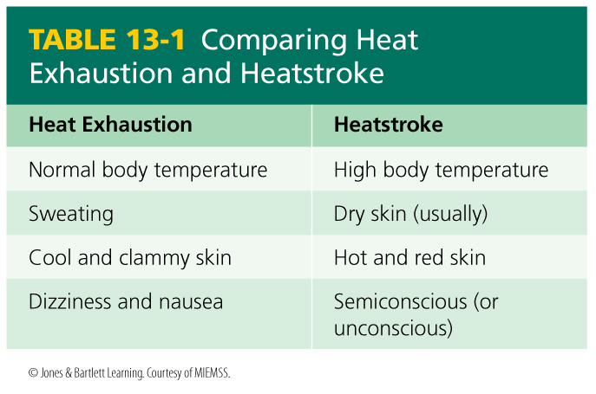
Heatstroke (4 of 4)
Notes:
Table: Comparing Heat Exhaustion and Heatstroke

Slide 18
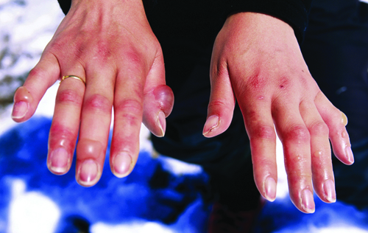
Frostbite (1 of 6)
Can result when exposed parts of body are exposed to a cold environment.
Following body parts are most susceptible:
Face.
Ears.
Fingers.
Toes.
Figure 13-3 The fingers are among the most common areas affected by frostbite.
Courtesy of Neil Malcom Winkelmann
Notes:
IV. Exposure to Cold:
A. Frostbite:
1. Frostbite can result when exposed parts of body are exposed to a cold environment.
a. Exposed body parts actually freeze.
2. Following body parts are most susceptible to frostbite:
a. Face.
b. Ears.
c. Fingers.
d. Toes.
Figure: Finger s are one of most common areas affected by frostbite.

Slide 19
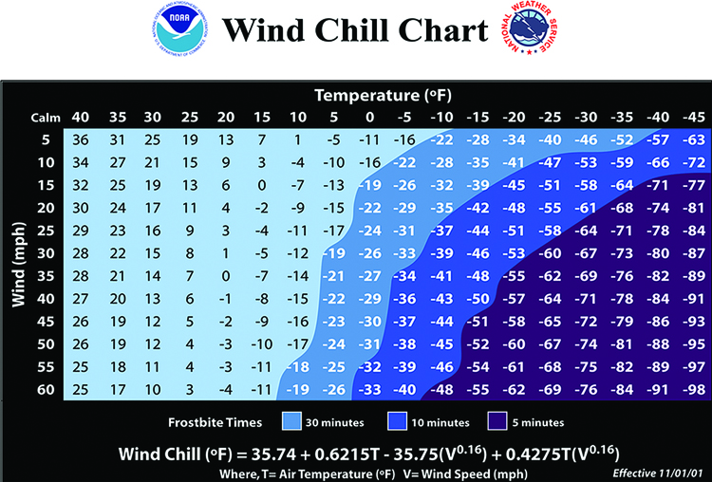
Frostbite (2 of 6)
Depending on temperature and wind velocity, frostbite can occur quickly.
Figure 13-4 Windchill table.
Courtesy of Neil Malcom Winkelmann
Notes:
3. Depending on temperature and wind velocity, frostbite can occur in a short period.
4. Increases in wind speed have same effect as decreases in temperature.
Figure: Wind Chill Chart

Slide 20
Frostbite (3 of 6)
Most susceptible people are those weakened by:
Old age.
Medical conditions.
Exhaustion.
Hunger.
Notes:
5. People weakened by old age, medical conditions, exhaustion, or hunger are most susceptible to frostbite.

Slide 21
Frostbite (4 of 6)
Superficial frostbite (frostnip):
Affected body part becomes numb and then turns a bright red color.
Eventually area loses its color and becomes pale.
There may be a loss of feeling and sensation.
Warming area must be done quickly and carefully.
Do not warm area by rubbing it.
Notes:
6. Superficial frostbite (frostnip):
a. Affected body part becomes numb and then turns a bright red color.
b. Eventually area loses its color and changes to pale white.
c. There may be a loss of feeling and sensation in injured area.
d. Treatment:
i. Warming a superficial frostbitten area or part must be done quickly and carefully.
ii. Simply putting the fingers, toes, or ears next to a warm body part is enough. Do not try to warm a frostbitten area by rubbing it with your hands or a blanket.

Slide 22
Frostbite (5 of 6)
Superficial frostbite (frostnip) (cont'd):
Treat patient for shock.
Deep frostbite:
Patient’s skin will be white and waxy.
Skin may be firm or frozen.
Swelling and blisters may be present.
If skin has thawed, it may appear flushed with areas of purple and white or may be mottled and cyanotic.
Notes:
iii. Treat frostbitten patient for shock.
7. Deep frostbite:
a. Patient’s skin will be white and waxy.
b. Skin may be firm or frozen.
c. Swelling and blisters may be present.
d. If skin has thawed, it may appear flushed with areas of purple and white or it may be mottled and cyanotic.
e. Treatment:
i. Follow scene size-up, primary assessment, and secondary assessment sequence.

Slide 23
Frostbite (6 of 6)
Deep frostbite (cont'd):
Treatment:
Follow scene size-up, primary assessment, and secondary assessment sequence.
Remove any jewelry on patient and cover extremity with dry clothing or dressings.
Do not:
Break blisters.
Rub injured area.
Apply heat.
Allow patient to walk on an affected lower extremity.
Provide prompt transport to a medical facility.
Notes:
ii. Remove any jewelry patient is wearing and cover extremity with dry clothing or dry dressings.
iii. Do not break blisters, rub injured area, apply heat, or allow patient to walk on an affected lower extremity.
iv. Provide prompt transport to a medical facility.

Slide 24
Hypothermia (1 of 6)
Occurs when a person’s body temperature falls to a subnormal range of below about 95°F (35°C).
Person’s body is not able to produce enough energy to keep internal temperature at a satisfactory level.
People most susceptible include:
Those with inadequate or wet clothing.
Individuals who are weakened by illness.
Intoxicated patients and patients who have abused drugs are at an especially high risk for developing hypothermia.
Notes:
B. Hypothermia:
1. Hypothermia occurs when a person’s body temperature drops to less than 95ºF (35ºC).
2. In hypothermia, a person’s body is not able to produce enough energy to keep internal (core) body temperature at a satisfactory level.
3 People with inadequate or wet clothing and those weakened by illness are most susceptible to hypothermia. Intoxicated patients and patients who have abused drugs are at an especially high risk for developing hypothermia.

Slide 25
Hypothermia (2 of 6)
Signs and symptoms:
Feeling cold.
Shivering.
Decreasing level of consciousness.
Sleepiness.
Lack of coordination.
Mental confusion.
Slowed reactions.
As body temp goes below 90°F (32°C), patient will lose consciousness.
Weak and very slow pulse.
Notes:
4. Signs and symptoms include:
a. Feeling cold.
b. Shivering.
c. Decreasing level of consciousness.
d. Sleepiness.
e. Lack of coordination.
f. Mental confusion.
g. Slowed reactions.
h. As body temperature goes below 90°F (32°C), patient will lose consciousness.
i. Weak and very slow pulse.

Slide 26
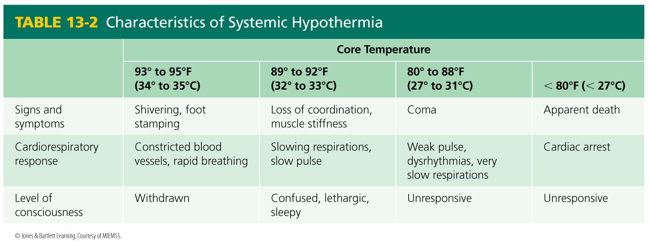
Hypothermia (3 of 6)
Notes:
Table: Characteristics of Systemic Hypothermia

Slide 27
Hypothermia (4 of 6)
Treatment:
Move patient to a warm location.
Remove wet clothing.
Place warm blankets over and under patient.
If patient is conscious, give warm fluids to drink.
If you do not have access to a building, move patient into a heated vehicle.
Notes:
5. Treatment of hypothermia:
a. Move patient to a warm location.
b. Remove wet clothing.
c. Place warm blankets over and under patient.
d. If patient is conscious, give warm fluids to drink.
e. If you do not have access to a building, move patient into a heated vehicle.

Slide 28
Hypothermia (5 of 6)
Treatment (cont'd):
If transport is delayed, you may need to use your own body heat to warm patient.
Handle patient gently.
Hypothermic patients must be examined by a physician.
Notes:
f. If transport is delayed or extended, you may need to use your own body heat to warm patient.
g. Handle patient gently.
h. Hypothermic patients must be examined by a physician.

Slide 29
Hypothermia (6 of 6)
Cardiac arrest and hypothermia:
If patient’s body temperature falls to less than 83°F (28°C), heart may stop and you will need to begin CPR.
Always start CPR and use an AED on hypothermia patients even if you believe they have been “dead” for several hours.
Not considered dead till warm and dead!
Notes:
6. Cardiac arrest and hypothermia:
a. If patient’s body temperature falls to less than 83°F (28°C), heart may stop and you will need to begin CPR.
b. Always start CPR and use an AED, if available, on hypothermic patients even if you believe they have been “dead” for several hours.
c. Hypothermia patients should never be considered dead until they have been warmed in an appropriate medical facility.

Slide 30
Drowning and Submersion (1 of 5)
Each year in United States, more than 3,500 people die from unintentional drowning.
Drowning is second leading cause of injury and death among children 1 to 14 years.
Drowning is defined as the process of experiencing respiratory impairment from suffocation or immersion in liquid.
Notes:
V. Drowning and Submersion:
A. Each year in United States, more than 3,500 people die from unintentional drowning (approximately 10 deaths per day). An additional 12,000 people are hospitalized because of injuries resulting from submersion in water.
B. Drowning is second leading cause of injury and death among children 1 to 14 years.
1. Alcohol consumption and drug abuse are contributing factors in many cases of drowning involving teenagers and adults.
C. Drowning is defined as the process of experiencing respiratory impairment from suffocation or immersion in liquid.

Slide 31
Drowning and Submersion (2 of 5)
Submersion injuries result from being beneath surface of water or another liquid.
Likely locations of drowning:
Streams.
Lakes.
Swimming pools.
Hot tubs.
Notes:
1. Submersion injuries result from being beneath surface of water or another liquid.
2. Likely locations of drowning include:
a. Streams.
b. Lakes.
c. Swimming pools.
d. Hot tubs.

Slide 32
Drowning and Submersion (3 of 5)
Likely locations of drowning (cont'd):
Wading pools.
Public fountains.
Storm drain ponds.
Hazards for drowning in infants and young children are also present in every house:
Bathtubs.
Toilets.
Mop buckets.
Notes:
e. Wading pools.
f. Public fountains.
g. Storm drain ponds.
3. Hazards for drowning in infants and young children are present in every house:
a. Bathtubs.
b. Toilets.
c. Mop buckets.
4. Young children can drown in liquids as shallow as 6".

Slide 33
Drowning and Submersion (4 of 5)
Process of drowning progresses through several stages:
Usually initial stage is panic.
In other instances, person:
Becomes fatigued, injured, cold, or entangled in seaweed or kelp.
Experiences a loss of orientation.
Becomes ill.
Feeling of panic produces an inefficient breathing pattern.
Notes:
D. Process of drowning progresses through several stages.
1. Usually initial stage is panic as person realizes that something is wrong.
2. In other instances, person:
a. Becomes fatigued, injured, cold, or entangled in seaweed or kelp.
b. Experiences a loss of orientation.
c. Becomes ill.
3. Feeling of panic produces an inefficient breathing pattern.
a. If a swimmer is not able to take in full breaths, ability to float is lost and exhaustion sets in.
b. Small quantities of water reaching larynx (voice box) cause a spasm of larynx (laryngospasm), which makes it hard or impossible to breath.
c. If this cycle of panic is not corrected, respiratory and cardiac arrest can result.

Slide 34
Drowning and Submersion (5 of 5)
Signs and symptoms of submersion injury:
Coughing.
Vomiting.
Difficulty breathing.
Respiratory arrest.
Cardiac arrest.
Broken bones or spinal injuries.
Hypothermia (when wet or low air temps).
Notes:
4. Signs and symptoms of submersion injury include:
a. Coughing.
b. Vomiting.
c. Difficulty breathing.
d. Respiratory arrest.
e. Cardiac arrest.
f. Broken bones or spinal injuries.
g. Hypothermia (when wet or low air temps).

Slide 35
Treatment of Submersion Injuries (1 of 2)
Assess scene safety.
If patient is still in water, do not exceed limits of your training in a rescue attempt.
Keep yourself safe and attempt rescue only if you can do so safely (reach, throw, row, and go sequence).
Call for additional help if needed.
If there is evidence of trauma and you need to move patient and protect spine.
Perform a primary assessment.
Notes:
E. Treatment of submersion injuries:
1. Assess scene safety.
a. If patient is still in water, do not exceed limits of your training in an attempt to rescue him or her.
b. Keep yourself safe and attempt rescue only if you can do so safely (reach, throw, row, and go sequence).
c. Call for additional help if needed.
d. If there is evidence of trauma and you need to move patient, protect spine from further injury.
2. Perform a primary assessment.

Slide 36
Treatment of Submersion Injuries (2 of 2)
Perform a primary assessment (continued):
Correct any airway, breathing, or circulation problems.
Begin CPR if indicated.
If patient is breathing adequately, administer high-flow oxygen.
Dry patient.
Cover patient with towels or blankets.
As soon as possible perform a secondary assessment to check for other injuries.
Notes:
2. Perform a primary assessment (continued):
a. Correct any airway, breathing, and circulation problems.
b. Begin CPR if indicated.
c. If patient is breathing adequately, administer high-flow oxygen.
d. As soon as ABCs are stabilized, dry patient.
e. Cover patient with towels or blankets to help preserve body temperature.
3. As soon as possible, perform a secondary assessment to check for other injuries.
4. Obtain patient’s medical history from patient if possible, or from any family members present.
5. Perform regular reassessments.
6. All patients who have sustained a submersion injury should be examined by a physician.

Slide 37
Cold Water Drowning (1 of 2)
Begin CPR on a drowning victim as long as patient does not exhibit definitive signs of death.
When a person is submerged in cold water, mammalian diving reflex may be activated.
This reflex slows heart rate and metabolic rate and decreases body’s demand for oxygen.
There have been instances of survival of patients submerged for over 30 minutes due to this reflex.
Notes:
F. Cold water drowning:
1. You should begin CPR on a drowning victim as long as patient does not exhibit definitive signs of death.
2. When a person is submerged in cold water, a protective mechanism called mammalian diving reflex may be activated.
a. This reflex slows heart rate and metabolic rate and decreases body’s demand for oxygen.
b. There have been instances of survival of patients submerged for over 30 minutes due to this reflex.

Slide 38
Cold Water Drowning (2 of 2)
When you encounter a person who has been submerged in cold water, start CPR and continue it until person has been delivered to a medical facility.
Notes:
3. When you encounter a person who has been submerged in cold water even for an extended period, CPR should be started and continued until person has been delivered to an appropriate medical facility.

Slide 39
Lightning Injuries (1 of 2)
Electrical injury resulting from a lightning strike can cause cardiac irregularities or cardiac arrest.
Treat patients by supporting their ABCs.
Oxygen administration, defibrillation, and CPR may be needed for some patients.
Patients must be transported to a medical facility.
Notes:
VI. Other Environmental Emergencies
A. Lightning injuries:
1. Electrical injury resulting from a lightning strike can cause cardiac irregularities or cardiac arrest.
2. Treat patients who have been struck by lightning by supporting the airway, breathing, and circulation.
a. Oxygen administration, defibrillation, and CPR may be needed for some patients.
b. Patients must be transported to an appropriate medical facility.

Slide 40
Lightning Injuries (2 of 2)
Lightning injuries can cause electrical burns.
Type of burn is mainly internal.
Extent of burn damage will not be visible right away after injury occurs.
Notes:
3. Lightning injuries can also cause electrical burns.
a. Type of burn is mainly internal, so extent of burn damage will not be visible right away after injury occurs.

Slide 41
Bites and Stings
Sometimes classified as environmental injuries or discussed under topic of poisoning.
In this text, bites and stings are discussed in Chapter 11, Poisoning and Substance Abuse.
Notes:
B. Bites and stings:
1. Bites and stings are sometimes classified as environmental injuries or discussed under topic of poisoning.
2. In this text, they are discussed in Chapter 11, Poisoning and Substance Abuse.

Slide 42
Summary (1 of 3)
Heat cramps are caused by electrolyte imbalance and dehydration.
A person experiencing heat exhaustion sweats profusely and becomes light-headed, dizzy, and nauseated.
Heatstroke results when a person has been in a hot environment for a long period, overwhelming the body’s sweating mechanism.
Body parts most susceptible to frostbite are the face, ears, fingers, and toes.
Notes:
A. Your approach to a patient who has experienced an environmental emergency should follow the patient assessment sequence.
B. Heat cramps are caused by electrolyte imbalance and dehydration. They usually involve muscles in calf, leg, or abdomen. Usually cramps disappear with rest and administration of water.
C. A person experiencing heat exhaustion sweats profusely and becomes light-headed, dizzy, and nauseated. Predisposing factors may make some people more susceptible to heat-related illnesses.
D. Heatstroke results when a patient has been in a hot environment for a long period, overwhelming body’s sweating mechanism. Patient’s body temperature rises until it reaches a level at which brain damage occurs.
E. Body parts most susceptible to frostbite are face, ears, fingers, and toes. Warming frostbitten part must be done quickly and carefully.

Slide 43
Summary (2 of 3)
Hypothermia occurs when a person’s body is not able to produce enough heat to keep internal (core) body temperature at a satisfactory level.
Hypothermic patients should never be considered dead until they have been warmed in an appropriate medical facility.
Notes:
F. Hypothermia occurs when a person’s body is not able to produce enough heat to keep internal (core) body temperature at a satisfactory level.
G. Initial signs of hypothermia include feeling cold, shivering, decreasing level of consciousness, and sleepiness. Signs of increasing hypothermia include a lack of coordination, mental confusion, and slowed reactions.
H. Hypothermic patients should never be considered dead until they have been warmed in an appropriate medical facility.

Slide 44
Summary (3 of 3)
Drowning can occur in a variety of settings around a home and outdoors.
Lightning injuries are caused by a powerful jolt of electrical current that passes through part of body.
Notes:
I. Drowning can occur in a variety of settings around a home and outdoors. Signs and symptoms of a submersion injury include coughing, vomiting, difficulty breathing, respiratory arrest, cardiac arrest, and trauma.
J. Lightning injuries are caused by a powerful jolt of electrical current that passes through part of body. They may cause irregular heart rhythms or cardiac arrest. They also cause an electrical type of burn that damages tissue within body.

Slide 45
Review
Heatstroke occurs when:
outside temperature exceeds 90°F.
the body’s heat-eliminating mechanisms are overwhelmed.
a person becomes dehydrated from excess perspiration.
humidity exceeds 80%.
Notes:
45

Slide 46
Review
Answer:
B. the body’s heat-eliminating mechanisms are overwhelmed.
B. the body’s heat-eliminating mechanisms are overwhelmed.

Slide 47
Review
You are called to the scene of a patient with deep frostbite. Which of the following actions would be appropriate for you to take?
Provide pain medication.
Rub the affected area to warm it up.
Arrange for prompt transport.
Apply heat directly to the damaged tissue.

Slide 48
Review
Answer:
C. Arrange for prompt transport.

Slide 49
Review
When you encounter a person who has been submerged in cold water and is unresponsive, you should:
do nothing. The patient is already dead.
transport him or her to a hospital because only physicians will be able to treat this patient.
warm the patient before taking any other action.
start CPR immediately.
Notes:
49

Slide 50
Review
Answer:
D. start CPR immediately.

