Slide 1
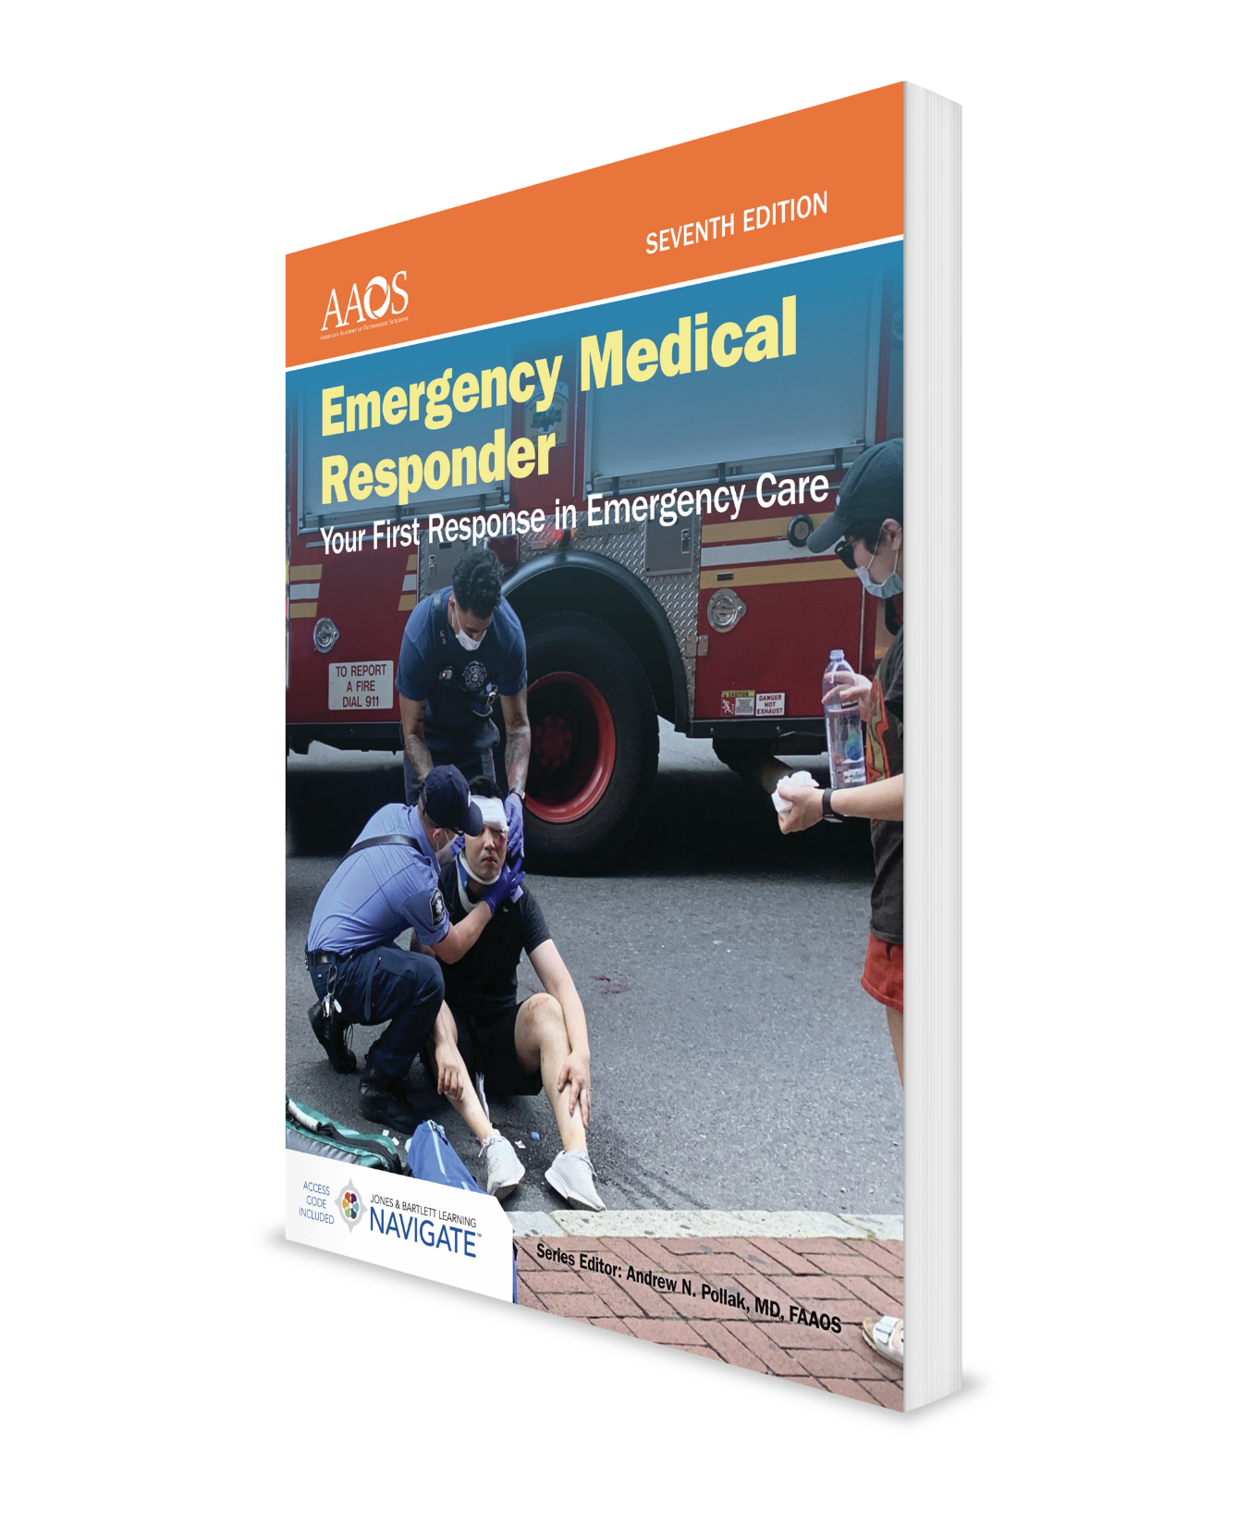
Professional Rescuer CPR
CHAPTER 8

Slide 2
National EMS Education Standard Competencies (1 of 4)
Shock and Resuscitation
Uses assessment information to recognize shock, respiratory failure or arrest, and cardiac arrest based on assessment findings and manages emergency while awaiting additional emergency response.
Notes:
Shock and Resuscitation
Uses assessment information to recognize shock, respiratory failure or arrest, and cardiac arrest based on assessment findings and manages emergency while awaiting additional emergency response.

Slide 3
National EMS Education Standard Competencies (2 of 4)
Assessment
Uses scene information and simple patient assessment findings to identify and manage immediate life threats and injuries within scope of practice of the EMR.
Notes:
Assessment
Uses scene information and simple patient assessment findings to identify and manage immediate life threats and injuries within scope of practice of the EMR.

Slide 4
National EMS Education Standard Competencies (3 of 4)
Primary Assessment
Primary assessment for all patient situations:
Level of consciousness.
Airway, breathing, and circulation (ABCs).
Identifying life threats.
Assessment of vital functions.
Begin interventions needed to preserve life.
Notes:
Primary Assessment
• Primary assessment for all patient situations. (p 144)
• Level of consciousness. (p 146; p 149)
• Airway, breathing, and circulation ABCs. (pp 144-145)
• Identifying life threats. (p 144)
• Assessment of vital functions. (pp 144-145)
• Begin interventions needed to preserve life. (p 144)

Slide 5
National EMS Education Standard Competencies (4 of 4)
Anatomy and Physiology
Uses simple knowledge of anatomy and function of upper airway, heart, vessels, blood, lungs, skin, muscles, and bones as foundation of emergency care.
Pathophysiology
Uses simple knowledge of shock and respiratory compromise to respond to life threats.
Notes:
Anatomy and Physiology
Uses simple knowledge of anatomy and function of upper airway, heart, vessels, blood, lungs, skin, muscles, and bones as foundation of emergency care.
Pathophysiology
Uses simple knowledge of shock and respiratory compromise to respond to life threats.

Slide 6
Introduction (1 of 2)
Cardiopulmonary resuscitation consists of:
Circulation (C)
Airway (A)
Breathing (B)
Airway and breathing skills may be lifesaving for a patient whose heart is still beating.
Notes:
I. Introduction
A. Cardiopulmonary resuscitation (CPR) consists of three major skills.
1. Circulation (C)
2. Airway (A)
3. Breathing (B)
B. Airway and breathing skills may be lifesaving for a patient whose heart is still beating.
1. In most cases, the patient’s heart has also stopped beating.
2. Rescue breathing alone will not save these patients.
3. The circulatory system must be functional to carry oxygen to the body.

Slide 7
Introduction (2 of 2)
To maintain or restore circulation manually, perform cardiac compressions.
To maintain both breathing and a heartbeat, rescue breathing and chest compressions must be done together.
Approximately 70% of patients in cardiac arrest are in a state of ventricular fibrillation.
Notes:
C. To maintain or restore circulation manually, perform cardiac compressions (closed-chest cardiac massage).
D. To maintain both breathing and a heartbeat, rescue breathing and chest compressions must be done together.
E. Approximately 70% of patients who experience cardiac arrest are in a state of ventricular fibrillation.
1. In this condition, the heart muscle is “quivering” and not effectively pumping blood.
2. An automated external defibrillator can help these patients.

Slide 8
Anatomy and Function of Circulatory System (1 of 8)
Circulatory system consists of:
A pump (the heart)
A network of pipes (blood vessels)
Fluid (blood)
Heart:
Located in chest between lungs.
Consists of four chambers, two on right side and two on left side.
Notes:
II. Anatomy and Function of Circulatory System
A. Circulatory system consists of three components:
1. A pump (the heart).
2. A network of pipes (blood vessels).
3. Fluid (blood).
B. Heart, which is about size of your fist, is located in chest between lungs.
1. Heart consists of four chambers, two on right side and two on left side.

Slide 9
Anatomy and Function of Circulatory System (2 of 8)
Heart (cont'd):
Each upper chamber is called an atrium.
Each lower chamber is called a ventricle.
Four chambers work in a well-ordered sequence to pump blood to lungs and to rest of body.
One-way valves allow blood to flow in only one direction.
Notes:
2. Each upper chamber is called an atrium.
a. Right atrium receives blood from the veins of body.
b. Left atrium receives highly oxygenated blood from lungs.
3. Each lower chamber is called a ventricle.
a. Right ventricle pumps deoxygenated blood to lungs.
b. Left ventricle pumps highly oxygenated blood throughout body.
4. Four chambers of heart work in a well-ordered sequence to pump blood to lungs and to rest of body.
5. One-way valves in heart and veins allow blood to flow in only one direction through circulatory system.

Slide 10
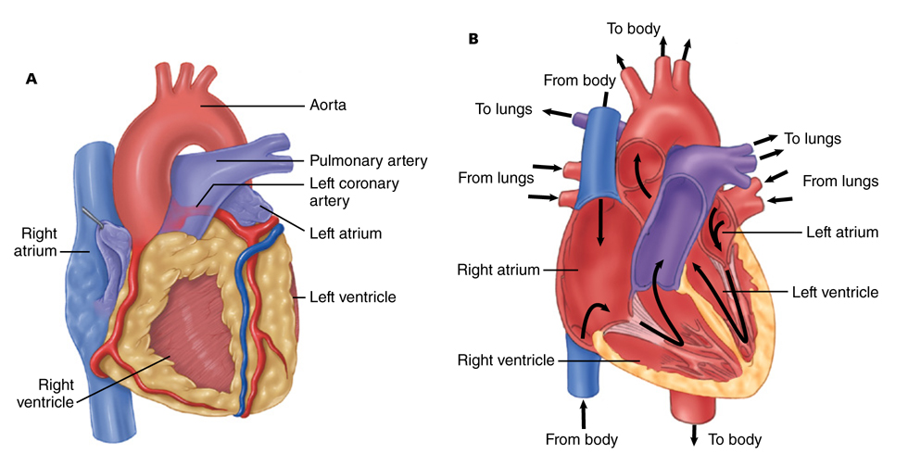
Anatomy and Function of Circulatory System (3 of 8)
Figure 8-1 The heart functions as the pump of the human circulatory system. A. External view. B. Cross-sectional view
© Jones & Bartlett Learning.
Notes:
Figure: Heart functions as the pump of human circulatory system. (Left) External view. (Right) Cross-sectional view.

Slide 11
Anatomy and Function of Circulatory System (4 of 8)
Arteries carry blood away from heart at high pressure.
Smaller arteries eventually branch into capillaries, smallest pipes in circulatory system.
Veins are thin-walled pipes that carry blood back to heart.
Notes:
6. Arteries carry blood away from heart at high pressure; therefore, walls of arteries are thick.
7. Smaller arteries eventually branch into capillaries, smallest pipes in circulatory system.
8. Veins are thin-walled pipes of circulatory system that carry blood back to heart.

Slide 12
Anatomy and Function of Circulatory System (5 of 8)
Four major artery locations:
Neck (carotid arteries)
Wrist (radial arteries)
Arm (brachial arteries)
Groin (femoral arteries)
Use these arteries to measure pulse.
A pulse is generated when heart contracts and sends a pressure wave through artery.
Notes:
C. There are four major artery locations.
1. Neck (carotid arteries)
2. Wrist (radial arteries)
3. Arm (brachial arteries)
4. Groin (femoral arteries)
5. Because these arteries lie between a bony structure and skin, you can use them to measure patient’s pulse.
a. A pulse is generated when heart contracts and sends a pressure wave through artery.

Slide 13
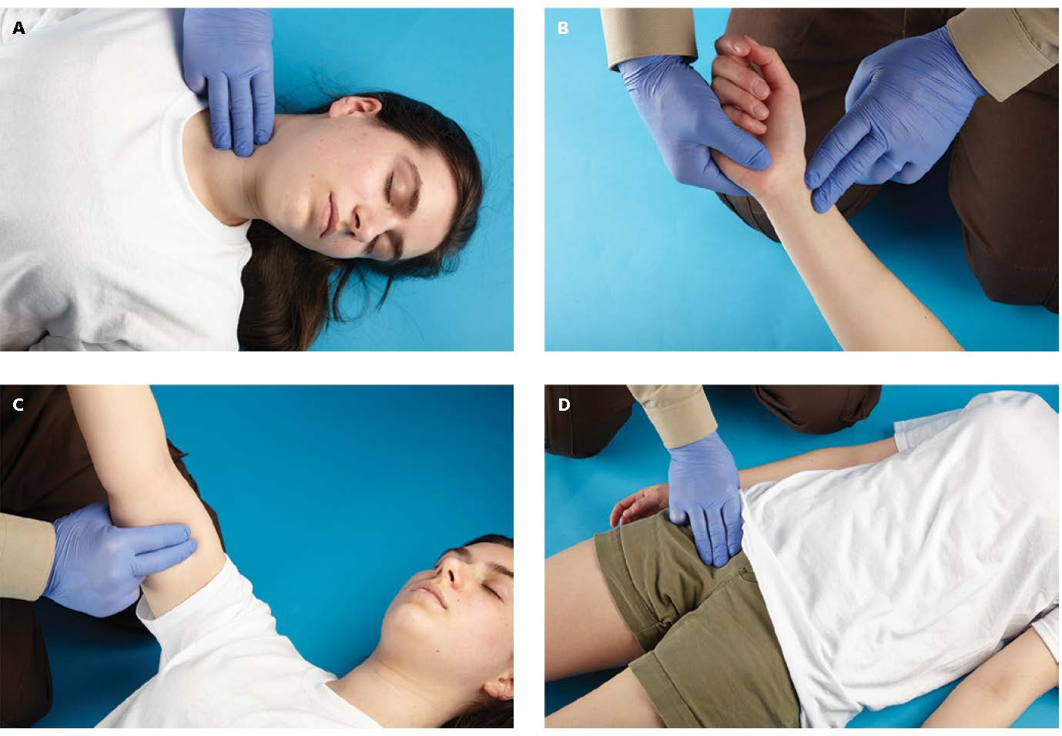
Anatomy and Function of Circulatory System (6 of 8)
Figure 8-2 Locations for assessing the patient’s pulse. A. Neck (carotid pulse). B. Wrist (radial pulse). C. Arm (brachial pulse). D. Groin (femoral pulse).
© Jones & Bartlett Learning.
Notes:
Figure: Locations for assessing patient’s pulse. (Top left) Neck (carotid pulse). (Top right) Wrist (radial pulse). (Bottom left) Arm (brachial pulse). (Bottom right) Groin (femoral pulse).

Slide 14
Anatomy and Function of Circulatory System (7 of 8)
Blood has several components.
Plasma
Red blood cells carry oxygen from lungs to the body and bring carbon dioxide back to lungs.
White blood cells devour bacteria and other disease-causing organisms.
Platelets start blood-clotting process.
Notes:
D. Blood has several components.
1. Plasma
2. Red blood cells
a. Red blood cells carry oxygen from lungs to the body and bring carbon dioxide back to lungs.
3. White blood cells
a. White blood cells are called infection fighters because they devour bacteria and other disease-causing organisms.
4. Platelets
a. Platelets start blood-clotting process.

Slide 15
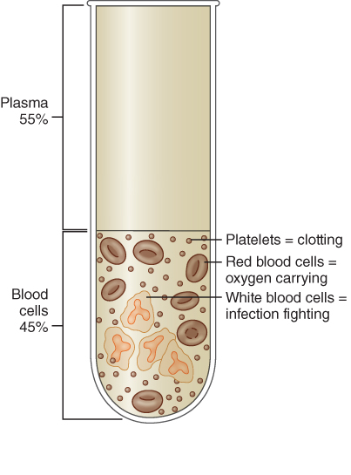
Anatomy and Function of Circulatory System (8 of 8)
Figure 8-3 The components of blood.
© Jones & Bartlett Learning.
Notes:
Figure: Components of blood.

Slide 16
Cardiac Arrest (1 of 3)
Cardiac arrest occurs when the heart stops contracting and no blood is pumped through blood vessels.
Without a supply of blood, cells of body will die.
Brain damage begins within 4 to 6 minutes.
Notes:
III. Cardiac Arrest
A. Cardiac arrest occurs when heart stops contracting and no blood is pumped through blood vessels.
B. Without a supply of blood, the cells of the body will die because they cannot get oxygen and nutrients and they cannot eliminate waste products.
1. Some organs are more sensitive to low oxygen levels than others.
2. Brain damage begins within 4 to 6 minutes after cardiac arrest.
3. Within 8 to 10 minutes, damage to brain may become irreversible.

Slide 17
Cardiac Arrest (2 of 3)
Causes of cardiac arrest:
Heart and blood vessel diseases.
Respiratory arrest, if untreated.
Medical emergencies such as epilepsy, diabetes, allergic reactions, electrical shock, and poisoning.
Drug overdose.
Drowning.
Suffocation.
Trauma and shock from massive blood loss.
Notes:
C. Cardiac arrest may have many different causes:
1. Heart and blood vessel diseases such as heart attack and stroke.
2. Respiratory arrest, if untreated.
3. Medical emergencies such as epilepsy, diabetes, allergic reactions, electrical shock, and poisoning.
4. Drug overdose.
5. Drowning.
6. Suffocation.
7. Trauma and shock caused by massive blood loss.

Slide 18
Cardiac Arrest (3 of 3)
Patient who has experienced cardiac arrest is unconscious and not breathing.
You cannot feel a pulse and patient looks dead.
Regardless of cause, initial treatment is same: providing CPR.
Notes:
a. Patient who has experienced cardiac arrest is unconscious and is not breathing.
b. You cannot feel a pulse and patient looks dead.
c. Regardless of cause, initial treatment is same: providing CPR.

Slide 19
Components of CPR (1 of 3)
CPR requires three types of skills:
C (circulation) skills.
A (airway) skills.
B (breathing) skills.
Airway and breathing skills:
Determine whether airway is open.
Correct a blocked airway with head tilt–chin lift or jaw-thrust maneuver.
Notes:
IV. Components of CPR
A. Technique of CPR requires three types of skills:
1. C (circulation).
2. A (airway) skills.
3. B (breathing) skills.
B. Airway and breathing skills:
1. Airway Management chapter addressed how to determine if airway is open, how to correct a blocked airway by using head tilt–chin lift or jaw-thrust maneuver, and how to correct absence of breathing by performing rescue breathing.

Slide 20
Components of CPR (2 of 3)
Airway and breathing skills (cont'd):
Determine whether patient is breathing.
Correct absence of breathing by performing rescue breathing.
Circulation skills:
Check patient for a pulse.
If there is no pulse, perform external chest compressions.
Notes:
C. To perform CPR, you must combine airway and breathing skills with circulation skills.
1. Check patient for a pulse.
2. If there is no pulse, correct patient’s circulation by performing external chest compressions.
a. By compressing patient’s sternum, you change pressure in patient’s chest and force enough blood through system to sustain life for a short period of time.

Slide 21
Components of CPR (3 of 3)
CPR by itself cannot sustain life indefinitely.
It should be started as soon as possible to give patient best chance for survival.
Many patients will need defibrillation and medication to be successfully resuscitated.
Notes:
D. CPR by itself cannot sustain life indefinitely.
1. Once it is recognized that patient is pulseless and not breathing, CPR should be started as soon as possible to give patient the best chance for survival.
2. Many patients will need defibrillation and medication to be successfully resuscitated from cardiac arrest.

Slide 22
Cardiac Chain of Survival (1 of 2)
Links in Chain of Survival include:
Recognition of cardiac arrest and activation of emergency response system.
Immediate CPR wit emphasis on high-quality chest compressions.
Rapid defibrillation.
Basic and advanced EMS care.
Advanced life support and postarrest care.
Notes:
V. The Cardiac Chain of Survival
A. CPR alone is not sufficient to save lives, but it is first treatment in American Heart Association’s Chain of Survival.
B. Links of Chain of Survival include:
1. Recognition of cardiac arrest and activation of emergency response system
2. Immediate CPR with emphasis on high-quality chest compressions
Rapid defibrillation
Basic and advanced emergency medical services care
5. Advanced life support and postarrest care
C. As an EMR, you can help patient by providing early CPR with an emphasis on high-quality chest compressions and by making sure that EMS system has been activated.
1. Chain of Survival is only as good as its weakest link.

Slide 23
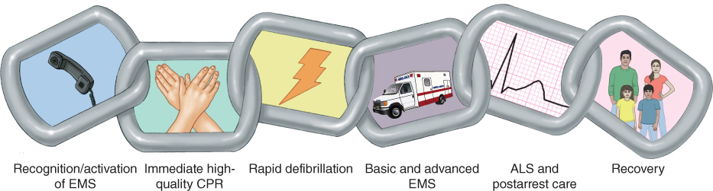
Cardiac Chain of Survival (2 of 2)
Figure 8-4 The five links of the cardiac chain of survival.
© Jones & Bartlett Learning. Data from American Heart Association.
Notes:
Figure: The five links of the cardiac chain of survival.

Slide 24
When to Start CPR (1 of 2)
CPR should be started on all nonbreathing, pulseless patients, unless they are obviously dead or have a do-not-resuscitate (DNR) order.
Signs of death
Decapitation: The head is separated from the rest of the body.
Rigor mortis: Temporary stiffening of muscles occurs several hours after death.
Notes:
VI. When to Start CPR
A. CPR should be started on all nonbreathing, pulseless patients, unless they are obviously dead or they have a do-not-resuscitate (DNR) order that is valid in your jurisdiction.
B. Following criteria are reliable signs of death and indicate that CPR should not be started.
1. Decapitation
a. Occurs when the head is separated from the rest of body.
b. There is obviously no chance of saving patient.
2. Rigor mortis
a. Temporary stiffening of muscles that occurs several hours after death
b. Indicates patient has been dead for a prolonged period of time and cannot be resuscitated

Slide 25
When to Start CPR (2 of 2)
Signs of death (cont'd):
Evidence of tissue decomposition: Actual flesh decay occurs only after a person has been dead for more than one day.
Dependent lividity: Red or purple color occurs on parts of patient’s body that are closest to ground.
Notes:
3. Evidence of tissue decomposition
a. Actual flesh decay occurs only after a person has been dead for more than a day.
4. Dependent lividity
a. Red or purple color that occurs on parts of patient’s body that are closest to ground.
b. Caused by blood seeping into tissues on dependent, or lower, part of person’s body.
c. Occurs after a person has been dead for several hours.
C. It is better to start CPR on a patient who is later declared dead than to withhold CPR from a patient whose life might have been saved.

Slide 26
When to Stop CPR (1 of 2)
Discontinue CPR only when:
Effective spontaneous circulation and ventilation are restored or patient begins to move.
Resuscitation efforts are transferred to another trained person with an equal or higher level of training who continues CPR.
A physician orders you to stop.
Patient is transferred to properly trained EMS personnel.
Notes:
VII. When to Stop CPR
A. You should discontinue CPR only when
1. Effective spontaneous circulation and ventilation are restored or the patient begins to move.
2. Resuscitation efforts are transferred to another person with an equal or higher level of training who continues CPR.
3. A physician orders you to stop.
4. Patient is transferred to properly trained EMS personnel.

Slide 27
When to Stop CPR (2 of 2)
Discontinue CPR only when (cont'd):
Reliable criteria for death are recognized.
You are too exhausted to continue resuscitation, environmental hazards endanger your safety, or continued resuscitation would place the lives of others at risk.
Notes:
5. Reliable criteria for death (as previously listed) are recognized.
6. You are too exhausted to continue resuscitation, environmental hazards endanger your safety, or continued resuscitation would place the lives of others at risk.

Slide 28
External Cardiac Compression (1 of 4)
In an unresponsive patient, scan chest quickly for signs of breathing and check for a pulse.
Check carotid pulse and look for signs of coughing or movement.
If there is no carotid pulse in an unresponsive patient, begin chest compressions.
To perform adult chest compressions, see Skill Drill 8-1.
Notes:
VIII. External Cardiac Compression
A. An adult patient in cardiac arrest is unconscious, has no carotid pulse and is not breathing or only gasping.
1. Check for circulation by feeling carotid pulse and look for no breathing or only gasping.
a. To check the carotid pulse, place your index and middle fingers on larynx.
b. Now slide your fingers into groove between the larynx and muscles at side of neck.
c. Keep your fingers there for at least 5 seconds but no more than 10 seconds to be sure pulse is absent and not just slow.
2. If there is no carotid pulse in an unresponsive patient, begin chest compressions.
a. Patient must be placed on a firm, horizontal surface.
b. Stand or kneel beside the patient’s chest and face the patient.
c. Place the heel of one hand in the center of the patient’s chest, on the lower half of the sternum, and place the heel of the other hand on top and interlock your fingers.
d. For steps on how to perform adult chest compressions, see [Skill Drill 8-1.]

Slide 29
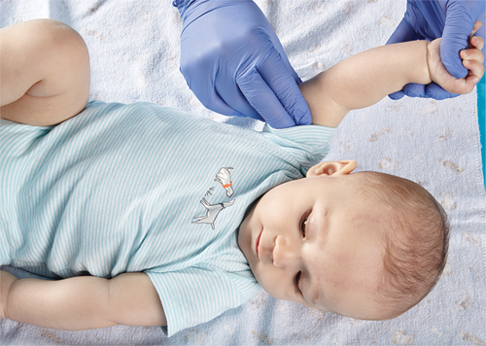
External Cardiac Compression (2 of 4)
External chest compressions on an infant:
To check an infant’s circulation, feel for brachial pulse on inside of upper arm.
Figure 8-6 Check the brachial pulse on the inside of the infant’s arm.
© Jones & Bartlett Learning.
Notes:
B. External chest compressions on an infant:
1. Infants (children younger than 1 year) who have experienced cardiac arrest will be unconscious, will not be breathing or only gasping, and will have no brachial pulse.
Figure: Check brachial pulse on inside of infant’s arm.

Slide 30
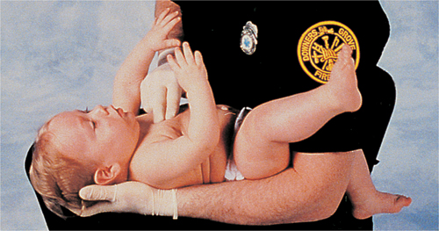
External Cardiac Compression (3 of 4)
External chest compressions on an infant (cont'd):
If there is no pulse, begin chest compressions with your two middle fingers.
Place infant on a solid surface or cradle infant in your arm.
You will not need to use much force.
Figure 8-7 Positioning the infant patient for proper CPR.
© American Academy of Orthopaedic Surgeons.
Notes:
2. You must begin chest compressions.
a. Use your two middle fingers to compress sternum.
b. Compress sternum at least one third the depth of chest.
c. Compress at a rate of 100-120 times per minute.
d. If you are only rescuer, give two rescue breaths after every 30 chest compressions.
e. If two rescuers are present, give two rescue breaths after every 15 chest compressions.
6. Place infant on a solid surface or cradle infant in your arm when doing chest compressions.
7. You will not need to use much force because infants are so small and their chests are so pliable.
Figure: Positioning the infant patient for proper CPR.

Slide 31
External Cardiac Compression (4 of 4)
External chest compressions on a child:
Check carotid pulse.
Begin chest compressions.
In smaller children, place heel of one hand in center of chest, in between nipples.
In larger children, use two hands.
Notes:
C. External chest compressions on a child:
1. Signs of cardiac arrest in a child (from age 1 year to the onset of puberty [12 to 14 years]) are same as those for an adult.
2. Check carotid pulse.
3. To perform chest compressions:
a. In smaller children, place the heel of one hand in center of chest, on the lower half of the sternum.
b. In larger children, perform chest compressions with two hands, as with the adult.
c. Compress sternum at least one third depth of chest.
d. Compress chest at a rate of at least 100 times per minute.
e. If you are the only rescuer, give two rescue breaths after every 30 chest compressions.
f. If two rescuers are present, give two rescue breaths after every 15 chest compressions.

Slide 32
Adult CPR (1 of 2)
One-rescuer adult CPR
Follow steps in Skill Drill 8-2.
You must deliver chest compressions and rescue breathing at a ratio of 30:2.
Notes:
IX. Adult CPR
A. One-rescuer adult CPR:
1. CPR consists of three skill sets.
a. Providing chest compressions.
b. Opening the airway.
c. Providing rescue breaths.
2. If you are the only trained person at scene, you must perform one-rescuer CPR.
a. Follow the steps in Skill Drill 8-2.
3. When performing one-rescuer CPR, you must deliver chest compressions and rescue breathing at a ratio of 30 compressions to two breaths.

Slide 33
Adult CPR (2 of 2)
Two-rescuer adult CPR
To avoid fatigue, rescuers should switch roles after every five cycles of CPR.
Follow steps in Skill Drill 8-3.
Switching positions should be accomplished as smoothly and quickly as possible.
CPR should not be interrupted for longer than 10 seconds.
Notes:
B. Two-rescuer adult CPR
1. Two-rescuer CPR is more effective than one-rescuer CPR.
a. One rescuer can deliver chest compressions while the other performs rescue breathing.
b. Chest compressions and ventilations can be given more regularly and without interruption.
2. To avoid rescuer fatigue, two rescuers should switch roles after every five cycles of CPR.
3. CPR should not be interrupted for longer than 10 seconds.
4. If possible, position yourselves on opposite sides of patient—one near the head and the other near chest.
5. Follow steps in Skill Drill 8-3.
6. Switching CPR positions
a. A switch allows the person giving compressions to rest his or her arms.
b. Switching positions should be accomplished as smoothly and quickly as possible to minimize the break in rate and regularity of compressions and ventilations.
c. One method of switching positions is as follows:
i. As Rescuer Two tires, he or she says out loud (instead of counting): “We—will—switch—this—time.”
ii. After 25 more chest compressions, Rescuer One completes two ventilations and moves to the chest to perform compressions.
iii. Rescuer Two moves to the head of the patient to maintain the airway and ventilation.
iv. Rescuer One then begins chest compressions.
d. Switching is much easier if the rescuers work on opposite sides of the patient.

Slide 34
Infant CPR (1 of 2)
One-rescuer infant CPR:
Follow steps in Skill Drill Performing One-Rescuer Infant CPR.
Compress chest 30 times with pads of your fingertips at a rate of 100-120 compressions per minute.
Give two breaths.
Perform a compression-to-ventilation ratio of 30:2.
Notes:
X. Infant CPR
A. One-rescuer infant CPR
1. Principles of CPR are the same for adults and infants, but slightly different techniques must be used.
2. Follow steps in Skill Drill Performing One-Rescuer Infant CPR.
a. Position the infant face up on a firm, flat surface.
b. Establish level of responsiveness. Call for additional help if patient is unconscious.
c. Check brachial pulse and check for signs of no breathing or only gasping.
d. If the infant has no pulse and is not breathing or only gasping, begin chest compressions.
e. Compress the chest 30 times with the pads of your fingertips at a rate of 100-120 compressions per minute.
f. Give two breaths.
g. If you are alone, continue to give 30 compressions followed by two rescue breaths until other providers arrive or until the infant begins to move.

Slide 35
Infant CPR (2 of 2)
Two-rescuer infant CPR:
Use two-thumb/encircling-hands technique for chest compressions.
Compress sternum at a rate of 100-120 compressions per minute.
Perform a compression-to-ventilation ratio of 15:2.
Notes:
B. Two-rescuer infant CPR:
1. Use two-thumb/encircling hands technique for chest compressions.
a. Place both thumbs side-by-side over lower half of infant’s sternum and encircle infant’s chest with your hands.
2. Compress sternum at a rate of 100-120 compressions per minute.
3. Use a compression-to-ventilation ratio of 15:2.

Slide 36
Child CPR (1 of 3)
Steps for child CPR are essentially same as for an adult.
Some variations include:
Use less force to compress child’s chest.
In small children, use only one hand to depress sternum.
Use less force to ventilate child.
Notes:
XI. Child CPR
A. One-rescuer and two-rescuer child CPR
1. A child is defined as a person between 1 year of age and the onset of puberty (12 to 14 years).
2. Steps for child CPR are essentially same as for an adult; however, some steps may require modification for a child.
3. These variations are as follows:
a. Use less force to compress the child’s chest.
b. In small children, use only one hand to depress sternum one half to one third depth of chest; use two hands in larger children.
c. Use less force to ventilate child.

Slide 37
Child CPR (2 of 3)
Steps to administer CPR to a child:
Establish child’s lack of responsiveness and breathing.
Check for circulation.
Provide chest compressions (rate of 100–120 compressions per minute).
Open airway.
Give two effective breaths.
Notes:
4. Follow these steps to administer CPR to a child:
a. Establish child’s level of responsiveness and check for breathing.
b. Check for circulation.
c. If no pulse and no breathing or only gasping, deliver 30 chest compressions.
d. Open airway.
e. Give two effective breaths.

Slide 38
Child CPR (3 of 3)
Steps to administer CPR to a child (cont'd):
Continue cycles of compressions and ventilations.
Reassess patient after five cycles of CPR and every 2 minutes thereafter.
Notes:
f. Continue compressions and ventilations in a 30:2 ratio for one rescuer and 15:2 for two rescuers.
g. Reassess patient after five cycles of CPR and every 2 minutes thereafter.
h. If you are alone with no communications device, perform 2 minutes of CPR before leaving patient to activate EMS system.

Slide 39
Signs of Effective CPR
A second rescuer feels a carotid pulse while you are compressing chest.
Patient’s skin color improves (from blue to pink).
Chest visibly rises during ventilations.
Compressions and ventilations are delivered at appropriate rate and depth.
Notes:
XII. Signs of Effective CPR
A. It is important to know signs of effective CPR so you can assess your efforts to resuscitate patient.
B. Signs of effective CPR:
1. A second rescuer feels a carotid pulse while you are compressing chest.
2. Patient’s skin color improves (from blue to pink).
3. Chest visibly rises during ventilations.
4. Compressions and ventilations are delivered at appropriate rate and depth.

Slide 40
Complications of CPR (1 of 4)
Broken ribs
You may break a patient’s ribs while delivering a compression.
To prevent this problem, use proper hand positioning and do not let your fingers come in contact with ribs.
If you hear a cracking sound, check and correct your hand position but continue CPR.
Notes:
XIII. Complications of CPR
A. Complications can be minimized by the use of proper technique.
B. Broken ribs
1. You may break a patient’s ribs while delivering a compression.
2. To prevent this problem, use proper hand positioning and do not let your fingers come in contact with ribs.
3. If you hear a cracking sound, check and correct your hand position but continue CPR.

Slide 41
Complications of CPR (2 of 4)
Gastric distention
Occurs when too much air is blown too fast and too forcefully into stomach.
Often causes regurgitation.
Ensure you have opened airway completely.
Do not blow excessive amounts of air into patient.
Notes:
C. Gastric distention
1. Gastric distention is caused when too much air is blown too fast and too forcefully into stomach.
2. Gastric distention causes abdomen to increase in size.
a. A distended abdomen pushes on the diaphragm and prevents lungs from inflating fully.
3. Gastric distention often causes regurgitation.
a. If regurgitation occurs, quickly turn patient to side, wipe out mouth with your gloved finger, and then return patient to a supine position.
4. You can prevent gastric distention by making sure you have opened airway completely.
5. Do not blow excessive amounts of air into patient.

Slide 42
Complications of CPR (3 of 4)
Regurgitation
Common during CPR
To minimize risk, minimize amount of air that enters stomach.
If patient regurgitates during CPR.
Turn patient onto his or her side.
Clear patient’s mouth of remaining vomitus.
Use suction if it is available.
Notes:
D. Regurgitation
1. Regurgitation (passive vomiting) is common during CPR, so responders should be prepared to manage this complication.
2. You can minimize the risk of regurgitation by minimizing amount of air that enters patient’s stomach.
3. When cardiac arrest occurs, the muscle that keeps food in stomach relaxes, allowing contents of stomach to back up.
4. If patient regurgitates as you are performing CPR
a. Immediately turn patient onto his or her side to allow vomitus to drain from mouth.
b. Clear patient’s mouth of remaining vomitus, first with your fingers and then with a clean cloth.
c. Use suction if it is available.
5. Do your best to clear any vomitus from the patient’s airway.

Slide 43
Complications of CPR (4 of 4)
Regurgitation (cont'd):
If airway is not cleared, two problems may arise:
Patient may breathe in vomitus into lungs.
You may force vomitus into lungs with next artificial ventilation.
As soon as you have cleared away vomitus, continue rescue breathing.
Notes:
6. If airway is not cleared, two problems may arise:
a. Patient may breathe in (aspirate) vomitus into lungs.
b. You may force vomitus into lungs with next artificial ventilation.
7. As soon as you have cleared away vomitus, continue rescue breathing.

Slide 44
Creating Sufficient Space for CPR (1 of 2)
EMRs may find themselves alone with patients in cardiac arrest.
You must create or find a space where you can perform CPR.
You need 3 feet to 4 feet of space on all sides of patient.
Notes:
XIV. Creating Sufficient Space for CPR
A. EMRs may find themselves alone with patients in cardiac arrest.
B. One of the first things you must do is create or find a space where you can perform CPR.
1. You need 3 feet to 4 feet of space on all sides of patient.
2. This will give enough space so that rescuers can change places, ALS procedures can be implemented, and an ambulance stretcher can be brought in.

Slide 45
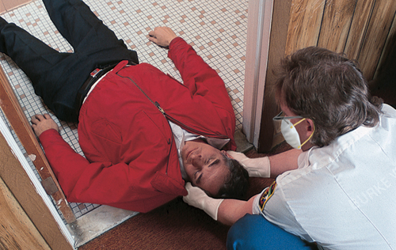
Creating Sufficient Space for CPR (2 of 2)
If there is not enough space around patient, you have two options:
Quickly rearrange furniture in room or arrange objects at scene to make space.
Quickly drag patient into an area that has more room.
Figure 8-15 Create sufficient space for CPR.
© American Academy of Orthopaedic Surgeons.
Notes:
C. If there is not enough space around patient, you have two options.
1. Quickly rearrange furniture in room or arrange objects at scene to make space.
2. Quickly drag patient into an area that has more room.
Figure: Create sufficient space for CPR.

Slide 46
Early Defibrillation by EMRs (1 of 3)
More than 70% of all out-of-hospital cardiac arrest patients have an irregular heart electrical rhythm called ventricular fibrillation (V-fib).
V-fib is a rapid, disorganized, and ineffective vibration of heart.
An electric shock applied to heart will defibrillate it and reorganize vibrations into effective heartbeats.
Greatest chance of survival for V-fib patient involves prompt use of an AED and CPR.
Notes:
XV. Early Defibrillation by EMRs
A. Each year in the United States, approximately 424,000 people die of coronary heart disease in an out-of-hospital setting.
B. More than 70% of all out-of-hospital cardiac arrest patients have an irregular heart electrical rhythm called ventricular fibrillation (V-fib).
1. V-fib is a rapid, disorganized, and ineffective vibration of heart.
2. An electric shock applied to the heart will defibrillate it and reorganize vibrations into effective heartbeats.
3. A patient in cardiac arrest stands the greatest chance for survival when early defibrillation is available.

Slide 47
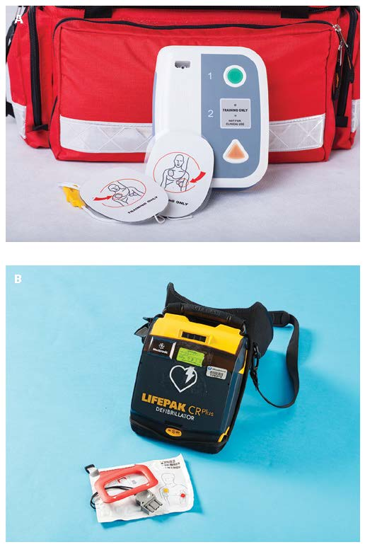
Early Defibrillation by EMRs (2 of 3)
Most EMS systems are equipping EMRs with automated external defibrillators (AEDs).
These machines identify ventricular fibrillation and advise rescuer to deliver a shock if needed.
Figure 8-16 Automated external defibrillators can vary in their design, features, and operation.
© Photographee.eu/Shutterstock.
Notes:
C. To get defibrillators to cardiac arrest patients more quickly, most EMS systems are equipping EMRs with automated external defibrillators (AEDs).
1. These machines accurately identify ventricular fibrillation and advise rescuer to deliver a shock if needed.
2. The links in chain of survival include:
a. Recognition of cardiac arrest and activation of EMS system.
b. Immediate CPR with emphasis on high-quality chest compressions.
c. Rapid defibrillation.
d. Basic and advanced EMS care.
e. Advanced life support and postarrest care.
Figure: Automated external defibrillators can vary in their design, features, and operation.

Slide 48
Early Defibrillation by EMRs (3 of 3)
Performing automated external defibrillation
Follow steps in Skill Drill 8-4.
AEDs vary in their operation, so learn how to use your specific AED.
Notes:
D. Performing automated external defibrillation
1. Steps for using an AED are listed in Skill Drill 8-4.
2. AEDs vary in their operation, so learn how to use your specific AED.
3. You must have the training required by your medical director to practice this procedure.

Slide 49
CPR Training
EMRs should:
Successfully complete a CPR course through a recognized agency.
Regularly update their skills by completing a recognized recertification course.
Your department should schedule periodic reviews of CPR theory and practice.
Notes:
XVI. CPR Training
A. EMRs should successfully complete a CPR course through a recognized agency.
1. Emergency Care and Safety Institute (ECSI)
2. American Heart Association (AHA)
3. American Red Cross (ARC)
B. EMRs should regularly update their skills by successfully completing a recognized recertification course.
C. Your department should schedule periodic reviews of CPR theory and practice for all people who are trained as EMRs.

Slide 50
Legal Implications of CPR (1 of 2)
Advance directives and living wills are legal documents that specify patient’s wishes regarding specified medical procedures.
CPR should be started on all patients unless signs of obvious death are present.
If a patient has an advance directive, physician at hospital will determine whether you should stop CPR.
Notes:
XVII. Legal Implications of CPR
A. Advance directives, living wills, and durable powers of attorney for health care are legal documents that specify the patient’s wishes regarding specified medical procedures.
1. Because you are not in a position to determine whether the advance directive or living will is valid, CPR should be started on all patients unless signs of obvious death are present.
2. If a patient has an advance directive or living will, physician at hospital will determine whether you should stop CPR.

Slide 51
Legal Implications of CPR (2 of 2)
Do not hesitate to start CPR on a pulseless, nonbreathing patient.
Without your help, patient will die.
Abandonment
Discontinuation of CPR without order of a licensed physician or without turning patient over to someone who is at least as qualified as you are
Notes:
B. Do not hesitate to start CPR on a pulseless, nonbreathing patient.
1. Without your help, the patient will certainly die.
2. The chances of encountering legal problems are minimal if you perform a careful assessment of the patient before beginning CPR.
C. Another potential legal pitfall is abandonment.
1. Abandonment is discontinuation of CPR without the order of a licensed physician or without turning patient over to someone who is at least as qualified as you are.
2. Your most important protection against a possible legal suit is to become thoroughly proficient in the theory and practice of CPR.

Slide 52
Summary (1 of 4)
Cardiac arrest occurs when heart stops contracting and no blood is pumped through blood vessels.
Chain of survival—recognition/activation of EMS, immediate high-quality CPR, rapid defibrillation, basic and advanced EMS, ALS and postarrest care
Notes:
XVIII. Summary
A. The circulatory system transports oxygenated blood from the lungs to the rest of the body. Each beat of the heart produces a pulse, which can be felt at various sites on the body, such as the inside of the wrist (radial), the neck (carotid), the inside of the upper arm (brachial), and the groin (femoral).
B. Cardiac arrest occurs when heart stops contracting and no blood is pumped through blood vessels. Brain damage begins within 4 to 6 minutes after the patient has experienced cardiac arrest. Within 8 to 10 minutes, the damage to the brain may become irreversible.
The chain of survival—recognition/activation of EMS, immediate high-quality CPR, rapid defibrillation, basic and advanced EMS, ALS and postarrest care—includes steps essential to successful emergency cardiac care.
D. When you arrive at an emergency scene, you must first assess the area for potential safety hazards. If the scene is unsafe, make it as safe as possible for yourself and the patient. As you approach the patient, look for possible causes of illness or injury. Next, assess the patient by checking responsiveness and CAB:
1. Circulation
2. Airway
3. Breathing

Slide 53
Summary (2 of 4)
Basic life support for adults and children follows same general steps:
Check responsiveness, circulation, breathing, and airway.
Intervene at any point where patient’s airway is obstructed, patient is not breathing, or patient has no circulation.
Notes:
E. If patient is not breathing, you must breathe for him or her. Check for a pulse. If it is absent, begin CPR.
F. Basic life support for adults and children follows same general steps: Check responsiveness, airway, breathing, and circulation. Intervene at any point where the patient’s airway is obstructed, the patient is not breathing, or the patient has no circulation.
K. Open an infant’s airway by using the head tilt–chin lift maneuver if you do not suspect a spinal injury. Be careful not to hyperextend the neck; this could obstruct the airway. If the infant is not breathing, provide two initial breaths. If these breaths produce visible chest rise, check for a brachial pulse.
L. If an infant does not have a pulse, or if the pulse rate is less than 60 beats per minute with poor perfusion (circulation), begin CPR. If you are alone, use two fingers to compress the chest 30 times, at a rate of 100-120 compressions per minute, to a depth equal to at least one third the depth of the chest. After 30 compressions, give two breaths. If two rescuers are present, use the two-thumb technique with the hands encircling the chest and provide 15 compressions to two breaths.

Slide 54
Summary (3 of 4)
Single most important cardiac arrest survival factor is early defibrillation.
The indications for using an automated external defibrillator (AED) are that patient is unresponsive, not breathing, and pulseless.
Notes:
M. Single most important cardiac arrest survival factor is early defibrillation. Indications for using an automated external defibrillator (AED) are that patient is unresponsive, not breathing, and pulseless.

Slide 55
Summary (4 of 4)
Once turned on and attached to patient’s bare chest, AED will analyze heart rhythm and advise whether a shock is indicated.
Notes:
N. Once turned on and attached to patient’s bare chest, the AED will analyze heart rhythm and advise whether a shock is indicated. If a shock is advised, ensure that no one is touching patient, deliver the shock, and immediately perform CPR for 2 minutes before reanalyzing the patient’s rhythm. If no shock is advised, perform CPR for 2 minutes and then reanalyze the patient’s rhythm. Continue CPR and rhythm analysis until ALS personnel arrive.

Slide 56
Review
A patient who is in cardiac arrest:
does not require rescue breathing.
does not have a pulse and is not breathing.
should be considered dead after 10 minutes of CPR.
requires treatment that is beyond the scope of practice of the EMR.

Slide 57
Review
Answer:
B. does not have a pulse and is not breathing.

Slide 58
Review
The majority of out-of-hospital cardiac arrest patients have an irregular heart electrical rhythm called ventricular fibrillation. How is this rhythm characterized?
Rapid, disorganized, and ineffective
Slow, disorganized, and ineffective
Rapid but effective
No electrical activity at all

Slide 59
Review
Answer:
A. Rapid, disorganized, and ineffective

Slide 60
Review
Which of the following is not a sign of effective CPR?
Compressions are delivered at a rate of 50 per minute.
You can feel a carotid pulse during chest compressions.
The patient’s skin color turns pink (from blue).
The chest visibly rises during ventilations.

Slide 61
Review
Answer:
A. Compressions are delivered at a rate of 50 per minute.

