Slide 1
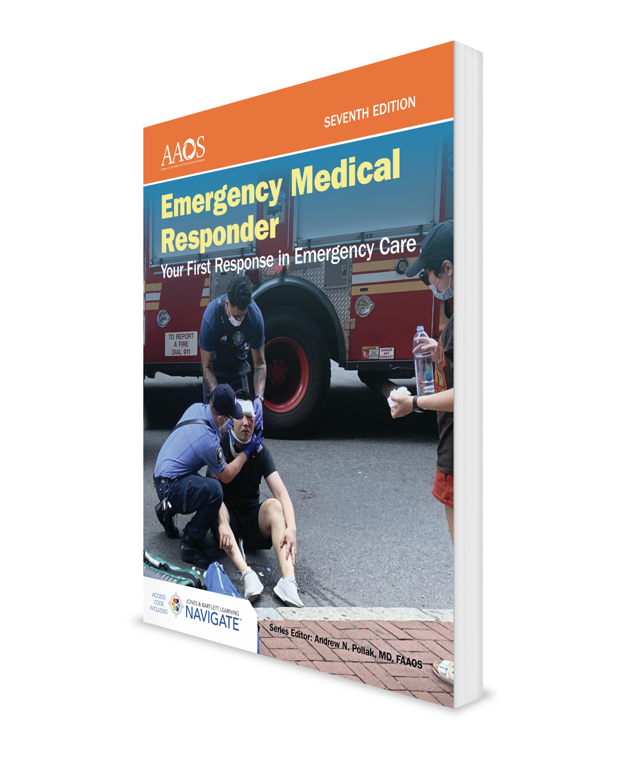
Professional Rescuer CPR
CHAPTER 8

Slide 2
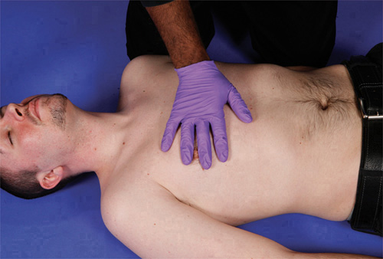
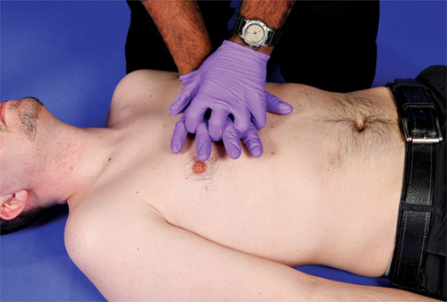
Skill Drill 8-1 Performing Adult Chest Compressions (1-2)
Step 2 Place your other hand on top of your first hand and interlock your fingers. It is important to locate and maintain the proper hand position while applying chest compressions. If your hands are too high, the force you apply will not produce adequate chest compressions. If your hands are too low, the force you apply may damage the liver. If your hands slip sideways off the sternum and onto the ribs, the compressions will not be effective and you may damage the ribs and lungs.
Step 1 Locate the top and bottom of the sternum. Place the heel of your hand in the center of the chest, on the lower half of the sternum.
© Jones & Bartlett Learning. Courtesy of MIEMSS.
© Jones & Bartlett Learning. Courtesy of MIEMSS.

Slide 3
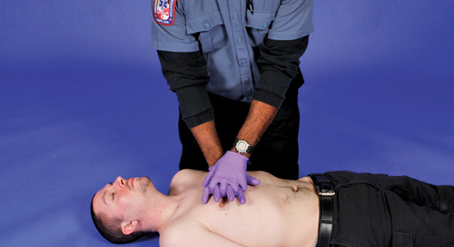
Skill Drill 8-1 Performing Adult Chest Compressions (2-2)
Step 3 After you have both hands in the proper position, compress the chest of an adult at least 2 inches (5 cm) straight down. For compressions to be effective, stay close to the patient’s side and lean forward so that your arms are directly over the patient. Keep your back straight and your elbows stiff so you can apply the force of your whole body to each compression, not just your arm muscles. Between compressions, make sure you completely release pressure on the chest to allow maximum filling of the patient’s heart. Never lean on the chest during compressions. Compressions must be rhythmic and continuous. Each compression cycle consists of one downward push followed by a rest so that the heart can refill with blood. Push hard and push fast. Compressions should be at the rate of 100 to 120 compressions per minute in all patients—adults, children, and infants. After every 30 chest compressions, give two rescue breaths (1 second per breath). Practice on a manikin until you can compress the chest smoothly and rhythmically.
© Jones & Bartlett Learning. Courtesy of MIEMSS.

Slide 4
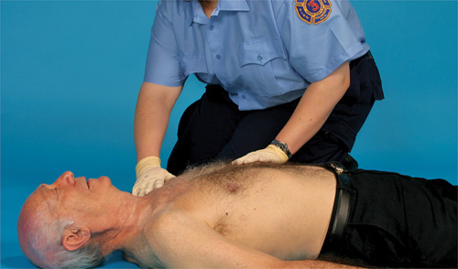
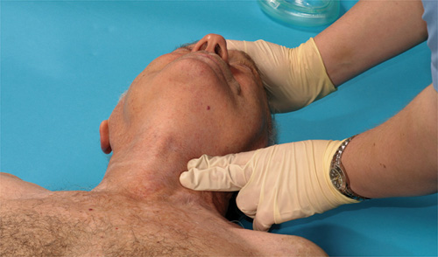
Skill Drill 8-2 Performing One-Rescuer Adult CPR (1-3)
Step 1 Establish unresponsiveness. Ask the patient, “Are you okay?” Gently shake the patient’s shoulder. If you do not get a response, call for additional help, activate the EMS system, and send someone to get an AED if one is available. Position the patient so he or she is flat on his or her back on a hard surface. Position yourself so that your knees are alongside the patient’s chest.
Step 2 Determine pulselessness by checking the carotid pulse and simultaneously checking for no breathing or only gasping. Check the pulse and breathing for no more than 10 seconds.
© Jones & Bartlett Learning. Courtesy of MIEMSS.
© Jones & Bartlett Learning. Courtesy of MIEMSS.

Slide 5
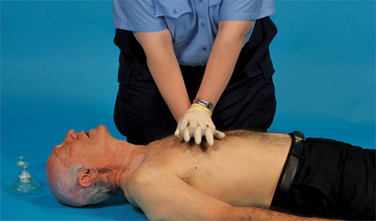
Skill Drill 8-2 Performing One-Rescuer Adult CPR (2-3)
Step 3 If the patient has no pulse and is not breathing or only gasping, begin chest compressions. Place the heel of one hand in the center of the chest, on the lower half of the sternum. Place your other hand on top of the first. Lock your fingers together and pull upward so that the only thing touching the patient’s chest is the heel of your hand. Lean forward so your shoulders are directly over your hands and the patient’s sternum. Keep your arms straight and compress the sternum at least 2 inches (5 cm), using the weight of your body. Relax between compressions, allowing the chest to fully recoil. Give 30 compressions at a rate of 100 to 120 compressions per minute, and count each one out loud as follows: “One and two and three and . . . .” Each set of 30 compressions should take between 15 and 18 seconds to complete.
© Jones & Bartlett Learning. Courtesy of MIEMSS.

Slide 6
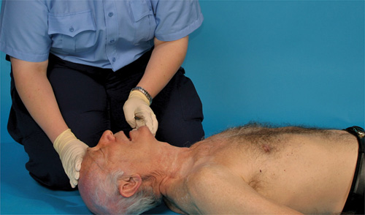
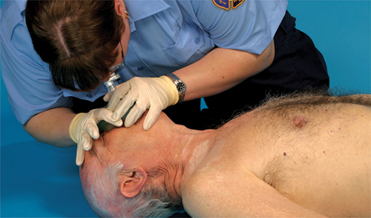
Skill Drill 8-2 Performing One-Rescuer Adult CPR (3-3)
Step 4 After 30 chest compressions, open the airway using a head tilt–chin lift or a jaw-thrust maneuver if you suspect a head or spinal injury.
Step 5 Give two rescue breaths (1 second each). Ensure that each breath produces visible chest rise. Continue cycles of 30 compressions and two rescue breaths until an AED arrives, patient care is assumed by other providers, or the patient starts to move.
© Jones & Bartlett Learning. Courtesy of MIEMSS.
© Jones & Bartlett Learning. Courtesy of MIEMSS.

Slide 7
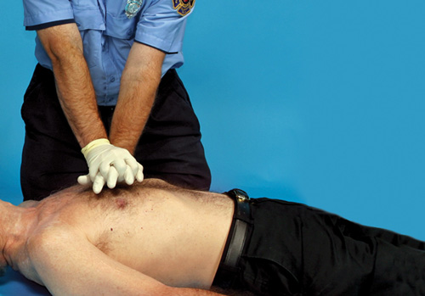
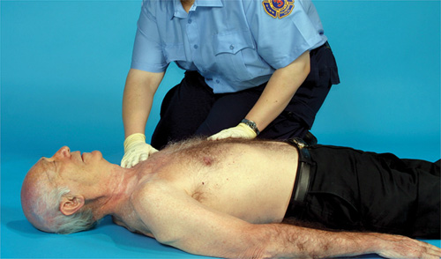
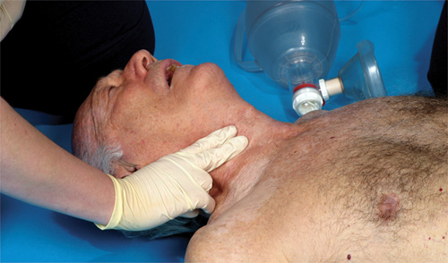
Skill Drill 8-3 Performing Two-Rescuer Adult CPR (1-2)
Step 1 Rescuer 1 establishes unresponsiveness. Rescuer 2 moves to the patient’s side to be ready to deliver chest compressions. Rescuer 1 activates the EMS system.
Step 2 If the patient is unresponsive, rescuer 1 determines pulselessness. Rescuer 1 simultaneously checks for signs of circulation and breathing by checking the carotid pulse and watching for chest rise for no more than 10 seconds. If the patient has no pulse and is not breathing or only gasping, continue to step 3.
Step 3 The rescuers begin CPR, starting with chest compressions. Rescuer 2 performs 30 chest compressions at a rate of 100 to 120 compressions per minute. Establish responsiveness and lack of breathing.
© Jones & Bartlett Learning. Courtesy of MIEMSS.
© Jones & Bartlett Learning. Courtesy of MIEMSS.
© Jones & Bartlett Learning. Courtesy of MIEMSS.

Slide 8
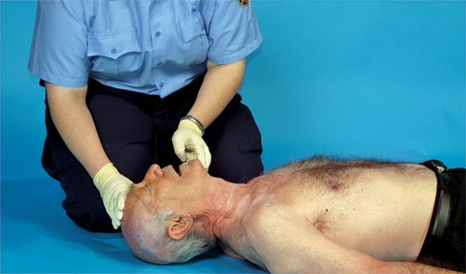
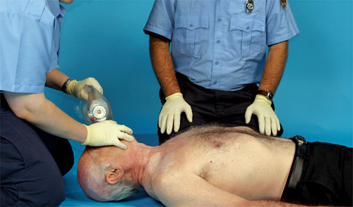
Skill Drill 8-3 Performing Two-Rescuer Adult CPR (2-2)
Step 4 Rescuer 1 opens the airway with a head tilt–chin lift or, in the case of a trauma or if a head or spinal injury is suspected, a jaw-thrust maneuver.
Step 5 Rescuer 1 gives two ventilations of 1 second each and observes for visible chest rise. Continue CPR for five cycles of 30 compressions and two ventilations (about 2 minutes). After 2 minutes of CPR, the rescuers switch positions. The switch time should take no longer than 5 seconds. Continue cycles of 30 chest compressions and two ventilations until an AED arrives, ALS personnel take over, or the patient starts to move.
© Jones & Bartlett Learning. Courtesy of MIEMSS.
© Jones & Bartlett Learning. Courtesy of MIEMSS.

Slide 9
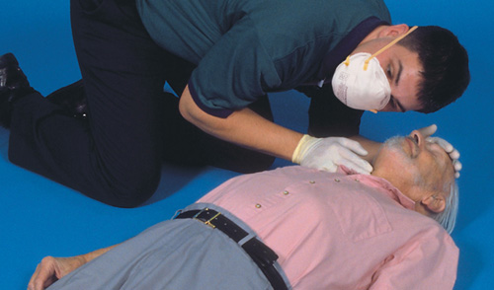
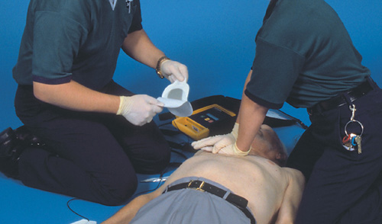
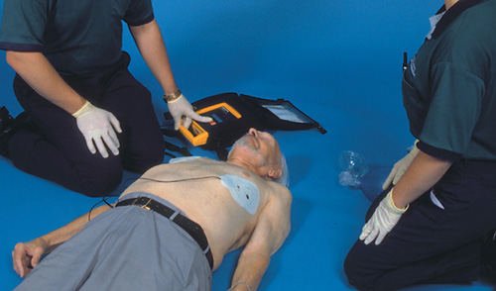
Skill Drill 8-4 Performing Automated External Defibrillation (1-2)
Step 1 If CPR is in progress when you arrive, check the effectiveness of the chest compressions by checking for a pulse. It is important to limit the amount of time compressions are interrupted. If the patient is responsive, do not apply the AED.
Step 2 If the patient is unresponsive, begin providing chest compressions as soon as possible. Perform compressions and rescue breaths at a ratio of 30 compressions to two breaths, continuing until an AED arrives and is ready for use. It is important to start chest compressions and use the AED as soon as possible. Compressions provide vital blood flow to the heart and brain, improving the patient’s chance of survival. If the cardiac arrest is witnessed, attach the AED as soon as it is available.
Step 3 Turn on the AED. Remove clothing from the patient’s chest area. Apply the pads to the chest: one just to the right of the breastbone (sternum) just below the collarbone (clavicle), the other on the left lower chest area with the top of the pad 2 to 3 inches (5 to 8 cm) below the armpit. Be sure that the pads are attached to the patient cables (and that they are attached to the AED in some models). Plug the pads’ connectors into the AED.
© Jones & Bartlett Learning. Courtesy of MIEMSS.
© Jones & Bartlett Learning. Courtesy of MIEMSS.
© Jones & Bartlett Learning. Courtesy of MIEMSS.

Slide 10
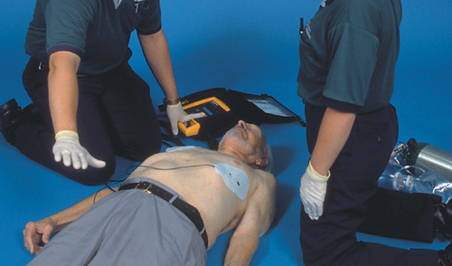
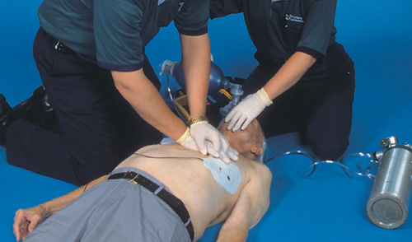
Skill Drill 8-4 Performing Automated External Defibrillation (2-2)
Step 4 Stop CPR. State aloud, “Clear the patient,” and ensure that no one is touching the patient. Push the analyze button, if there is one, and wait for the AED to determine if a shockable rhythm is present. If your AED has voice prompts, follow the verbal instructions. Allow the AED to analyze the rhythm. If a shock is not advised, perform five cycles (about 2 minutes) of CPR beginning with chest compressions. Then reassess the patient’s pulse and reanalyze the cardiac rhythm. If a shock is advised, reconfirm that no one is touching the patient and push the shock button. After the shock is delivered, immediately resume CPR, beginning with chest compressions.
Step 5 After five cycles (about 2 minutes) of CPR, reanalyze the patient’s cardiac rhythm. Do not interrupt chest compressions for more than 10 seconds. Repeat the cycle of 2 minutes of CPR, one shock (if indicated), and 2 minutes of CPR. Arrange for transport, and contact medical control as needed.
© Jones & Bartlett Learning. Courtesy of MIEMSS.
© Jones & Bartlett Learning. Courtesy of MIEMSS.

