Slide 1
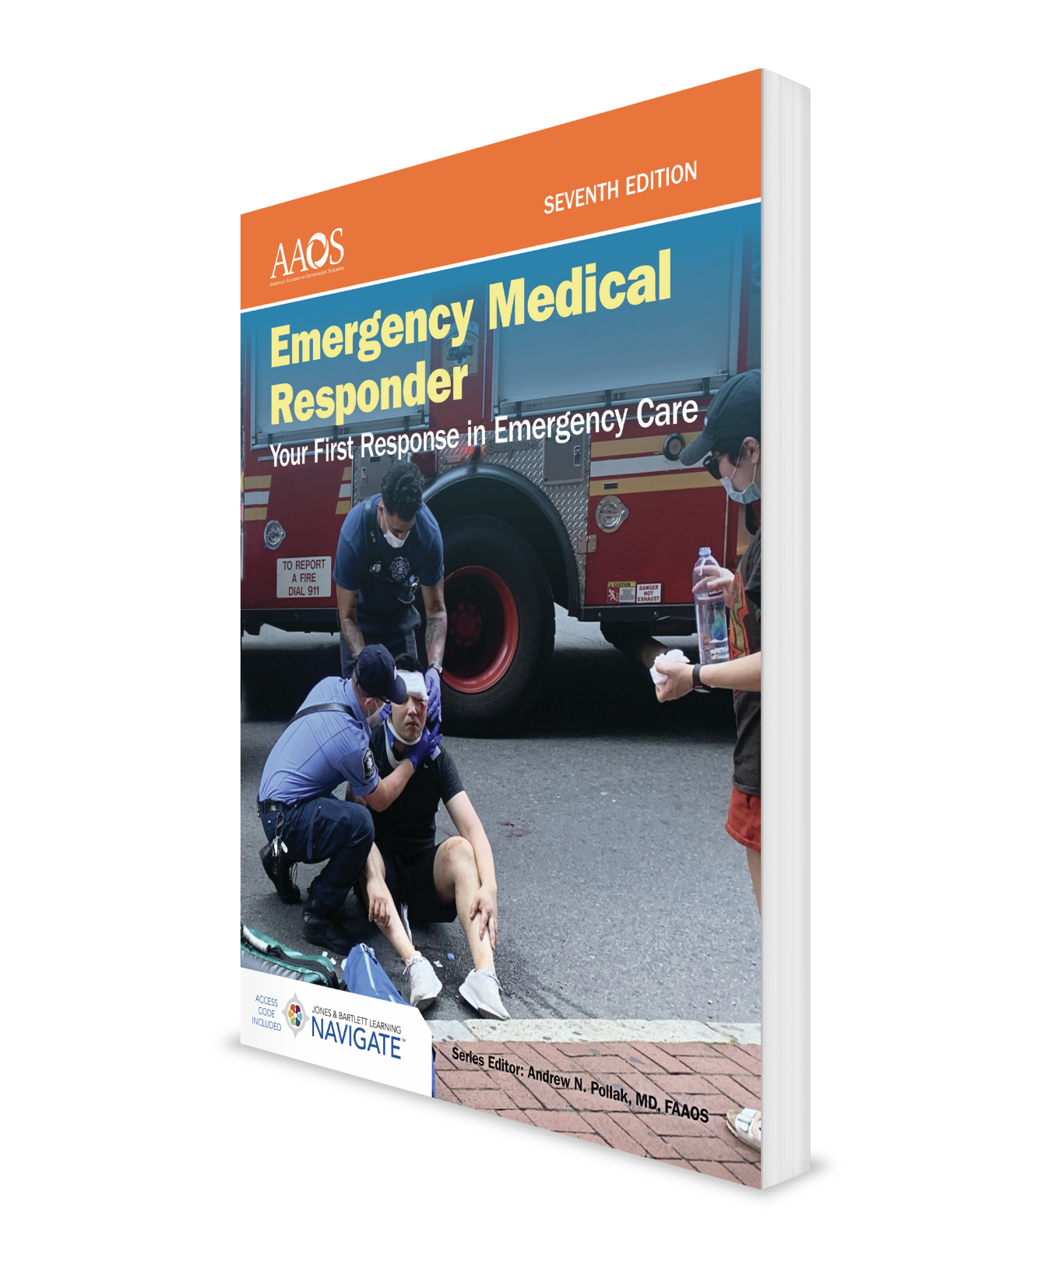
Patient Assessment
CHAPTER 9

Slide 2
National EMS Education Standard Competencies (1 of 5)
Assessment
Use scene information and simple patient assessment findings to identify and manage immediate life threats and injuries within scope and practice of the EMR.
Notes:
Assessment
Use scene information and simple patient assessment findings to identify and manage immediate life threats and injuries within scope and practice of the EMR.

Slide 3
National EMS Education Standard Competencies (2 of 5)
Scene Size-Up
Ensure scene safety.
Determine MOI/NOI.
Take standard precautions.
Determine number of patients.
Consider additional resources.
Notes:
Scene Size-Up
• Ensure scene safety.
• Determine mechanism of injury or nature of illness.
• Take standard precautions.
• Determine the number of patients.
• Consider additional resources.
Standard precautions (p 173)

Slide 4
National EMS Education Standard Competencies (3 of 5)
Primary Assessment
Form a general impression.
Assess level of responsiveness.
Perform rapid exam to identify life threats.
Assess airway.
Assess breathing.
Assess circulation.
Update responding EMS units.
Notes:
Primary Assessment
• Form a general impression.
• Assess level of responsiveness.
• Perform rapid exam to identify life threats.
Assess airway.
Assess breathing.
Assess circulation.
• Update responding EMS units.

Slide 5
National EMS Education Standard Competencies (4 of 5)
History Taking
Investigate chief complaint (SAMPLE history).
Notes:
History Taking
• Determining the chief complaint (pp 178-179)
• SAMPLE: signs and symptoms, allergies, medications, pertinent past medical history, last meal, events leading up to incident

Slide 6
National EMS Education Standard Competencies (5 of 5)
Secondary Assessment
Systematically assess patient.
Assess vital signs.
Reassessment
Repeat primary assessment.
Reassess vital signs.
Reassess chief complaint.
Recheck effectiveness of treatment.
Identify and treat changes in patient’s condition.
Notes:
Secondary Assessment
• Systematically assess patient. (pp 181-187)
• Assessment of vital signs. (pp 187-191)
Reassessment
• Repeat primary assessment, reassess vital signs, chief complaint, recheck effectiveness of treatment, and identify and treat changes in patient’s condition. (pp 192-193)

Slide 7
Introduction (1 of 2)
EMRs are first trained EMS providers at many emergency scenes.
Patient assessment sequence:
Perform a scene size-up.
Perform a primary assessment.
Obtain patient’s medical history.
Perform a secondary assessment.
Perform a reassessment.
Notes:
I. Introduction
A. EMRs are the first trained emergency medical services (EMS) providers at many emergency scenes.
1. Your assessment of scene and the patient will affect level of care requested for patient.
2. It is important that you are able to perform a systematic patient assessment to determine whether your patient has a medical condition or has sustained injuries from trauma.
B. Patient assessment sequence consists of five steps:
1. Perform a scene size-up.
2. Perform a primary assessment.
3. Obtain patient’s medical history.
4. Perform a secondary assessment.
5. Perform a reassessment.
C. This sequence allows you to systematically gather information you need.

Slide 8
Introduction (2 of 2)
Skills and knowledge presented in this chapter follow an assessment-based care model.
Treatment rendered is based on patient’s symptoms.
Assessment-based care requires you to conduct a careful and thorough evaluation.
Notes:
D. Skills and knowledge presented in this chapter follow an assessment-based care model.
1. With assessment-based care, treatment rendered is based on patient’s symptoms.
2. Assessment-based care requires you to conduct a careful and thorough evaluation of patient so that you can provide appropriate care.

Slide 9
Patient Assessment Sequence
Patient assessment sequence provides a framework so that you can:
Safely size-up an emergency scene.
Conduct a primary assessment.
Obtain patient’s history.
Conduct a secondary assessment.
Conduct reassessment of patient.
Notes:
II. Patient Assessment Sequence
A. Patient assessment sequence provides a framework so that you can:
1. Safely approach an emergency scene.
2. Conduct a primary assessment.
3. Obtain patient’s history.
4. Conduct a secondary assessment.
5. Conduct reassessment of patient.

Slide 10
Scene Size-Up (1 of 8)
General overview of incident and its surroundings.
Review dispatch information:
Location of incident.
Main problem or type of incident.
Number of people involved.
Safety issues at scene.
Notes:
III. Scene Size-up
A. Scene size-up is a general overview of incident and its surroundings.
B. Review dispatch information:
1. Anticipate possible conditions by reviewing and understanding dispatch information.
2. Your dispatcher should have obtained following information:
a. Location of incident.
b. Main problem or type of incident.
c. Number of people involved.
d. Safety issues at scene.

Slide 11
Scene Size-Up (2 of 8)
Review dispatch information (cont'd):
Other factors can affect your actions:
Time of day
Day of the week
Weather conditions
Mentally prepare for other situations you may find when you arrive on scene.
If you come across a medical emergency, contact dispatch using your two-way radio.
Notes:
3. Other factors can also affect your actions:
a. Time of day
b. Day of the week
c. Weather conditions
4. Think about the resources that may be needed and mentally prepare for other situations you may find when you arrive on scene.
5. If you should come across a medical emergency, notify the emergency medical dispatch center by using your two-way radio.
a. If you do not have a two-way radio, use a cellular phone or send someone to call for help.

Slide 12
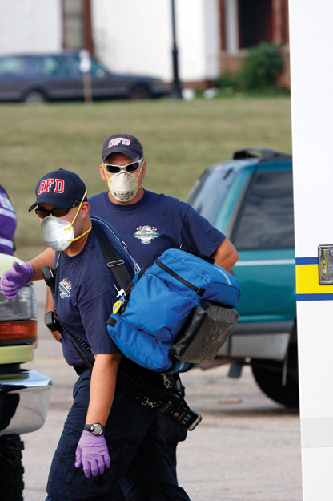
Scene Size-Up (3 of 8)
Ensure scene safety
Park your vehicle so that it helps secure scene and minimizes traffic blockage.
Scan scene and determine:
Extent of incident.
Possible number of people injured.
Presence of possible hazards.
Figure 9-2 Perform a scene size-up.
© Nancy G Fire Photography,Nancy Greifenhagen/Alamy Stock Photo
Notes:
C. Ensure scene safety.
1. Park your vehicle so that it helps secure scene and minimizes traffic blockage.
2. Scan scene to ensure that you are not putting yourself in danger and make these determinations:
a. Extent of the incident.
b. Possible number of people injured.
c. Presence of possible hazards.
Figure: Perform a scene size-up.

Slide 13
Scene Size-Up (4 of 8)
Ensure scene safety (cont'd).
Visible hazards include:
Crash or crime scene.
Fallen electrical wires.
Traffic.
Spilled gasoline.
Unstable buildings or surfaces.
Weather.
Crowds.
Notes:
3. Hazards can be visible or invisible.
a. Visible hazards include:
i. Scene of a crash.
ii. Fallen electrical wires.
iii. Traffic.
iv. Spilled gasoline.
v. Unstable buildings.
vi. Crime scene.
vii. Weather.
viii. Crowds.
ix. Unstable surfaces such as slopes, ice, and water.

Slide 14
Scene Size-Up (5 of 8)
Ensure scene safety (cont'd).
Invisible hazards include:
Electricity.
Biologic hazards.
Hazardous materials.
Poisonous fumes.
If a scene is unsafe, keep people away until specially trained teams arrive.
Notes:
b. Invisible hazards include:
i. Electricity.
ii. Biologic hazards.
iii. Hazardous materials.
iv. Poisonous fumes.
4. Note hazards, consider your ability to manage them, and decide whether to call for assistance.
5. If a scene is unsafe, keep people away until specially trained teams arrive.
6. Identify potential exit routes from the scene in the event a hazard becomes life threatening, and wear appropriate personal protective equipment.

Slide 15
Scene Size-Up (6 of 8)
Determine MOI or NOI.
Look for clues that may indicate how accident happened.
Ask patient, family members, or bystanders for additional information.
Do not rule out any injury without conducting a secondary assessment.
Notes:
D. Determine mechanism of injury (MOI) or nature of illness (NOI).
1. Look for clues that may indicate how accident happened.
2. If you can determine MOI or NOI, you can sometimes predict patient’s injuries.
3. Ask patient, family members, or bystanders for additional information.
4. Do not rule out any injury without conducting a secondary assessment of patient.

Slide 16
Scene Size-Up (7 of 8)
Take standard precautions.
Always have gloves and a mask readily available.
Consider whether use of additional protection may be necessary.
Wash your hands thoroughly after contact with a patient or contaminated materials.
Notes:
E. Take standard precautions.
1. Before arriving at the scene, prepare yourself by anticipating the types of standard precautions for infectious diseases that may be required.
2. Always have gloves and a mask readily available.
3. Consider whether use of additional protection, such as eye protection, gowns, or masks, may be necessary.
4. Wash your hands thoroughly after contact with a patient or contaminated materials.

Slide 17
Scene Size-Up (8 of 8)
Determine number of patients.
Call for additional assistance if you think you will need help.
It may be necessary to perform triage.
Consider additional resources, including:
Law enforcement.
Fire department units.
Utility company personnel.
Wrecker operators.
Notes:
F. Determine the number of patients.
1. Call for additional assistance if you think you will need help.
2. It may be necessary to sort patients into groups according to severity of their injuries to determine which patients should be treated and transported first.
G. Consider additional resources, including:
1. Law enforcement personnel for traffic control or crowd control.
2. Fire department units for spilled fuel, fire, or extrication.
3. Utility company personnel for damaged utility lines.
4. Wrecker operators for vehicle removal
H. Report on need for additional resources to dispatch at same time you report on number of patients.

Slide 18
Primary Assessment (1 of 9)
Purpose of primary assessment is to identify life threats to patient.
Form a general impression:
Note patient’s sex and approximate age.
Determine whether patient has experienced trauma or illness.
Determine patient’s level of consciousness.
Notes:
IV. Primary Assessment
A. Purpose of primary assessment is to identify life threats to patient.
1. These life threats are related to problems with patient’s airway, breathing, and circulation.
2. It is important to identify any life-threatening conditions quickly so you can take immediate actions to correct these conditions.
B. Form a general impression.
1. Note sex and approximate age of patient.
2. Your impressions may help you determine whether patient has experienced trauma or illness.
3. Patient’s position or the sounds he or she is making may help indicate the nature of problem.
4. As you address the patient, you may gain some insight into the patient’s level of consciousness.
5. Do not let your initial impression block out later information.

Slide 19
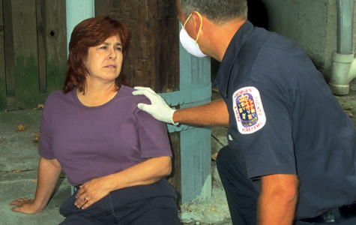
Primary Assessment (2 of 9)
Assess level of responsiveness.
Introduce yourself to establish:
Your reason for being at scene.
Fact that you will be helping patient
Patient’s level of consciousness
Introduce yourself even if patient appears to be unconscious.
Figure 9-4 As you approach the patient, introduce yourself. If a patient appears unconscious, gently touch or shake the patient’s shoulder to get a response
© Jones & Bartlett Learning.
Notes:
C. Assess level of responsiveness.
1. Introduce yourself to establish following:
a. Your reason for being at the scene.
b. Fact that you will be helping patient.
c. Level of consciousness of patient.
2. Introduction should put patient at ease.
3. Ask patient’s name, and then use it when talking with patient, family, or friends.
4. Introduce yourself even if patient appears to be unconscious.
a. Many patients who appear to be unconscious can hear your voice.
b. Call to patient in a tone of voice that is loud enough for patient to hear.
c. If patient does not respond, gently touch patient or shake the patient’s shoulder to see if you can generate a response.
5. Patient’s level of consciousness can range from fully conscious to unconscious.
Figure: As you approach the patient, introduce yourself. If a patient appears unconscious, gently touch or shake the patient’s shoulder to get a response.

Slide 20
Primary Assessment (3 of 9)
Assess level of responsiveness (cont'd).
Use AVPU scale.
Alert
Verbal
Pain
Unresponsive
Notes:
6. Describe the patient’s level of consciousness using the AVPU scale:
a. Alert
i. An “alert and oriented” patient knows his or her name, where he or she is, and the correct date or day of the week.
b. Verbal
i. A patient is “responsive to verbal stimuli” even if he or she reacts only to loud sounds.
c. Pain
i. Response to pain is tested by pinching patient’s earlobe or skin over collarbone.
ii. A patient who withdraws from stimulus is said to be “responsive to painful stimuli.”
d. Unresponsive
i. Patient does not respond to either verbal or painful stimuli.

Slide 21
Primary Assessment (4 of 9)
Perform a rapid exam.
Identify life threats.
Sequence is “ABC” unless suspected cardiac arrest then “CAB.”
Assess airway.
If patient is alert and able to answer questions, airway is open.
In an unconscious patient, you must open airway.
Inspect airway for foreign bodies or secretions.
Clear airway as needed.
You may need to insert an airway adjunct.
Notes:
D. Perform a rapid exam to identify life threats. Sequence is “AB” unless suspected cardiac arrest or arterial external bleeding then do “CAB.”
1. Assess the airway.
a. If patient is alert and able to answer questions without difficulty, airway is open.
b. In an unconscious patient, you must open airway using head tilt–chin lift maneuver for patients with medical problems and jaw-thrust maneuver for patients who have suffered trauma.
c. Inspect airway for foreign bodies or secretions.
d. Clear airway as needed, using finger sweeps or suction.
e. You may need to insert an airway adjunct.

Slide 22
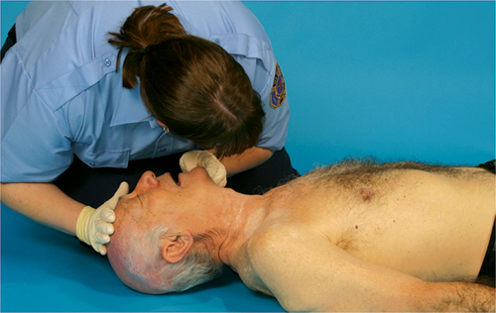
Primary Assessment (5 of 9)
Perform a rapid exam (cont'd):
Assess breathing.
Assess rate and quality of breathing.
If patient is unconscious, use look, listen, and feel approach.
Check for foreign objects and remove them.
If patient is not breathing, open airway and perform rescue breathing.
Figure 9-5 Check the patient’s breathing.
© Jones & Bartlett Learning. Courtesy of MIEMSS.
Notes:
2. Assess breathing.
a. Assess rate and quality of patient’s breathing.
b. If patient is unconscious, use look, listen, and feel approach.
c. If patient is having difficulty breathing or if you hear unusual sounds, check for an object in patient’s mouth and remove it.
d. If you cannot detect any movement of chest and no sounds of air are coming from nose and mouth, breathing is absent.
i. Take immediate steps to open patient’s airway and perform rescue breathing.
ii. If trauma is suspected, protect cervical spine by keeping patient’s head in a neutral position and using jaw-thrust maneuver to open airway.
Figure: Check the patient’s breathing.

Slide 23
Primary Assessment (6 of 9)
Perform a rapid exam (cont'd):
Assess circulation.
If patient is unconscious, check a carotid pulse.
If patient is conscious, assess radial pulse.
Check patient for severe external bleeding.
Assess patient’s skin color and temperature.
Notes:
3. Assess circulation.
a. If patient in unconscious, check a carotid pulse.
i. Place your index and middle fingers together and touch larynx.
ii. Slide your two fingers off larynx toward patient’s ear until you feel a slight notch.
iii. Practice this maneuver until you can find a carotid pulse within 5 seconds of touching larynx.
b. If patient is conscious, assess radial pulse.
i. Place your index and middle fingers on patient’s wrist at thumb side.
c. Quickly check patient for severe external bleeding.
i. If you discover severe bleeding, you must take immediate action to control it by applying direct pressure over wound.

Slide 24
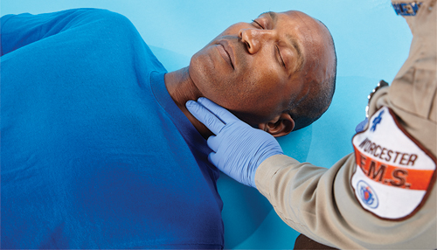
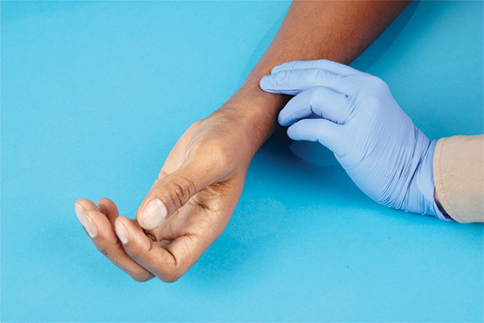
Primary Assessment (7 of 9)
Figure 9-6 Check an unconscious patient’s circulation by checking the carotid pulse.
Figure 9-7 Take the radial pulse if the patient is conscious.
© Jones & Bartlett Learning.
© Jones & Bartlett Learning.
Notes:
Figure: (Left) Check an unconscious patient’s circulation by checking carotid pulse. (Right) Take radial pulse if patient is conscious.

Slide 25
Primary Assessment (8 of 9)
Perform a rapid exam (cont'd):
Descriptions of skin color:
Pale—white or light in color, indicating decreased circulation to that part of body or to all of body.
Flushed—red in color, indicating excess circulation to that part of body.
Blue—cyanotic, indicating lack of oxygen and possible airway problems.
Yellow—also called jaundice, indicating liver problems.
Normal.
Notes:
d. Quickly assess patient’s skin color and temperature. Skin color is described as follows:
i. Pale—white or light color, indicating decreased circulation to that part of body or to all of body.
ii. Flushed—red in color, indicating excess circulation to that part of body.
iii. Blue—also called cyanosis, indicating lack of oxygen and possible airway problems.
iv. Yellow—also called jaundice, indicating liver problems.
v. Normal.

Slide 26
Primary Assessment (9 of 9)
Update responding EMS units.
Elements of report:
Age and sex of patient.
Chief complaint.
Level of responsiveness.
Status of airway, breathing, and circulation.
Try to perform all four steps of primary assessment quickly as you make contact with patient.
Notes:
E. Update responding EMS units.
1. Update responding EMS units about condition of patient.
2. This report should include at least following items:
a. Age and sex of patient.
b. Chief complaint.
c. Level of responsiveness.
d. Status of airway, breathing, and circulation.
3. Try to perform all four steps of primary assessment quickly as you make contact with patient.

Slide 27
History Taking (1 of 4)
Investigate chief complaint.
Do not allow a conscious patient’s comments to distract you.
Purposes of obtaining a history is to:
Gather a systematic account of past medical conditions, illnesses, and injuries.
Determine events leading up to present medical situation.
Determine signs and symptoms of current condition.
Notes:
V. History Taking
A. Investigate chief complaint.
1. It is important to acknowledge patient’s primary or chief complaint and provide reassurance.
2. Do not allow a conscious patient’s comments to distract you from completing assessment sequence.
3. Three purposes of obtaining a medical history are:
a. To gather a systematic account of patient’s past medical conditions, illnesses, and injuries.
b. To determine events leading up to present medical situation.
c. To determine signs and symptoms of current condition.

Slide 28
History Taking (2 of 4)
Investigate chief complaint (cont'd):
Question patient in a clear and systematic manner.
Learn relevant facts, including:
Serious injuries, illnesses, or surgeries.
Prescription medicines.
Over-the-counter (OTC) medicines and herbal medicines.
Allergies to any medicines, foods, or seasonal allergens.
Notes:
4. Question patient in a clear and systematic manner to gain as much information as possible.
5. Learn relevant facts about the patient’s past medical history:
a. Serious injuries, illnesses, or surgeries.
b. Prescription medicines.
c. Over-the-counter (OTC) medicines and herbal medicines.
d. Allergies to any medicines, foods, or seasonal allergens.

Slide 29
History Taking (3 of 4)
Obtain a SAMPLE history.
Provides a framework to ask further questions of patient.
Ask the patient one question at a time.
Listen carefully and use good eye contact.
If patient is unconscious or senile, a family member or friend may be able to help.
Communicate this information to other EMS personnel.
Notes:
B. Obtain SAMPLE history.
1. SAMPLE history provides a framework to ask needed questions of patient.
2. Remember to ask patient one question at a time.
3. Listen carefully and use good eye contact.
a. Signs and symptoms
i. Ask patient which signs and symptoms occurred at beginning of the episode, and which he or she is experiencing now.
ii. If patient is experiencing pain, ask him or her to describe pain.
b. Allergies
i. Ask whether patient is allergic to any medications or foods, or has seasonal allergies.
c. Medications
i. If patient is taking prescription medications, ask patient purpose of these medicines.
ii. Ask if patient is taking OTC supplements or herbal remedies.
d. Pertinent past medical history
i. Ask patient if he or she has any existing medical conditions, serious illnesses, or serious injuries.
ii. Ask patient if he or she has been hospitalized recently.
e. Last oral intake
i. Ask when patient last had something to eat or drink.
f. Events leading up to this illness or injury
i. Ask patient to describe what he or she was doing when symptoms of this event started.
4. If patient is unconscious or senile, a family member, friend, or coworker may be able to answer your questions.
5. Important information can often be found on a medical identification necklace, bracelet, or card.
6. Information you gain needs to be communicated to other EMS personnel to help them in their assessment and treatment of patient.

Slide 30
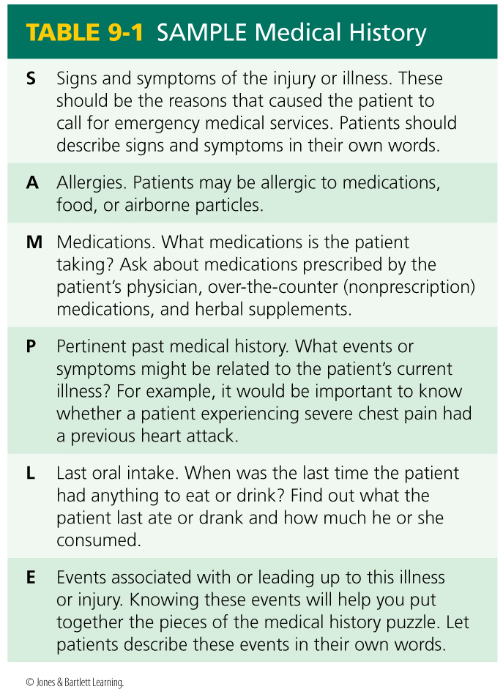
History Taking (4 of 4)
Notes:
Table: SAMPLE Medical History

Slide 31
Secondary Assessment (1 of 12)
Secondary assessment is done to assess non–life-threatening conditions.
Physical examination helps you locate and begin initial management of signs and symptoms of illness or injury.
A sign is something about patient you can see or feel for yourself.
A symptom is something patient tells you about his or her condition.
Notes:
VI. Secondary Assessment
A. Secondary assessment is done to assess non–life-threatening conditions after you have completed primary patient assessment and stabilized life-threatening conditions.
B. Vital signs are taken as part of secondary assessment.
C. Physical examination helps you locate and begin initial management of signs and symptoms of illness or injury.
1. Signs and symptoms
a. A sign is something about patient you can see or feel for yourself.
b. A symptom is something patient tells you about his or her condition.
c. You need to be able to assess selected signs and report them systematically when you transfer patient care.

Slide 32
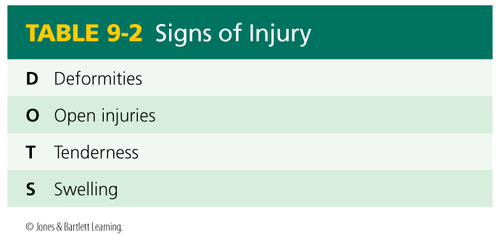
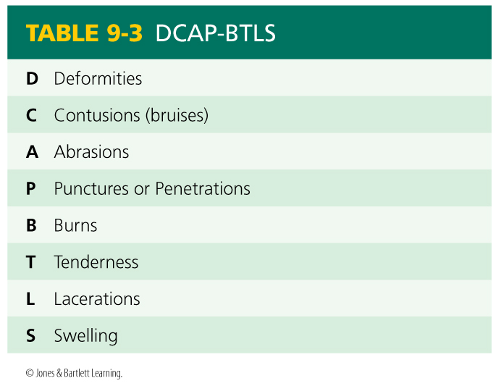
Secondary Assessment (2 of 12)
Notes:
D. Systematically assess the patient.
1. Look and feel for the following signs of injury (use the acronym DOTS):
a. Deformities.
b. Open injuries.
c. Tenderness.
d. Swelling.
2. Some EMS providers find it helpful to use mnemonic DCAP-BTLS.
a. Deformities.
b. Contusions.
c. Abrasions.
d. Punctures or Penetrations.
e. Burns.
f. Tenderness.
g. Lacerations.
h. Swelling.
Table (left): Signs of Injury
Table (right): DCAP-BTLS

Slide 33
Secondary Assessment (3 of 12)
Secondary assessment of entire body
Can be done whether patient is conscious or unconscious.
Assume that all unconscious, injured patients have spinal injuries.
Stabilize head and spine to minimize movement during patient examination.
Follow steps in Skill Drill 9-1 to perform a secondary assessment.
Notes:
E. Secondary assessment of entire body:
1. Conduct a thorough, hands-on, full-body assessment in a logical, head-to-toe, systematic manner.
2. Use a clear, concise format to communicate your findings to other medical personnel.
3. The full-body assessment can be done whether patient is conscious or unconscious.
4. Assume that all unconscious, injured patients have spinal injuries.
a. Stabilize head and spine to minimize movement during patient examination.
b. Immobilize all injured, unconscious patients on a backboard before transporting them.
5. Follow steps in Skill Drill 9-1 to perform a secondary assessment.
a. Assess head.
b. Assess eyes.
c. Assess nose.
d. Assess mouth.
e. Check for unusual breath odors.
f. Assess neck and face.
g. Assess work of breathing.
h. Assess chest for injury.
i. Assess abdomen.
j. Assess pelvis.
k. Assess back.
l. Assess extremities.

Slide 34
Secondary Assessment (4 of 12)
Exam of a specific area of body:
Performed on patients who have sustained nonsignificant MOIs or on responsive medical patients
Based on chief complaint – may focus on body system (ie, medical complaint of chest pain: focus on cardiovascular system)
Focuses your attention on immediate problem.
Notes:
F. Exam of a specific area of the body:
1. An exam of a specific area of body is generally performed on patients who have sustained nonsignificant MOIs and on responsive medical patients.
2. This type of examination is based on chief complaint. May focus on body system (cardiovascular, respiratory, GI/GU, reproductive, nervous, etc.)
3. The goal of exam of a specific area of the body is to focus your attention on immediate problem.

Slide 35
Secondary Assessment (5 of 12)
Assess vital signs.
Respiration
Normal adult resting respiratory rate is 12 to 20 breaths per minute.
Count patient’s breath for 1 minute.
Check breathing rate and quality.
Pulse
Indicates speed and force of heartbeat.
Take radial pulse of a conscious patient.
Notes:
G. Assess vital signs.
1. Respiration
a. Respiratory rate indicates how fast patient is breathing.
b. Normal adult resting respiratory rate is 12 to 20 breaths per minute.
c. One cycle of inhaling (breathing in) and exhaling (breathing out) is counted as one breath (respiration).
d. Count patient’s breaths for 1 minute to determine respiratory rate.
e. Check breathing rate and quality.
i. Is it rapid and shallow or slow?
ii. Is it deep, wheezing, gasping, panting, snoring, noisy, or labored?
iii. If the patient is not breathing, respiration is described as “absent.”
2. Pulse
a. Pulse indicates speed and force of heartbeat.
b. A pulse can be felt anywhere on the body where an artery passes over a hard structure such as a bone.
c. Four most common pulse points:
i. Radial (wrist)
ii. Carotid (neck)
iii. Brachial (arm)
iv. Posterior tibial (ankle)
d. Take radial pulse of a conscious patient.

Slide 36
Secondary Assessment (6 of 12)
Assess vital signs (cont'd):
Pulse (cont'd)
Take carotid pulse of an unconscious patient.
When examining an infant, use brachial pulse.
In a normal adult, resting pulse rate is 60 to 100 beats per minute.
Athletic adults could be 40 to 60 resting.
Determine rhythm and quality.
Capillary refill
Ability of circulatory system to return blood to capillary vessels.
Notes:
e. Take carotid pulse of an unconscious patient.
f. When examining an infant, use brachial pulse.
g. To determine pulse rate (heartbeats per minute), find patient’s pulse with your fingers, count beats for 30 seconds, and multiply by 2.
i. In a normal adult, resting pulse rate is 60 to 100 beats per minute.
ii. In children, pulse rate is normally faster (70 to 150 beats per minute).
iii. Athletic adults could have a resting heartbeat of 40 to 60 beats per minute.
h. You should be able to determine rhythm and describe the quality of pulse.
i. Note whether the pulse is regular or irregular.
ii. A strong pulse is referred to as a bounding pulse.
iii. A weak pulse is called a thready pulse.
3. Capillary refill
a. Capillary refill is ability of the circulatory system to return blood to capillary vessels after blood has been squeezed out.
b. It is checked on patient’s fingernails or toenails.

Slide 37
Secondary Assessment (7 of 12)
Assess vital signs (cont'd):
Capillary refill (cont'd)
Squeeze patient’s nail bed firmly between your thumb and forefinger until nail bed looks pale.
Release pressure and count 2 seconds.
Patient’s nail bed should return to pink in this time, indicating a normal capillary refill.
Notes:
c. To perform this test
i. Squeeze patient’s nail bed firmly between your thumb and forefinger until nail bed looks pale.
ii. Release pressure and count 2 seconds.
iii. Patient’s nail bed should return to pink in this time, indicating a normal capillary refill.
d. Capillary refill will be delayed or entirely absent if:
i. Patient has lost a lot of blood and is in shock.
ii. Blood vessels supplying that limb have been damaged.
iii. You are in a cold environment.

Slide 38
Secondary Assessment (8 of 12)
Assess vital signs (cont'd):
Blood pressure (BP)
Systolic pressure is force exerted on walls of arteries as heart contracts.
Diastolic pressure is arterial pressure during relaxation phase of heart.
Hypertension exists when BP remains greater than 130/90 mm Hg.
Check BP by palpation (feeling) or auscultation (listening).
Notes:
4. Blood pressure (BP)
a. High blood pressure (hypertension) may indicate that patient is susceptible to a stroke.
b. Low blood pressure (hypotension) generally indicates presence of shock.
c. BP measurement consists of a reading of two numbers, which represent pressures found in arteries as heart contracts and relaxes.
i. High number (systolic pressure) is the force exerted on walls of the arteries as heart contracts.
ii. Lower number (diastolic pressure) is arterial pressure during the relaxation phase of heart.
d. Normal blood pressure
i. Hypertension exists when BP remains greater than 130/90 mm Hg after repeated examinations over several weeks.
ii. Hypotension exists when systolic pressure falls to 90 mm Hg or less.
e. Checking BP by palpation.
i. Apply BP cuff to uninjured arm.
ii. Wrap cuff around upper arm.
iii. Bottom of cuff should be 1" to 2" above crease of elbow.
iv. Be sure to use appropriate size cuff for patient, such as a narrow cuff for a child and an extra-large cuff for an obese adult.
v. Turn control knob on BP inflator bulb clockwise to close valve.
vi. With fingers of your other hand, locate radial pulse at patient’s wrist.
vii. Slowly pump up BP cuff until you can no longer feel radial pulse.
viii. Continue to pump up cuff for another 30 mm and then slowly release pressure in the cuff.
ix. When you first feel pulse return, note needle on dial—this is systolic pressure.
x. Palpation method does not give you a diastolic pressure.
f. Checking BP by auscultation
i. Apply BP cuff in same manner and position as in palpation method.
ii. After you apply cuff, locate brachial artery pulse on medial side of arm at the crease of elbow.
iii. Put earpieces of stethoscope in your ears and place diaphragm of stethoscope over the site of brachial pulse.
iv. When you can no longer hear sound of brachial pulse, note pressure on dial.
v. Continue to inflate cuff for another 30 mm, and then slowly and smoothly release air from cuff.
vi. Carefully watch the indicator needle and listen for the pulse to return—this is the systolic pressure.
vii. As cuff pressure continues to fall, listen for moment when pulse disappears—this is diastolic pressure.
viii. BP taken by auscultation is reported as systolic pressure over diastolic pressure and is always given in even numbers.

Slide 39
Secondary Assessment (9 of 12)
Assess vital signs (cont'd):
Skin condition
Check for skin color, temperature, and moisture.
Normal body temperature is 98.6°F (37°C).
Normal skin conditions are described as warm, pink, and dry.
Pupil size and reactivity.
Examine each eye to detect signs of head injury, stroke, or drug overdose.
Notes:
5. Skin condition
a. Check for color, temperature, and moisture.
b. Normal body temperature is about 98.6°F (37°C).
i. You can estimate a patient’s body temperature by placing back of your hand on patient’s forehead.
c. Some illnesses can cause the skin to become excessively moist or excessively dry.
d. Possible descriptions of patient’s skin:
i. Hot and dry
ii. Hot and moist
iii. Cold and dry
iv. Cold and moist
e. Normal skin conditions are described as warm, pink, and dry.
6. Pupil size and reactivity
a. It is important to examine each eye to detect signs of head injury, stroke, or drug overdose.

Slide 40
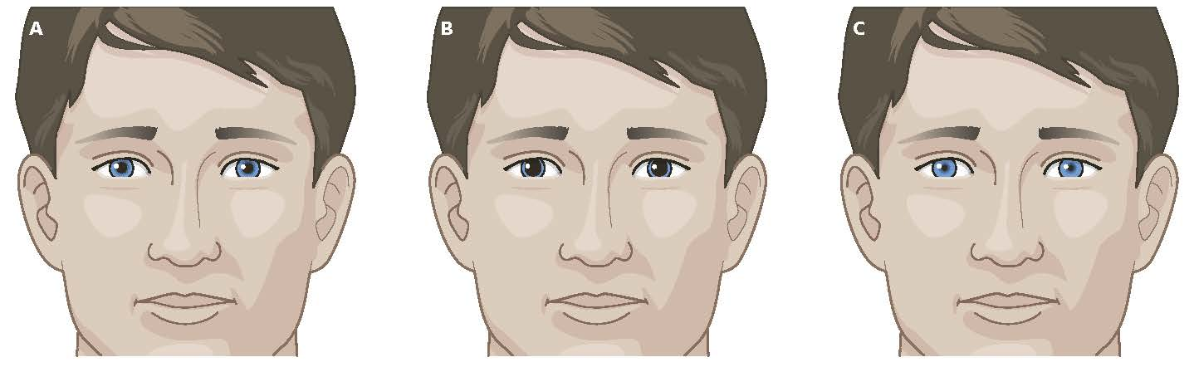
Secondary Assessment (10 of 12)
Assess vital signs; (cont'd)
Pupil size and reactivity (cont'd)
Determine whether pupils are of equal size and whether both react when light is shone into them.
FIGURE 9-18 Normal pupils (A), dilated pupuls (B), and constricted pupils (C).
© Jones & Bartlett Learning.
Notes:
b. Determine whether the pupils are of equal size and whether both react (contract) when light is shone into them.
Figure: Normal pupils (Left), dilated pupils (Center), and constricted pupils (Right)
.

Slide 41
Secondary Assessment (11 of 12)
Assess vital signs (cont'd):
Pupil size and reactivity (cont'd)
Pupils of unequal size can indicate a stroke or injury to brain.
Pupils may remain constricted in a person who is taking narcotics.
Dilated pupils indicate a relaxed or unconscious state.
Notes:
c. Abnormal findings:
i. Pupils of unequal size can indicate a stroke or injury to brain.
ii. Pupils that remain constricted are often present in a person who is taking narcotics.
iii. Pupils that remain dilated (enlarged) indicate a relaxed or unconscious state.

Slide 42
Secondary Assessment (12 of 12)
Assess vital signs (cont'd):
Level of responsiveness
Observe and note any changes that occur between time of your arrival and time you turn over patient’s care to higher-level personnel.
Use AVPU scale.
Notes:
7. Level of responsiveness
a. Observe and note any changes that occur between time of your arrival and time you turn over patient’s care to higher-level personnel.
b. Use AVPU scale to determine level of responsiveness.
H. Signs review
1. Signs are indicators of illness or injury that you can observe in a patient.
2. Vital signs include patient’s:
a. Respirations.
b. Pulse.
c. Capillary refill.
d. Blood pressure.
e. Skin condition.
f. Temperature.
g. Pupil size and reaction.
h. Level of consciousness.

Slide 43
Reassessment (1 of 4)
If you need to continue to care for patient, some parts of the patient assessment need to be repeated.
Repeat the primary assessment.
Recheck the patient’s level of responsiveness and ABCs.
Continue to maintain an open airway and to monitor breathing and pulse for rate and quality.
Notes:
VII. Reassessment
A. If you need to continue to care for patient, it is necessary to regularly repeat some parts of patient assessment—this is process of reassessment.
B. Repeat primary assessment.
1. Recheck patient’s level of responsiveness, and recheck patient’s airway, breathing, and circulation.
2. Continue to maintain an open airway and to monitor breathing and pulse for rate and quality.

Slide 44
Reassessment (2 of 4)
Reassess vital signs.
Observe patient’s skin color and temperature.
Reassess patient’s BP.
Reassess chief complaint.
Recheck effectiveness of treatment.
If patient’s status changes, determine whether you need to alter your care.
Notes:
C. Reassess vital signs.
1. Observe the patient’s skin color and temperature.
2. Reassess patient’s BP.
D. Reassess chief complaint.
1. Reassess chief complaint to see if there has been any change.
E. Recheck effectiveness of treatment.
1. Check whether interventions you took were effective.
2. If there is a change, determine whether you need to alter your care of patient.

Slide 45
Reassessment (3 of 4)
Identify and treat changes in patient’s condition.
Reassess patient.
Reassess a stable patient every 15 minutes.
If patient is unstable, repeat the reassessment every 5 minutes.
Notes:
F. Identify and treat changes in patient’s condition.
1. Identify and treat changes you have noticed in patient’s condition.
G. Reassess patient.
1. Reassess a stable patient every 15 minutes.
2. If patient is unstable, repeat the reassessment every 5 minutes.

Slide 46
Reassessment (4 of 4)
Provide a hand-off report, including:
Age and sex of patient.
History of incident.
Patient’s chief complaint.
Patient’s level of responsiveness.
How you found patient.
Status of vital signs.
Results of secondary patient assessment.
Any pertinent medical conditions (using the SAMPLE format).
Any interventions provided and how the patient responded.
Notes:
H. Provide a hand-off report.
1. Describe your findings concisely and accurately to EMS personnel who take over care of your patients in a hand-off report.
a. Provide age and sex of patient.
b. Describe history of incident.
c. Describe patient’s primary or chief complaint.
d. Describe patient’s level of responsiveness.
e. Describe how you found patient.
f. Report on status of vital signs: airway, breathing, and circulation (including severe bleeding).
g. Describe results of secondary patient assessment.
h. Report any pertinent medical conditions using SAMPLE format.
i. Report interventions provided and how patient responded.
2. Examine every patient involved in an incident before you begin major treatment of any single patient.
a. Exceptions to this rule are patients with airway, breathing, and circulatory problems (severe bleeding or shock).
b. These problems must be treated as you encounter them during patient assessment.

Slide 47
A Word About Medical and Trauma Patients (1 of 2)
Patients can generally be classified into two main categories:
Those who have a sudden illness.
Those who sustain trauma.
Patient assessment sequence can be used to examine patients who have experienced illnesses, trauma, or both.
Notes:
VIII. A Word About Medical and Trauma Patients
A. Patients can generally be classified into two main categories:
1. Those who have a sudden illness:
a. Heart attacks.
b. Strokes.
c. Asthma.
d. Gallbladder problems.
2. Those who sustain trauma:
a. Falls.
b. Motor vehicle crashes.
c. Sports-related injuries.
B. Patient assessment sequence can be used to examine patients who have experienced illnesses, trauma, or both.

Slide 48
A Word About Medical and Trauma Patients (2 of 2)
When examining medical patients, follow basic assessment sequence.
When caring for a trauma patient, perform secondary assessment before taking medical history.
Always avoid jumping to conclusions.
Notes:
1. When examining medical patients, follow the basic sequence:
a. Complete a scene size-up.
b. Perform a primary assessment.
c. Obtain the patient’s medical history (SAMPLE).
d. Perform a secondary assessment.
e. Perform reassessment.
2. When caring for a trauma patient, modify preceding sequence slightly.
a. Perform the secondary assessment before taking patient’s medical history.
C. Although it is often helpful to consider whether patient’s problem is caused by trauma or sudden illness, avoid jumping to conclusions.
1. Most important factor to remember is to follow a system of patient assessment that will gather all information needed.

Slide 49
Summary (1 of 4)
A complete patient assessment consists of five steps:
Perform a scene size-up,
Perform a primary assessment,
Obtain a patient’s medical history,
Perform a secondary assessment, and
Provide reassessment.
Scene size-up is a general overview of incident and its surroundings.
Notes:
IX. Summary
A. A complete patient assessment consists of five steps: perform a scene size-up, perform a primary assessment, obtain a patient’s medical history, perform a secondary assessment, and provide reassessment.
B. Scene size-up is a general overview of incident and its surroundings. On basis of this information, you can make decisions about safety of scene, type of incident, mechanism of injury or illness, number of patients, and need for additional resources.

Slide 50
Summary (2 of 4)
During primary assessment, determine and correct any life-threatening conditions.
Steps of primary assessment are to:
Form a general impression of patient
Assess responsiveness
Perform a rapid scan that consists of checking and correcting problems with patient’s airway, breathing, and circulation.
Finally, update responding EMS units
Notes:
C. During primary assessment, determine and correct any life-threatening conditions. Steps of primary assessment are to form a general impression of patient, assess responsiveness, and perform a rapid scan that consists of checking and correcting problems with patient’s airway, breathing, and circulation. Finally, update responding EMS units.

Slide 51
Summary (3 of 4)
A medical history provides a systematic account of patient’s past medical conditions, illnesses, and injuries to determine signs and symptoms of current condition.
Secondary assessment of patient consists of a secondary assessment of entire body used to assess non–life-threatening conditions.
Notes:
D. Purpose of obtaining a medical history is to gather a systematic account of patient’s past medical conditions, illnesses, and injuries to determine signs and symptoms attributable to current condition. SAMPLE history provides a framework to ask further questions of patient.
E. Secondary assessment of patient consists of a secondary assessment of entire body used to assess non–life-threatening conditions. It is done only after completing primary assessment and stabilizing any life-threatening conditions. This assessment helps you locate and begin management of signs and symptoms of illness or injury. After completing secondary assessment of entire body, assess patient’s vital signs.

Slide 52
Summary (4 of 4)
If patient is stable, repeat vital signs every 15 minutes. If patient is unstable, repeat the vital signs every 5 minutes.
Provide a concise and accurate hand-off report to EMS personnel.
Notes:
F. Watch all patients carefully for changes in their status. If patient is stable, repeat the vital signs every 15 minutes. If patient is unstable, repeat vital signs every 5 minutes. If patient’s condition changes, repeat primary assessment and identify any changes in patient’s condition.
G. Provide a concise and accurate hand-off report to EMS personnel.
H. Patients can generally be classified into two main categories: medical and trauma. When examining medical patients, follow patient assessment sequence:
1. Size-up the scene.
2. Perform a primary assessment.
3. Obtain the patient’s medical history using SAMPLE format.
4. Perform a secondary assessment. Examine patient from head to toe and assess vital signs.
5. Provide ongoing reassessment.
I. When examining trauma patients, perform secondary assessment before obtaining patient’s medical history.

Slide 53
Review
Which of the following steps might be performed during the scene size-up?
Assessing vital signs using appropriate monitoring devices.
Forming a general impression of patient.
Notifying dispatch to send fire personnel.
Performing a full-body scan.

Slide 54
Review
Answer:
C. Notifying dispatch to send fire personnel.

Slide 55
Review
The goal of primary assessment is to:
quickly diagnose the patient’s condition.
determine need to perform a full-body assessment.
determine number of patients.
identify and treat life threats.

Slide 56
Review
Answer:
D. identify and treat life threats.

Slide 57
Review
After performing a primary assessment and treating any immediate life threats, you should next:
determine priority of patient care and transport.
reassess patient.
recheck your interventions.
promptly transport patient to closest hospital.

Slide 58
Review
Answer:
A. determine priority of patient care and transport.

