Slide 1
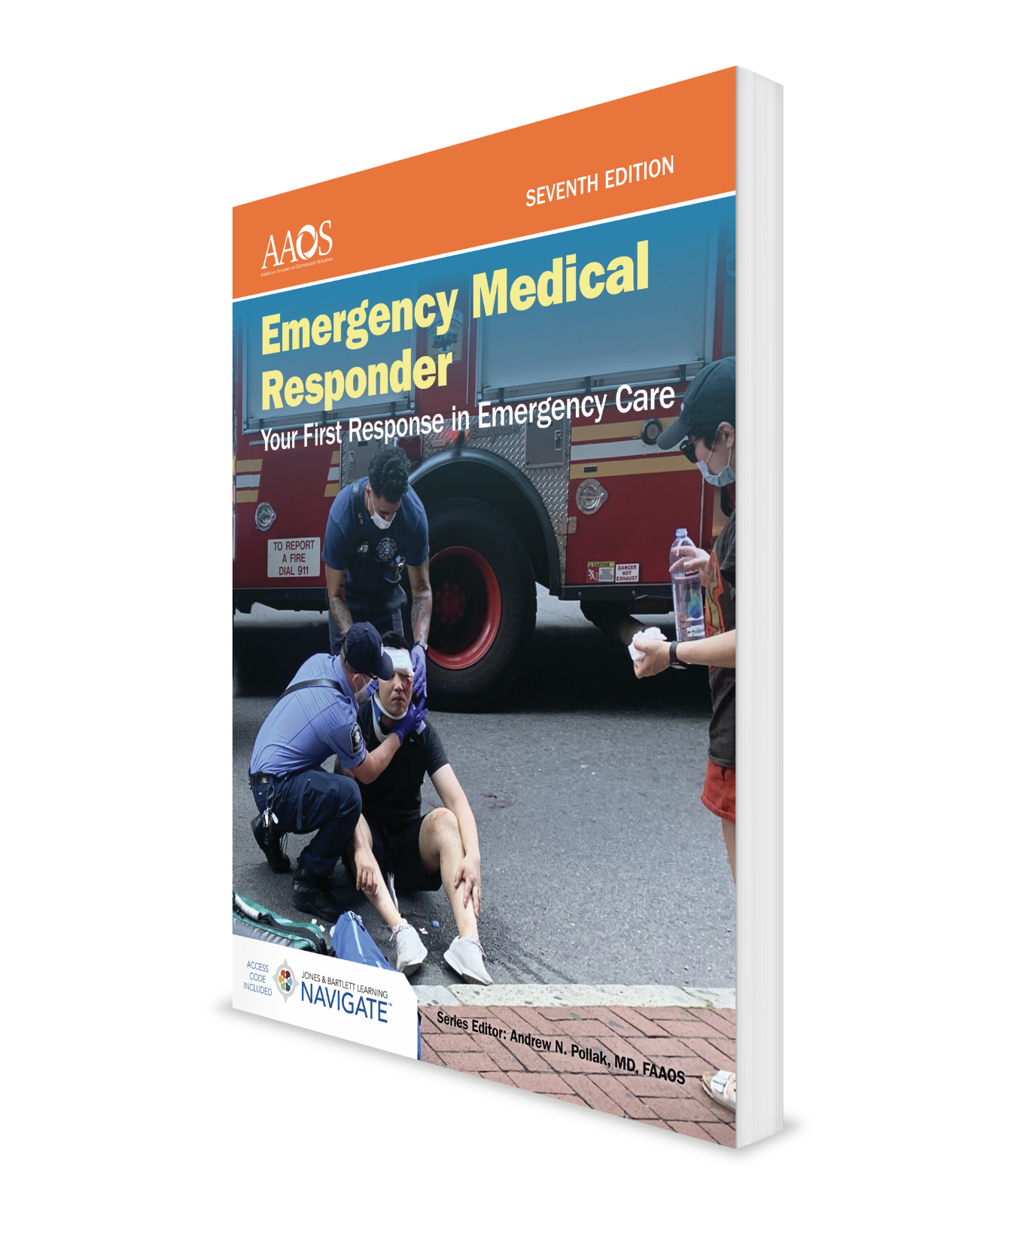
Patient Assessment
CHAPTER 9

Slide 2
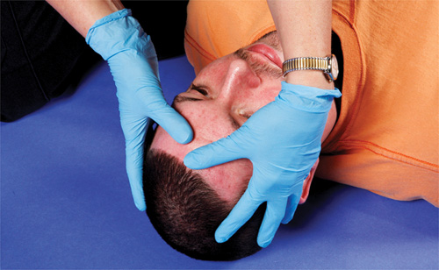
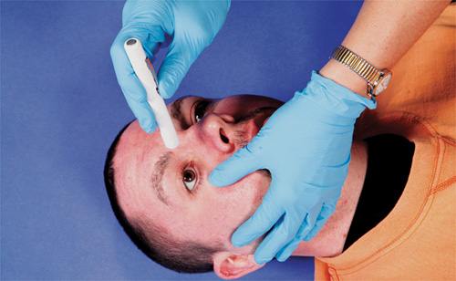
Skill Drill 9-1 Performing a Secondary Assessment (1-6)
Step 1 Assess the head. Use both hands to thoroughly examine all areas of the scalp. Do not move the patient’s head! This precaution is especially important if the patient is unconscious or has sustained a spinal injury. Injuries to the head tend to bleed excessively. Be sure to find the actual wound; do not be fooled by areas of matted, bloody hair. If necessary, remove the patient’s eyeglasses and put them in a safe place. Many patients who need eyeglasses become upset if their eyeglasses are taken away. Use your judgment in each case. Be considerate of the patient. If the patient is wearing a wig, it may be necessary to remove the hairpiece to complete the head examination. Be sure to check the entire head for bumps, areas of tenderness, and bleeding.
Step 2 Assess the eyes. Cover one of the patient’s eyes for 5 seconds. Then quickly open the eyelid and watch the pupil, the dark part at the center of the eye. The normal reaction of the pupil is to constrict (get smaller) within about 1 second. If you are examining a patient’s eyes at night or in the dark, use a flashlight and aim the light at the closed eye. A pupil that fails to react to light or pupils that are unequal in size may be important diagnostic signs; report this information to personnel at the next level of medical care.
© Jones & Bartlett Learning. Courtesy of MIEMSS.
© Jones & Bartlett Learning. Courtesy of MIEMSS.

Slide 3
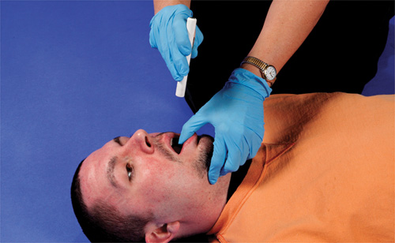
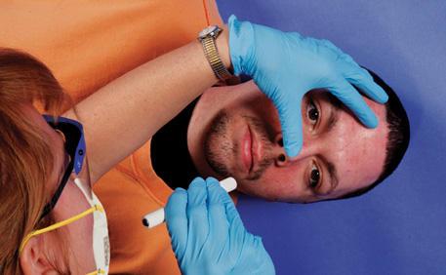
Skill Drill 9-1 Performing a Secondary Assessment (2-6)
Step 3 Assess the nose. Assess the nose for tenderness or deformity, which may indicate a broken nose. Check to see if there is any blood or fluid coming from the nose.
Step 4 Assess the mouth. Your first assessment of the mouth should have taken place when you checked to see whether the patient was breathing. Now recheck the mouth for foreign objects such as food, vomitus, dentures, gum, chewing tobacco, and loose teeth. Be sure to carefully clear away any material that obstructs the patient’s airway. In addition, be ready to manage any vomiting. It is important to prevent aspiration (inhalation) of vomitus into the lungs.
© Jones & Bartlett Learning. Courtesy of MIEMSS.
© Jones & Bartlett Learning. Courtesy of MIEMSS.

Slide 4
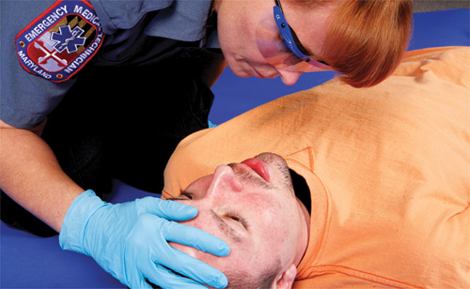
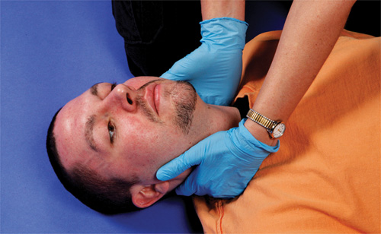
Skill Drill 9-1 Performing a Secondary Assessment (3-6)
Step 5 Check for unusual breath odors. Use your sense of smell to aid in the assessment. A patient who has diabetes may have a fruity breath odor. Do not allow the presence of alcohol on the patient’s breath to change the way you treat the patient. In fact, if you detect the smell of alcohol, you should conduct an especially careful physical examination, particularly if the patient appears to be severely injured. Consider skipping this step of the assessment in the face of known community transmission of a dangerous viral illness via the airborne route. In such a context, the risk to the provider clearly outweighs the advantage to patient care associated with gaining additional information about the patient’s condition. Remember to place any unconscious patient who has not sustained trauma in the recovery position. This position helps keep the patient’s airway open and prevents aspiration of vomitus into the airway or lungs.
Step 6 Assess the neck and face. Assess the neck carefully using both hands, one on each side of the patient’s neck. Be sure to touch the vertebrae (the bony part of the back of the neck) to see whether gentle pressure produces pain. Check the neck veins. Swollen (distended) neck veins may indicate heart conditions or major trauma to the chest. Examine the neck for a stoma (opening), which indicates that the patient is a neck breather. A neck breather is a person who has undergone a surgical procedure in which the airway above the stoma has been removed. The stoma may be the patient’s only means of breathing, and the patient may not be able to speak normally. The stoma is often concealed behind an article of clothing or a bib. While you are performing the hands-on assessment of the head and neck, be sure to note the color of the facial skin, its temperature, and whether it is moist or dry (TABLE 9-4). After you have completed the head examination, be sure to note any bumps, bruises, cuts, or other abnormalities.
© Jones & Bartlett Learning. Courtesy of MIEMSS.
© Jones & Bartlett Learning. Courtesy of MIEMSS.

Slide 5
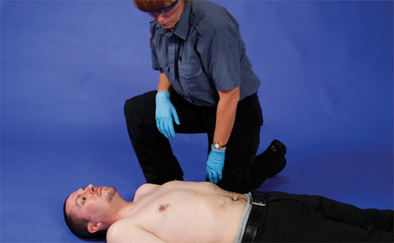
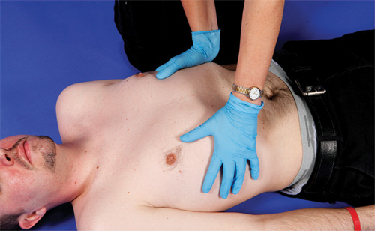
Skill Drill 9-1 Performing a Secondary Assessment (4-6)
Step 7 Assess the work of breathing. If the patient is conscious, ask him or her to take a deep breath and tell you whether he or she feels any pain on inhalation or exhalation. Note whether the patient breathes with difficulty.
Step 8 Assess the chest for injury. Look and listen for signs of difficult breathing such as coughing, wheezing, or foaming at the mouth. It is important to look at both sides of the chest completely, noting any injuries, bleeding, or sections of the chest that move abnormally, unequally, or painfully. Unequal motion of one side or section of the chest may be a sign of a serious condition, called a flail chest, which can result from multiple rib fractures (breaks). Be sure to run your hands over all parts of the chest. Like the head and neck examinations, try to move the patient as little as possible while you assess the chest. Apply firm but gentle pressure to the collarbone (clavicle) to check for fractures. Check the chest for fractured ribs by placing your hands on the chest and pushing down gently but firmly. Then put your hands on each side of the chest and push inward, gently squeezing the chest.
© Jones & Bartlett Learning. Courtesy of MIEMSS.
© Jones & Bartlett Learning. Courtesy of MIEMSS.

Slide 6
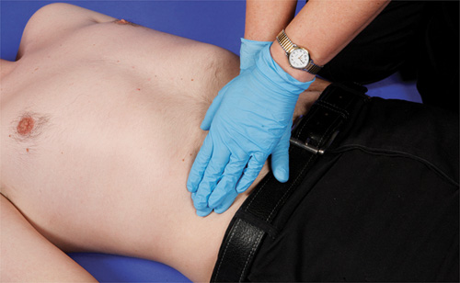
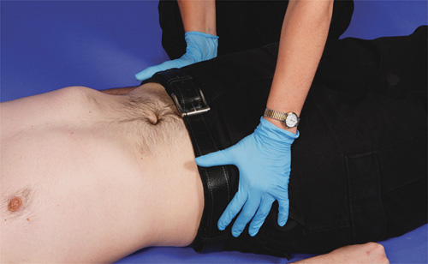
Skill Drill 9-1 Performing a Secondary Assessment (5-6)
Step 9 Assess the abdomen. Continue your assessment downward to the abdomen (stomach and groin). Look for any signs of external bleeding, penetrating injuries, or protruding parts, such as intestines. Ask the patient to relax the stomach muscles and observe whether the stomach remains rigid. Rigidity is often a sign of abdominal injury. Swelling is also a sign of abdominal injury. Note whether the clothing has been soiled with urine or feces. This finding may be an important diagnostic sign for certain illnesses or injuries, such as stroke. Make sure you check the genital area for external injuries. Although both the patient and you may be socially uncomfortable during this examination, it must be done if there is any suspicion of injury.
Step 10 Assess the pelvis. Next, check for fractures of the pelvis. First check for signs of obvious bruising, bleeding, or swelling. If no pain is reported by the patient, then gently press on the pelvic bones. If the patient reports pain or tenderness or if you note any movement, a severe injury may be present in this region.
© Jones & Bartlett Learning. Courtesy of MIEMSS.
© Jones & Bartlett Learning. Courtesy of MIEMSS.

Slide 7
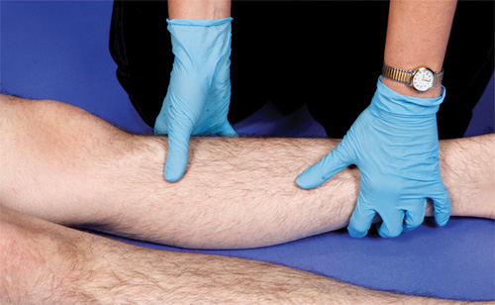
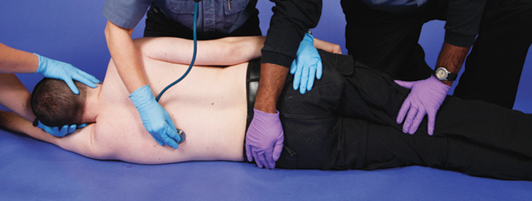
Skill Drill 9-1 Performing a Secondary Assessment (6-6)
Step 11 Assess the back. The patient’s back should be checked one side of the back at a time. Use one hand to gently lift the patient’s shoulder and then, using your other hand, slide it down the patient’s back as you inspect the surface. In cases where a patient has been injured, move the patient as a unit, taking care to support the head and spine to keep them in proper alignment. Continue to stabilize the head and neck to prevent movement while you examine the patient. As you check each side of the back, be sure that your hands go all the way to the midline of the patient’s body so you can feel the spinal column. Check one-half the back from one side, then switch sides and check the other side in the same manner. This ensures that no part of the back is missed during the examination. If the patient is lying on his or her side or stomach, it will be much easier to examine the patient’s back. If the patient must be rolled onto a backboard, you can examine the patient’s back while the patient is on his or her side. Do not wait for a backboard if this will delay your examination of the patient.
Step 12 Assess the extremities. Do a systematic assessment of each extremity to determine whether there are any injuries. This examination consists of the following five steps:
Observe the extremity to determine whether there is any visible injury. Look for bleeding and deformity.
Examine for tenderness in each extremity by encircling it with both hands and gently, but firmly, squeezing each part of the limb. Watch the patient’s face and listen to see if the patient shows any signs of pain.
Ask the patient to move the extremity. Check for normal movement. Determine whether there is any pain when the patient moves the extremity.
Check for sensation by touching the bare skin of each ex-tremity. See if the patient can feel your touch.
Assess the circulatory status of each extremity by checking for the presence of a distal pulse in that extremity and by checking for capillary refill (discussed later in this chapter).
© Jones & Bartlett Learning. Courtesy of MIEMSS.
© Jones & Bartlett Learning. Courtesy of MIEMSS.

