Slide 1
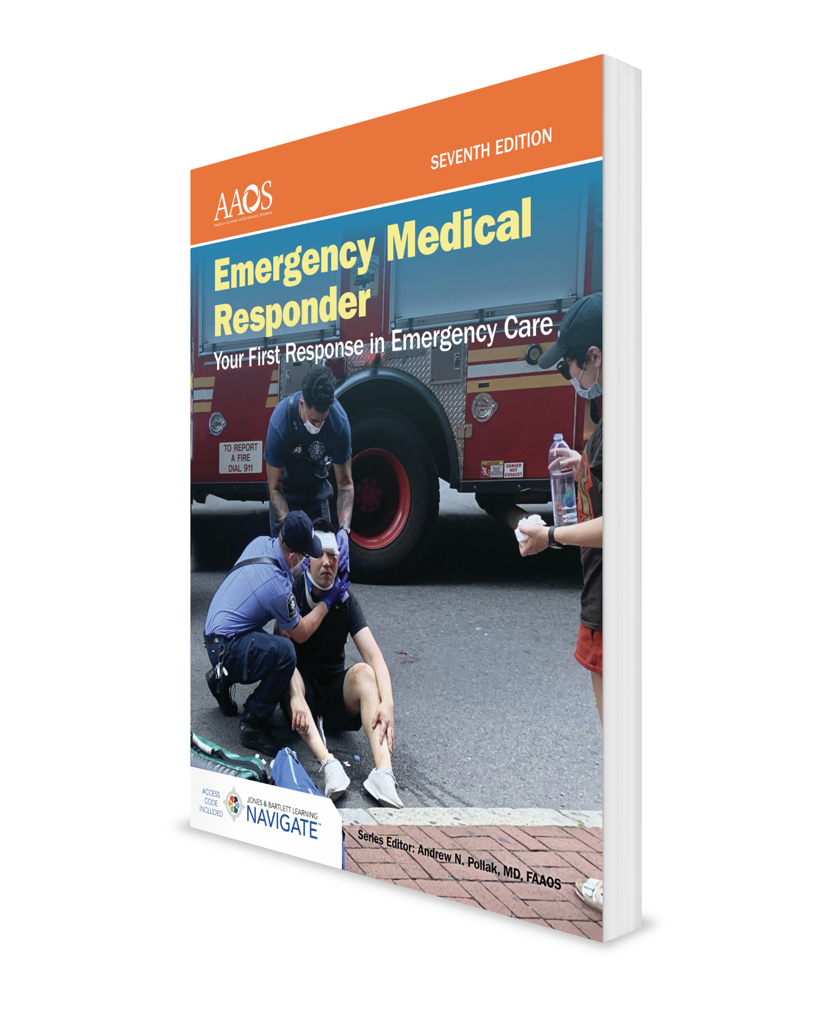
Workplace Safety and Wellness
CHAPTER 2

Slide 2
National EMS Education Standard Competencies (1 of 4)
Preparatory
Uses simple knowledge of the emergency medical services (EMS) system, safety/well-being of the emergency medical responder (EMR), and medical/legal issues at scene of an emergency while awaiting a higher level of care.
Notes:
Preparatory
Uses simple knowledge of the emergency medical services (EMS) system, safety/well-being of the emergency medical responder (EMR), and medical/legal issues at scene of an emergency while awaiting a higher level of care.

Slide 3
National EMS Education Standard Competencies (2 of 4)
Workforce Safety and Wellness
Standard safety precautions
Personal protective equipment
Stress management
Dealing with death and dying
Crew resource management
Prevention of work-related injuries and illnesses
Notes:
Workforce Safety and Wellness
• Standard safety precautions (pp 23-29)
• Personal protective equipment (pp 24-25)
• Stress management (pp 19-21)
• Dealing with death and dying (p 18)
• Crew resource management (pp 22-23)
• Prevention of work-related injuries and illnesses (pp 25-29)

Slide 4
National EMS Education Standard Competencies (3 of 4)
Medicine
Recognizes and manages life threats based on assessment findings of a patient with a medical emergency while awaiting additional emergency response.
Notes:
Medicine
Recognizes and manages life threats based on assessment findings of a patient with a medical emergency while awaiting additional emergency response.

Slide 5
National EMS Education Standard Competencies (4 of 4)
Infectious Diseases
Awareness of
A patient who may have an infectious disease
How to decontaminate equipment after treating a patient
Notes:
Infectious Diseases
Awareness of
• A patient who may have an infectious disease (pp 23-26)
• How to decontaminate equipment after treating a patient (p 29)

Slide 6
Introduction
You, your patients, and their families can experience various degrees of stress and grief during and following a medical emergency.
To fulfill your duties as an EMR, you need to be in good physical condition.
You should have a complete physical exam to ensure that you are healthy enough to do your job.
Notes:
I. Introduction
A. You, your patients, and their families can experience various degrees of stress and grief during and following a medical emergency.
B. To fulfill your duties as an EMR, you need to be in good physical condition.
1. As a new EMR, you should have a complete physical exam to ensure that you are healthy enough to do your job.

Slide 7
Emotional Aspects of Emergency Medical Care (1 of 3)
You must learn how to avoid unnecessary stress and how to prevent your stress level from getting too high.
Most-stressful calls include:
A patient who reminds you of a close family member
Very young or very old patients
Critical patients
Death
Notes:
II. Emotional Aspects of Emergency Medical Care
A. Providing emergency medical care as an EMR is stressful.
1. You must learn how to avoid unnecessary stress and how to prevent your stress level from getting too high.
2. Some calls are more stressful than others, including:
a. A patient who reminds you of a close family member
b. Very young or very old patients
c. Critical patients
d. Death

Slide 8
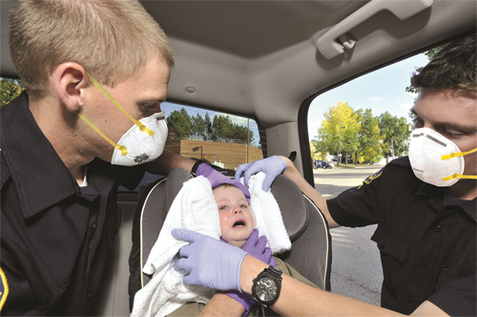
Emotional Aspects of Emergency Medical Care (2 of 3)
The most stressful calls include (cont’d):
Unusual danger
Violence
Unusual sights, smells, or sounds
Mass casualties
Figure 2-1 Certain kinds of patients may produce a high level of stress.
© Kevin Link / Science Source
Notes:
e. Unusual danger
f. Violence
g. Unusual sights, smells, or sounds
h. Mass casualties
Figure: Certain kinds of patients may produce a high level of stress

Slide 9
Emotional Aspects of Emergency Medical Care (3 of 3)
You must make a conscious effort to prevent and reduce stress:
Learn to recognize signs and symptoms of stress.
Adjust your lifestyle to include stress-reducing activities.
Learn which services and resources are available to help you.
Grief reaction triggers:
Death of a loved one
Major injury or traumatic experience
Serious illness, drug or alcohol addiction, incarceration
End of a relationship or divorce, major personal rejection
Loss of a job or income
Notes:
3. Because you work in a stressful environment, you must make a conscious effort to prevent and reduce unnecessary stress.
a. Learn to recognize signs and symptoms of stress.
b. Adjust your lifestyle to include stress-reducing activities.
c. Learn which services and resources are available to help you.
4. Grief reaction triggers include:
a. Death of a loved one
b. Major injury or traumatic experience
c. Serious illness
d. Drug or alcohol addiction
e. Incarceration
f. End of a relationship or divorce
g. Major personal rejection
h. Loss of a job or income

Slide 10
Normal Reactions to Stress
Five stages of reaction to death and dying
Denial: Person experiencing denial cannot believe what is happening.
Anger: Normal reaction to stress and will sometimes be directed at you.
Bargaining: Act of trying to make a deal to postpone death and dying.
Depression: Patient is usually silent or seems to retreat into his or her own world.
Acceptance: Patient understands that death and dying cannot be changed.
Notes:
III. Normal Reactions to Stress
A. EMRs need to know how stress can affect them and the people for whom they provide emergency medical care.
1. Because dying is one of the most stressful experiences that people may have, the grief reaction to death and dying provides a basis for looking at stress.
2. Five stages of reaction to death and dying proposed by Dr. Elisabeth Kübler-Ross:
a. Denial (“Not me!”): Person experiencing denial cannot believe what is happening.
b. Anger (“Why me?”): Understanding that anger is a normal reaction to stress should help EMRs deal with anger that is directed at them by a patient or a patient’s family.
c. Bargaining (“Okay, but…”): Bargaining is act of trying to make a deal to postpone death and dying.
d. Depression (“Heavy-hearted”): Person who is unusually silent or who seems to retreat into his or her own world may have reached this stage.
e. Acceptance: Acceptance does not mean that you are satisfied with the situation; it means that you understand that death and dying cannot be changed.

Slide 11
Stress Management (1 of 7)
Recognizing stress
Warning signs to help you recognize stress:
Irritability
Inability to concentrate
Change in normal disposition
Difficulty in sleeping or nightmares
Anxiety
Indecisiveness
Guilt
Notes:
B. Stress management
1. Recognizing stress
a. An important step in managing stress in yourself and others is ability to recognize its signs and symptoms.
b. Once you recognize that stressors are present, you can take steps to prevent or reduce stress.
c. Warning signs to help you recognize stress:
i. Irritability
ii. Inability to concentrate
iii. Change in normal disposition
iv. Difficulty in sleeping or nightmares
v. Anxiety
vi. Indecisiveness
vii. Guilt

Slide 12
Stress Management (2 of 7)
Recognizing stress (cont’d):
Warning signs (cont’d):
Loss of appetite or overeating
Loss of interest in sexual relations
Loss of interest in work
Isolation
Feelings of hopelessness
Alcohol or drug misuse or abuse
Physical symptoms
Notes:
viii. Loss of appetite or overeating
ix. Loss of interest in sexual relations
x. Loss of interest in work
xi. Isolation
xii. Feelings of hopelessness
xiii. Alcohol or drug misuse or abuse
xiv. Physical symptoms

Slide 13

Stress Management (3 of 7)
Preventing stress
Eat: A healthy, well-balanced diet helps prevent and reduce stress.
Figure 2-2 A healthy diet is illustrated by the USDA MyPlate food guidance system.
Courtesy of USDA.
Notes:
C. Preventing stress
1. Three simple-to-remember techniques can help prevent stress.
Eat: A healthy, well-balanced diet helps prevent and reduce stress.
Figure: A healthy diet is illustrated by the USDA MyPlate food guidance system.

Slide 14
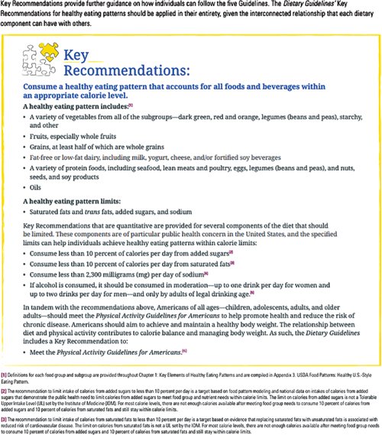
Stress Management (4 of 7)
Figure 2-3 Key Recommendations: Components of Healthy Eating Patterns from the USDA’s 2015–2020 Dietary Guidelines for Americans.
USDA Dietary Guidelines for Americans 2015- 2020, Eight Edition, page 15. Available at https://health.gov/sites/default/files/2019-09/2015-2020_Dietary_Guidelines.pdf
Notes:
Figure: Steps you can take to plan a healthy diet. A healthy, well-balanced diet helps prevent and reduce stress. Healthy eating pattern includes:
A variety of vegetables from all of the subgroups-dark green, red and orange, legumes (beans and peas), starchy, and other.
Fruits, especially whole fruits.
Grains, at least half of which are whole grains.
Fat-free or low-fat dairy, including milk, yogurt, cheese, and/or fortified soy beverages.
A variety of protein foods, including seafood, lean meats and poultry, eggs, legumes (beans and peas), nuts, seeds, and soy products.
Oils

Slide 15
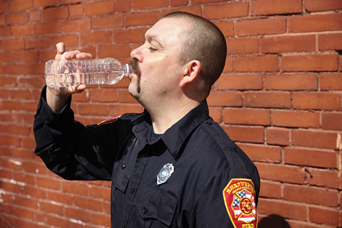
Stress Management (5 of 7)
Preventing stress (cont’d):
Drink: Drink adequate amounts of fluid every day and avoid consuming excessive caffeine and alcohol.
Be merry: Learn to balance your lifestyle.
Figure 2-4 Drinking adequate quantities of water is important.
© Jones & Bartlett Learning.
Notes:
b. Drink: Active EMS providers need to drink adequate amounts of fluid every day and avoid consuming excessive caffeine and alcohol.
c. Be merry: When a person is happy, he or she generally is not experiencing an elevated level of stress; therefore, it is important to learn to balance your lifestyle.
Figure: Drinking adequate quantities of water is important.

Slide 16
Stress Management (6 of 7)
Preventing stress (cont’d):
Other ways to prevent stress:
Spend time with your friends and family.
Develop hobbies or activities that are not related to your job.
Exercise regularly – increase activity no matter what form of exercise.
Meditation or religious activities
Assistance from a mental health professional
Notes:
2. Other ways to prevent stress:
a. Spend time with your friends and family
b. Develop hobbies or activities that are not related to your job
c. Exercise regularly
d. Meditation or religious activities
e. Assistance from a mental health professional – stress is not a sign of weakness that suggests you can’t handle the job; it is a natural human reaction and can be managed.

Slide 17
Stress Management (7 of 7)
Reducing stress
You may benefit from the help of a mental health professional who is trained to listen in a nonjudgmental way.
Critical incident stress management (CISM) is a comprehensive stress available through some public safety departments.
Notes:
2. Reducing stress
a. You may benefit from the help of a mental health professional.
i. Psychologists
ii. Psychiatrists
iii. Social workers
iv. Specially trained clergy
b. They are trained to listen in a nonjudgmental way and to help you find ways to diminish your stress.
c. Critical incident stress management (CISM) is a program available through some public safety departments.
i. Preincident stress education provides information about the stresses that you will encounter and the reactions you may experience.
ii. On-scene peer support and disaster support services provide aid for you on the scene of especially stressful incidents.
iii. A debriefing may help to alleviate the stress reactions caused by high-stress emergency situations by allowing an open discussion of feelings, fears, and reactions.
iv. Contact the CISM team if you are involved in a high-stress incident.

Slide 18
Crew Resource Management (CRM)
CRM is a way for team members to work together with leader to develop and maintain a shared understanding of emergency situation.
In the loud and often hectic environment of EMS, it is easy for errors to occur. When you believe there is an immediate or potential problem brought to team leader’s attention use PACE:
P – Probe
A – Alert
C - Challenge
E - Emergency
Notes:
Crew Resource Management (CRM)
CRM is a way for team members to work together with leader to develop and maintain a shared understanding of emergency situation
In the loud and often hectic environment of EMS, it is easy for errors to occur. When you believe there is an immediate or potential problem brought to team leader’s attention use PACE:
1. P – Probe. Look or ask to confirm the problem or make sense of the situation.
2. A – Alert. Communicate the problem to the team leader.
3. C – Challenge. If the issue is not corrected, then clearly challenge the team’s present course of action that is leading to the problem and suggest an alternative plan.
4. E – Emergency. If the problem is clear and critical (such as an immediate safety issue), then immediately communicate the emergency to the entire team.

Slide 19
Workforce Safety
You will encounter a wide variety of hazards at emergency scenes.
It is important for you to:
Recognize these hazards.
Know which steps to take to minimize the risk they pose to your patients, your partners, and yourself.
Notes:
IV. Workforce Safety
A. As an EMR, you will encounter a wide variety of hazards at emergency scenes.
1. It is important for you to recognize these hazards and to know which steps you need to take to minimize the risk they pose to your patients, your partners, and yourself.
2. This section covers common hazards you will encounter, including infectious diseases, traffic, crime and violence, crowds, electrical hazards, fire, hazardous materials, unstable objects, sharp objects, animals, environmental conditions, and special rescue situations.

Slide 20
Infectious Diseases
Infectious diseases – illnesses that are caused by germs
Bacteria, viruses, or fungi that enter the body and multiply
They can spread from one person to another.
Understand how they spread to protect yourself, patients, and other providers.
Knowledge will also prevent you from becoming unduly alarmed.
Diseases of recent years include:
MRSA
COVID-19
MERS
H1N1
AIDS
Hepatitis and TB
Notes:
B. Infectious diseases – illnesses that are caused by germs such as bacteria, viruses, or fungi that can enter the body, multiply, and cause an infection.
1. They can spread from one person to another. The EMR should understand how these diseases are spread in order to protect yourself, your partners, and other caregivers from contracting a disease. This knowledge will also prevent you from becoming unduly alarmed when you encounter these diseases.
2. In recent years, diseases such as methicillin-resistant Staphylococcus aureus (MRSA), COVID-19 (coronavirus), Middle East respiratory syndrome (MERS), H1N1 virus, AIDS, and the growing concern about hepatitis and tuberculosis (TB) have increased awareness of infectious (communicable) diseases.

Slide 21
Methods of Disease Transmission (1 of 4)
The three most common routes of transmission are:
Direct contact with infectious agents.
Indirect contact with airborne droplets.
Contact with infected blood.
Direct contact
MRSA infection is caused by a staph bacteria and spread by direct contact.
Most MRSA infections occur in health care settings such as hospitals, dialysis centers, and nursing homes.
They are more likely to appear in people with weakened immune systems.
In healthy people, MRSA may show up as a skin rash.
As an EMR, follow standard precautions to avoid contracting MRSA.
Notes:
Methods of Disease Transmission – three most common routes of transmission are direct contact with infectious agents, indirect contact with airborne droplets, and contact with infected blood.
Direct contact
a. Methicillin-resistant Staphylococcus aureus (MRSA) infection is caused by the bacterium Staphylococcus aureus – often called staph – and spread by direct contact.
b. Most MRSA infections occur in health care settings such as hospitals, dialysis centers, and nursing homes.
c. They are more likely to appear in people with weakened immune systems.
d. In healthy people, MRSA may show up as a skin sore.
e. As an EMR, follow standard precautions to avoid contracting MRSA.

Slide 22
Methods of Disease Transmission (2 of 4)
Airborne pathogens
Infectious diseases that are spread through indirect contact with airborne droplets include seasonal influenza, COVID-19, TB, and severe acute respiratory syndrome (SARS).
Spread through tiny droplets from respiratory system when person coughs or sneezes.
Also transmitted by indirect contact by touching a surface with virus on it.
The EMR should wear a HEPA or N-95 mask.
Review the procedure for donning and doffing N-95 mask.
Review most up to date info on COVID-19 from CDC.
Notes:
3. Airborne pathogens
a. Infectious diseases that are spread through indirect contact with airborne droplets include seasonal influenza, COVID-19, TB, and severe acute respiratory syndrome (SARS).
b. These diseases are spread through tiny droplets from the respiratory system when a person coughs or sneezes. They can also be transmitted by indirect contact if a person touches a surface contaminated with the virus.
c. The EMR should protect themselves by donning a high-efficiency particulate air (HEPA) respirator (commonly called a N-95 mask). To be effective, the mask should be fit tested to the individual for an proper seal.
d. Review the procedure for donning and doffing an N-95 mask.
e. Helpful to review the most up to date information on the Coronavirus Disease 2019 (COVID-19) as presented in the “Words of Wisdom” box in the textbook. Be careful to check with the CDC for the most up to date information on this serious disease confronting the EMS and health care community.

Slide 23
Methods of Disease Transmission (3 of 4)
Bloodborne pathogens
Infectious microorganisms in the blood – viruses can cause AIDS, hepatitis B and C
HIV is transmitted by contact with infected blood.
No evidence of transmission by contact with other body fluids (unless visible blood).
Exposure can take place by:
Blood splashed/sprayed into your eyes, nose, mouth or open sore/cut.
You have blood from patient on your hands and then touch your eyes, nose, mouth, or broken skin.
A needle that was used to inject the patient breaks your skin.
Broken glass at an incident covered with infected patient blood penetrates your glove and skin.
Notes:
4. Bloodborne Pathogens
a. Infectious microorganisms in blood that can cause disease. The viruses that cause AIDS and hepatitis B and C are bloodborne pathogens.
b. HIV is transmitted by contact with infected blood, semen, or vaginal secretions.
c. There is no evidence that HIV is transmitted by contact with sweat, saliva, tears, sputum, urine, feces, vomitus, or nasal secretions, unless these fluids contain visible signs of blood.
d. Exposure can take place in the following ways:
i. Blood splashed or sprayed into your eyes, nose, mouth or an open sore or cut.
ii. You have blood from an infected patient on your hands and then touch your eyes, nose, mouth or open sore or cut.
iii. A needle that was used to inject the patient breaks your skin.
iv. Broken glass at a MVC or other incident that is covered with blood from an infected patient penetrates your glove and skin.

Slide 24
Methods of Disease Transmission (4 of 4)
Bloodborne pathogens (continued)
Some HIV patients do not know they are infected.
They may not show symptoms, so EMR should always wear gloves!
Hepatitis B is spread by bloodborne contact and far more contagious than HIV.
Check with your medical director about the vaccine for hepatitis B if you do not yet have it.
Meningitis and syphilis are both spread by contact with contaminated blood.
Notes:
4. Bloodborne Pathogens (continued)
e. Remember some HIV patients do not know they are infected and others do not show symptoms, so always wear latex or nitrile gloves when in contact with secretions or blood from any patient.
f. Hepatitis B is also spread by bloodborne contact and far more contagious than HIV. EMRs should check with their medical director about receiving injections of hepatitis vaccine to protect against the infection.
g. Both meningitis and syphilis are also spread by contact with contaminated blood.

Slide 25
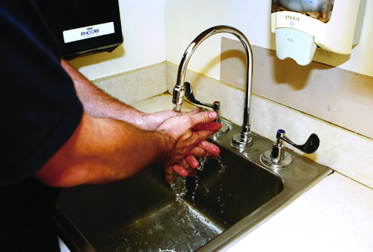
Standard Precautions (1 of 2)
Federal regulations require all health care workers assume all patients are potentially infected with pathogens – spread by direct contact, airborne transmission or blood.
Standard precautions for bloodborne pathogens
Always wear latex/nitrile gloves when handling patients. Change after contact with each patient. Wash hands immediately after removing gloves.
Always wear protective mask, eyewear, or a face shield when you anticipate blood or body fluid splatter.
Wash hands and other skin surfaces immediately and thoroughly with soap/water if contaminated with blood or other body fluids.
Do not recap, cut, or bend used needles. Place them in a sharps container.
Figure 2-11 Wash your hands thoroughly with soap and water if you are contaminated with blood or other body fluids.
© Jones & Bartlett Learning. Courtesy of MIEMSS.
Notes:
D. Standard precautions
1. Federal regulations require all health care workers, including EMRs, to assume that all patients are potentially infected with pathogens that can spread by direct contact, airborne transmission, or blood.
2. Standard precautions for bloodborne pathogens
a. Always wear approved latex or nitrile gloves when handling patients. Change gloves after contact with each patient. Wash hands with soap and water immediately after removing your gloves.
b. Always wear a protective mask, eyewear, or a face shield when you anticipate that blood or other body fluids may splatter.
c. Wash your hands and other skin surfaces immediately and thoroughly with soap and water it they become contaminated with blood or other body fluids.
d. Do not recap, cut, or bend used needles. Place them directly in a puncture-resistant container designed for “sharps.”

Slide 26
Standard Precautions (2 of 2)
Standard precautions for airborne pathogens
Steps recommended by CDC and OSHA vary with specific disease outbreaks.
Specific precautions to prevent spread of influenza or COVID-19 include:
Be aware of any community-based outbreaks that require droplet precautions.
Assess patient upon arrival from a distance of at least 6 feet, if possible.
Inquire about influenza, COVID-19, or other specific exposures.
Perform hand hygiene before and after patient care activities.
A disposable surgical mask should be placed on the patient if the person shows signs of respiratory illness such as coughing, sneezing, or a fever.
Health care providers may need to don an N-95 mask to protect from exposure to infected droplets.
For eye protection, use cleanable goggles or disposable face shield to protect eyes, nose, and mouth during procedures that are likely to generate splashes or sprays of blood or body secretions.
Notes:
Precautions for Airborne Pathogens
a. The steps recommended by the CDC and OSHA vary with specific disease outbreaks, so you need to stay current with these recommendations and follow local protocols.
b. Specific precautions to prevent the spread of influenza or COVID-19 should include:
i. Be aware of any community based outbreaks of influenza, COVID-19 or other epidemic disease that require droplet precautions.
ii. Assess the patient upon arrival from a distance of at least 6 feet, if possible.
iii. Inquire specifically about influenza, COVID-19, or other exposures.
iv. Perform hand hygiene before and after patient care activities.
v. A disposable surgical mask should be placed on the patient if the person shows signs of respiratory illness such as coughing, sneezing, or a fever.
vi. Health care providers may need to don an N-95 mask to protect themselves from exposure to infected droplets.
vii. For eye protection, use cleanable goggles or disposable face shields to protect the eyes, nose, and mouth during procedures that are likely to generate splashes or sprays of blood or body secretions.

Slide 27
Personal Protective Equipment (PPE) (1 of 2)
Review the proper procedure in donning and doffing PPE.
See Skill Drill 2-1 for gloves.
To don infectious disease PPE, follow these steps:
Select gloves, mask, and eye protection to ensure that they are not torn or ripped and that they are the correct size.
Put on gloves.
Put on mask.
Put on eye protection.
Notes:
4. Immunizations
a. Review the proper procedures in donning and doffing needed protective equipment such as gloves (Skill Drill 2-1).
b. To don infectious disease PPT, follow these steps:
i. Select gloves, mask, and eye protection to ensure that they are not torn or ripped and that they are the correct size.
ii. Put on gloves.
iii. Put on a mask.
iv. Put on eye protection.

Slide 28
Personal Protective Equipment (PPE) (2 of 2)
To doff infectious disease PPE, follow these steps:
Remove and discard gloves using steps listed in Skill Drill 2-1. Take care not to contaminate your hands. Dispose of gloves in a biohazard bag.
Remove eye protection. Remove by strap and avoid touching front surface of eye protection. Discard in a biohazard bag or prepare for reprocessing.
Remove mask by tilting head slightly forward, grasping elastic straps, and sliding them off your ears and head. Remove mask without touching front fabric. Discard mask in a biohazard bag or in a receptacle for reprocessing.
Perform hand hygiene by washing with soap/warm water or by using alcohol-based hand sanitizer.
Notes:
c. To doff infectious disease, PPE follow these steps:
i. Remove and discard gloves using steps listed in Skill Drill 2-1. Take care not to contaminate your hands. Dispose of gloves in a biohazard bag.
ii. Remove eye protection. Remove by strap and avoid touching front surface of eye protection. Discard in a biohazard bag or prepare for reprocessing.
iii. Remove mask by tilting head slightly forward, grasping elastic straps, and sliding them off your ears and head. Remove mask without touching front fabric. Discard mask in a biohazard bag or in a receptacle for reprocessing.
iv. Perform hand hygiene by washing with soap and warm water or by using alcohol-based hand sanitizer.

Slide 29
Immunizations
Immunizations are recommended for EMS responders: influenza, tetanus prophylaxis, hepatitis B vaccine.
Check status of your varicella (chickenpox) vaccine, and your measles, mumps, and rubella (MMR) vaccine.
Tuberculin testing may also be recommended.
Notes:
5. Immunizations
a. Certain immunizations are recommended for EMS responders, including influenza, tetanus prophylaxis, and hepatitis B vaccine.
b. Check the status of your varicella (chickenpox) vaccine, and your measles, mumps, and rubella (MMR) vaccine.
c. Tuberculin testing may also be recommended.

Slide 30
Responding to Scene (1 of 4)
Scene safety is a most important consideration to you as an EMR.
Includes your safety and safety of all other people present at scene.
An injured or dead EMR cannot help those in need.
Drive safely and always fasten your seatbelt when you are in your vehicle.
Notes:
E. Responding to the scene
1. Scene safety is a most important consideration to you as an EMR.
a. Safety considerations need to include your own safety and safety of all other people present at scene.
b. An injured or dead EMR cannot help those in need.
c. Drive safely and always fasten your seatbelt when you are in your vehicle.

Slide 31
Responding to Scene (2 of 4)
Dispatch
Use dispatch information to anticipate hazards and determine how to approach scene.
Response
Fasten your seatbelt, plan best route, and drive quickly but safely to scene.
Notes:
2. Dispatch
a. Use your dispatch information to anticipate hazards and determine how to approach scene.
3. Response
a. Vehicle accidents are a major cause of death and disability for law enforcement personnel, firefighters, and EMS personnel.
b. Fasten your seatbelt, plan best route, and drive quickly but safely to scene.

Slide 32
Responding to Scene (3 of 4)
Parking your vehicle
Park your vehicle so that it protects the area from traffic hazards.
Be sure that emergency warning lights are operating correctly.
Be careful when getting out of your vehicle.
Notes:
4. Parking your vehicle
a. Park your vehicle so that it protects the area from traffic hazards.
b. Be sure that emergency warning lights are operating correctly.
c. Be careful when getting out of your vehicle, especially if you must step into a traffic-filled area.

Slide 33
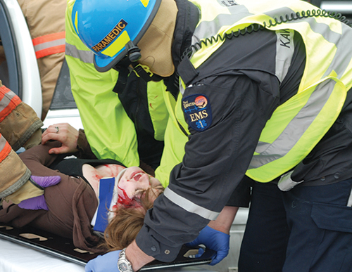
Responding to Scene (4 of 4)
Parking your vehicle (cont’d)
Wear approved safety vests when working on an active highway.
If your vehicle is not needed, park it out of way of traffic.
Figure 2-13 Reflective clothing helps make you more visible.
© Murray Wilson/Fotolia.com
Notes:
d. Federal safety standards require EMRs to wear approved safety vests when they are working on an active highway.
e. If your vehicle is not needed to protect the incident scene, park it out of the way of traffic.
Figure: Reflective clothing helps make you more visible.

Slide 34
Assessing Scene (1 of 8)
Scan entire area carefully to determine what hazards are present and address them in most appropriate order.
Traffic
Control the flow of traffic on a busy highway.
If you need assistance, call before you get out of your vehicle.
Notes:
F. Assessing the scene
1. Scan the entire area carefully to determine what hazards are present and address them in the most appropriate order.
2. Traffic
a. Control flow of traffic on a busy highway.
b. If you need more help to handle traffic, call for assistance before you get out of your vehicle.

Slide 35
Assessing Scene (2 of 8)
Crime or violence
If you are trained in law enforcement procedures, follow local protocols.
If you are not, proceed very carefully.
If you have doubts about safety of a scene, wait at a safe distance and request help from law enforcement officials.
If scene involves a crime, avoid disturbing anything unless it is absolutely necessary.
Notes:
3. Crime or violence
a. If you are trained in law enforcement procedures, follow local protocols.
b. If you are not a law enforcement official, proceed very carefully.
c. If you have doubts about safety of a scene, wait at a safe distance and request help from law enforcement officials.
d. If the scene involves a crime, take a mental picture and avoid disturbing anything at the scene unless it is absolutely necessary.

Slide 36
Assessing Scene (3 of 8)
Crowds
Assess crowd’s mood before you get into a position from which you cannot exit.
Request help before crowd is out of control.
Electrical hazards
Do not approach scene and keep other people away from source of hazard.
Notes:
4. Crowds
a. Crowds may be friendly and helpful or hostile.
b. Assess crowd’s mood before you get into a position from which you cannot exit.
c. Request help from law enforcement officials before crowd is out of control.
d. You may have to wait for arrival of police before you approach patient.
5. Electrical hazards
a. Do not approach a scene if there are indications of electrical problems.

Slide 37
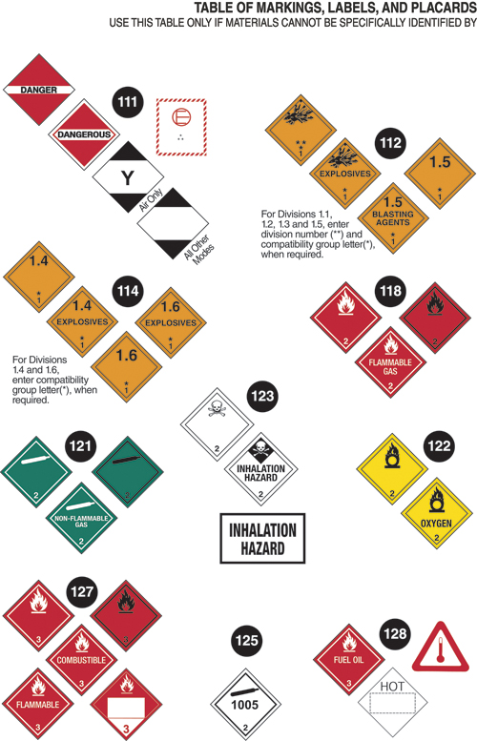
Assessing Scene (4 of 8)
Electrical hazards (cont’d)
Make sure the electrical current has been turned off by a qualified person before you get close to the source.
Wear a helmet with a chin strap and face shield.
Fire
If you are a trained firefighter, follow rescue and firefighting procedures.
If you are not a trained firefighter, do not exceed the limits of your training.
Never enter a burning building without proper turnout gear and SCBA.
Hazardous materials
Should be marked with placards.
Figure 2-14B Hazardous materials placards
Data from US Department of Transportation, "Table of Marketings, Labels and Placards" from the 2020 Emergency Response Guidebook, similar to page 8 of 2016 edition. Retrieved from https://www.phmsa.dot.gov/sites/phmsa.dot.gov/files/docs/ERG2016.pdf.
Notes:
b. Keep all other people away from the source of the hazard.
c. Make sure that the electrical current has been turned off by a qualified person before you get close to the source of the current.
d. Wear a helmet with a chin strip and face shield.
6. Fire
a. Fire can result in injury or death to you and to the patient.
b. If you are a trained firefighter, follow the rescue and firefighting procedures established for your department.
c. If you are not a trained firefighter, do not exceed the limits of your training.
d. Never enter a burning building without proper turnout gear and self-contained breathing apparatus.
e. Carefully assess the fire hazard before you determine your course of action.
7. Hazardous materials
a. Hazardous materials may be found almost anywhere.
b. Federal regulations require vehicles that are transporting a certain quantity of hazardous materials to be marked with specific placards.

Slide 38
Assessing Scene (5 of 8)
Hazardous materials (cont’d)
If you believe that a crash may involve hazardous materials, stop uphill and upwind and use binoculars to observe scene.
Odors or fumes may be first indication.
Call for assistance.
Unstable objects
Vehicles, trees, poles, buildings, cliffs, and piles of material
Notes:
c. If you believe that a crash may involve hazardous materials, stop uphill and upwind at some distance from the crash and use binoculars to determine whether the vehicle is marked with a placard.
d. Odors or fumes may be the first indication of hazardous materials.
e. Call for assistance.
f. Remain far enough away so that you do not become an additional casualty.
F. Unstable objects
1. Unstable objects may include vehicles, trees, poles, buildings, cliffs, and piles of materials.

Slide 39
Assessing Scene (6 of 8)
Unstable objects (cont’d)
Vehicles may need to be stabilized before patient extrication can begin.
Undeployed air bags are hazards.
Fires and explosions can result in unstable buildings.
Sharp objects
Broken glass at scene of a motor vehicle crash.
Wear heavy leather or firefighting gloves over your medical gloves to prevent injuries.
Notes:
2. After an accident, vehicles may need to be stabilized before you assess the patient or begin patient extrication.
3. Undeployed air bags represent another hazard following a motor vehicle collision.
4. Fires and explosions can result in unstable buildings.
5. Assess stability before attempting to enter a building.
6. If in doubt, call for trained personnel.
G. Sharp objects
1. Sharp objects are frequently present at an emergency scene.
2. They may include broken glass at the scene of a motor vehicle crash or hypodermic needles in the pocket of a drug addict.
3. Wear heavy leather or firefighting gloves over your medical gloves to prevent injuries.

Slide 40
Assessing Scene (7 of 8)
Animals
Can be pets, farm stock, or wild.
Should be secured in another part of house away from patient.
May present other hazards such as bites, kicking, or even trampling.
Environmental conditions
Dress appropriately for the expected weather.
Be alert for damage from high winds.
Keep your patients dry and comfortable.
Use emergency lighting when operating in the dark.
Notes:
H. Animals
1. Can be pets, farm stock, or wild
2. Present in a wide variety of indoor and outdoor settings
3. Can become very upset in the confusion of a medical emergency and should be secured in another part of the house away from the patient
4. May present other hazards such as bites, kicking, or even trampling.
I. Environmental conditions
1. Dress appropriately for the expected weather.
2. Be alert for possible damage from high winds.
3. Keep your patients dry and comfortable.
4. Use emergency lighting when operating in the dark to help you avoid hazards.

Slide 41
Assessing Scene (8 of 8)
Special rescue situations
Water rescue, ice rescue, confined-space or below-grade rescue, terrorism, and mass-casualty incidents
Do not enter an emergency situation that is unsafe unless you have proper training and equipment.
Notes:
J. Special rescue situations
1. These situations include water rescue, ice rescue, confined-space or below-grade rescue, terrorism, and mass-casualty incidents
2. Do not enter an emergency situation that is unsafe unless you have proper training and equipment.

Slide 42
Summary (1 of 3)
Stress is a normal part of an EMR’s life.
Five stages of grief process when dealing with death and dying are denial, anger, bargaining, depression, and acceptance.
Stress management consists of recognizing, preventing, and reducing critical incident stress.
According to CRM concept, each member is responsible for maintaining awareness of current patient situation and sharing any critical information with the team leader.
Notes:
V. Summary
A. EMRs should understand the role that stress plays in the lives of emergency care providers and patients who have experienced a sudden illness or accident. Stress is a normal part of an EMR’s life.
Five stages of grief process when dealing with death and dying are denial, anger, bargaining, depression, and acceptance. Patients and rescuers move through these stages at different paces.
Stress management consists of recognizing, preventing, and reducing critical incident stress.
According to crew resource management (CRM) concept, each member is responsible for maintaining awareness of the current patient situation and sharing any critical information with the team leader.

Slide 43
Summary (2 of 3)
You should understand how airborne and bloodborne diseases are spread and how standard precautions prevent spread of infection.
Notes:
D. Scene safety is an important part of your job. You should understand how airborne and bloodborne diseases are spread and how standard precautions prevent spread of infection.

Slide 44
Summary (3 of 3)
As you arrive on the scene of a collision or illness, you must assess scene for hazards, including traffic, crime, crowds, unstable objects, sharp objects, electrical problems, fire, hazardous materials, animals, environmental conditions, special rescue situations, and infectious disease exposure.
Notes:
E. As you arrive on the scene of a collision or illness, you must assess scene for a wide variety of hazards, including traffic, crime, crowds, unstable objects, sharp objects, electrical problems, fire, hazardous materials, animals, environmental conditions, special rescue situations, and infectious disease exposure. You should understand the safety equipment and precautions that are needed for the various types of rescue situations.

Slide 45
Review
Common signs or symptoms of stress include:
increased appetite.
decreased muscle tension.
greater ability to think clearly.
irritability.

Slide 46
Review
Answer:
D. irritability.

Slide 47
Review
You are called to a scene that seems unsafe. What is your best course of action?
Refuse to respond.
Wait at a safe distance and request law enforcement.
Proceed to the patient, but with caution.
Put the needs of the patient ahead of your safety.

Slide 48
Review
Answer:
B. Wait at a safe distance and request law enforcement.

Slide 49
Review
Which of the following is not a consideration when responding to an emergency scene?
Road conditions
Other drivers on the road
Personal safety, such as a seatbelt
Always using lights and sirens

Slide 50
Review
Answer:
D. Always using lights and sirens

