Slide 1
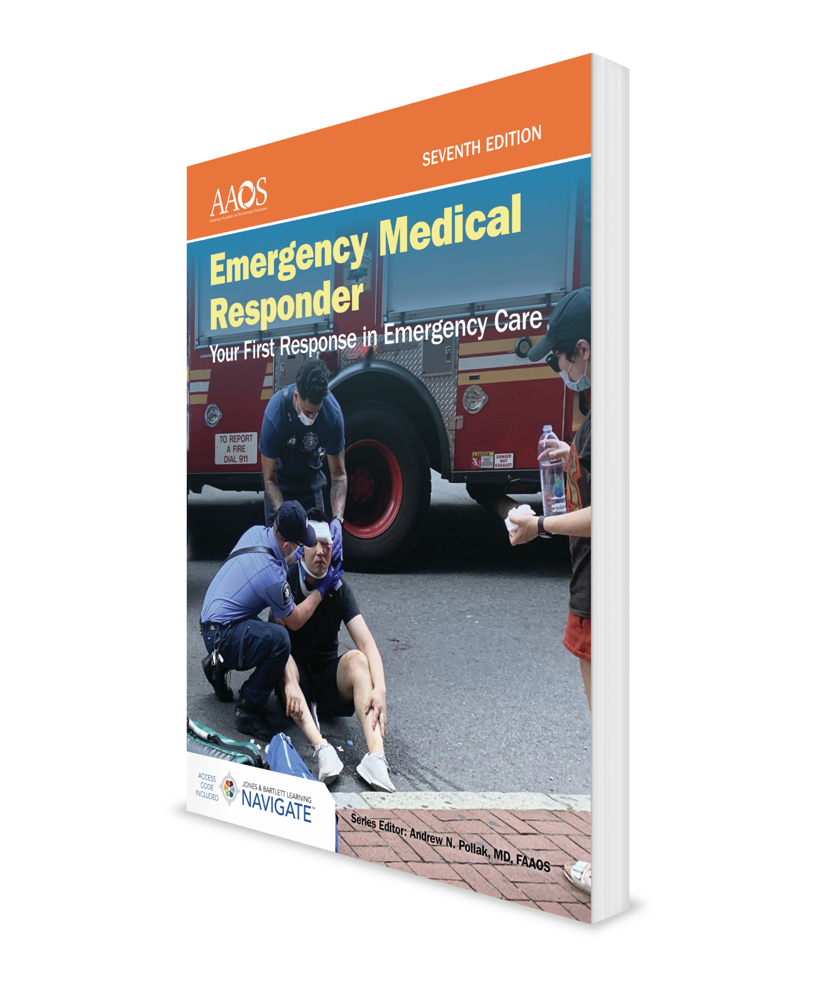
Medical, Legal, and Ethical Issues
CHAPTER 4

Slide 2
National EMS Education Standard Competencies (1 of 2)
Preparatory
Uses simple knowledge of the EMS system, safety/well-being of the EMR, and medical/legal issues at scene of an emergency while awaiting a higher level of care.
Notes:
Preparatory
Uses simple knowledge of the emergency medical services (EMS) system, safety/well-being of the emergency medical responder (EMR), medical/legal issues at the scene of an emergency while awaiting a higher level of care.

Slide 3
National EMS Education Standard Competencies (2 of 2)
Medical/Legal and Ethics
Consent/refusal of care
Confidentiality
Advance directives
Tort and criminal actions
Evidence preservation
Statutory responsibilities
Mandatory reporting
Ethical principles/moral obligations
End-of-life issues
Notes:
Medical/Legal and Ethics
• Consent/refusal of care (pp 63-64)
• Confidentiality (p 67)
• Advance directives (p 64)
• Tort and criminal actions (p 62)
• Evidence preservation (p 68)
• Statutory responsibilities (pp 62-65; pp 67-69)
Mandatory reporting (pp 68-69)
• Ethical principles/moral obligations (p 63)
• End-of-life issues (pp 64-65)

Slide 4
Introduction
Laws differ from one location to another, so EMRs should learn specific laws that apply in their state and local jurisdiction.
Do not lose sight of these concepts:
Above all else, do no harm.
Provide all your care in good faith.
Provide proper consistent care, be compassionate, and maintain your composure.
Notes:
I. Introduction
A. EMRs need to know some basic legal principles that guide how they provide care to patients.
B. Knowing these principles can help EMRs provide the best possible care.
C. Laws differ from one location to another, so EMRs should learn the specific laws of their state and local jurisdiction.
D. Do not lose sight of the following concepts when providing patient care:
1. Above all else, do no harm.
2. Provide all your care in good faith, keeping the patient’s best interest uppermost in your mind.
3. Provide proper consistent care, be compassionate, and maintain your composure.

Slide 5
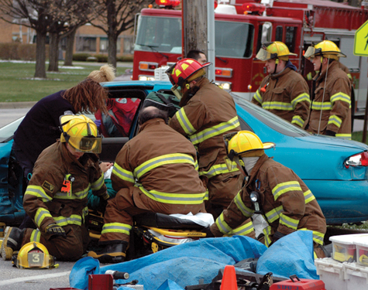
Duty to Act
If you are employed by an agency as an EMR and you are dispatched to scene of an accident or illness, you have a duty to act.
You must proceed quickly to the scene and provide emergency medical care within the limits of your training and available equipment.
Failure to respond or render necessary emergency care leaves you and your agency vulnerable to legal action.
Figure 4-1 EMRs dispatched to an emergency scene.
Courtesy of Captain David Jackson, Saginaw Township Fire Department.
Notes:
II. Duty to Act
A. If you are employed by an agency that has designated you as an EMR and you are dispatched to the scene of an accident or illness, you have a duty to act.
1. You must proceed quickly to the scene and provide emergency medical care within the limits of your training and available equipment.
B. Failure to respond or render necessary emergency care leaves you and your agency vulnerable to legal action.
Figure: EMRs dispatched to an emergency scene.

Slide 6
Standard of Care
Standard of care is the manner in which you must act or behave.
You must meet two criteria:
Treat patient to the best of your ability.
Provide care that a reasonable, prudent person with similar training would provide under similar circumstances.
Notes:
III. Standard of Care
A. As a trained EMR, you are expected to use your knowledge and skills to the best of your ability under the circumstances.
1. The standard of care is the manner in which you must act or behave.
2. To comply with standard of care, you must meet two criteria:
a. Treat the patient to the best of your ability.
b. Provide care that a reasonable, prudent person with similar training would provide under similar circumstances.
B. It is important to know your local standards of care and what statutes affect your community.

Slide 7
Scope of Care
Scope of care is defined by
US Department of Transportation’s Emergency Medical Responder Educational Standards
Medical protocols or standing orders (regional or state)
Online medical direction
Notes:
IV. Scope of Care
A. Scope of care is defined by:
1. US Department of Transportation’s Emergency Medical Responder Educational Standards
a. These standards specify the skills taught in this course and the way those skills should be performed.
b. State scope of care laws may modify parts of the specifications in the education standards.
2. Medical protocols or standing orders (regional or state)
3. Online medical direction

Slide 8
Ethical Responsibilities and Competence (1 of 2)
Treating a patient ethically means doing so in a manner that conforms to accepted professional standards of conduct.
Stay up-to-date on skills and knowledge.
Review your performance and assess your techniques.
Evaluate your response times.
Try to follow up patient outcomes.
Take continuing education classes.
Participate in quality improvement activities.
Notes:
V. Ethical Responsibilities and Competence
A. The community expects you to conform to the established codes of what is right and wrong.
1. Treating a patient ethically means doing so in a manner that conforms to accepted professional standards of conduct.
a. Stay up-to-date on EMR skills and knowledge.
b. Review your performance and assess your techniques.
c. Evaluate your response times.
d. Try to follow up patient care outcomes with your medical director or hospital personnel.
e. Take continuing education classes and refresher courses.
f. Participate in quality improvement activities within your department.

Slide 9
Ethical Responsibilities and Competence (2 of 2)
Ethical behavior requires honesty.
Always provide complete and correct reports to other EMS providers.
Never change a report except to correct an error.
Notes:
B. Ethical behavior requires honesty.
1. Always provide complete and correct reports to other EMS providers.
2. Never change a report except to correct an error.

Slide 10
Consent for Treatment (1 of 4)
Consent simply means giving approval or permission.
Expressed consent
Patient actually lets you know—verbally or nonverbally—that he or she is willing to accept treatment. Ideally the consent will be expressed and also informed.
Sometimes called actual consent.
Patient must be of legal age and able to make a rational decision.
Discuss “emancipated minor” as defined in your state law.
Notes:
VI. Consent for Treatment
A. Consent simply means giving approval or permission.
B. Legally, several types of consent exist.
1. In expressed consent, the patient actually lets you know—verbally or nonverbally—that he or she is willing to accept treatment.
a. Expressed consent is based on the assumption that the patient has the right to determine what will be done to his or her body. Should also be informed.
b. Sometimes called actual consent.
c. The patient must be of legal age and able to make a rational decision. Discuss “emancipated minor” as defined in your state law.

Slide 11
Consent for Treatment (2 of 4)
Implied consent
Patient does not specifically refuse emergency care.
Do not hesitate to treat an unconscious patient.
Consent for minors
Under the law, minors are not considered capable of speaking for themselves.
Notes:
2. Any patient who does not specifically refuse emergency care can be treated under the principle of implied consent.
a. You should never hesitate to treat an unconscious patient.
C. Consent for minors
1. A minor is a person who has not yet reached the legal age (usually 18) designated by a particular state.
2. Under the law, minors are not considered capable of speaking for themselves.

Slide 12
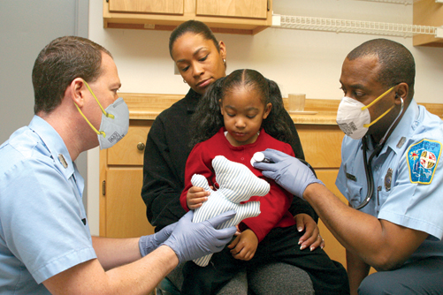
Consent for Treatment (3 of 4)
Consent for minors (cont’d)
Emergency treatment must wait until a patient or legal guardian consents to treatment.
If permission cannot be quickly obtained, do not hesitate to give appropriate medical care.
Figure 4-2 Do not delay or withhold emergency medical treatment from a patient who is a minor.
© Jones & Bartlett Learning. Courtesy of MIEMSS.
Notes:
3. Emergency treatment of a minor by a physician must wait until a parent or legal guardian consents to the treatment.
If permission cannot be quickly obtained, do not hesitate to give appropriate emergency medical care.
Figure: Do not delay or withhold emergency medical treatment from a patient who is a minor.

Slide 13
Consent for Treatment (4 of 4)
Consent of patients with a mental illness
If person appears to be a threat to self or others, place this person under medical care.
Know your state’s legal mechanisms for handling these patients.
Do not hesitate to involve law enforcement agencies.
Notes:
D. Consent of patients with a mental illness
1. Legal issues are more complicated if the patient who refused to be treated appears to be out of touch with reality.
2. If person appears to be a threat to self or others, place this person under medical care.
3. Know your state’s legal mechanisms for handling these patients.
4. Do not hesitate to involve law enforcement agencies.

Slide 14
Patient Refusal of Care (1 of 2)
A competent adult has a legal right to refuse treatment.
Help person understand consequences of refusing care by explaining:
Treatment
Reason that the treatment is needed
Potential risks if treatment is not provided
Alternative treatments that might help
Notes:
VII. Patient Refusal of Care
A. A competent adult has a legal right to refuse treatment.
B. You can continue to talk with a person who has refused care and try to help him or her understand the consequences of refusing care.
1. Explain to the person:
a. The treatment
b. The reason that the treatment is needed
c. The potential risks if the treatment is not provided
d. Any alternative treatments that might help

Slide 15
Patient Refusal of Care (2 of 2)
Patient refusals should be documented on your patient care record according to your agency protocols.
Notes:
C. Patient refusals should be documented on your patient care record according to your agency protocols.

Slide 16
Advance Directives (1 of 3)
An advance directive is a document that specifies what a person would like to be done if he or she becomes unable to make his or her own medical decisions.
A living will
Written document drawn up by a patient, a physician, and a lawyer.
States types of medical care person wants or wants withheld.
Notes:
VIII. Advance Directives
A. An advance directive is a document that specifies what a person would like to be done if he or she becomes unable to make his or her own medical decisions.
B. Three kinds of advance directives exist.
1. A living will
a. Written document drawn up by a patient, a physician, and a lawyer
b. States types of medical care person wants or wants withheld if he or she is unable to make treatment decisions
c. Often written when a patient has a terminal condition

Slide 17
Advance Directives (2 of 3)
A durable power of attorney for health care
Allows a patient to designate another person to make decisions about medical care.
A do-not-resuscitate (DNR) order
Written request giving permission to medical personnel to withhold resuscitation in the event of cardiac arrest.
Additional terms for these types of orders:
MOLST or POLST
Notes:
2. A durable power of attorney for health care
a. Allows a patient to designate another person to make decisions about medical care
b. May refer to the representative as the patient’s health care agent or health care proxy
3. A do-not-resuscitate (DNR) order
a. Written request giving permission to medical personnel to withhold resuscitation in the event of cardiac arrest.
b. Most frequently used for patients who are in hospitals or nursing homes.
c. Additional terms: medical orders for life-sustaining treatment (MOLST) or physician’s orders for life sustaining treatment (POLST).

Slide 18
Advance Directives (3 of 3)
If you are unable to determine if an advance directive is legally valid, begin appropriate medical care.
Some states have systems in place, such as bracelets, to identify patients with advance directives.
Notes:
C. If you are unable to determine if an advance directive is legally valid, begin appropriate medical care.
D. Some states have systems in place, such as bracelets, to identify patients with advance directives.

Slide 19
Abandonment
Abandonment occurs when a trained person begins emergency care and then leaves the patient before another trained person takes over.
Once you have started treatment, you must continue it until a person who has at least as much training arrives and takes over.
Notes:
IX. Legal Concepts
A. Abandonment
1. Abandonment occurs when a trained person begins emergency care and then leaves patient before another trained person takes over.
2. Once you have started treatment, you must continue treatment until a person who has at least as much training arrives and takes over.

Slide 20
People Dead at Scene (1 of 2)
If you see any signs that a person is alive, you should begin providing care.
You cannot assume a person is dead unless one of these conditions exists:
Decapitation
Rigor mortis
Tissue decomposition
Dependent lividity
Notes:
B. People dead at the scene
1. If you see any signs that a person is alive, you should begin providing necessary care.
2. You cannot assume a person is dead unless one or more of these conditions exist:
a. Decapitation: Head is separated from the body
b. Rigor mortis: Temporary stiffening of muscles after death
c. Tissue decomposition: Occurs after a person has been dead for more than a day
d. Dependent lividity: Red or purple color found on the parts of the patient’s body that are closest to the ground

Slide 21
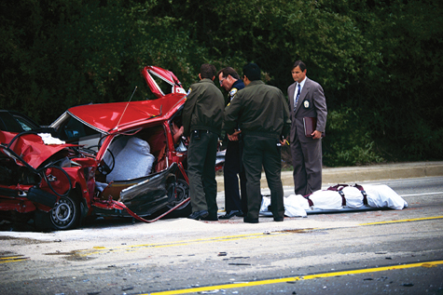
People Dead at Scene (2 of 2)
If any signs of death are present, consider the patient to be dead.
It is important that you know the protocol your department uses in dealing with patients who are dead at scene.
Figure 4-3 Learn the protocol for dealing with patients who are obviously dead at the scene.
© Corbis/Getty.
Notes:
3. If any signs of death are present, consider the patient to be dead.
4. It is important that you know the protocol your department uses in dealing with patients who are dead on the scene.
Figure: Learn the protocol for dealing with patients who are obviously dead at the scene.

Slide 22
Negligence
Negligence occurs when a patient sustains further injury or harm because care administered did not meet the standard of care.
These four conditions must be present:
Duty to act
Breach of duty
Resulting injuries
Proximate cause
Notes:
C. Negligence
1. Occurs when a patient sustains further injury or harm because the care administered did not meet the standard of care.
2. For negligence to occur, four conditions must be present:
a. Duty to act
b. Breach of duty
c. Resulting injuries
d. Proximate cause

Slide 23
Confidentiality (1 of 2)
Most patient information is confidential.
Patient history
Assessment findings
Treatment provided
Your communication with patient
Information should be shared only with other medical personnel who are directly involved in the patient’s care.
Notes:
D. Confidentiality
1. Most patient information is confidential, including patient history, assessment findings, treatment provided, as well as your communication with the patient.
2. Information should be shared only with other medical personnel who are directly involved in the patient’s care.

Slide 24
Confidentiality (2 of 2)
In certain situations, you may release confidential information to designated individuals.
Health Insurance Portability and Accountability Act of 1996 (HIPAA)
Strengthens laws for the protection of privacy of health care information and safeguards patient confidentiality.
Notes:
3. In certain situations, you may release confidential information to designated individuals.
4. Some information about a patient’s care may be classified as public information, including the patient’s name, address, age, and the hospital to which he or she was transported.
5. Health Insurance Portability and Accountability Act of 1996 (HIPAA)
a. HIPAA had many aims, including improving portability and continuity of health insurance coverage and combating waste and fraud in health insurance and in the provision of health care.
b. The section of the act that most affects EMS relates to patient privacy.
i. The aim of this section is to strengthen laws for the protection of the privacy of health care information and to safeguard patient confidentiality.
ii. HIPAA provides guidance on what type of information is protected, the responsibility of health care providers regarding that protection, and the penalties for breaching that protection.
iii. Most personal health information is protected and should not be released without the patient’s permission.
iv. When you are unsure whether information is protected, do not release it to anyone other than those directly involved in the care of the patient.
v. Each service is required to have a manual and privacy officer who can answer questions.
vi. You can expect to receive further training on how HIPAA affects your specific response agency and resource hospital.

Slide 25
Good Samaritan Laws
Protect citizens from liability for errors or omissions in giving good-faith emergency care.
Vary considerably from state to state.
May no longer be needed.
Provide little or no legal protection for an EMS provider.
Notes:
X. Good Samaritan Laws
A. Good Samaritan laws protect citizens from liability for errors or omissions in giving good faith emergency care.
B. These laws vary considerably from state to state.
C. Legal experts have noted that Good Samaritan laws may no longer be needed.
1. These laws provide little or no legal protection for an EMS provider. Often, EMS provider levels are addressed in other sections of the State’s Public Health or Education Law.

Slide 26
Regulations
Become familiar with federal, state, local, and agency regulations that affect your job.
Certification or registration may be required to work as an EMR.
You are always responsible for keeping certifications or registrations current.
Notes:
XI. Regulations
A. You should become familiar with the federal, state, local, and agency regulations that affect your job.
B. Certification or registration may be required to work as an EMR.
C. You are always responsible for keeping certifications or registrations current.

Slide 27
Reportable Events (1 of 2)
Reportable crimes include:
Knife wounds
Gunshot wounds
Motor vehicle crashes
Suspected child or elder abuse
Domestic violence
Dog bites
Rape
Notes:
XII. Reportable Events
A. State and federal agencies have requirements for reporting certain events, including crimes and certain infectious diseases.
1. Reportable crimes include
a. Knife wounds
b. Gunshot wounds
c. Motor vehicle crashes
d. Suspected child abuse
e. Domestic violence
f. Elder abuse
g. Dog bites
h. Rape

Slide 28
Reportable Events (2 of 2)
Learn which crimes are reportable in your area and know your agency’s procedures for reporting these crimes.
Failure to notify proper authorities of reportable events may result in penalties against you or your agency.
Notes:
B. Learn which crimes are reportable in your area and know your agency’s procedures for reporting these crimes.
C. Failure to notify proper authorities of reportable events may result in penalties against you or your agency.

Slide 29
Crime Scene Operations (1 of 3)
Many emergency medical situations are also crime scenes.
Keep these considerations in mind:
Protect yourself.
If you determine that a crime scene is unsafe, wait in a safe location until law enforcement personnel tell you that the scene is safe for entry.
Your first priority is patient care.
Notes:
XIII. Crime Scene Operations
A. Many emergency medical situations are also crime scenes.
B. As an EMR, you should keep the following considerations in mind:
1. Protect yourself. Be sure the scene is safe before you try to enter.
2. If you determine that a crime scene is unsafe, wait in a safe location until law enforcement personnel tell you the scene is safe for entry.
3. Your first priority is patient care. Nothing except your personal safety should interfere with that effort.

Slide 30
Crime Scene Operations (2 of 3)
Considerations (cont’d):
When you are assessing the scene, document anything that seems unusual.
Move patient only if necessary.
Touch only what you need to touch to gain access to patient.
Preserve crime scene for investigation.
Do not cut through knife or bullet holes in patient’s clothing.
Notes:
4. When you are assessing the scene, document anything you see that seems unusual.
5. Move the patient only if necessary. If you must move patient, take a mental “snapshot” of the scene.
6. Touch only what you need to touch to gain access to patient.
7. Preserve crime scene for further investigation.
8. Be careful not to cut through knife or bullet holes in patient’s clothing.

Slide 31
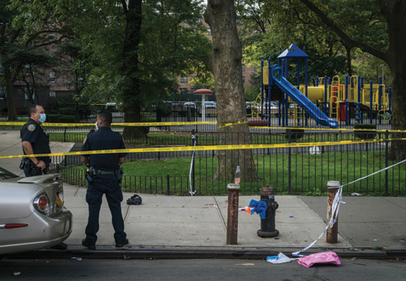
Crime Scene Operations (3 of 3)
Considerations (cont’d):
Be careful where you place equipment.
Keep nonessential people away.
Work with the appropriate law enforcement authorities on scene.
Consider writing a short report about incident.
Figure 4-4 Try to cause as little disruption to a crime scene as possible without compromising patient care.
© Steve Sanchez Photos/Shutterstock
Notes:
9. Be careful where you place equipment to avoid changing or destroying evidence.
10. Keep nonessential people away from the scene.
11. Work with the appropriate law enforcement authorities on the scene to ensure that everyone has the information they need.
12. After you have attended to a patient at a crime scene, consider writing a short report about incident as soon as possible and make a sketch of the scene that shows how and where you found patient.
Figure: Crime scene operations require you to change scene as little as possible.

Slide 32
Documentation (1 of 2)
Your documentation is the initial account describing patient’s condition and care administered.
Serves as a legal record of your treatment.
Provides a basis for evaluating the quality of care provided.
Should be clear, concise, accurate, and readable.
Notes:
XIV. Documentation
A. Documentation should be done according to the policies of your organization.
B. Policies should follow appropriate local and state laws.
C. Your documentation is the initial account describing patient’s condition and the care administered.
1. Serves as a legal record of your treatment
2. Provides a basis for evaluating the quality of care provided
3. Should be clear, concise, accurate, and readable

Slide 33
Documentation (2 of 2)
Documentation should include: include
Condition of patient when found.
Patient’s description of injury/illness.
Patient’s initial and repeat vital signs.
Treatment you gave patient.
Agency and personnel who took over treatment of patient.
Any reportable conditions present.
Any infectious disease exposure.
Anything unusual regarding situation.
Notes:
D. Documentation should include:
1. Condition of patient when found.
2. Patient’s description of injury or illness.
3. Patient’s initial and repeat vital signs.
4. Treatment you gave patient.
5. Agency and personnel who took over treatment of patient.
6. Any reportable conditions present.
7. Any infectious disease exposure.
8. Anything unusual regarding the situation.

Slide 34
Summary (1 of 3)
As an EMR, you have a duty to act when you are dispatched on a medical call as a part of your official duties.
You should understand differences between expressed consent, implied consent, consent for minors, consent of patients with mental illness, and right to refuse care.
Notes:
XV. Summary
A. As an EMR, you have a duty to act when you are dispatched on a medical call as a part of your official duties.
B. You are held to a certain standard of care, which is related to your level of training, and you are expected to perform to the level to which a similarly trained person would perform under similar circumstances.
C. You should understand the differences between expressed consent, implied consent, consent for minors, consent of patients with mental illness, and right to refuse care.

Slide 35
Summary (2 of 3)
Advance directives give a patient the right to have care withheld.
You should understand the concepts of abandonment, negligence, and confidentiality, as well as purpose of Good Samaritan laws.
Notes:
D. Advance directives give a patient the right to have care withheld. Because emergency medical responders cannot determine the validity of these documents, it is best to begin treatment for these patients.
E. You should understand the concepts of abandonment, negligence, and confidentiality, as well as purpose of Good Samaritan laws.

Slide 36
Summary (3 of 3)
Certain events that deal with contagious diseases, abuse, or illegal acts must be reported to the proper authorities.
Crime scene operations are a complex environment.
Your job is not complete until paperwork (documentation) is done.
Understanding and following these concepts will help you to be a good EMR.
Notes:
F. You must understand the various federal and state regulations that govern your performance as an EMR. You must also understand your department’s operational regulations. Certain events that deal with contagious diseases, abuse, or illegal acts must be reported to the proper authorities; you should know how to deal with these reportable events.
G. Crime scene operations are a complex environment. Following proper procedures ensures that the patient receives good medical care and that the crime scene is not compromised for the law enforcement investigation.
H. Your job is not complete until paperwork (documentation) is done. It is important that EMRs document their findings and treatment. This provides good patient care and adequate legal documentation.
I. By understanding and following these legal concepts, you will build the foundation for the skills you need to be a good EMR.

Slide 37
Review
Emergency medical responders have the legal duty to act:
only when they are being compensated by a certified agency.
if they witness an emergency scene while not on duty.
even when outside of their response jurisdiction.
if they are employed by an agency as EMRs.

Slide 38
Review
Answer:
D. if they are employed by an agency as EMRs.

Slide 39
Review
Patients are legally able to make a decision regarding their care if they:
are of legal age according to state law.
have injuries that are life-threatening.
refused transport to the hospital prior to becoming unresponsive.
have bystanders who can verify their competency.

Slide 40
Review
Answer:
A. are of legal age according to state law.

Slide 41
Review
EMRs have the ethical responsibility to:
provide care only when a paramedic is present.
discuss details of each case with their coworkers and families.
transport all patients to the closest hospital.
conform to accepted professional standards of conduct.

Slide 42
Review
Answer:
D. conform to accepted professional standards of conduct.

