Slide 1
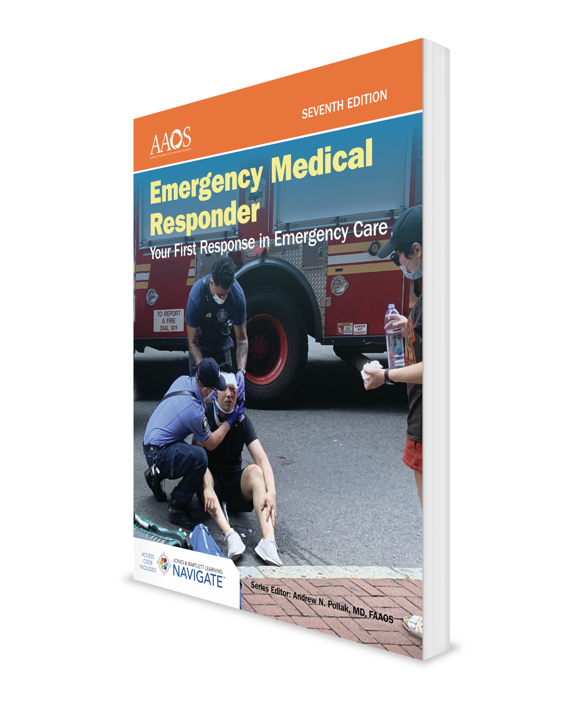
Childbirth
CHAPTER 16

Slide 2
National EMS Education Standard Competencies (1 of 6)
Special Patient Populations:
Recognizes and manages life threats based on simple assessment findings for a patient with special needs while awaiting additional emergency response.
Notes:
Special Patient Populations:
Recognizes and manages life threats based on simple assessment findings for a patient with special needs while awaiting additional emergency response.

Slide 3
National EMS Education Standard Competencies (2 of 6)
Obstetrics:
Recognition and management of:
Normal delivery.
Vaginal bleeding in pregnant patient.
Neonatal Care:
Newborn care.
Neonatal resuscitation.
Notes:
Obstetrics:
Recognition and management of:
• Normal delivery. (pp XXX-XXX)
• Vaginal bleeding in pregnant patient. (pp XXX-XXX)
Neonatal care:
• Newborn care. (p XXX)
• Neonatal resuscitation. (pp XXX-XXX)

Slide 4
National EMS Education Standard Competencies (3 of 6)
Medicine:
Recognizes and manages life threats based on assessment findings of a patient with a medical emergency while awaiting additional emergency response.
Notes:
Medicine:
Recognizes and manages life threats based on assessment findings of a patient with a medical emergency while awaiting additional emergency response.

Slide 5
National EMS Education Standard Competencies (4 of 6)
Gynecology:
Recognition and management of shock associated with:
Vaginal bleeding.
Notes:
Gynecology:
Recognition and management of shock associated with:
• Vaginal bleeding. (pp XXX-XXX)

Slide 6
National EMS Education Standard Competencies (5 of 6)
Trauma:
Uses simple knowledge to recognize and manage life threats based on assessment findings of an acutely injured patient while awaiting additional emergency response.
Notes:
Trauma:
Uses simple knowledge to recognize and manage life threats based on assessment findings of an acutely injured patient while awaiting additional emergency medical response.

Slide 7
National EMS Education Standard Competencies (6 of 6)
Special Considerations in Trauma:
Recognition and management of trauma in:
Pregnant patient.
Pediatric patient.
Geriatric patient.
Notes:
Special Considerations in Trauma:
Recognition and management of trauma in:
• Pregnant patient. (p XXX)
• Pediatric patient. (Chapter 17, Pediatric Emergencies)
• Geriatric patient. (Chapter 18, Geriatric Emergencies)

Slide 8
Introduction
Childbirth is a normal, natural part of life.
Your part of process involves helping, guiding, and supporting newborn as it is born.
After birth, you should ensure newborn is breathing adequately and being kept warm.
Two indicators of an impending birth:
Frequency of contractions.
Crowning.
Notes:
I. Introduction.
A. EMRs may be called on to assist in birth of a child.
1. If you remember some easy steps, you can effectively assist in birth process and offer comfort and support to both mother and newborn.
B. Childbirth is a normal and natural part of life.
1. You may not have time or necessary assistance to transport pregnant woman to hospital.
2. Your part of process involves helping, guiding, and supporting newborn as it is born.
3. Following birth, you should ensure that newborn is breathing adequately and being kept warm.
C. There will be times when timing of childbirth catches everyone by surprise or a complication has developed.
D. There are two key indicators of an impending birth:
1. Frequency of contractions.
2. Appearance of newborn’s head during a contraction (crowning).

Slide 9
Anatomy and Function of Female Reproductive System (1 of 2)
Ovaries produce eggs.
Egg travels through fallopian tube to uterus.
Uterus (womb) holds fertilized egg as it develops during a pregnancy.
Developing newborn (fetus) is encased in an amniotic sac for support and floats in amniotic fluid.
Notes:
II. Anatomy and Function of Female Reproductive System:
A. Major female reproductive organs:
1. Ovaries produce eggs.
a. Egg released by the ovaries travels through fallopian tube to uterus.
2. The uterus (womb) holds the fertilized egg as it develops during a pregnancy.
a. Developing newborn (fetus) is encased in an amniotic sac for support and floats in amniotic fluid.
b. Placenta, or afterbirth, draws nutrients from wall of uterus.
c. These nutrients and oxygen are delivered to fetus through the umbilical cord.

Slide 10
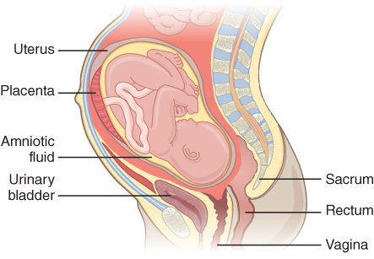
Anatomy and Function of Female Reproductive System (2 of 2)
External opening is called birth canal (vagina).
Figure 16-1 Anatomy of a pregnant woman.
© Jones & Bartlett Learning.
Notes:
External opening of female reproductive system is called birth canal (vagina).
Figure: Anatomy of a pregnant woman.

Slide 11
Stages of Labor (1 of 3)
First stage: pregnant woman’s body prepares for birth.
Characterized by these conditions:
Initial contractions occur.
Bag of waters breaks.
Bloody show occurs.
Newborn’s head does not appear during contractions.
Notes:
III. Assessing the Birth Situation:
A. Stages of labor :
1. First stage of labor, pregnant woman’s body prepares for birth.
a. This stage is characterized by following conditions:
i. Initial contractions occur.
ii. Bag of waters breaks.
iii. Bloody show (mucous plug) occurs.
iv. Newborn’s head does not appear during contractions.
b. Check woman’s vagina to determine whether newborn is crowning.
c. Report your findings to responding ambulance crew.

Slide 12
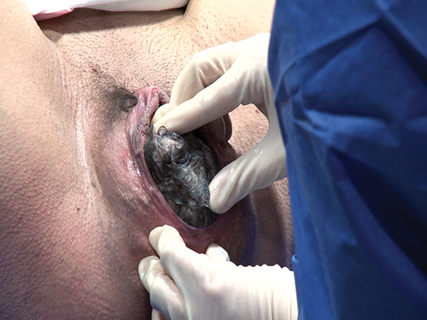
Stages of Labor (2 of 3)
Second stage: birth of newborn.
You will see newborn’s head crowning during contractions.
There is no time for transport.
Figure 16-2 Crowning occurs when the newborn’s head appears at the vaginal opening.
© University of Maryland Shock Trauma Center/MIEMSS.
Notes:
2. Second stage involves birth of newborn.
a. You will see newborn’s head crowning during contractions, at which time you must prepare to assist woman with delivery.
There is no time for transport.
Figure: Crowning occurs when newborn’s head appears at vaginal opening.

Slide 13
Stages of Labor (3 of 3)
Third stage: delivery of placenta (afterbirth).
You must assist in stabilizing condition of mother and newborn and delivering placenta.
Notes:
3. Third stage involves delivery of placenta (afterbirth).
a. You must assist in stabilizing condition of mother and newborn and delivering placenta.

Slide 14
Is There Time to Reach Hospital? (1 of 3)
Is this woman’s first pregnancy?
A woman experiencing her first labor will usually have more time to reach hospital.
Has woman experienced a bloody show?
Has bag of waters broken?
Bag of waters usually breaks toward end of first stage of labor.
Notes:
B. Is there time to reach hospital?
1. Following questions will help you determine how close pregnant woman is to delivery and whether there is time to transport her to hospital.
a. Is this woman’s first pregnancy?
i. A woman experiencing her first labor will usually have more time to reach hospital.
b. Has the woman experienced a bloody show?
i. If yes, first stage of labor is about to begin.
c. Has bag of waters broken?
i. Bag of waters usually breaks toward end of the first stage of labor and may give some idea of the progress of birth process.

Slide 15
Is There Time to Reach Hospital? (2 of 3)
How frequent are contractions?
Contractions less than 2 minutes apart usually indicate that delivery will occur very soon.
Does woman feel an urge to move her bowels?
When newborn’s head is in birth canal, it presses against rectum.
Do not allow her to go to toilet.
Notes:
d. How frequent are contractions?
i. If contractions are more than 5 minutes apart, you can usually transport woman to hospital.
ii. Contractions less than 2 minutes apart usually indicate that delivery will occur very soon.
e. Does woman feel an urge to move her bowels?
i. When newborn’s head is in birth canal, it presses against rectum and woman may feel urge to move her bowels.
ii. Do not allow her to go to toilet.
iii. This urge is an indication that delivery is imminent.

Slide 16
Is There Time to Reach Hospital? (3 of 3)
Is newborn’s head crowning?
Is transportation available?
Is ambulance responding?
How far is it to hospital?
Will bad weather, a natural disaster, or traffic prevent prompt arrival of transportation?
Notes:
f. Is newborn’s head crowning?
i. Crowning indicates that newborn will be born in next few minutes.
g. Is transportation available?
i. Is ambulance responding?
ii. How far is it to hospital?
iii. Will bad weather, a natural disaster, or traffic prevent prompt arrival of transportation?

Slide 17
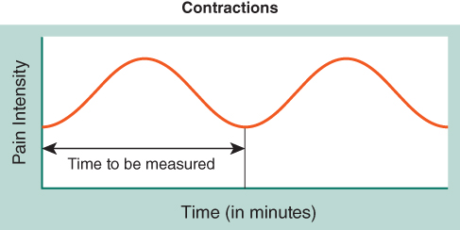
Timing Contraction Cycles
Time contraction cycles from beginning of one contraction to beginning of next.
If contractions are less than 3 minutes apart, delivery is close.
Figure 16-3 Time the contractions from the beginning of one to the beginning of the next.
© Jones & Bartlett Learning.
Notes:
C. Timing contraction cycles.
1. Time contraction cycles from beginning of one contraction to beginning of next.
2. If contractions are less than 3 minutes apart, delivery is close.
Figure: Time contractions from beginning of one to beginning of next.

Slide 18
Detecting Crowning
Observe vaginal opening during a contraction.
If you see head crowning during contraction, prepare for delivery.
Do not risk transporting woman to hospital.
Notes:
D. Detecting crowning.
1. Observe vaginal opening during a contraction.
2. If you see head crowning during contraction, prepare for delivery.
3. Do not risk transporting woman to hospital if child’s head is crowning.

Slide 19
Preparing for Delivery (1 of 3)
As you prepare to assist patient in delivery, keep two things in mind:
Calm woman: Delivery is a natural process.
Calm yourself: You are there to help.
Notes:
E. Preparing for delivery:
1. As you prepare to assist patient in delivery, keep two things in mind:
a. Calm woman—delivery is a natural process.
b. Calm yourself—you are there to help.

Slide 20
Preparing for Delivery (2 of 3)
You will not be able to maintain sterile conditions.
Attempt to be as clean as possible.
Wash your hands thoroughly.
If you do not have a sterile delivery kit, use gloves from your EMR life support kit.
Have plenty of clean towels ready.
Notes:
2. You will not be able to maintain sterile conditions, but you must attempt to be as clean as possible.
a. Wash your hands thoroughly.
b. If you do not have a sterile delivery kit, use gloves from your EMR life support kit.
c. Have plenty of clean towels ready to cover newborn and to clean mother.

Slide 21
Preparing for Delivery (3 of 3)
Place patient on a firm surface that is padded with blankets, folded sheets, or towels.
Elevate woman’s hips 2" to 4" with pillows and blankets.
Place woman on her back with knees bent and feet flat on surface beneath her.
Notes:
3. Place patient on a firm surface that is padded with blankets, folded sheets, or towels.
4. Elevate patient’s hips 2" to 4" with pillows and blankets.
5. Place woman in a comfortable position.
a. This is often on her back with knees bent and feet flat on surface beneath her.

Slide 22
Standard Precautions and Childbirth
A woman in childbirth will expel both blood and body fluids.
Use sterile gloves whenever possible.
Follow steps in Skill Drill 16-1 to put on sterile gloves.
Wear face and eye protection.
Wearing a surgical gown can help keep fluids off your body.
Notes:
IV. Standard Precautions and Childbirth:
A. Because a woman in childbirth will expel both blood and body fluids, use standard precautions during delivery.
1. Try not to get any more blood or fluids on you than is absolutely necessary.
2. Use sterile gloves whenever possible.
a. Follow steps in Skill Drill 16-1 to put on sterile gloves.
3. Because fluids can splatter on your face during delivery process, wear face and eye protection.
4. Wearing a surgical gown can help keep fluids off your body.

Slide 23
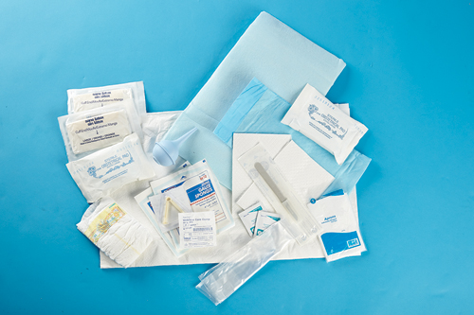
Equipment (1 of 3)
Your emergency care equipment should include a prepacked obstetric (OB) delivery kit, which includes:
Sterile gloves.
Umbilical cord clamp.
Figure 16-4 Commercial obstetric (OB) kit.
© Jones & Bartlett Learning.
Notes:
V. Equipment
A. Your emergency care equipment should include a prepackaged obstetric (OB) delivery kit, which includes:
1. Sterile gloves.
2. Umbilical cord clamp.
Figure: Commercial obstetric (OB) kit.

Slide 24
Equipment (2 of 3)
OB kit contents (cont'd):
Sterile drapes and towels.
Sanitary pads.
4" × 4" gauze pads.
Towel or blanket for newborn.
Bulb syringe.
Plastic placenta bag.
Notes:
3. Sterile drapes and towels.
4. Sanitary pads.
5. 4" × 4" gauze pads.
6. Towel or blanket for newborn.
7. Bulb syringe.
8. Plastic placenta bag.

Slide 25
Equipment (3 of 3)
You will also need following:
Sheets or towels for mother.
Suction (if available).
Oxygen (if available).
Newborn-sized face mask.
If you do not have a delivery kit, look for appropriate substitute materials.
Notes:
B. You will also need the following items:
1. Sheets or towels for mother.
2. Suction (if available).
3. Oxygen (if available and if you are trained to use it).
4. Newborn-sized face mask.
C. If you do not have a delivery kit, look for appropriate substitute materials.

Slide 26
Assisting With Delivery (1 of 5)
There are two lives to be considered: life of mother and life of newborn.
Do not neglect to perform a patient assessment on woman.
Your primary purpose is to assist in delivery of newborn.
Be as clean as possible during entire delivery process.
Notes:
VI. Assisting With Delivery:
A. Two lives to be considered in this situation: life of mother and life of newborn.
1. Do not neglect to perform a patient assessment on woman.
a. Determine whether she has any medical conditions.
b. Obtain a baseline set of vital signs and repeat them at least every 15 minutes.
c. Throughout delivery process, continue to monitor woman’s ABCs.
2. Your primary purpose is to assist in delivery of newborn.
a. Do not let woman go to bathroom and do not hold her legs together.
B. Be as clean as possible during the entire delivery process.
1. Do not touch the vaginal area except during the delivery.

Slide 27
Assisting With Delivery (2 of 5)
Newborn’s head should emerge slowly to prevent undue stress on newborn and tearing of vaginal tissues.
As head emerges, support newborn’s head and tell woman to stop pushing.
Do not attempt to pull newborn during delivery.
Notes:
C. Newborn’s head should emerge slowly to prevent undue stress on newborn and tearing of vaginal tissues.
1. As head emerges, support newborn’s head and tell woman to stop pushing.
2. Do not attempt to pull newborn during delivery.

Slide 28
Assisting With Delivery (3 of 5)
In a normal birth:
Newborn will turn to its side by itself after head emerges.
Rest of body will be delivered spontaneously.
Newborn will be wet and slippery.
Keep newborn’s head at about level of woman’s vagina.
Notes:
a. In a normal birth, newborn will turn to its side by itself after head emerges and rest of body will be delivered spontaneously.
b. Newborn will be wet and slippery.
c. Keep newborn’s head at about level of woman’s vagina.

Slide 29
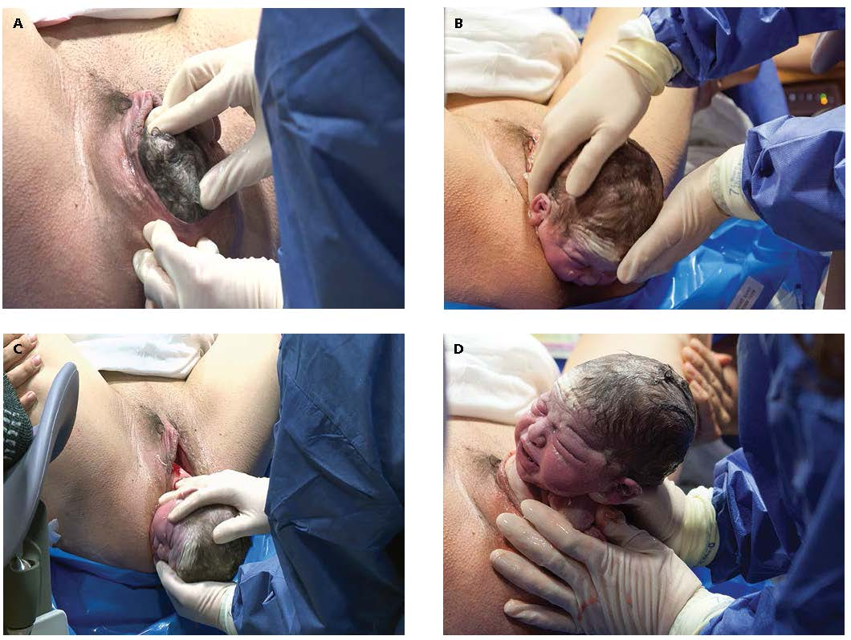
Assisting With Delivery (4 of 5)
Figure 16-5 Phases of the second stage of labor. A. The head begins to deliver. B. Delivery of the head. C. Delivery of the upper shoulder. D. Delivery of the lower shoulder.
© University of Maryland Shock Trauma Center/MIEMSS.
Notes:
Figure: Phases of second stage of labor. (Top left) Head begins to deliver. (Top right) Delivery of head. (Bottom left) Delivery of upper shoulder. (Bottom right) Delivery of lower shoulder.

Slide 30
Assisting With Delivery (5 of 5)
If amniotic sac has not broken, tear it with your fingers and push it away from newborn’s head and mouth.
If umbilical cord is wrapped around neck, attempt to slip it over head.
If you cannot disentangle newborn, attempt to reduce pressure on cord.
Never pull on umbilical cord.
Notes:
3. If amniotic sac has not broken, tear it with your fingers and push it away from newborn’s head and mouth.
4. If umbilical cord is wrapped around newborn’s neck, attempt to slip cord over newborn’s head.
a. If you cannot disentangle newborn from umbilical cord, attempt to reduce pressure on cord.
b. Never pull on umbilical cord; it is extremely fragile.

Slide 31
Caring for Newborn (1 of 4)
Clear newborn’s mouth and nose.
Use a bulb syringe if one is available.
Suction mouth first and then nostrils two to three times until they are clear.
If a bulb syringe is not available, wipe mouth and nose with a gauze pad.
Place newborn on mother’s abdomen to keep newborn from losing warmth.
Notes:
D. Caring for newborn.
1. Clear newborn’s mouth and nose.
a. Use a bulb syringe if one is available.
b. Suction mouth first and then nostrils two to three times until they are clear.
c. If a bulb syringe is not available, wipe newborn’s mouth and nose with a gauze pad.
2. Place newborn on mother’s abdomen to keep newborn from losing too much warmth.

Slide 32
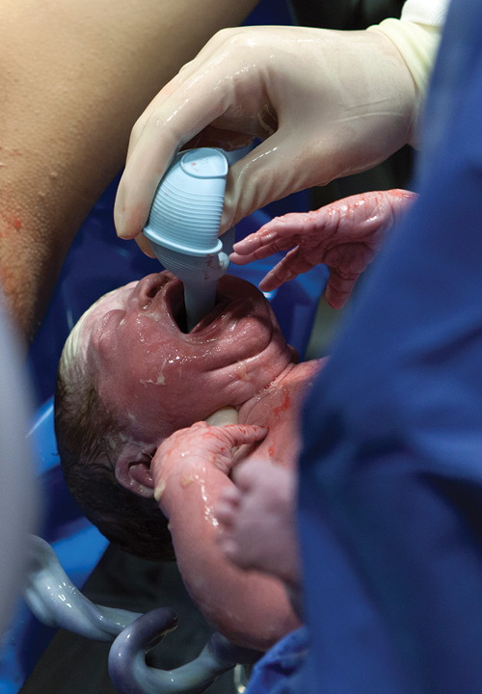
Caring for Newborn (2 of 4)
Figure 16-6 Suction the mouth and nose to clear the airway of mucus and amniotic fluid. Use a bulb syringe in a newborn’s mouth first, then use the bulb syringe to suction the newborn’s nose.
© University of Maryland Shock Trauma Center/MIEMSS.
Notes:
Figure: Suction mouth and nose to clear airway of mucus and amniotic fluid. Use a bulb syringe in a newborn ’s mouth first, then use bulb syringe to suction newborn’s nose.

Slide 33
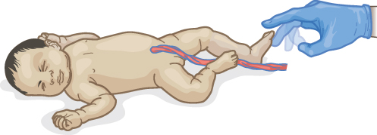
Caring for Newborn (3 of 4)
If newborn is not breathing, suction mouth and nose again.
Rub newborn’s back or flick the soles of newborn’s feet to stimulate breathing.
Use a towel to dry newborn and then wrap him or her in a blanket to keep him or her warm.
Figure 16-7 Gently flick your fingers against the soles of the feet to stimulate breathing in the newborn.
© Jones & Bartlett Learning.
Notes:
3. If newborn is not breathing, suction mouth and nose again.
a. Rub newborn’s back or flick soles of newborn’s feet to stimulate breathing.
4. Use a towel to dry newborn, and then wrap newborn in a blanket to keep him or her warm.
Figure: Gently flick your fingers on soles of the newborn’s feet to stimulate breathing in newborn.

Slide 34
Caring for Newborn (4 of 4)
Place newborn on its side with head slightly lower than trunk.
When umbilical cord stops pulsating, clamp it with umbilical cord clamps or tie it with gauze.
Note time of delivery.
If there are multiple births, prepare for second delivery.
Notes:
5. Place newborn on his or her side with head slightly lower than trunk to aid drainage of secretions from airway.
6. When umbilical cord stops pulsating, clamp it with umbilical cord clamps or tie it with gauze between the mother and newborn.
7. Note time of the delivery so it can be properly reported on newborn’s birth certificate.
8. In rare event that you encounter multiple births, prepare for second delivery.

Slide 35
Delivery of Placenta (1 of 3)
Placenta usually delivers on its own within 30 minutes after delivery.
Never pull on umbilical cord.
Leave umbilical cord uncut and attached to placenta and newborn until EMS unit arrives.
Notes:
E. Delivery of placenta.
1. Placenta usually delivers on its own within 30 minutes after delivery.
2. Never pull on umbilical cord to help deliver placenta.
3. Leave umbilical cord uncut and attached to placenta and newborn until transporting EMS unit arrives.

Slide 36
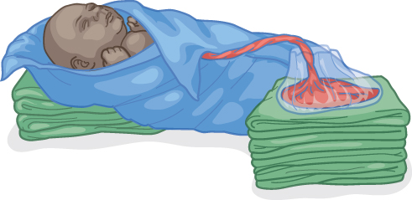
Delivery of Placenta (2 of 3)
After placenta is delivered:
Wrap it in a towel or newspaper with three-quarters of umbilical cord.
Place it in a plastic bag and transport it to hospital.
Keep it at same level as newborn.
Figure 16-8 If sterile supplies are unavailable and you cannot cut the umbilical cord, keep the placenta, still attached at the cord, at the same level as the newborn during transport to the hospital.
© Jones & Bartlett Learning.
Notes:
4. After placenta is delivered:
a. Wrap it in a towel or newspaper with three quarters of umbilical cord.
b. Place it in a plastic bag and transport it to hospital.
c. Keep it at same level as newborn to prevent blood from newborn flowing back into placenta.

Slide 37
Delivery of Placenta (3 of 3)
Mother’s bleeding usually stops after placenta is delivered.
If it does not, massage uterus.
Place one hand just above mother’s pubic bone.
Use your other hand to press down into abdomen and, using a circular motion, massage uterus until it becomes firm.
This should take 3 to 5 minutes.
Notes:
5. Mother’s bleeding usually stops after placenta is delivered.
6. If it does not, massage uterus to help stop bleeding.
a. Place one hand with fingers fully extended just above mother’s pubic bone.
b. Use your other hand to press down into abdomen and, using a circular motion, gently massage uterus until it becomes firm.
c. This should take 3 to 5 minutes.

Slide 38
Aftercare of Mother and Newborn (1 of 2)
Continue to observe mother and newborn and keep both warm.
About every 3 to 5 minutes, check uterus for firmness.
Recheck vagina for any excessive bleeding.
In a normal delivery, mother will lose 300 to 500 mL (1 to 2 cups) of blood.
Notes:
VII. Aftercare of Mother and Newborn:
A. Continue to observe mother and newborn carefully, and keep both of them warm.
1. Cover newborn’s head and body to prevent loss of body heat.
B. Approximately every 3 to 5 minutes, check uterus for firmness.
C. Recheck vagina for any excessive bleeding.
1. In a normal delivery, mother will lose 300 to 500 mL (1 to 2 cups) of blood.

Slide 39
Aftercare of Mother and Newborn (2 of 2)
Continue to massage uterus if it is not firm or if bleeding continues.
Clean mother with clean, moist towels or cloths.
Give her small amounts of water to drink if she is thirsty.
Notes:
2. Continue to massage uterus using a circular motion if it is not firm or if bleeding continues.
D. Clean mother with clean, moist towels or cloths and give her small amounts of water to drink if she is thirsty.

Slide 40
Resuscitating Newborn
If newborn does not breathe on its own within first minute after birth, proceed with steps listed in Skill Drill 16-2.
Notes:
VIII. Resuscitating Newborn
A. If newborn does not breathe on its own within first minute after birth, proceed with steps listed in Skill Drill 16-2.

Slide 41
Complications of Pregnancy and Childbirth (1 of 14)
Ectopic pregnancy and shock in pregnant women:
An ectopic pregnancy occurs when a fertilized egg becomes implanted in fallopian tube rather than in uterus.
As embryo starts to grow, it expands and causes fallopian tube to rupture.
Notes:
IX. Complications of Pregnancy and Childbirth:
A. Ectopic pregnancy and shock in pregnant women:
1. An ectopic pregnancy occurs when a fertilized egg becomes implanted in fallopian tube rather than in uterus.
2. As embryo starts to grow, it expands and causes fallopian tube to rupture.

Slide 42
Complications of Pregnancy and Childbirth (2 of 14)
Ectopic pregnancy and shock in pregnant women (cont'd):
This rupture causes acute abdominal pain, internal bleeding, and shock.
Treat patient for shock.
Arrange for prompt transport.
Notes:
3. This rupture causes:
a. Acute abdominal pain.
b. Internal bleeding.
c. Shock.
4. Treat patient for shock and arrange for prompt transport.

Slide 43
Complications of Pregnancy and Childbirth (3 of 14)
Miscarriage and vaginal bleeding:
A miscarriage (spontaneous abortion) is delivery of an incomplete or underdeveloped fetus.
If a miscarriage occurs:
Save fetus and all tissues that pass from vagina.
Control woman’s bleeding and treat for shock.
Arrange for prompt transport.
Notes:
B. Miscarriage and vaginal bleeding:
1. A miscarriage (spontaneous abortion) is delivery of an incomplete or underdeveloped fetus.
2. If a miscarriage occurs:
a. Save fetus and all tissues that pass from vagina.
b. Control woman’s bleeding and treat her for shock.
c. Arrange for prompt transport.

Slide 44
Complications of Pregnancy and Childbirth (4 of 14)
Miscarriage and vaginal bleeding (cont'd):
Vaginal bleeding is often first sign of a miscarriage.
When a woman experiences vaginal bleeding:
Perform a patient assessment.
Obtain a good medical history.
Obtain a set of vital signs.
Arrange for prompt transport.
Provide emotional support if she miscarried.
Notes:
3. Vaginal bleeding in a pregnant woman is often first sign of a miscarriage.
4. Anytime a woman experiences vaginal bleeding:
a. Perform a patient assessment.
b. Obtain a good medical history
c. Obtain a set of vital signs to determine whether she is experiencing shock.
d. Arrange for prompt transport.
5. A woman who miscarries will be upset about losing newborn and will need emotional support as well as emergency medical care.

Slide 45
Complications of Pregnancy and Childbirth (5 of 14)
Premature birth:
Any newborn weighing less than 5 pounds (2 kg) or delivered before 36 weeks is premature.
Premature newborns are smaller, thinner, and usually redder than full-term newborns.
Keep premature newborns warm because they lose heat rapidly.
Arrange for prompt transport.
Notes:
C. Premature birth:
1. Any newborn weighing less than 5 pounds (2 kg) or delivered before 36 weeks of pregnancy is considered premature.
2. Premature newborns are smaller, thinner, and usually redder than full-term newborns.
3. Keep premature newborns warm because they lose heat rapidly.
4. Arrange for prompt transport.

Slide 46
Complications of Pregnancy and Childbirth (6 of 14)
Unbroken bag of waters:
Carefully break bag and push it away from nose and mouth so newborn can breathe.
Be careful not to injure newborn in process.
Suction newborn’s mouth and then nose to help him or her to breathe.
Notes:
D. Unbroken bag of waters:
1. In rare circumstances, bag of amniotic fluid does not break.
2. Carefully break bag and push it away from newborn’s nose and mouth so he or she can breathe.
3. Be careful not to injure newborn in process.
4. Suction newborn’s mouth and then nose to help him or her begin to breathe.

Slide 47
Complications of Pregnancy and Childbirth (7 of 14)
Prolapse of umbilical cord:
Cord may be compressed between newborn and woman’s pelvis during contractions.
Place pregnant patient in a position that raises her hips.
Keep cord covered and moist, and do not try to push it back into vagina.
Notes:
E. Prolapse of umbilical cord
1. On rare occasions, umbilical cord appears from vagina before fetus is delivered.
2. Cord may be compressed between newborn and the woman’s pelvis during contractions, cutting off newborn’s blood supply.
a. Prolapse of umbilical cord is a serious emergency that requires immediate transport.
3. Place pregnant patient in a position that raises her hips.
4. Keep cord covered and moist, and do not try to push it back into vagina.

Slide 48
Complications of Pregnancy and Childbirth (8 of 14)
Prolapse of umbilical cord (cont'd):
Administer oxygen if it is available.
Arrange for prompt transport.
Some EMS systems recommend placing woman in a kneeling position to take pressure off cord.
Notes:
5. Administer oxygen if it is available.
6. Arrange for rapid transport.
7. Some EMS systems recommend placing woman in a kneeling position to take pressure off cord.

Slide 49
Complications of Pregnancy and Childbirth (9 of 14)
Breech birth:
Newborn’s buttocks come down birth canal first, rather than head.
Arrange for prompt transport.
Support newborn’s buttocks and legs as they are delivered.
Head usually follows on its own.
Notes:
F. Breech birth:
1. In a breech birth, newborn’s buttocks come down birth canal first, rather than head.
2. Arrange for prompt transport.
a. A breech birth slows labor, so there will be more time for transport to emergency department.
3. Support newborn’s buttocks and legs as they are delivered; head usually follows on its own.

Slide 50
Complications of Pregnancy and Childbirth (10 of 14)
Breech birth (cont'd):
If head does not deliver within 3 minutes:
Arrange for prompt transport.
Insert a gloved hand into vagina and use your fingers to keep newborn’s airway open.
In very rare cases, arm or leg is first part of newborn to appear in birth canal.
Limb presentation cannot be handled in field.
Notes:
4. If head does not deliver within 3 minutes
a. Arrange for prompt transport.
b. Insert a gloved hand into vagina and use your fingers to keep newborn’s airway open by forming a pocket over newborn’s nose and mouth.
5. In very rare cases, arm or the leg is first part of newborn to appear in birth canal.
a. Limb presentation is an extreme emergency that cannot be handled in field.
b. Arrange for rapid transport.

Slide 51
Complications of Pregnancy and Childbirth (11 of 14)
Stillborn delivery:
Sometimes an newborn dies in uterus before labor.
Fetus will generally have an unpleasant odor and will not exhibit any signs of life.
Carefully wrap stillborn newborn in a blanket.
Turn your attention to mother and provide physical care and emotional support.
Notes:
G. Stillborn delivery:
1. Sometimes a newborn dies in uterus before labor begins.
2. Fetus will generally have an unpleasant odor and will not exhibit any signs of life.
3. Carefully wrap stillborn newborn in a blanket.
4. Turn your attention to mother and provide physical care and emotional support.

Slide 52
Complications of Pregnancy and Childbirth (12 of 14)
Multiple births:
Another set of labor contractions will begin shortly after delivery of first newborn.
Get ready to repeat procedure you completed for delivering first newborn.
Excessive bleeding after delivery:
Approximately 1 to 2 cups of blood is lost during normal childbirth.
Notes:
H. Multiple births:
1. Another set of labor contractions will begin shortly after delivery of the first newborn.
2. Get ready to repeat procedures you completed for delivering first newborn.
I. Excessive bleeding after delivery:
1. Approximately 1 or 2 cups of blood is lost during normal childbirth.

Slide 53
Complications of Pregnancy and Childbirth (13 of 14)
Excessive bleeding after delivery (cont'd):
If mother is bleeding severely:
Place one or more clean sanitary pads at opening of vagina.
Elevate her legs and hips.
Treat her for shock.
Arrange for rapid transport.
Notes:
2. If mother is bleeding severely:
a. Place one or more clean sanitary pads at opening of vagina.
b. Elevate her legs and hips.
c. Treat her for shock.
d. Arrange for rapid transport.

Slide 54
Complications of Pregnancy and Childbirth (14 of 14)
Excessive bleeding after delivery (cont'd):
Encourage newborn to nurse at mother’s breast.
Massage uterus with your hand.
If area between mother’s vagina and anus is torn and bleeding, treat it as you would an open wound.
Notes:
3. Encourage newborn to nurse at mother’s breast because nursing contracts uterus and can often help stop bleeding.
4. Massage uterus with your hand.
5. If area between mother’s vagina and anus is torn and bleeding, treat it as you would an open wound.

Slide 55
Vehicle Collisions and Pregnant Women (1 of 3)
Woman should be examined by a physician.
Forces involved in even a minor crash may be great enough to injure woman or unborn child.
Promptly assess patient and arrange transport to hospital.
Notes:
X. Vehicle Collisions and Pregnant Women:
A. Woman should be examined by a physician.
1. Forces involved in even a minor crash may be great enough to injure the woman or unborn child.
B. Promptly assess patient and arrange transport to hospital.

Slide 56
Vehicle Collisions and Pregnant Women (2 of 3)
If woman exhibits signs or symptoms of shock:
Monitor airway, breathing, and circulation.
Arrange for administration of high-flow oxygen.
Have woman lie on her left side rather than on her back.
Notes:
C. If woman exhibits signs or symptoms of shock:
1. Monitor airway, breathing, and circulation.
2. Arrange for administration of high-flow oxygen.
3. Have woman lie on her left side rather than on her back.

Slide 57
Vehicle Collisions and Pregnant Women (3 of 3)
In rare cases, a crash can be severe enough to kill pregnant woman but not fetus.
Provide CPR to woman while transporting her to closest medical facility.
Notes:
D. In rare circumstances, a crash can be severe enough to kill pregnant woman but not fetus.
1. Provide CPR to the woman while transporting her to closest medical facility.

Slide 58
Summary (1 of 3)
Key indicators in estimating how soon a delivery will occur are crowning and time between contractions.
Stage one of labor is characterized by following conditions: initial contractions occur, bag of waters breaks, and bloody show occurs, but newborn’s head does not appear.
Notes:
A. This chapter presents skills and knowledge you need to assist in birth of a newborn.
B. Key indicators when estimating how soon a delivery will occur are crowning and time between contractions. By assessing these two factors, you can determine whether a woman should be transported to a medical facility or whether birth will occur outside hospital.
C. Normal labor consists of three distinct stages which are as follows:
1. Stage one is characterized by following conditions: initial contractions occur, bag of waters breaks, and bloody show occurs, but newborn’s head does not appear.

Slide 59
Summary (2 of 3)
Stage two of labor involves actual birth. You will see newborn’s head crowning during contractions, at which time you must prepare to assist woman with delivery.
Stage three of labor involves delivery of placenta. You must assist in stabilizing condition of mother and newborn and delivering placenta.
Exercise standard precautions when assisting with a delivery.
Notes:
2. Stage two involves actual birth. You will see newborn’s head crowning during contractions, at which time you must prepare to assist woman with delivery.
3. Stage three involves delivery of placenta. You must assist in stabilizing condition of mother and newborn and delivering placenta.
D. Exercise standard precautions when assisting with a delivery

Slide 60
Summary (3 of 3)
After delivery, you have two patients to care for—mother and newborn.
If newborn does not breathe on its own within first minute after birth, proceed with steps to resuscitate.
Although most pregnancies and births are uneventful, you should be aware of possible complications, including ectopic pregnancies and shock, vaginal bleeding and miscarriage, premature births, an unbroken bag of waters, a prolapsed umbilical cord, breech birth, a stillborn delivery, multiple births, and excessive bleeding after delivery.
Notes:
E. After delivery, you have two patients to care for—mother and newborn.
F. If newborn does not breathe on its own within first minute after birth, proceed with steps to resuscitate newborn.
G. Although most pregnancies and births are uneventful, you should be aware of possible complications, including ectopic pregnancies and shock, vaginal bleeding and miscarriage, premature births, an unbroken bag of waters, a prolapsed umbilical cord, breech birth, a stillborn delivery, multiple births, and excessive bleeding after delivery.
H. Keep in mind that childbirth is usually a happy event. You are there to assist in delivery, which in most cases has a happy, healthy outcome.

Slide 61
Review
For the EMR, assisting with delivery involves:
determining exactly when the woman will deliver.
transporting the pregnant woman only.
supporting the newborn’s head as it emerges and telling the woman to stop pushing.
pulling on the newborn to expedite birth.
Notes:
61

Slide 62
Review
Answer:
C. supporting the newborn’s head as it emerges and telling the woman to stop pushing.

Slide 63
Review
As soon as a baby is born, it is important to:
cool the baby to stimulate breathing.
ensure that the baby is dried and warmed.
keep newborn’s head higher than its body.
immediately cut the umbilical cord.
Notes:
63

Slide 64
Review
Answer:
B. ensure that the baby is dried and warmed.

Slide 65
Review
Complications of pregnancy include all of the following, except:
premature birth.
prolapsed cord.
breech birth.
multiple births.
Notes:
65

Slide 66
Review
Answer:
D. multiple births.

