Slide 1

Pediatric Emergencies
CHAPTER 17

Slide 2
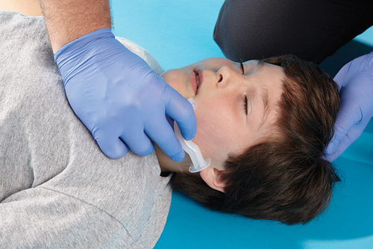
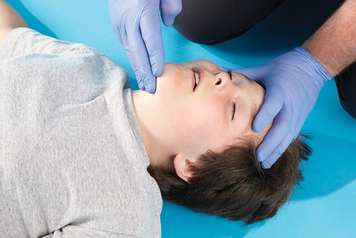
Skill Drill 17-1 Inserting an Oral Airway in a Child (1-2)
Step 1 Select the proper size oral airway by measuring from the patient’s earlobe to the corner of the mouth.
Step 2 Position the patient’s airway. If the emergency is medical, use the head tilt–chin lift maneuver, avoiding hyperextension. If the patient has a traumatic injury, use the jaw-thrust maneuver.
© Jones & Bartlett Learning. Courtesy of MIEMSS.
© Jones & Bartlett Learning. Courtesy of MIEMSS.

Slide 3
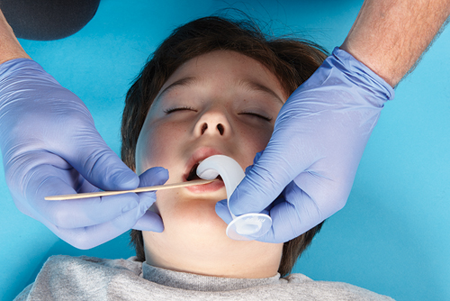
Skill Drill 17-1 Inserting an Oral Airway in a Child (2-2)
Step 3 Depress the patient’s tongue with a tongue blade. Press the tongue forward and away from the roof of the mouth. Follow the anatomic curve of the roof of the patient’s mouth to slide the airway into place. Be gentle. The mouths of children and infants are fragile.
© Jones & Bartlett Learning. Courtesy of MIEMSS.

