Slide 1
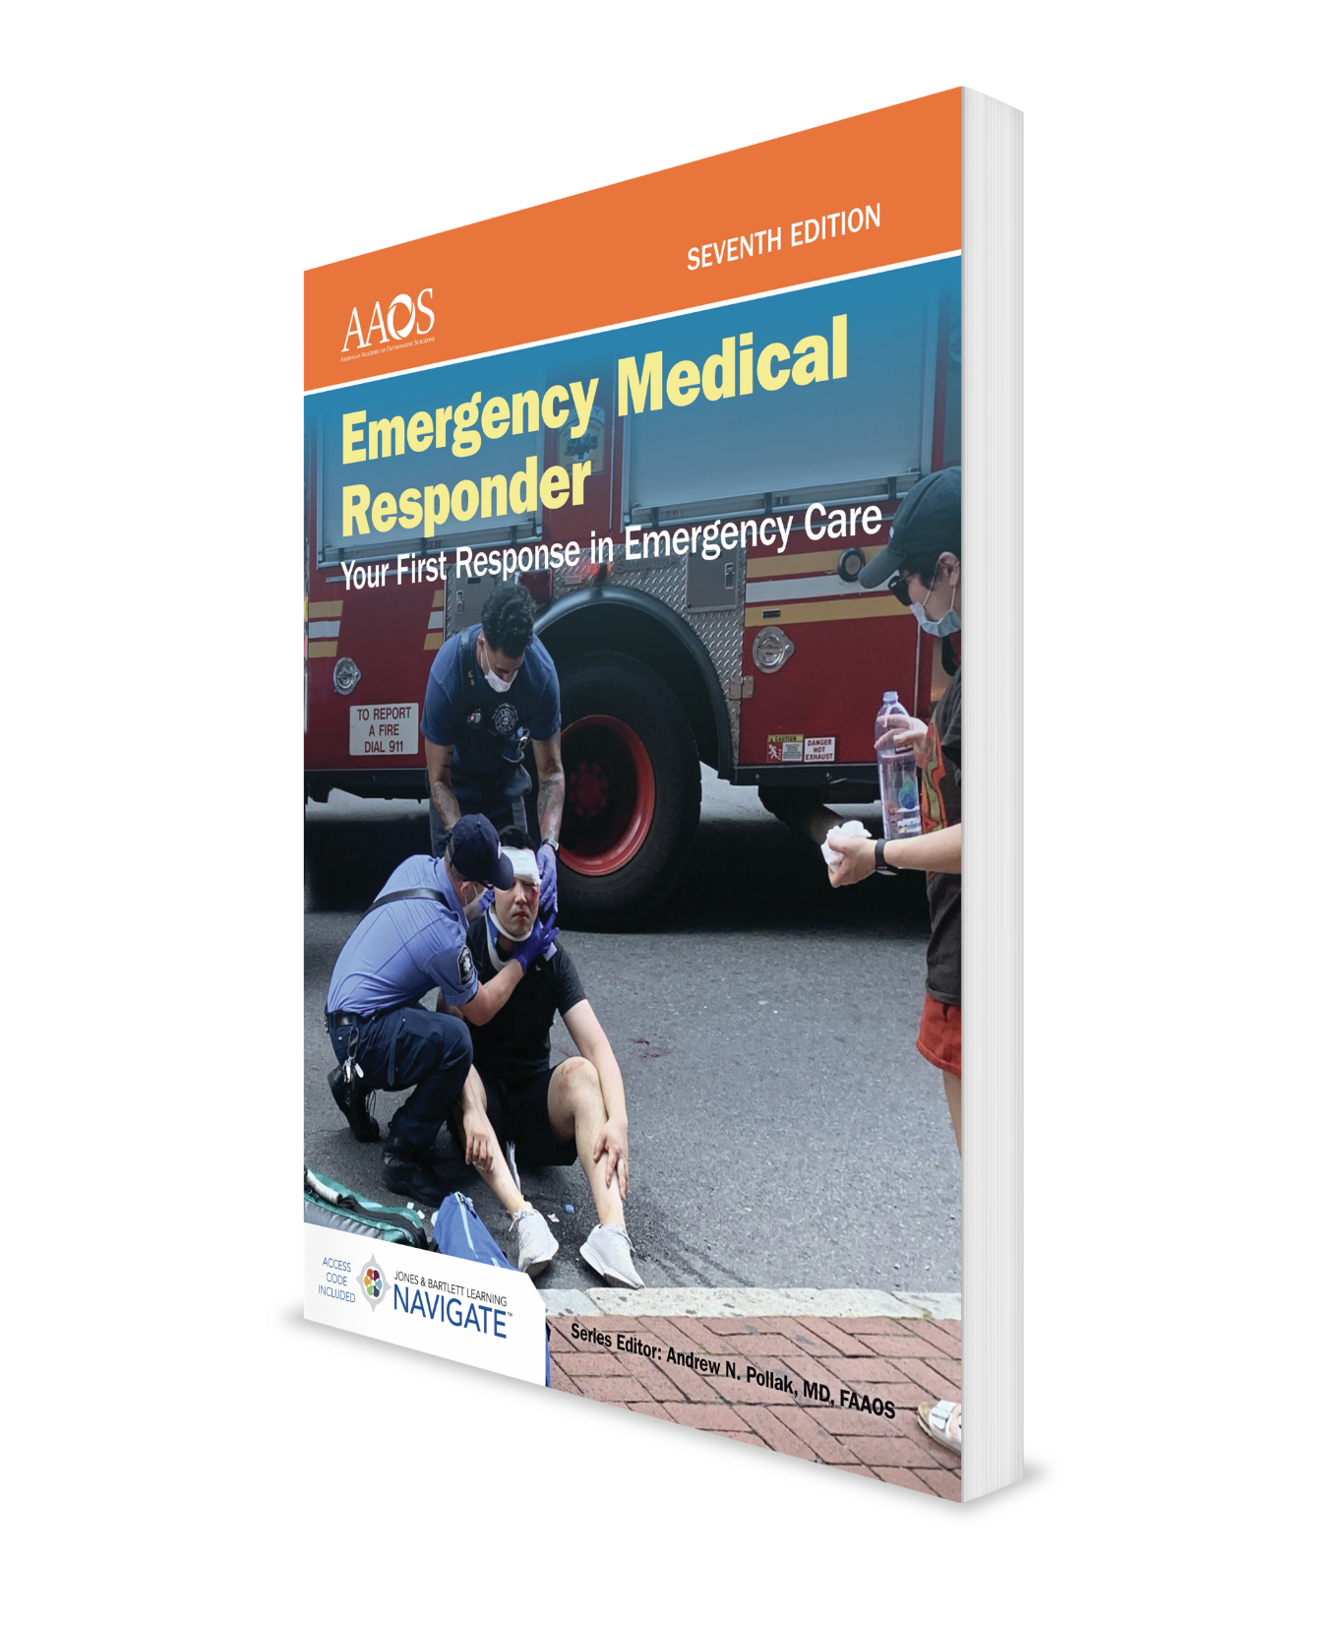
Transport Operations
CHAPTER 19

Slide 2
National EMS Education Standard Competencies (1 of 2)
EMS Operations:
Knowledge of operational roles and responsibilities to ensure safe patient, public, and personnel safety.
Notes:
EMS Operations:
Knowledge of operational roles and responsibilities to ensure safe patient, public, and personnel safety.

Slide 3
National EMS Education Standard Competencies (2 of 2)
Principles of Safely Operating a Ground Ambulance:
Risk and responsibilities of emergency response.
Air Medical:
Safe air medical operations.
Criteria for utilizing air medical response.
Notes:
Principles of Safely Operating a Ground Ambulance:
• Risks and responsibilities of emergency response. (pp 402-404)
Air Medical:
• Safe air medical operations. (pp 406-407)
• Criteria for utilizing air medical response. (p 404)

Slide 4
Introduction
To be an effective EMR, you need to:
Prepare for call.
Review dispatch information.
Respond safely to scene.
Perform a scene size-up.
Perform initial patient assessment and provide emergency care.
Update other responding units and transfer care to other EMS personnel.
Complete postrun activities.
Notes:
I. Introduction:
A. To be an effective EMR you need to:
1. Prepare for call.
2. Review dispatch information.
3. Respond safely to scene.
4. Perform a scene size-up.
5. Perform initial patient assessment and provide emergency care
6. Update other responding units and transfer care to other EMS personnel.
7. Complete postrun activities.

Slide 5
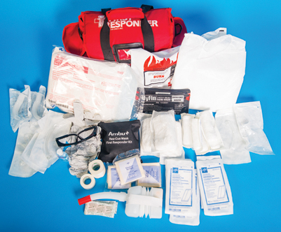
Preparing for a Call (1 of 2)
Preparing for a call:
Ensure that your vehicle is ready to respond at all times.
Be prepared to respond promptly using most direct route available.
Make sure you have proper equipment.
Figure 19-1 Suggested contents of an EMR life support kit.
© Jones & Bartlett Learning.
Notes:
A. You may respond using a fire department vehicle, a law enforcement vehicle, your private vehicle, or on foot.
1. You must ensure that these vehicles are ready to respond at all times.
2. Follow a regular schedule to inspect and maintain all vehicles.
3. Check tire pressures, fluid levels, and fuel levels.
B. Be prepared to respond promptly using most direct route available.
C. Make sure you have proper equipment to perform your job, including:
1. Patient examination equipment.
2. Personal safety equipment.
3. Resuscitation equipment.
4. Bandaging and dressing equipment.
5. Patient immobilization equipment.
6. Extrication equipment.
D. Equipment must be stocked and maintained on a regular basis according to schedule specified by your agency.
Figure: Suggested contents of an EMR life support kit.

Slide 6
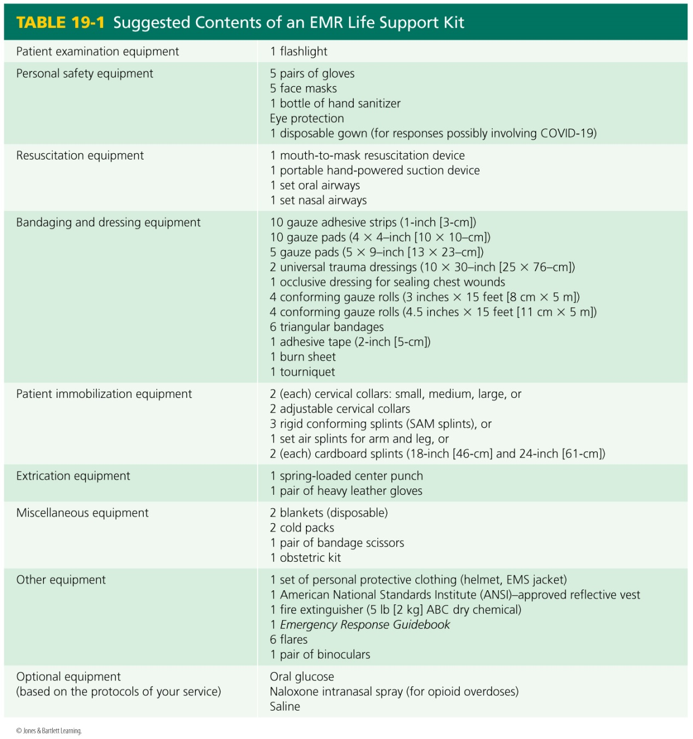
Preparing for a Call (2 of 2)
Notes:
Table: Suggested Contents of an EMR Life Support Kit

Slide 7
Phases of an EMR Call (1 of 6)
Dispatch:
Dispatch facility is a center that citizens can call to request emergency medical care.
Most centers are part of a 9-1-1 system.
Dispatchers should obtain proper information from caller and instruct callers on how to perform life-saving techniques until you arrive.
Notes:
III. Phases of an EMR Call:
A. Dispatch:
1. Dispatch facility is a center that citizens can call to request emergency medical care.
2. Most centers are part of a 9-1-1 system that is responsible for dispatching fire, police, and EMS responders.
3. Dispatchers should obtain proper information from caller and instruct callers on how to perform life-saving techniques such as CPR until you arrive.

Slide 8
Phases of an EMR Call (2 of 6)
Information from dispatch should include:
Nature of call.
Name and location of patient.
Number of patients.
Any special problems.
Call-back number from caller.
Notes:
4. You may receive your dispatch information by telephone, radio, pager, computer terminal, or written printout.
5. Information from dispatch should include:
a. Nature of call.
b. Name and location of patient.
c. Number of patients.
d. Any special problems.
e. Call-back number from caller.

Slide 9
Phases of an EMR Call (3 of 6)
Response to scene:
Get to scene quickly and safely.
Consider traffic patterns and time of day.
Always use seatbelts.
Keep all equipment secured.
Use warning devices according to state laws.
Do not exceed a safe speed.
Drive defensively.
Notes:
B. Response to scene:
1. Your first priority is to get to scene quickly and safely.
2. Consider traffic patterns and time of day before you select best route.
3. Be sure you know how to get to location of call.
4. Follow safety procedures.
a. Be certain that all personnel are properly seated and secured with approved seatbelts.
b. Keep all equipment secured.
c. Use warning devices according to your state laws and according to regulations specified by your agency.
i. Emergency warning devices allow you to request right of way; they do not guarantee it.
ii. Be especially careful at intersections and railroad crossings.
d. Do not exceed a safe speed for the vehicle you are operating.
e. Drive defensively so you are not involved in a crash.

Slide 10
Phases of an EMR Call (4 of 6)
Arrival at scene:
Place your vehicle in a safe location.
Perform a scene size-up.
Look for hazards.
Control flow of traffic.
Determine number of patients and need for additional resources.
Provide patient care.
Notes:
C. Arrival at scene:
1. Place your vehicle in a safe location to minimize chance of injury.
2. Consider how best to use your vehicle warning lights.
3. Perform a scene size-up as outlined in patient assessment sequence.
4. Look for hazards:
a. Downed electrical lines.
b. Leaking fuel.
c. Broken glass.
d. Fire.
5. Control flow of traffic to ensure safety of rescuers, patients, and bystanders.
6. Determine number of patients and identify whether you need additional resources.
7. Provide patient care using knowledge and skills you have learned in this course.

Slide 11
Phases of an EMR Call (5 of 6)
Transferring care of patient to other EMS personnel.
Give them a brief report of situation and tell them what care you have provided.
Ask them if they have any questions for you.
Offer to assist them in caring for patient.
Notes:
D. Perform patient assessment and provide emergency care.
E. Transferring care of patient to other EMS personnel
1. Transfer care to more highly trained personnel.
a. Give them a brief report of situation as you initially observed it and tell them what care you have provided.
b. Ask them if they have any questions for you.
c. Offer to assist them in caring for patient.

Slide 12
Phases of an EMR Call (6 of 6)
Postrun activities:
Complete paperwork.
Clean your equipment and replace needed supplies.
Only after you have completed these activities should you resume regular duties or notify your dispatcher that you are ready for another call.
Notes:
F. Postrun activities:
1. Your job is not done until you have completed paperwork.
2. You must also clean your equipment and replace needed supplies.
3. Only after you have completed these activities should you resume regular duties or notify your dispatcher that you are ready for another call.

Slide 13
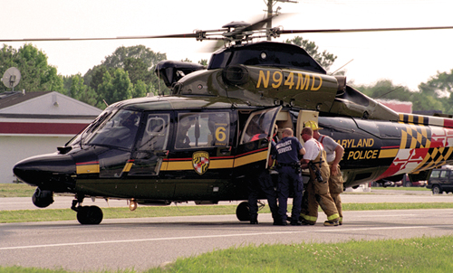
Helicopter Operations (1 of 3)
Helicopters are used for by EMS systems to:
Reach patients.
Transport patients to medical facilities.
Remove patients from inaccessible areas.
Figure 19-2 Helicopters are often used in EMS operations.
© Mark C. Ide.
Notes:
IV. Helicopter Operations:
A. Helicopters are used for following by EMS systems to:
1. Reach patients.
2. Transport patients to medical facilities.
3. Remove patients from inaccessible areas.
Figure: An EMS helicopter.

Slide 14
Helicopter Operations (2 of 3)
Helicopters have several advantages.
They can respond quickly above traffic congestion and wilderness areas.
They usually carry specialized equipment.
Their personnel may be able to perform some advanced skills not available from personnel staffing ground ambulances.
Helicopters are limited by bad weather.
Notes:
B. Helicopters have several advantages.
1. They can respond quickly above traffic congestion and wilderness areas.
2. They usually carry specialized equipment.
3. Their personnel may be able to perform some advanced skills not available through personnel staffing ground ambulances.
C. Helicopters are limited by bad weather, and they are unable to fly under conditions of limited visibility.

Slide 15
Helicopter Operations (3 of 3)
If your EMS system uses a helicopter:
Obtain a copy of ground operations procedures.
Schedule an orientation session with helicopter personnel.
Know how to request a helicopter response as well as what the criteria for calling a helicopter for trauma patients, medical patients, and wilderness response are.
Notes:
D. If your EMS system uses a helicopter:
1. Obtain a copy of ground operations procedures.
2. Schedule an orientation session with helicopter personnel.
3. Know how to request a helicopter response as well as what the criteria for calling a helicopter for trauma patients, medical patients, and wilderness response are.

Slide 16
Helicopter Safety Guidelines (1 of 4)
Helicopters can be dangerous to untrained personnel.
Main rotors spin at 300 rpm and may be just 4′ above ground.
Tail rotor spins at more than 3,000 rpm, and may be invisible to an unwary person.
Rotors can generate winds of 60 to 80 mph.
Notes:
E. Helicopter safety guidelines:
1. Helicopters can provide lifesaving transport for patients with serious injuries to an appropriate medical facility.
2. Helicopters are dangerous to untrained personnel.
a. Main rotor spins at more than 300 revolutions per minute (rpm) and may be just 4′ above ground.
b. Tail rotor spins at more than 3,000 rpm, and may be invisible to an unwary person.
c. Rotors can generate a “wash” equivalent to winds of 60 to 80 mph.

Slide 17
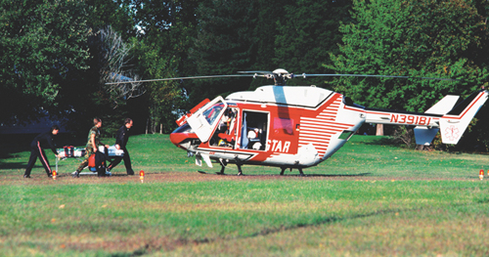
Helicopter Safety Guidelines (2 of 4)
Setting up landing zone (LZ):
Pilots usually land and take off into wind.
Most civilian helicopters need a landing zone of 100’ × 100’.
Landing zone should be as flat as possible and free of debris.
Figure 19-3 Landing zone with cones and warning devices in place.
© Thomas R. Fletcher/Alamy.
Notes:
3. Setting up landing zone (LZ):
a. Pilots usually land and take off into wind.
b. Size of a landing zone depends on the size of helicopter.
i. Most civilian helicopters need a landing zone of at least 100′ × 100′ (30 x 30 m) which is 10,000 square feet.
ii. Military aircraft may need a larger area.
c. Landing zone should be as flat as possible and free of debris.
Figure: Landing zone with cones and warning devices in place.

Slide 18
Helicopter Safety Guidelines (3 of 4)
Setting up landing zone (LZ) (cont’d):
Check for any nearby wires.
If site slopes or has any obstacles, notify pilot.
When marking area, avoid using flags, fusees, or flashing emergency lights.
Keep vehicles clear of LZ.
Notes:
d. Check for any nearby wires.
e. If site slopes or has any obstacles, notify pilot.
f. Check with the helicopter service to see how you should secure and mark perimeter of site.
i. Avoid using flags or other objects that can be blown away.
ii. Fusees (red signal flares) can create a fire hazard and should not be used.
iii. White lights and flashing emergency lights can interfere with pilot’s vision.
Keep vehicles clear of LZ.
h. Close windows and doors of any nearby vehicles.
i. Some helicopter services request that a charged hose line be available for fire emergencies.

Slide 19
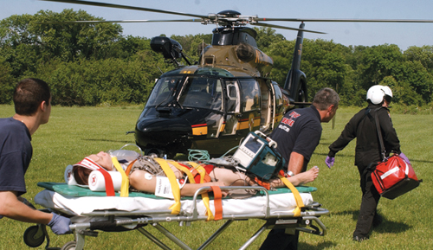
Helicopter Safety Guidelines (4 of 4)
Loading patients into helicopters:
Secure all loose clothing, sheets, and instruments.
Use eye protection.
Approach a helicopter from front and only after pilot signals that it is safe.
Follow flight crew’s instructions.
Give patient report to crew, away from noise, and offer your assistance.
Patients need to be packaged properly and securely.
Figure 19-4 Approach helicopters from the front so the pilot can see you.
© Mark C. Ide.
Notes:
4. Loading patients into helicopters:
a. Secure all loose clothing, sheets, and instruments.
b. Use eye protection to prevent debris from getting into your eyes.
c. Approach a helicopter from front and only after pilot or crew member signals that it is safe.
d. Follow flight crew’s instructions.
e. Give patient report to crew, away from helicopter’s noise, and offer your assistance.
f. Patients need to be packaged properly and securely.
g. If you will be working with a helicopter ambulance, arrange an orientation session with helicopter personnel so you will be prepared in an emergency.
Figure: Approach helicopters from front so pilot can see you.

Slide 20
Summary
As an EMR, you need proper equipment on an emergency call, including medical equipment in your life support kit, your personal safety equipment, and equipment to safeguard accident scene.
Six phases of an emergency call are preparation, dispatch, response to scene, arrival at scene, transferring care of patient to other EMS personnel, and postrun activities.
If you will be working with a medical helicopter, you need to know proper safety precautions and loading procedures for helicopter transport.
Notes:
A. In preparing yourself for a call, you must understand your role as a member of emergency medical system and be prepared to respond promptly.
B. As an EMR, you need proper equipment on an emergency call, including medical equipment in your life support kit, your personal safety equipment, and equipment to safeguard accident scene.
C. Six phases of an emergency call are preparation, dispatch, response to scene, arrival at scene, transferring care of patient to other EMS personnel, and postrun activities.
D. If you will be working with a medical helicopter, you need to know proper safety precautions and loading procedures for helicopter transport.
E. By learning simple but important skills involving EMS operations, you can become an effective member of EMS system in your community.

Slide 21
Review
Which of the following is not a phase of an EMR call?
Arrival at scene.
Postrun activities.
Scheduling for upcoming shifts.
Preparation.
Notes:
21

Slide 22
Review
Answer:
C. Scheduling for upcoming shifts.

Slide 23
Review
Information from dispatch should include all of the following, except:
number of patients.
nature of call.
nearest hospital.
call-back number.
Notes:
23

Slide 24
Review
Answer:
C. nearest hospital.

Slide 25
Review
When approaching a helicopter, you should:
always approach from the rear.
always approach from the front.
attempt to move the patient to the aircraft as soon as it lands.
not need eye protection.
Notes:
25

Slide 26
Review
Answer:
B. always approach from the front.

