Slide 1

Vehicle Extrication and Special Rescue
CHAPTER 20

Slide 2
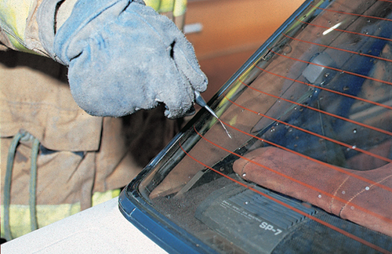
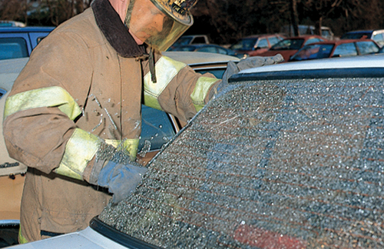
Skill Drill 20-1 Accessing the Vehicle Through the Window (1-2)
Step 1 Wear heavy-duty leather gloves and eye protection, if available. Place the spring-loaded center punch at the lower corner of the window.
Step 2 Press on the center punch to break the window.
© Jones & Bartlett Learning. Courtesy of MIEMSS.
© Jones & Bartlett Learning. Courtesy of MIEMSS.

Slide 3
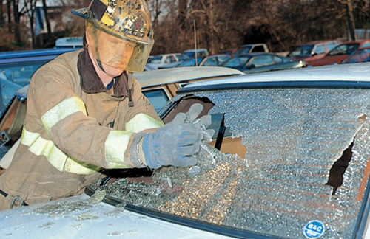
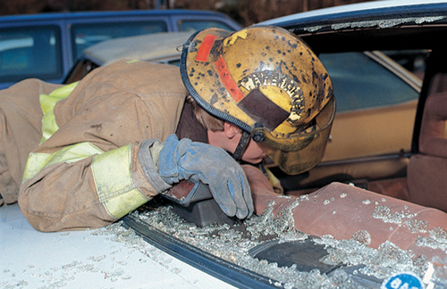
Skill Drill 20-1 Accessing the Vehicle Through the Window (2-2)
Step 3 With gloved hands, remove the broken glass to the outside of the vehicle.
Step 4 Enter the vehicle through the window.
© Jones & Bartlett Learning. Courtesy of MIEMSS.
© Jones & Bartlett Learning. Courtesy of MIEMSS.

Slide 4
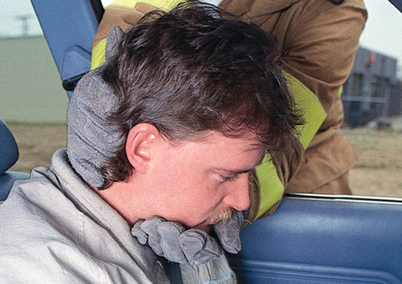
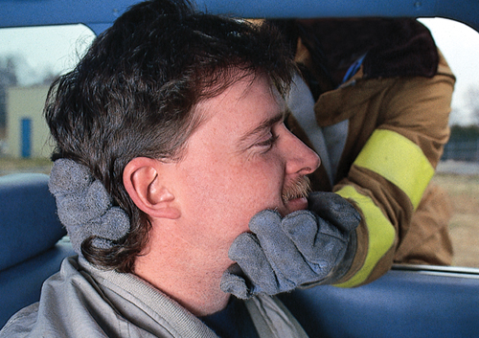
Skill Drill 20-2 Airway Management in a Vehicle
Step 1 Place one hand under the patient’s chin and your other hand on the back of the patient’s head.
Step 2 Raise the patient’s head to a neutral position to open the airway.
© Jones & Bartlett Learning. Courtesy of MIEMSS.
© Jones & Bartlett Learning. Courtesy of MIEMSS.

Slide 5
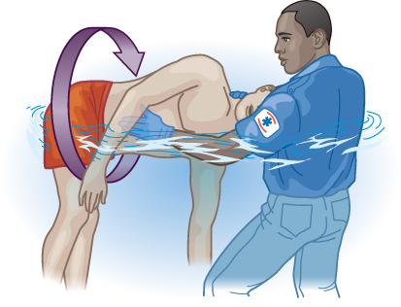
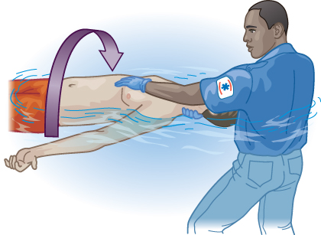
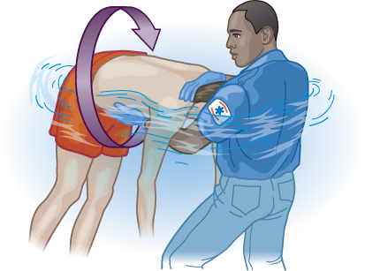
Skill Drill 20-3 Turning a Patient in the Water
Step 1 Support the back and head with one hand. Place your other hand on the front of the patient to keep the head and neck stabilized.
Step 2 Keep the head in the neutral position and carefully turn the patient as a unit.
Step 3 Stabilize the patient’s head and neck.
© Jones & Bartlett Learning.
© Jones & Bartlett Learning.
© Jones & Bartlett Learning.

