Slide 1
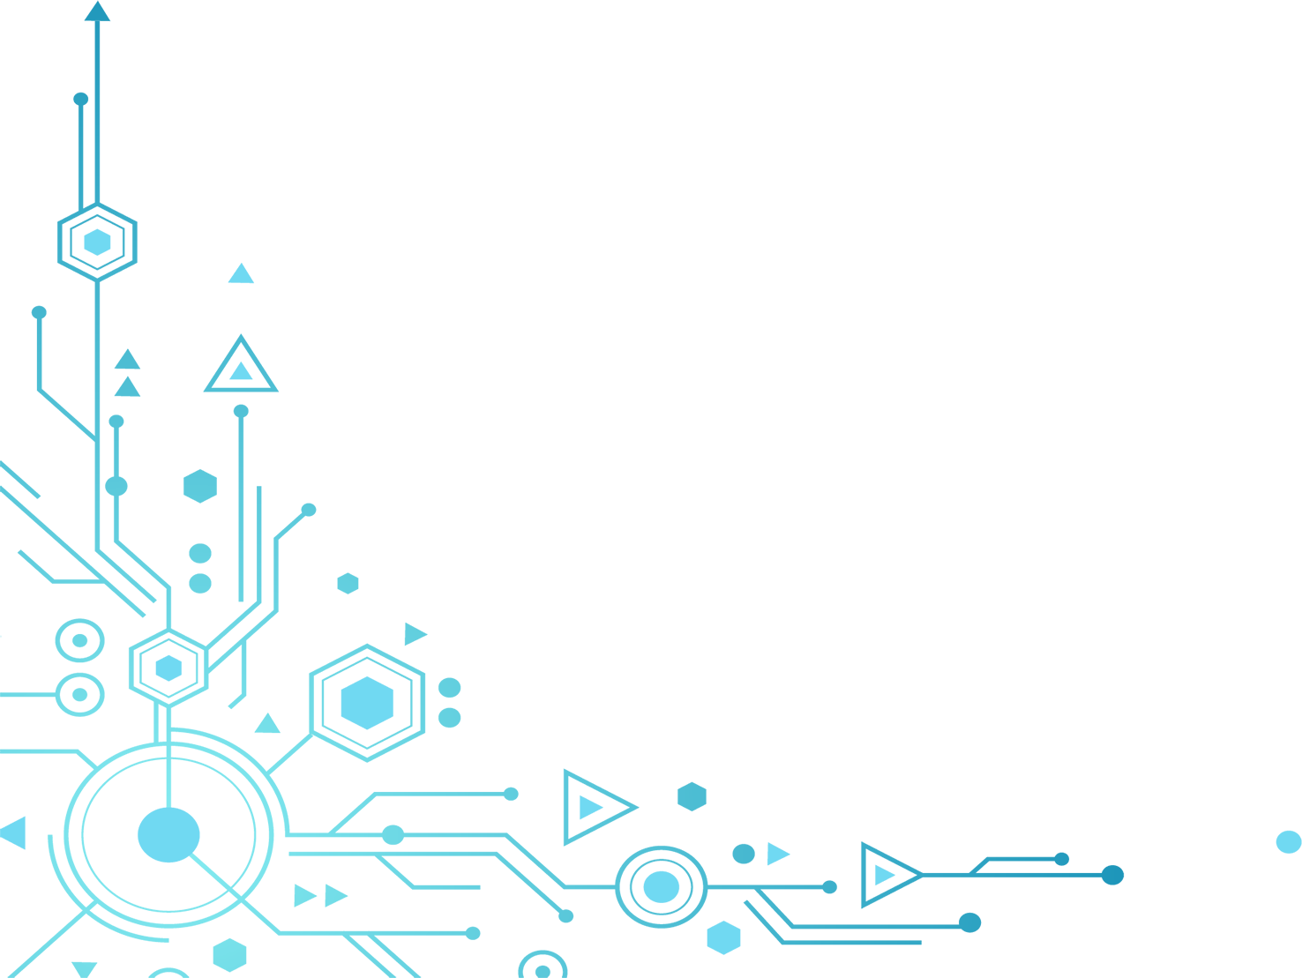
Understanding Network Hardware Components
This presentation will provide an overview of the different network hardware components used to build computer networks. It will cover the function and purpose of each component, as well as their importance in ensuring the smooth and secure transmission of data across the network.
By: Manuel Fernández Caballero

Slide 2

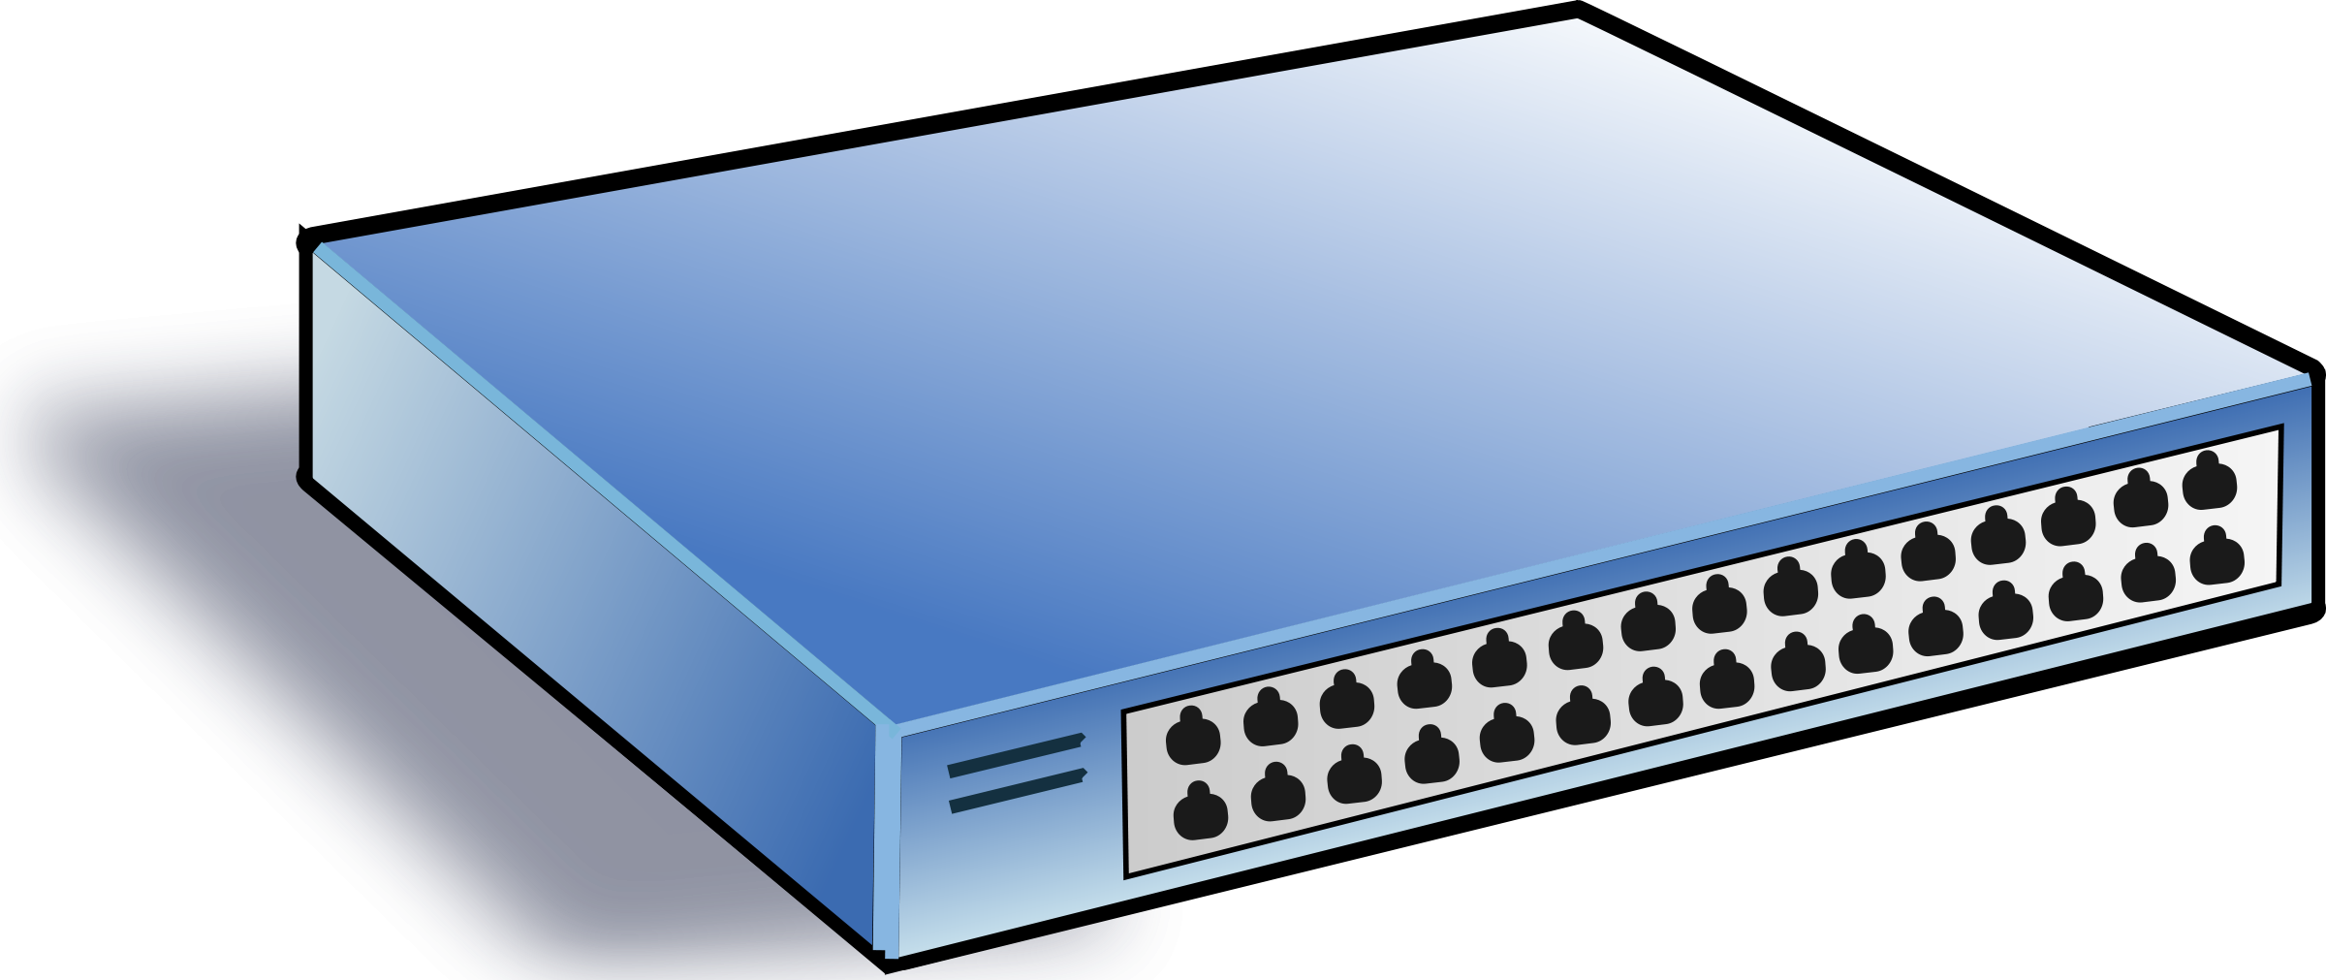
Switch
A switch is a hardware device that connects devices on a network. It is responsible for forwarding data to the correct destination device based on its MAC address. Switches are commonly used in local area networks (LANs) to connect computers, printers, and other devices.

Slide 3
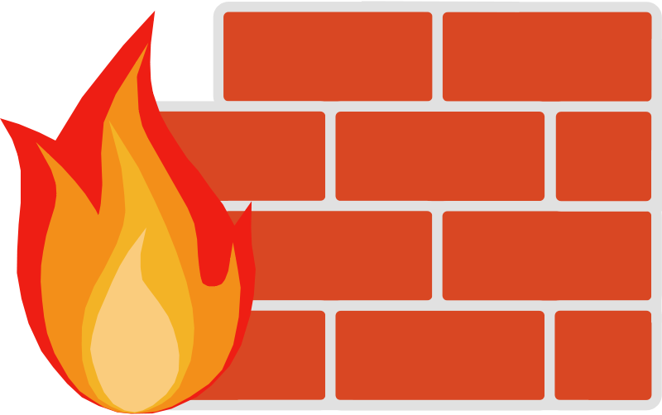
Firewall
A firewall is a hardware or software component that is used to protect a network from unauthorized access. It monitors incoming and outgoing network traffic and blocks traffic that is not authorized. Firewalls are commonly used in corporate networks to protect sensitive data from hackers and other threats.

Slide 4
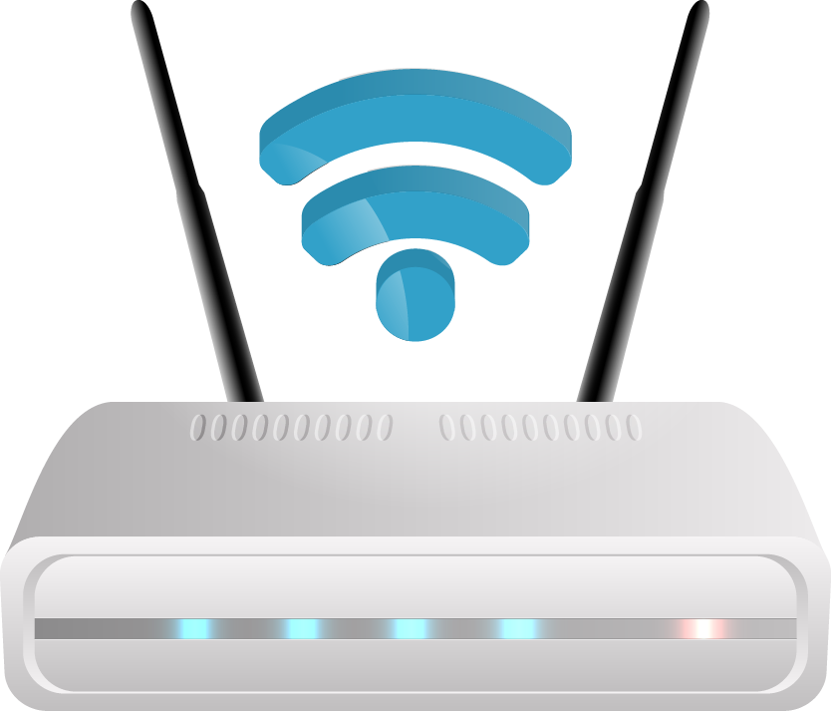
Router
A router is a network device that connects multiple networks and routes data between them. Routers are commonly used to connect a LAN to the Internet. They are responsible for directing data packets between networks and determining the best path for data to travel.

Slide 5
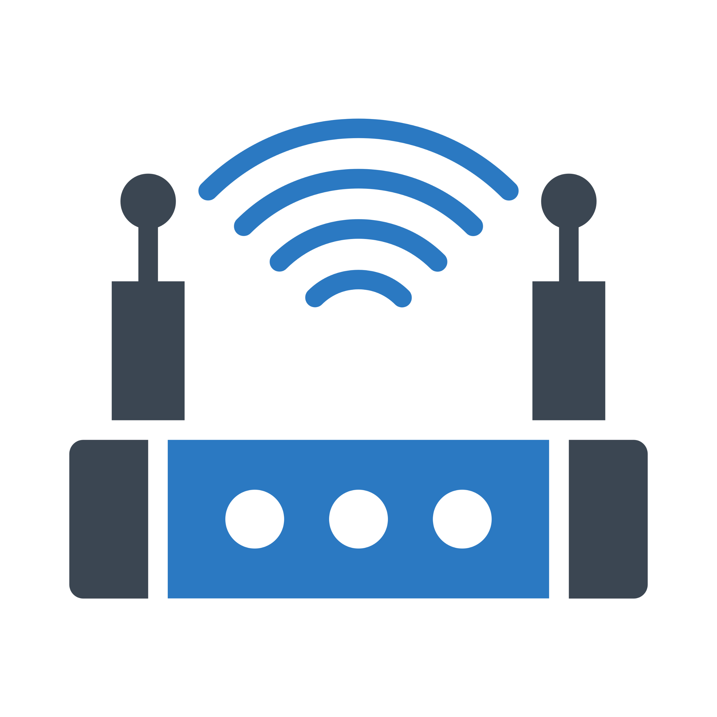
Access Point
An access point is a device that is used to connect wireless devices to a wired network. It provides wireless connectivity to devices such as laptops, smartphones, and tablets. Access points are commonly used in businesses and public places to provide wireless Internet access.

Slide 6
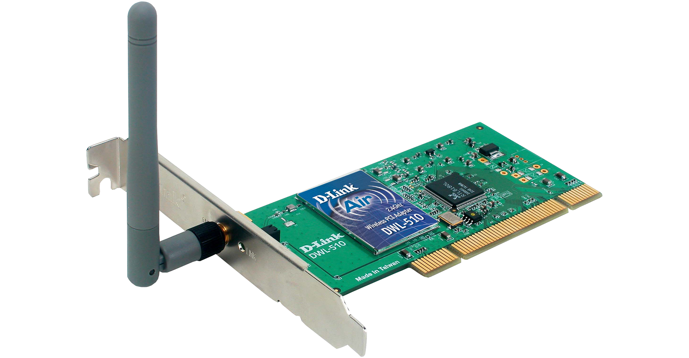
Network Interface Card (NIC)
A Network Interface Card, also known as a network adapter or Ethernet card, is a hardware component that is installed in a computer to connect it to a network. NICs come in different types such as wired or wireless and are used to communicate with other devices on the network.

Slide 7
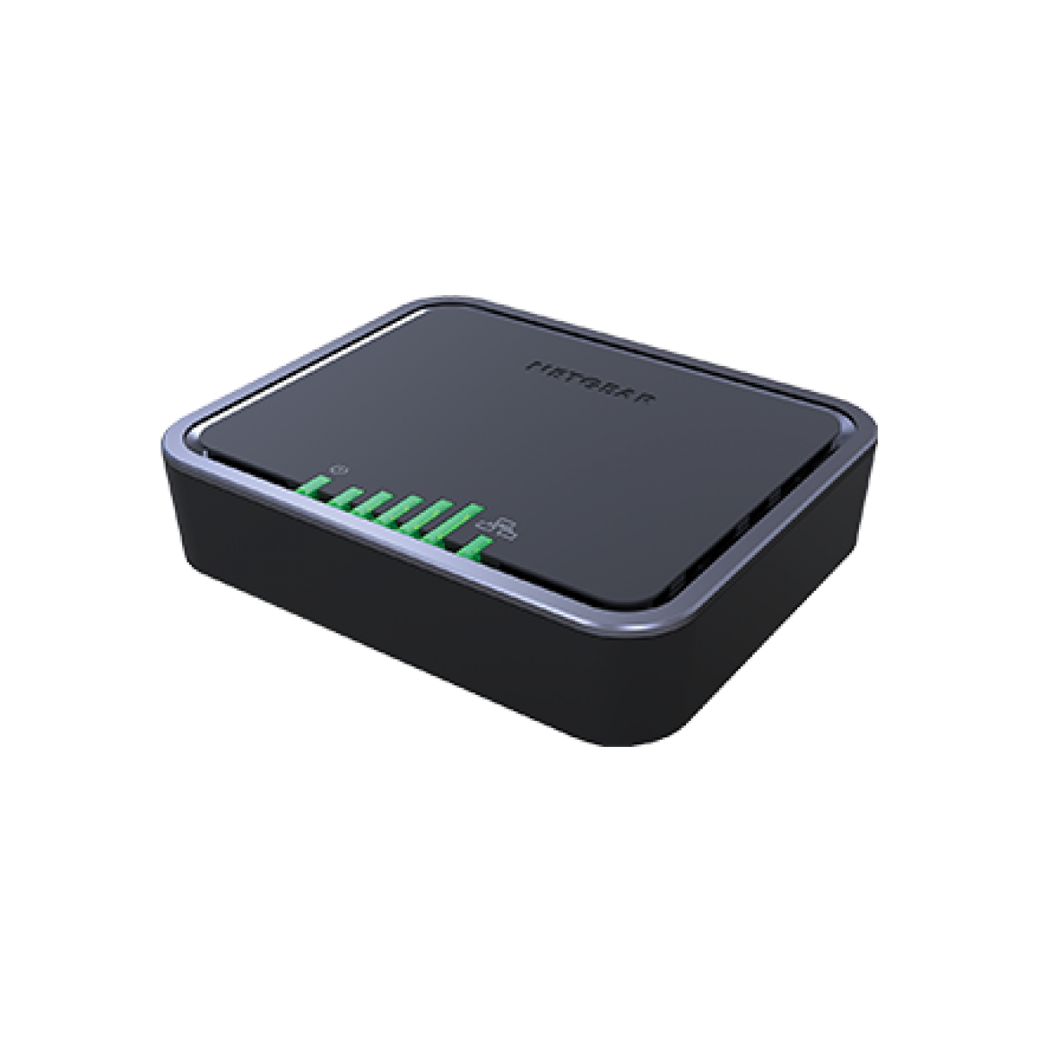
Modem
A modem is a device that connects a computer to the Internet. It converts digital data into analog signals that can be transmitted over telephone or cable lines. Modems are commonly used to connect to the Internet using a telephone line or cable TV network.

