Slide 1



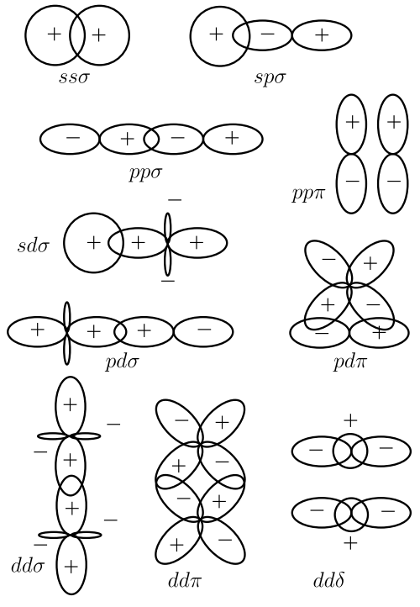
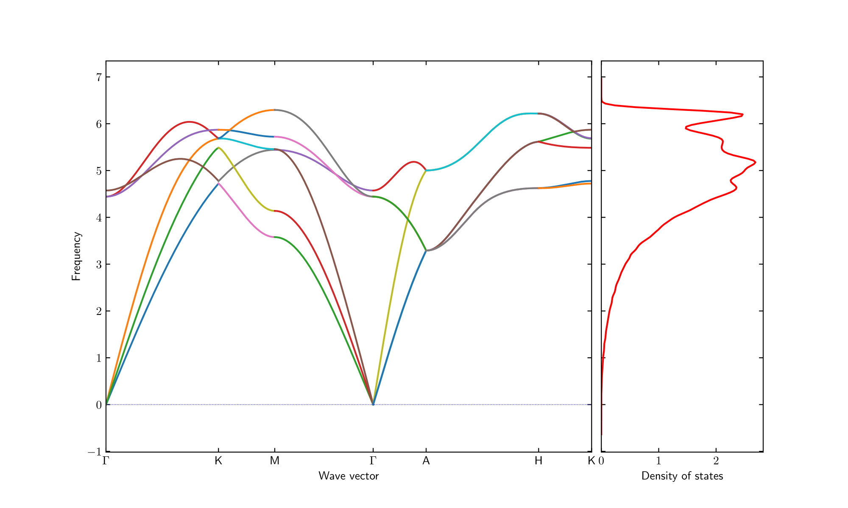
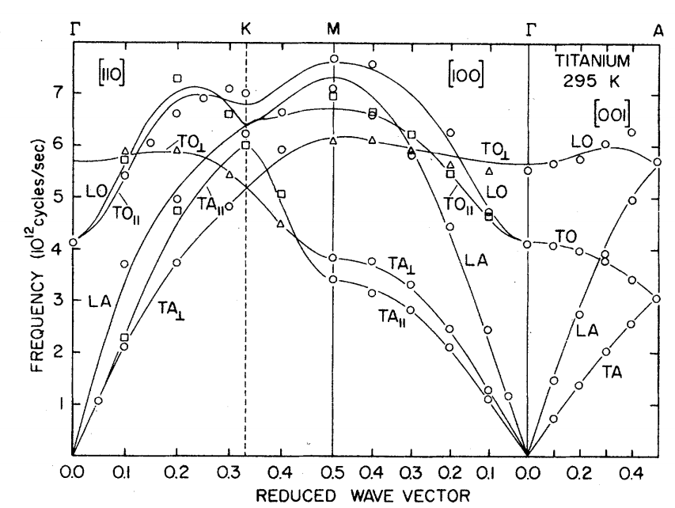
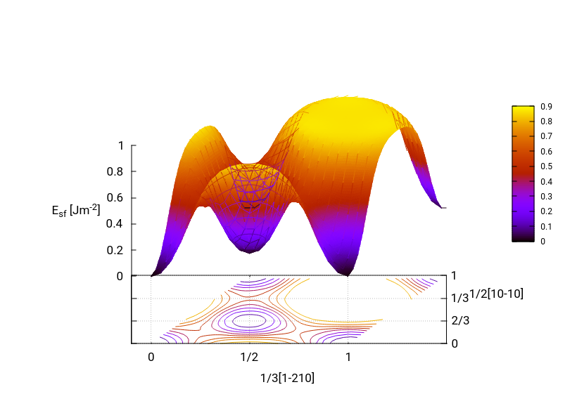
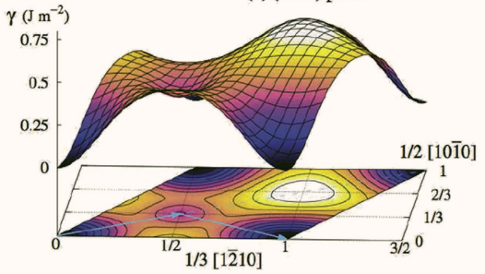
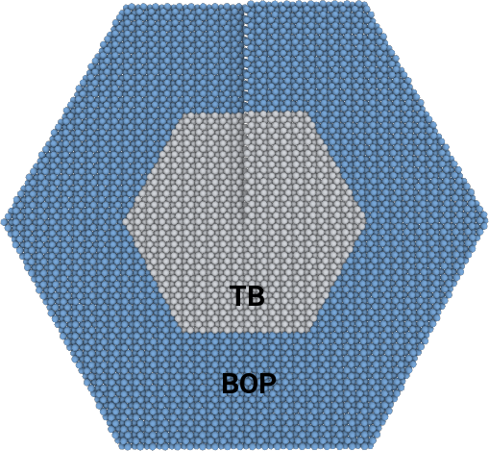
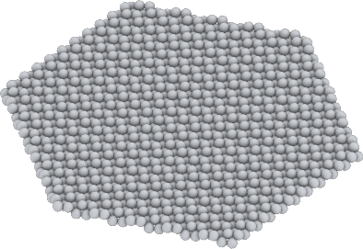
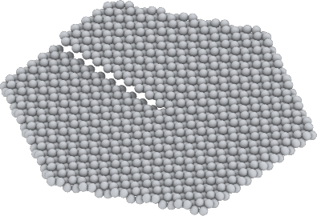
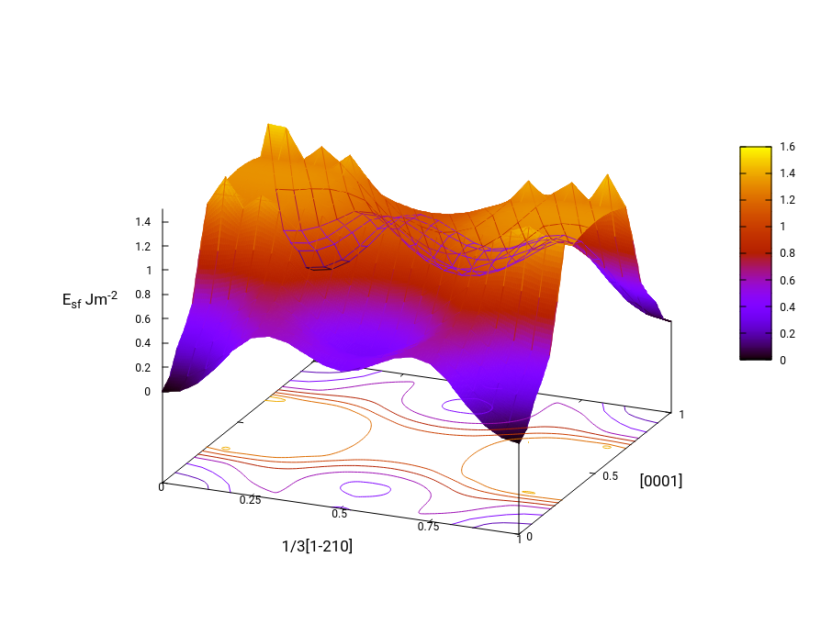
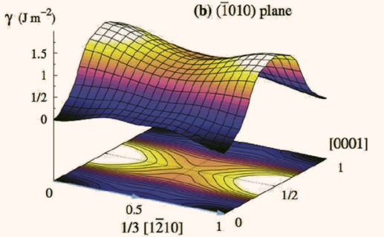
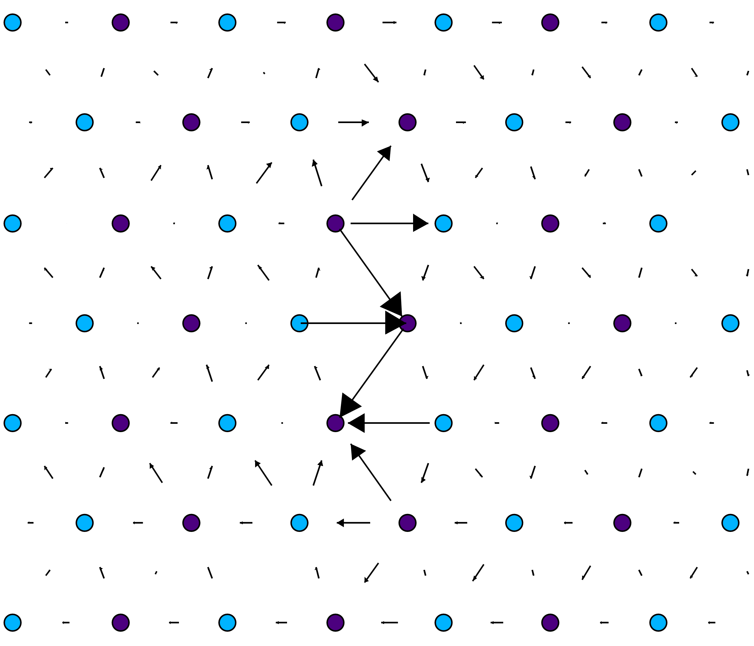
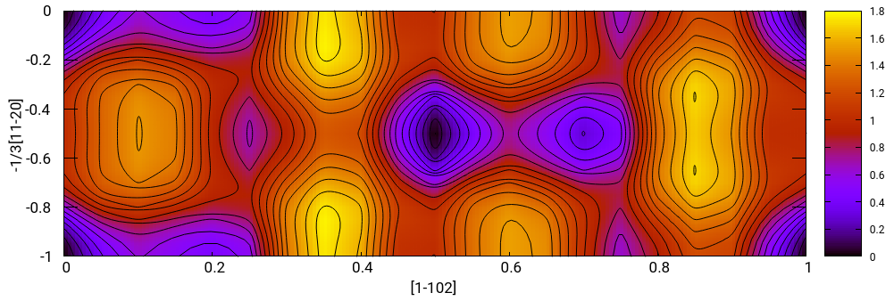
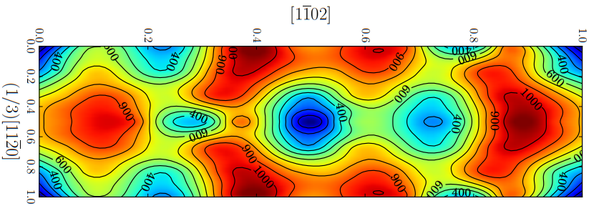
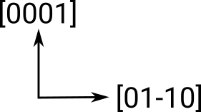
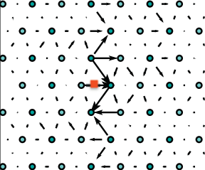
Atomistic modelling of oxygen solute hardening in titanium alloys.
Tigany Zarrouk, Tony Paxton and Dave Rugg
Email: tigany.zarrouk@kcl.ac.uk
Department of Physics, King's College London, Strand, London WC2R 2LS, UK
Screw dislocations control plasticity in titanium.
Solute-hardening is not well understood on an atomistic scale.
Ab initio quantum mechanics is too computationally expensive.
Tight-binding approximation is quantum mechanical yet less expensive.
We have made a tight-binding model for titanium with which we can investigate atomistic mechanisms for oxygen solute-hardening.
Tight-binding models need parameters.
Overlaps between atomic orbitals of atoms are parameters.
This titanium model is d-orbital only.
Ab initio Density Functional Theory (DFT) calculations and empirical quantities are fitted to.
Particle swarm algorithm used for fitting.
Validation achieved by comparison of:
Lattice wave dispersion (phonons).
Generalised stacking fault energy surfaces.
Dislocation core structure.
Dissolution/vacancy formation energies.
Validation Tests
Quantity | Units | TB model | Literature
E_{vacancy formation} | [eV] | 1.01 | 1.27 [Exp. Hashimoto (1984)] 1.95 [DFT Angsten (2013)]
ΔE_{solution}(tetra. - octa.) | [eV] | 0.80 | 1.20 [DFT Kwasniak (2013)]
Phonons
Tight Binding
Experiment [2]
G
K
M
G
A
Results of Fitting
Quantity | Units | TB model | Target
a_{α} | [bohr] | 5.52 | 5.57
c/a | ratio | 1.571 | 1.587
C₁₁ | [GPa] | 175.3 | 176.1
C₃₃ | [GPa] | 195.5 | 190.5
C₄₄ | [GPa] | 59.6 | 50.8
C₁₂ | [GPa] | 70.2 | 86.9
C₁₃ | [GPa] | 67.5 | 68.3
Quantity | Units | TB model | Target
a_{α} | [bohr] | 5.52 | 5.57
c/a | ratio | 1.571 | 1.587
C₁₁ | [GPa] | 175.3 | 176.1
C₃₃ | [GPa] | 195.5 | 190.5
C₄₄ | [GPa] | 59.6 | 50.8
C₁₂ | [GPa] | 70.2 | 86.9
C₁₃ | [GPa] | 67.5 | 68.3
Generalised Stacking Fault Energies
Gamma surfaces are plots of the excess energy of a faulted lattice, compared to an unfaulted one, with respect to fault vector.
Minima show areas where stable stacking faults occur.
These predict possible dislocation dissociations in the model.
Tight Binding
DFT [3]
Method
Create dislocation in cell.
Put oxygen into different sites (octahedral) near core.
Relax cell to see how the core structure changes.
Basal Plane
Predicted Splitting:
DFT: 1/3[1-210]  1/3[1-100] + 1/3[0-110]
TB: 1/3[1-210]  1/3[1-100] + 1/3[0-110]
z
y
x
Periodicity along y
Dislocation Core Structure
Differential Displacement maps of screw dislocation core upon relaxation in tight-binding (TB) and Density Functional Theory (DFT / ab initio).
Arrows denote out-of-plane displacements.
An arrow joining two columns corresponds to displacement by a full Burger’s vector.
Position of elastic centre of dislocation core is marked by the red square.
Good agreement between model and DFT thus validating model.
Prismatic Plane
Predicted Splitting:
DFT: 1/3[1-210]  1/6[1-210] + 1/6[1-210]
TB: 1/3[1-210]  (1/6[1-210] + 0.15[0001]) + (1/6[1-210] - 0.15[0001])
Tight Binding
Tight-binding
First order Pyramidal Plane.
Pseudopot. [4]
Predicted Splitting:
Pseudopotential: 1/3[2-1-13]  4/18[1-102] + 4/18[42-62] + 4/18[2-1-13]
TB: 1/3[2-1-13]  4/18[1-102] + 4/18[42-62] + 4/18[2-1-13]
Applications:
Alloy design.
Stress-corrosion cracking.
Electrochemistry.
DFT [1]
References:
[1] Ghazisaeidi, (2012), Core structure of a screw dislocation in Ti from density functional theory and classical potentials
[2] Stassis, D. Arch, B. (1979), Lattice Dynamics of hcp Ti.
[3] Rodney, Ventelon (2016), Ab initio modelling of dislocation core properties in metals and semiconductors
[4] Ready (2019), Stacking faults and the γ-surface on {1-101} pyramidal planes in α-titanium.
Notes:
<number>

