Slide 1
Data Science in Public Mental Health: A New Analytic Framework
Charith Silva (School of Computing, Science and Engineering University of Salford-Manchester)
Mahsa Saraee (School of Cardiovascular Sciences Faculty of Biology, Medicine and Health University of Manchester)
Mo Saraee (School of Computing, Science and Engineering University of Salford-Manchester)
Presented By:-
Piyush Sharma
B3
1911104

Slide 2
Abstract
This paper presents a new framework that mental health professionals can use to solve challenges they face using data science.
Recently, Data Science has changed the way we manage, analyze and leverage data in healthcare industry. Data science projects differ from conventional data analysis, primarily because of the scientific approach used during data science projects.
One of the motives for introducing a new framework is to motivate healthcare professionals to use "Data Science" to address the challenges of mental health.
It also helps to predict the time and resources needed early in the process to get a clear idea of the problem to be solved.

Slide 3
Introduction
The amount of data that is being collected in mental healthcare sector has increased enormously over the past years.
Availability of large number of mental healthcare data sources and the quality of data enables a novel exploratory research approach to finding hidden patterns and new knowledge from the data rather than conducting traditional statistical analysis on mental healthcare data.
Electronic medical records (EMR) has become more widespread in hospitals in worldwide. So, availability of patient data enable researcher to analyse and find interesting information which can be beneficial to treat mental health patients.

Slide 4
The clinicians that have to work with the outcomes of a data science project are usually unfamiliar with the concept of data science, which creates a gap between domain experts and the technical staff performing the analysis.
Tackling this problem will greatly alleviate the challenge of interaction with the local healthcare professionals during the data science project, requiring them to consistently engage in the analysis.
This paper proposed novel visual data mining framework for Mental Health study. The proposed visual data mining approach contains the ability to engage healthcare professionals in the most parts of analysis process.

Slide 5
RELATED WORK – Joint strategic needs assessment(JSNA)
The Joint Strategic Needs Assessment (JSNA) is a process by which local governments and clinical groups assess the present and future healthcare and wellbeing needs of the local community to inform local decision-makers in UK.
In the context of mental health, the main aim of this framework is to understand the determinants of mental health in an area and consider social and contextual factors that affect mental health.
Toolkit provide an overview of the path of public mental healthcare and provide a portal for detailed information and knowledge about specific aspects of mental illness care, mental well-being, and support available and requirements by people with mental health problems.
The proposed framework in this paper is an extension of this JSNA toolkit and it allows to use JSNA recommended data indicator and carryout advance scientific experiment on public mental health.

Slide 6
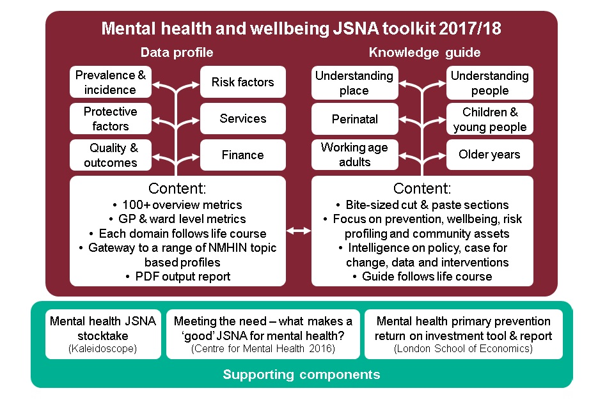

Slide 7
Methodology
This section explains the research methodology and approach used for this study.

Slide 8
A. Knowledge discovery
Authors of this study use Knowledge Discovery (KDD) process conjunction with data mining to identify any hidden patterns in the data.
Knowledge Discovery (KDD) is an interdisciplinary area focusing upon methodologies for extracting useful knowledge from data. It is a complete process of digging deep and discovering useful previously unknown knowledge from data.
The impact and relationships of knowledge can then be correlated. Thus, this knowledge can be merged through its interlinkages and relationships, creating comprehensive knowledge for public mental health.

Slide 9
B. Visual Data Exploration
Visual Data Exploration technique and data mining techniques will be used to gain hidden knowledge and understand the correlation between factors associated with mental health.
Model visualization is the process of using visual techniques to make the discovered knowledge understandable and interpretable by humans.

Slide 10
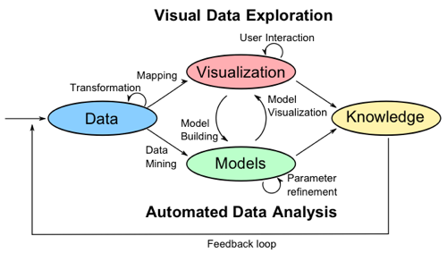
Below Visual Analytics process was introduced by Kohlhammer and his team to describe the process of visual analysis.
The process begins with data retrieval and transformation, then an automatic data analysis approach such as data mining is employed to evaluate models and extract the information.

Slide 11
Proposed framework
This research present new data analytic framework for data acquisition, data fusion, data storing, managing, processing, analysing, visualising and modelling for public mental health related data science projects.
One of a main motivation of building this new framework is to help healthcare professionals to address public mental health issues.

Slide 12
A. Problem definition
A problem definition is a brief description of the subjects that need to be addressed by the Data Science project.
In this step, it does not need to describe your approach to addressing the problem.
The 5W1H technique can be used to describe the problem. The five W's and the H are acronyms for Who? What? Where? When? Why? and How?
Participant: Problem definition must be defined by the healthcare professionals.

Slide 13
B. Requirement gathering
Compiling business requirements is a vital first step for any type of project. Requirement gathering is an important part of any Data Science or Data Analytic project.
The development of a wide range of requirements early in the project will allow for accurate cost estimates; shorter project time periods; greater patient satisfaction, and improved final solution accuracy.
It is always best to avoid talking about technology or solutions until the requirements are fully understood by the project owners and participants.
Participant: This will be a joint excise of project owners such as healthcare professional and data analysists/scientists.

Slide 14
C. Data Acquisition
The acquisition of complex, resource-rich data set is essential for mental health data projects and applications. Data collection and database maintenance are the most cost-effective and time consuming aspects of data science projects.
Mental health related data can be available in different file formats. As a result, it may be difficult to obtain the correct type of data for the project.
Integrated analysis of different types of data from the local and national repositories improves the ability to identify hidden patterns, trends and relationships at a national and local level.
Therefore, it is always good to acquire many different related datasets.
i. Risk factors ii. Services iii. Protective factors iv. Quality & outcomes v. Prevalence & incidence
Participant: As this is a technical task, data analyst will perform this task. But paper highly recommend getting help from healthcare professional who typically own the data sources.

Slide 15
D. Analysis and visualization of data attributes
Data visualization aids project participants to understand the data by engaging it in a visual context. Correlations, Patterns, trends, and links that may not be detected in the data are detected and identified more easily if users can use appropriate data visualization techniques.
Data Attribute can be describing as a data field that represents characteristics or features of a data object/ Dataset.
Data attribute visualisation in the early stage of the project can be beneficial for entire project. Because, early data attribute visualisation can spot some of the correlation (if any) and you can easily spot some attributes having strong correlations amongst themselves.
In this stage, we visualize the data attribute that was acquired from the previous data acquisition stage which has been analysed and designed in a way that project participants can take advantage of the analysis without mining deeper into data.
Participant: This will be a joint excise of project owners such as healthcare professional and data analysists/scientists.

Slide 16
E. Data fusion, filtering and pre-processing
The aim of a data fusion (data integration) process is to maximize the useful information content acquired by heterogeneous sources in order to infer relevant situations and events related to the observed environment.
Data integration from heterogeneous data sources helps to improve the capability to identify hidden patterns, trends, and relationships.
Data pre-processing converts data to a format that will be processed more easily and efficiently. Data filtering is one of the steps to explore, filter, and state data before shifting to the modelling process.
Participant: As this is highly technical task, data analyst will perform this task.

Slide 17
F. Data cleansing
Real world data are often incomplete, inconsistent, and noisy. The purpose of data cleansing is to improve the quality of data that will be exercised by the data analyst.
High accuracy of the prediction model will be achieved if the data is comprehensive, complete, consistent and accurate.
Domain knowledge is vital for data cleansing activities.
Participant: As this is technical task, data analyst will perform this task. But it is highly recommended to get help from healthcare professional. This is because mental healthcare domain knowledge is vital for this stage, both healthcare professional and data analyst can be involved in this stage.

Slide 18
G. Feature Selection
In the Data Science field, feature selection is the process of selecting a subset of relevant attributes to be used in model building.
It provides the mechanism of determining the useful patterns in the data, which then decreases the execution time, and decreases the overall dimensionality of the data with an improvement in execution performance.
Feature selection techniques are primarily intended to improve model prediction performances and runtimes, to reduce model overfitting, and to increase generalization.
Participant: As this is highly technical task, data analyst will perform this task.

Slide 19
H. Data Partitioning
Dividing data into training and testing sets is an important part of building data mining and machine learning models.
The training set is used to train or build a model. Once you create a predictive model using the training set, you must validate the performance of the predictive model using new dataset, the data set is known as the test dataset or validation dataset.
Participant: As this is highly technical task, data analyst will perform this task.

Slide 20
I. Predictive modelling
Predictive modelling is a process that uses data, mathematics and statistics to predict outcomes with data models.
Predictive modelling build, test and validate a model to predict the probability of an outcome. This is an iterative process and often involve training the model; testing the model on the same data set and finally find best fit model based on the business requirement.
Building predictive models are useful in any industry because they provide hidden insight about most of the complex questions they face and allow users to create reasonably accurate predictions.
Participant: As this is highly technical task, data analyst will perform this task.

Slide 21
J. Visual Data Exploration
Visual analytics combines automated analysis techniques with interactive visualisations for an effective understanding, reasoning and decision making on the basis of very large and complex datasets.
Visual exploration of the data and the results from the models have been considered as an interesting application and attracted attention from both the academic and industry communities.
Domain knowledge is vital for visual data exploration and it will add lot of knowledge to this step to understand and interpret the results.
Participant: This will be a joint excise of project owners such as healthcare professional and data analysists/scientists.

Slide 22
K. Predictive Model Performance Evaluation
To get the true value of a predictive model, it is vital to know how good the model fit the data. Therefore, performance assessment plays a dominant role in predictive modeling technology.
Predictive model performance is calculated and compared by selecting the correct metrics.
Therefore, it is vital to choose the correct measurements for a given predictive model to get an accurate result.
It is very important to evaluate appropriate predictive models because several types of data sets will be used for the same predictive model.
Participant: As this is highly technical task, data analyst will perform this task.

Slide 23
L. Knowledge Extraction
Knowledge extraction is a complex process allowing the identification of previously unknown structures and potentially useful original information from large amount of data.
Knowledge Discovery is the non-trivial process of identifying valid, novel, potentially useful and ultimately understandable patterns from large data collections.
Participant: This will be a joint excise of project owners such as healthcare professional and data analysists/scientists.

Slide 24
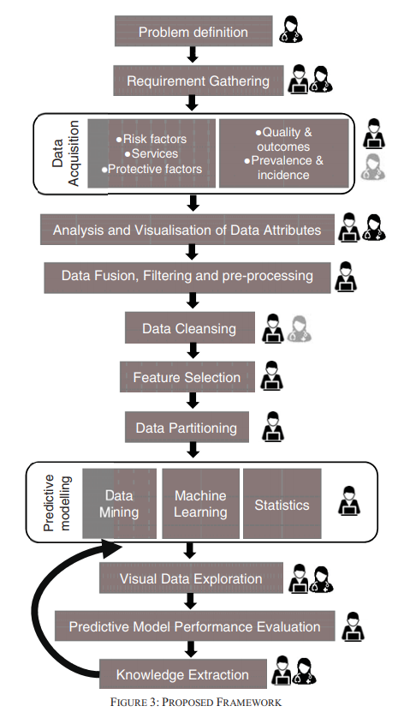

Slide 25
Conclusion
Data Science in healthcare is an evolving field of great importance to deliver a projection and deeper understanding of disease classification, specifically in mental health.
The main objective of this paper is to present a new structure that mental health professionals can use to solve challenges using data science.
This framework is highly structured with a heavy emphasis on upfront planning. This waterfall style framework requires a project to be planned to begin to end, with no phase of a project beginning until the previous one has ended.
One of the motives for introducing a new framework is to motivate healthcare professionals to use "data science" to address the challenges of mental health.

Slide 26
Implementation
Look for a Dataset related to mental health or issues related to mental health. (Mental health and Suicide rates)
Analysis and visualization of Data
Data cleansing
Visual Data Exploration
Python NumPy, Panda and Matplotlib

Slide 27
THANK YOU

