Slide 1

Predictive Modeling & Optimization for Silicon (SI) Control in Blast Furnaces
Prepared by: Gaurav Khandelwal
Date: 11/08/2025

Slide 2
Problem Statement
Current Challenges | Objectives
SI content directly affects hot metal quality and production cost. Fluctuations in SI lead to inefficiencies, potential equipment stress, and increased corrective actions. Lack of predictive visibility and automated optimization. | Predict SI content from real-time furnace operational parameters. Detect anomalies in SI deviations proactively. Perform root cause analysis for SI variations. Recommend optimal furnace settings using optimization algorithms.

Slide 3
Data Overview
Source: Blast furnace sensor data & process logs.
Timeframe: [X months/years]
Features: 21 variables (flow rates, temperatures, pressures, chemical compositions, etc.)
Target Variable: SI (%)
Granularity: Hourly / Batch-level

Slide 4
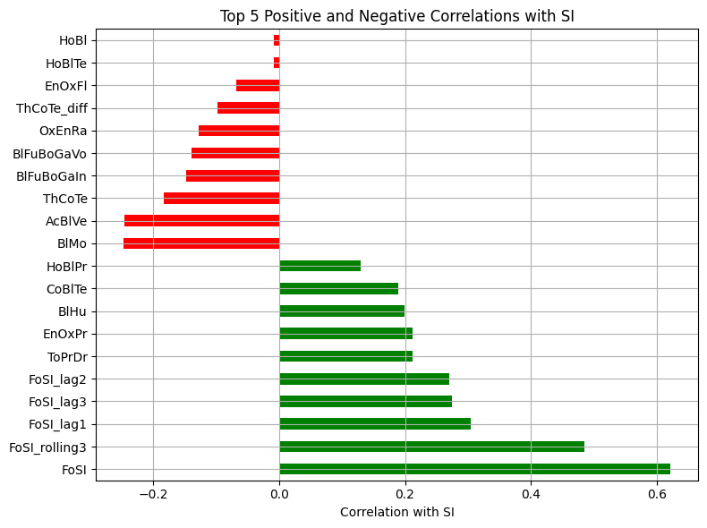
Data Preparation
Initial data exploration and data cleaning with missing value treatment and checking duplicates
Feature engineering:
Lag features
Rolling averages
Correlation with SI
Multicollinearity Treatment with a correlation threshold of 0.9
.

Slide 5
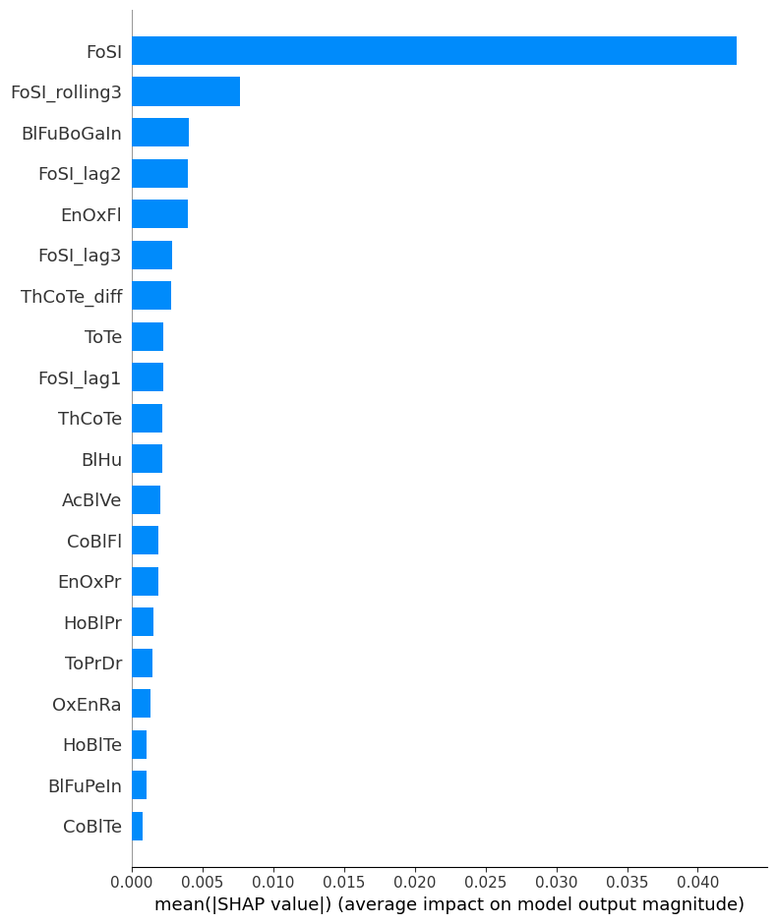
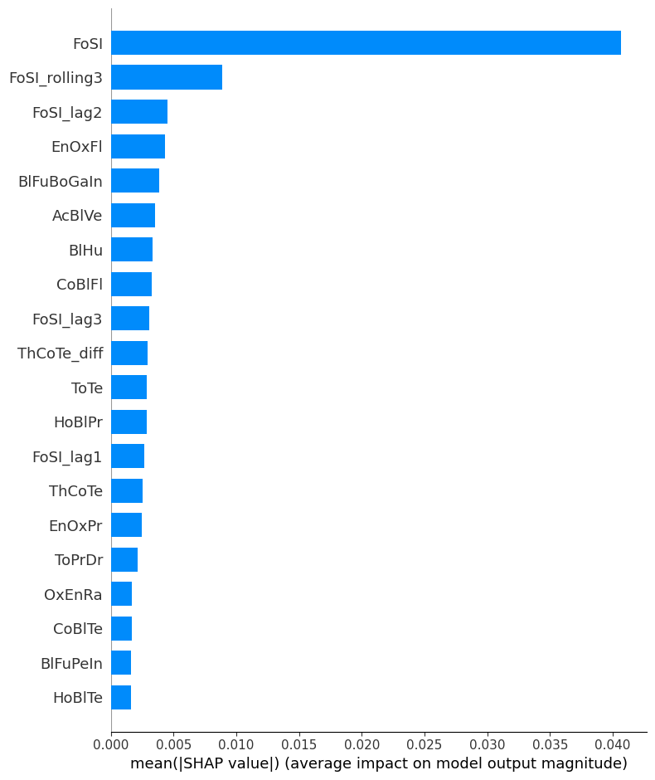
Model Development
XG – Boost Regressor
RSq : .41 RMSE : .09 Mape : .14
Light GBM Regressor
RSq : .42 RMSE : .08 Mape : .14

Slide 6
Real-time Anomaly Detection
Model Training
Flags SI deviations beyond control limits.
SHAP-based feature attribution for root cause insight.
Output:
Anomaly flag
Top contributing parameter

Slide 7
Optimization Approach
Objective: Adjust parameters to minimize deviation from target SI.
Method: Bayesian Optimization + PuLP for constraint handling.
Constraints: Process parameter safety limits, operational feasibility.
Output: Recommended setpoints for furnace control.

Slide 8
Deployment Strategy
Create a pipeline to for data processing and model refresh on latest data
01
Save trained model as .pkl.
02
Create Python API for:
03
Real-time prediction
Anomaly detection
Optimization recommendations
Integrate with plant control dashboard (REST API ).
04
**Detailed architecture flow can be created based on preferred cloud service

Slide 9
Questions?

