Slide 1
Range-Rate OD
2021-07-04

Slide 2

Assumptions
Know range-rate to >= 3 pulsars at >= 3 known times each
Know gravitational parameter ($μ$) of central body
Know pulsar coordinates in inertial frame (e.g., SSB)

Slide 3
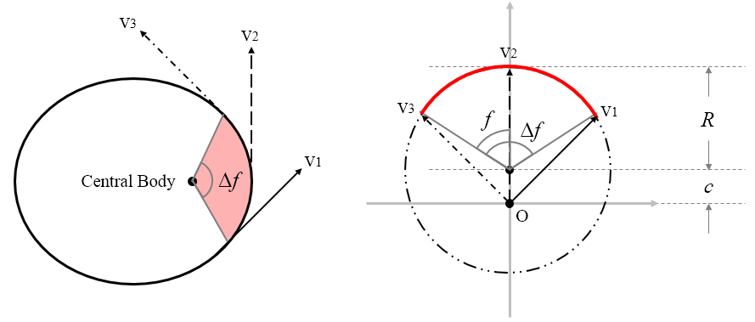
Hodograph Review
y
x

Slide 4

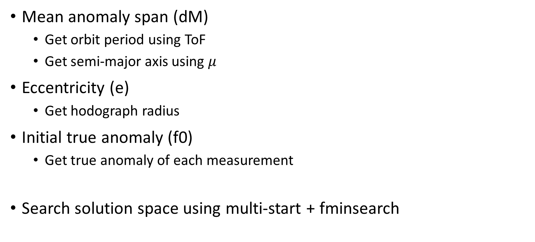
Approach – Guess f0, e, dM
Mean anomaly span (dM)
Get orbit period using ToF
Get semi-major axis using $μ$
Eccentricity (e)
Get hodograph radius
Initial true anomaly (f0)
Get true anomaly of each measurement
Search solution space using multi-start + fminsearch
$$T=\frac{2π}{dM}⋅(t_{n}−t_{1})$$
$$a=\sqrt[3]{μ⋅{\left(\frac{T}{2π}\right)}^{2}}$$
$$R=\sqrt{\frac{μ}{a(1−e^{2})}}$$

Slide 5

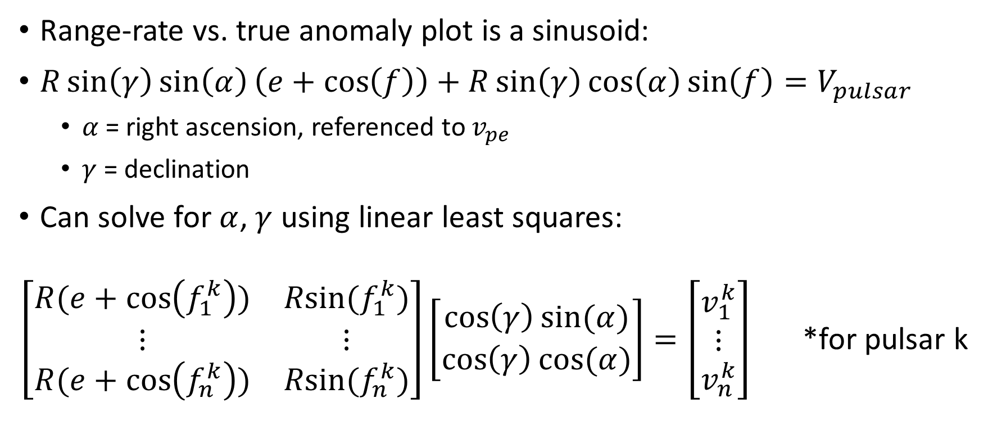


Objective Function 1: Sinusoid Fit
Range-rate vs. true anomaly plot is a sinusoid:
$R\sin\left(γ\right)\sin\left(α\right)\left(e+\cos\left(f\right)\right)+R\sin\left(γ\right)\cos\left(α\right)\sin\left(f\right)=V_{pulsar}$
$α$ = right ascension, referenced to $v_{pe}$
$γ$ = declination
Can solve for $α$, $γ$ using linear least squares:
$\left[\begin{matrix}R(e+\cos\left(f_{1}^{k}\right)) & Rsin⁡(f_{1}^{k}) \\ ⋮ & ⋮ \\ R(e+\cos\left(f_{n}^{k}\right)) & Rsin⁡(f_{n}^{k})\end{matrix}\right]\left[\begin{matrix}\cos\left(γ\right)sin⁡(α) \\ \cos\left(γ\right)cos⁡(α)\end{matrix}\right]=\left[\begin{matrix}v_{1}^{k} \\ ⋮ \\ v_{n}^{k}\end{matrix}\right]$ *for pulsar k
$$A$$
$$x$$
$$b$$

Slide 6

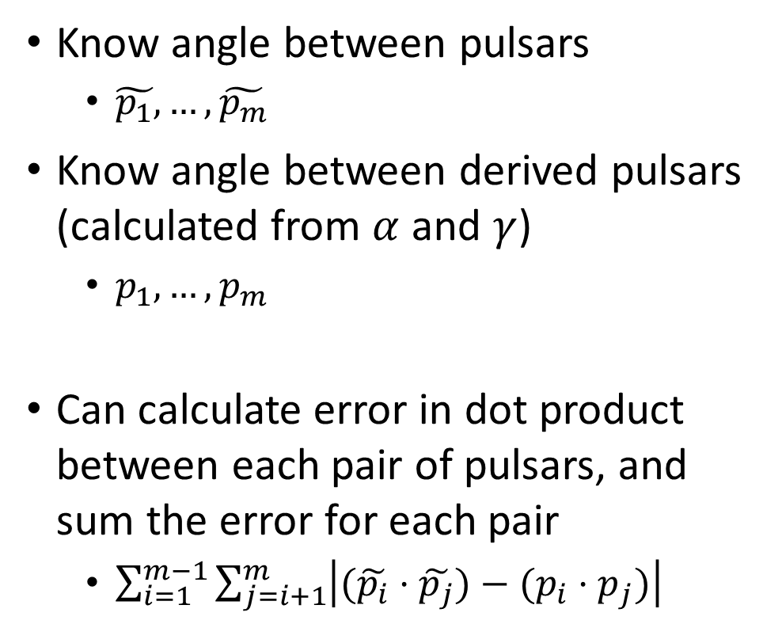



Objective Function 2: Pulsar Alignment
Know angle between pulsars
$\tilde{p_{1}}, …, \tilde{p_{m}}$
Know angle between derived pulsars (calculated from $α$ and $γ$)
$p_{1}, …, p_{m}$
Can calculate error in dot product between each pair of pulsars, and sum the error for each pair
$\sum_{i=1}^{m−1}{\sum_{j=i+1}^{m}{\left|(\tilde{p_{i}}⋅\tilde{p_{j}})−(p_{i}⋅p_{j})\right|}}$
$$\tilde{p_{1}}$$
$$\tilde{p_{2}}$$
$$p_{2}$$
$$p_{1}$$

Slide 7

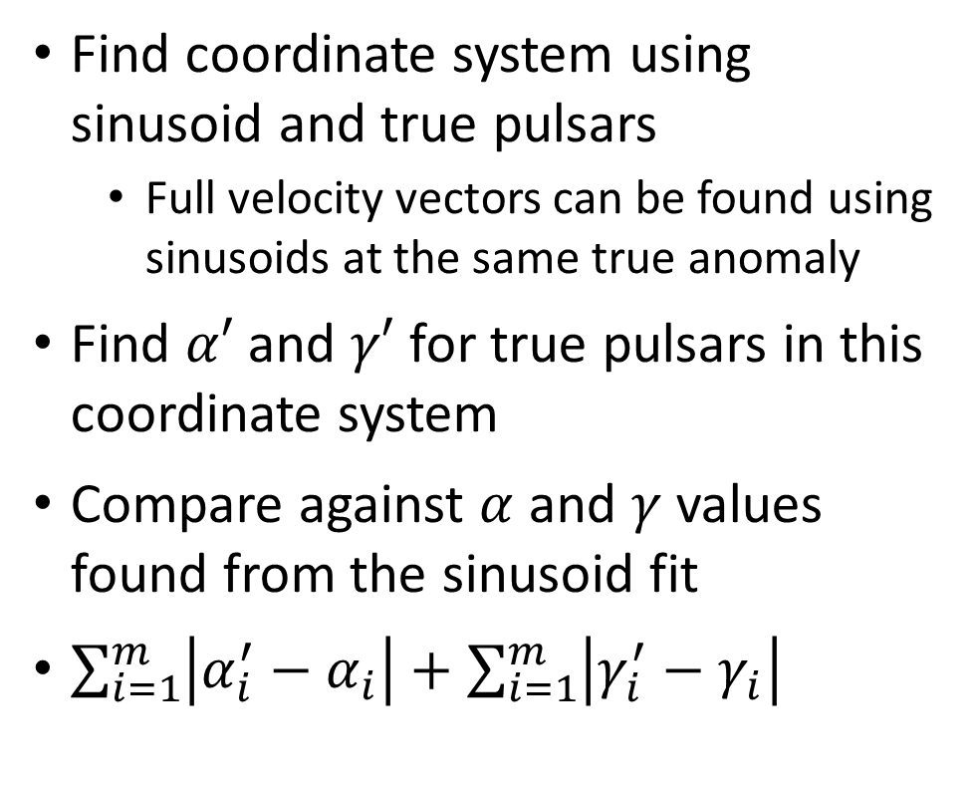



Objective Function 3: Frame Alignment
Find coordinate system using sinusoid and true pulsars
Full velocity vectors can be found using sinusoids at the same true anomaly
Find $α′$ and $γ′$ for true pulsars in this coordinate system
Compare against $α$ and $γ$ values found from the sinusoid fit
$\sum_{i=1}^{m}{\left|α_{i}^{′}−α_{i}\right|}+\sum_{i=1}^{m}{\left|γ_{i}^{′}−γ_{i}\right|}$
$$p_{1}$$
$$\tilde{p_{2}}$$
$$\tilde{p_{1}}$$
$$p_{2}$$

Slide 8

Objective Function Summary
$$g\left(f_{0},e,dM\right)=\sum_{i=1}^{m}{\frac{(A_{i}x_{i}−b_{i})}{\left\|b_{i}\right\|}}+\sum_{i=1}^{m−1}{\sum_{j=i+1}^{m}{\left|(\tilde{p_{i}}⋅\tilde{p_{j}})−(p_{i}⋅p_{j})\right|}}+\sum_{i=1}^{m}{\left|α_{i}^{′}−α_{i}\right|}+\sum_{i=1}^{m}{\left|γ_{i}^{′}−γ_{i}\right|}$$

Slide 9
Algorithm
Search for minimum objective function in 35 x 35 x 35 grid of evenly spaced points
Use fminsearch to find solution
fminsearch uses the Nelder-Mead algorithm
Original Grid
Shifted Along Y
Shifted Along X

Slide 10
Limitations
Slow compared to analytic OD methods
6-10 seconds per run, depending on number of measurements & grid size
Certain orbits need finer search
Some orbits only need 25^3, while others need 35^3
Unclear which orbits. Heuristically:
Eccentricity near 0 or 1
Mean anomaly span near 0
Currently only for elliptic orbits + measurements within 1 orbit period
Work in progress – should be easy to fix these
Proof that global min exists and is near true solution?

Slide 11
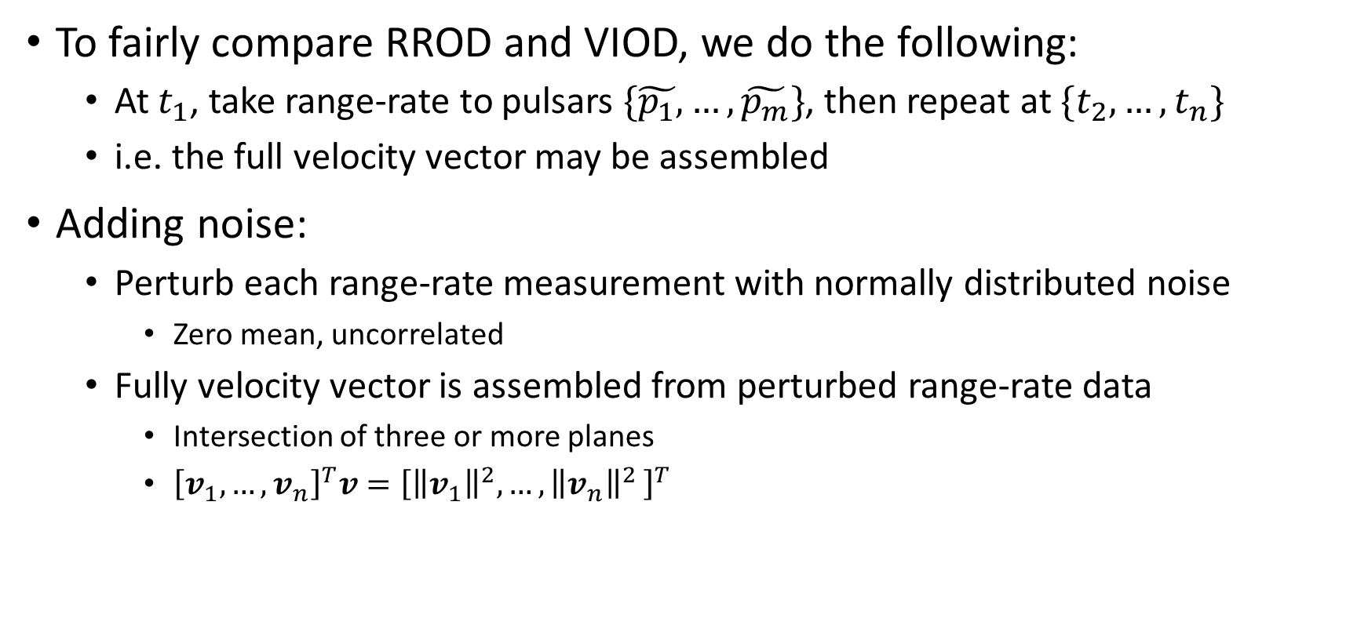
Noise Model
To fairly compare RROD and VIOD, we do the following:
At $t_{1}$, take range-rate to pulsars $\{\tilde{p_{1}}, …,\tilde{p_{m}}\}$, then repeat at $\{t_{2}, …, t_{n}\}$
i.e. the full velocity vector may be assembled
Adding noise:
Perturb each range-rate measurement with normally distributed noise
Zero mean, uncorrelated
Fully velocity vector is assembled from perturbed range-rate data
Intersection of three or more planes
${\left[v_{1},…,v_{n}\right]}^{T}v={\left[{\left\|v_{1}\right\|}^{2},{…,\left\|v_{n}\right\|}^{2}\right]}^{T}$

Slide 12
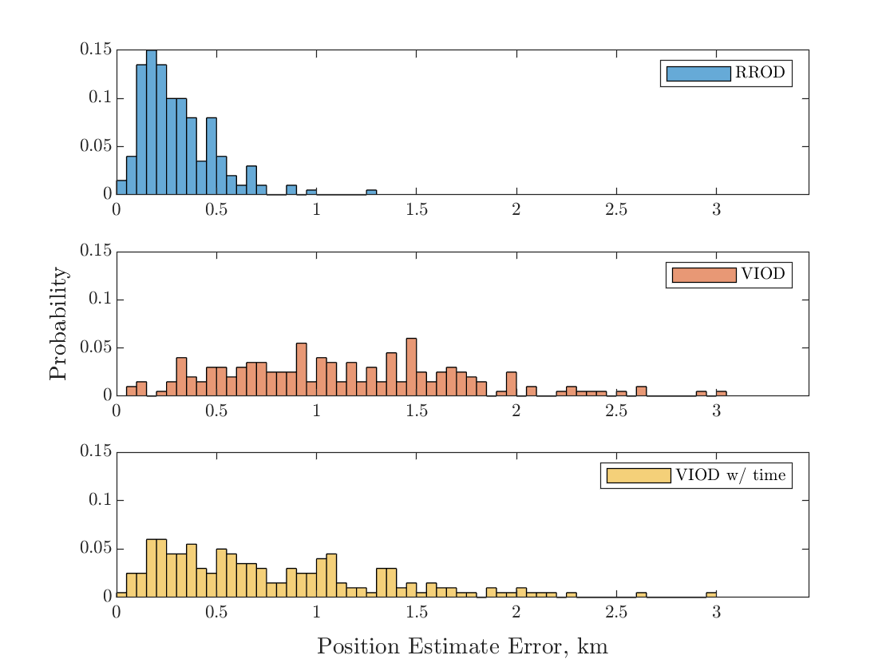
Preliminary Results
Not an exact replica of StarNAV:
Simpler noise model
StarNAV-VIOD had some issues with e = 0 / f0 = 0
StarNAV-VIOD better than pure VIOD
Consistent with StarNAV results
Need more quantitative comparisons
RROD significantly better than both – why?
Does the noise model give RROD an unfair advantage?
410 km LEO (similar to StarNav ex.), e = 0.03, f0 = 10 deg,
dT = 90 mins (92%), noise = 0.5m/s, #obsv = 90, #sim = 200

Slide 13
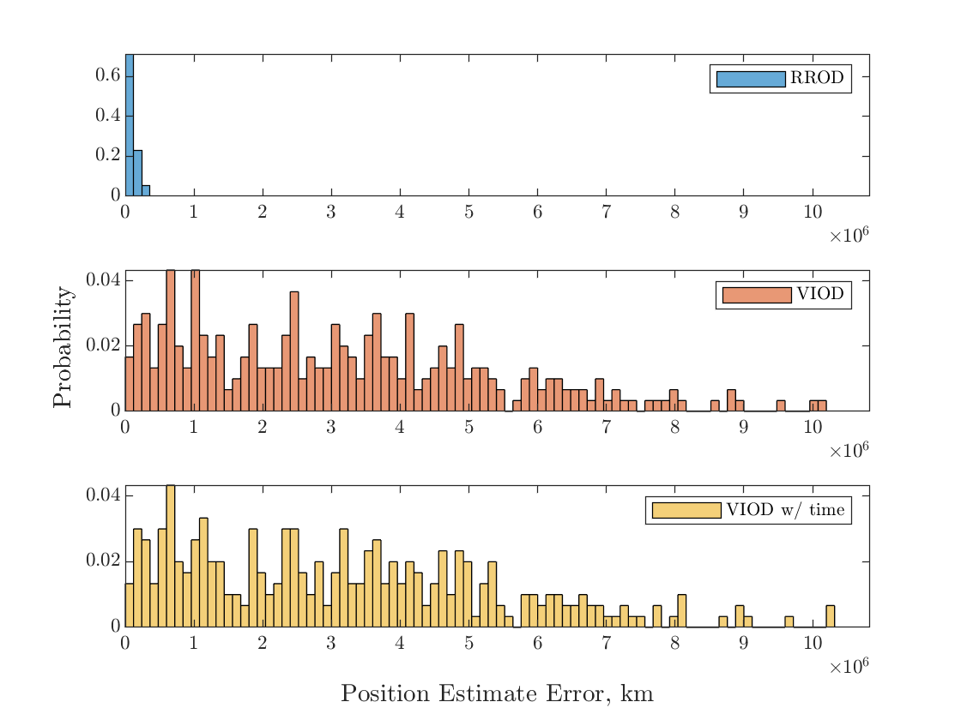
Preliminary Results
RROD is 25 times more accurate than VIOD
StarNAV-VIOD does not perform better than regular VIOD in this case
Neptune case not shown – RROD is about two orders of magnitude better
Earth-Mars Hohmann transfer, e = 0.21, f0 = 140 deg
dT = 10.3 days (2%), noise = 0.5m/s, #obsv = 10, #sim = 300

Slide 14
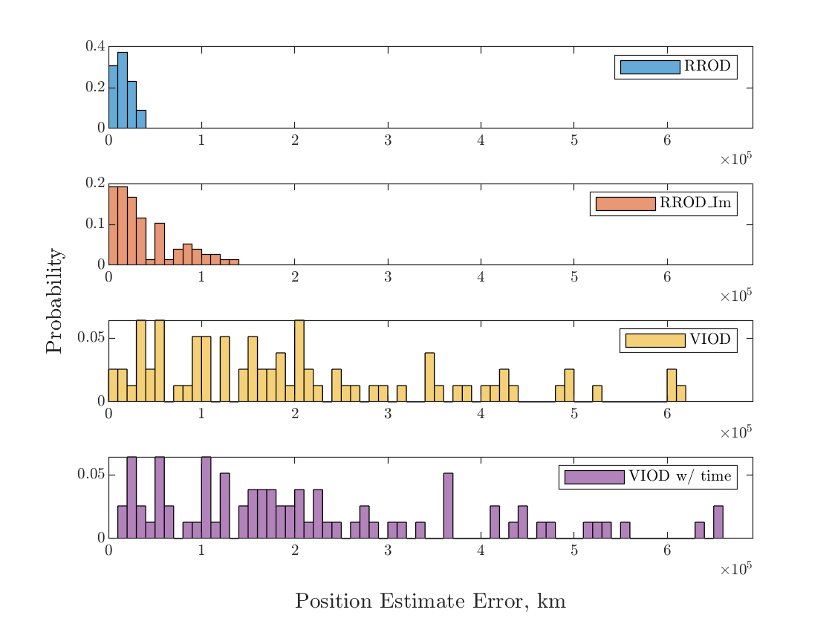
Using Imaginary Pulsars
What if we create range-rate data from velocity vectors?
Fairest possible comparison – RROD has no accesses to additional data
RROD_Im method pretends that the x-, y-, and z-axis values of the velocity vector used for VIOD are its range-rate measurements
RROD_Im still performs better than VIOD!
Earth-Mars Hohmann transfer, e = 0.21, f0 = 90 deg
dT = 25 days (5%), noise = 0.5m/s, #obsv = 20, #sim = 100

Slide 15
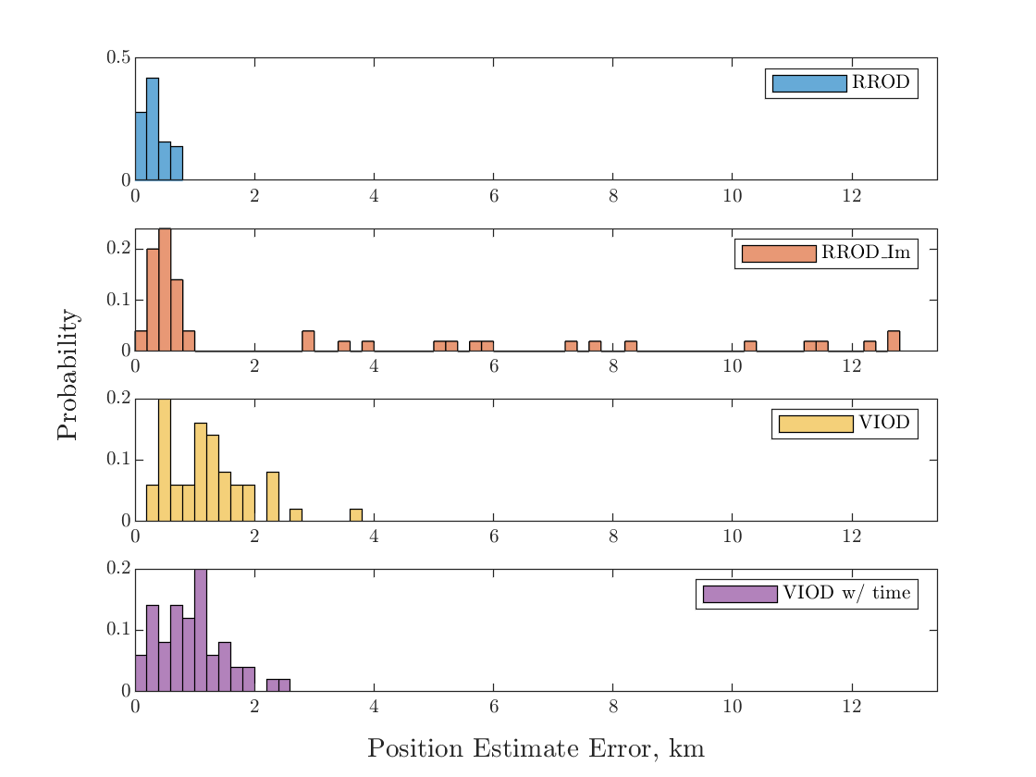
Using Imaginary Pulsars
The “imaginary pulsar” method does not always do well – several outliers exist in this case
Need more testing to figure out when this method fails
410 km LEO, e = 0.03, f0 = 10 deg
dT = 90 mins (92%), noise = 0.5m/s, #obsv = 50, #sim = 70

Slide 16
Considerations
How to benchmark this method? Many variables
All VIOD variables
Number of pulsars
Arrangement of measurements (timing, order)
Improving the noise model
Look for existing range-rate noise models

Slide 17
Summary
Developed relations between range-rate and the hodograph
Developed objective function and algorithm to perform RROD
Range-rate OD appears to be feasible
Method seems capable of outperforming VIOD

