Slide 1
Range-Rate OD
2021-07-04

Slide 2
Assumptions
Know range-rate to >= 3 pulsars at different times
Know pulsar coordinates
Know time elapsed between range-rate measurements

Slide 3
Approach – Guess f0, e, dM
Mean anomaly span (dM)
Get orbit period
Get semi-major axis
Eccentricity (e)
Get hodograph radius
Initial true anomaly (f0)
Get true anomaly of each measurement
Search solution space using brute force + gradient descent

Slide 4
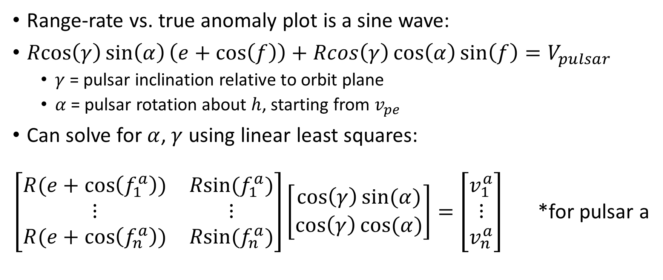
Objective Function 1: Circle Fit
Range-rate vs. true anomaly plot is a sine wave:
$Rcos\left(γ\right)\sin\left(α\right)\left(e+\cos\left(f\right)\right)+Rcos\left(γ\right)\cos\left(α\right)\sin\left(f\right)=V_{pulsar}$
$γ$ = pulsar inclination relative to orbit plane
$α$ = pulsar rotation about $h$, starting from $v_{pe}$
Can solve for $α$, $γ$ using linear least squares:
$\left[\begin{matrix}R(e+\cos\left(f_{1}^{a}\right)) & Rsin⁡(f_{1}^{a}) \\ ⋮ & ⋮ \\ R(e+\cos\left(f_{n}^{a}\right)) & Rsin⁡(f_{n}^{a})\end{matrix}\right]\left[\begin{matrix}\cos\left(γ\right)sin⁡(α) \\ \cos\left(γ\right)cos⁡(α)\end{matrix}\right]=\left[\begin{matrix}v_{1}^{a} \\ ⋮ \\ v_{n}^{a}\end{matrix}\right]$ *for pulsar a

Slide 5
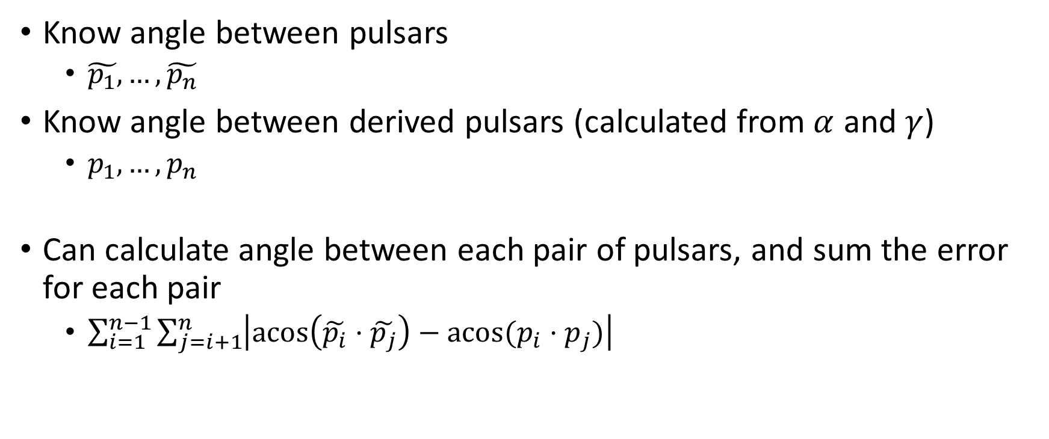
Objective Function 2: Pulsar Alignment
Know angle between pulsars
$\tilde{p_{1}}, …, \tilde{p_{n}}$
Know angle between derived pulsars (calculated from $α$ and $γ$)
$p_{1}, …, p_{n}$
Can calculate angle between each pair of pulsars, and sum the error for each pair
$\sum_{i=1}^{n−1}{\sum_{j=i+1}^{n}{\left|\operatorname{acos}\left(\tilde{p_{i}}⋅\tilde{p_{j}}\right)−acos⁡(p_{i}⋅p_{j})\right|}}$

Slide 6

Objective Function 3: Frame Alignment
Find coordinate system using sine wave and true pulsars
Full velocity vectors can be found using sine waves at the same true anomaly
Find $α′$ and $γ′$ for true pulsars in this coordinate system
Compare against $α$ and $γ$ values found from the circle fit

Slide 7
Algorithm
Brute force search solution space (10 x 10 x 10 usually sufficient), apply fminsearch for each guess
fsolve
Reduce search radius, re-center at best solution
Repeat steps 1-3 until objective function converges

Slide 8
Limitations
Slow compared to analytic OD methods
5-20 seconds per run, depending on resolution of brute force search
Extreme values need finer search
Eccentricity near 0 or 1
Mean anomaly span near 0
Elliptic orbits, measurements within 1 orbit period
Work in progress – should be easy to fix these
Proof that global min exists and is near true solution?

Slide 9
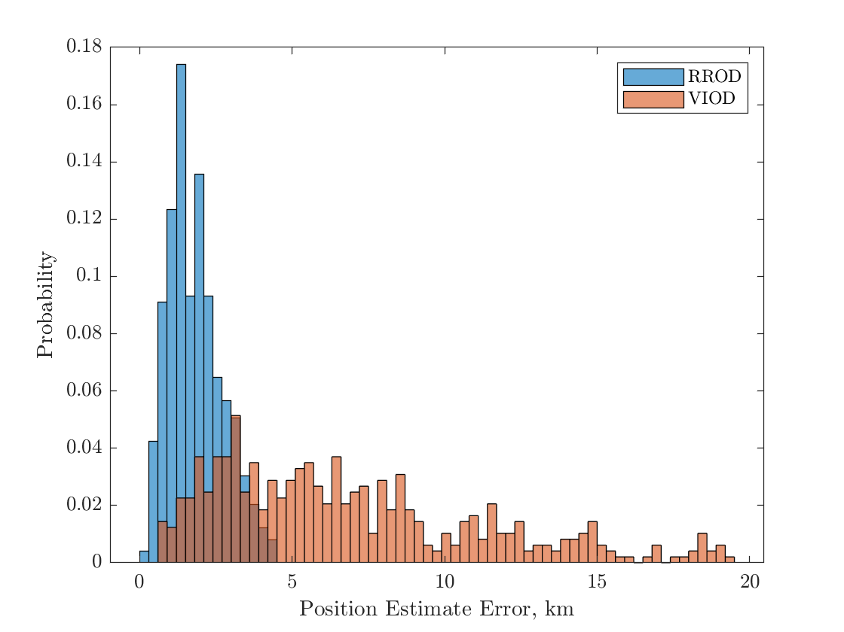
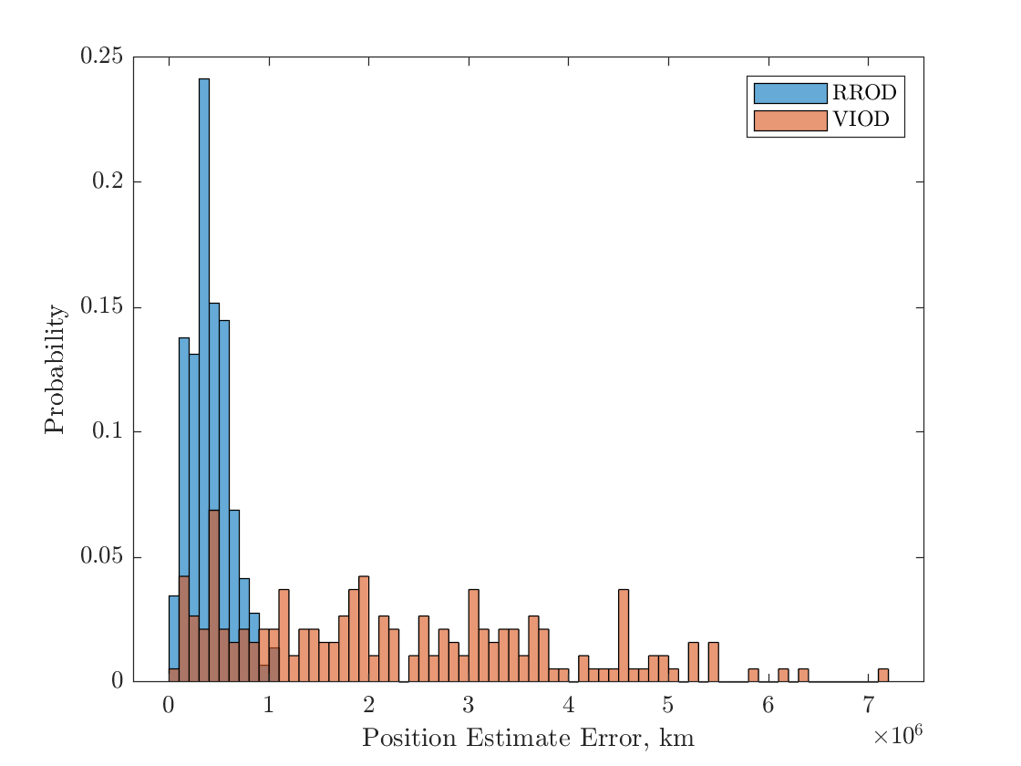
Temp
Text

Slide 10
Considerations
How to benchmark this method? Many variables
All VIOD variables
Number of pulsars
Arrangement of measurements (timing, order)

