Slide 1
Precision Motion Control
Lab 02

Slide 2
Overview
Repetitive Control
Iterative Learning Control

Slide 3
Repetitive Control

Slide 4
Step1. Design your RC controller
Please design your RC controller in Lab2_RC.m.
Lab2_RC.m will generate two files, one is reference file (.csv), and the other is controller file (.dat).
Warning:
1. We suggest you not to change the name of the saving files in Lab2_RC.m code.
2. Lab2_RC.m needs sub-functions tf2host.m and zpetc.m, so please put all files in the same folder. If you used zplpf.m, please also place it in the same folder.

Slide 5
Step2. Drag files to the target folder
C:\112-2_PMC\Lab02-ILC\<GroupName>\design
C:\112-2_PMC\Lab02-ILC\<GroupName>\design

Slide 6
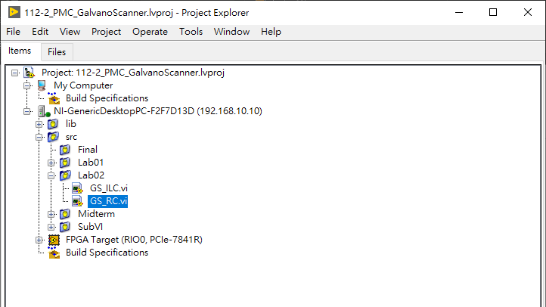
Step3. Find GS_RC.vi

Slide 7
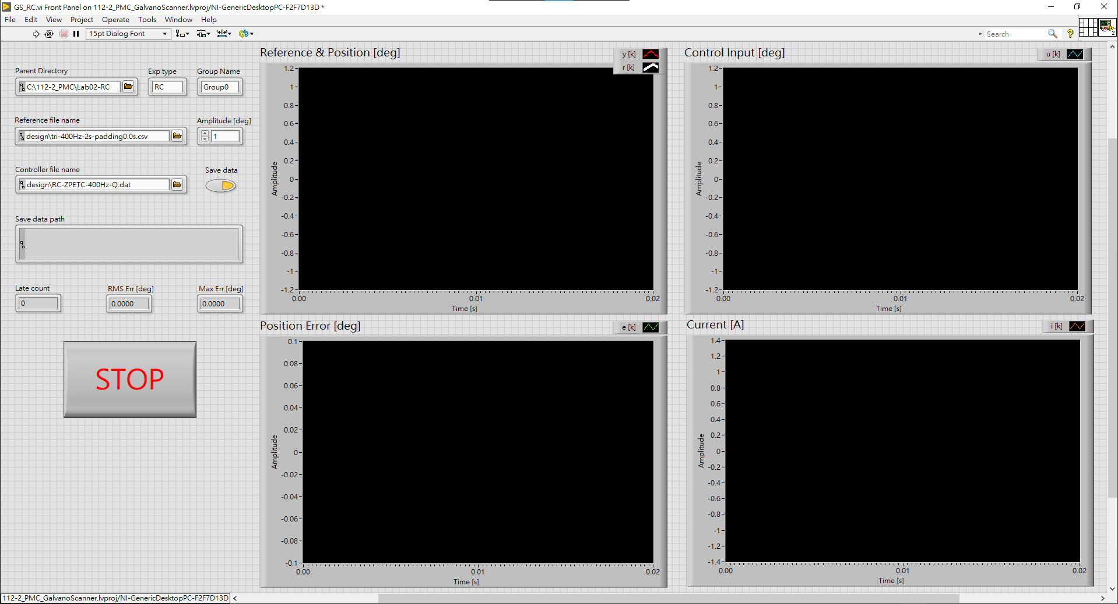
Step4. Just click the run button and you will see the result
Make sure file paths are correct.
Data is saved here

Slide 8
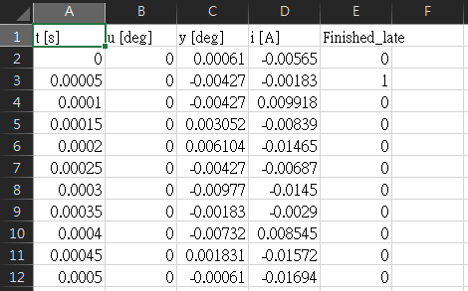
Step5. Find the saved Data
Data in folder C:\112-2_PMC\Lab02-RC\<GroupName>\results
u [deg] : control input
y [deg] : output position
i [A] : current

Slide 9
Step6. Post-Processing the Data
Good luck.

Slide 10
Iterative Learning Control

Slide 11
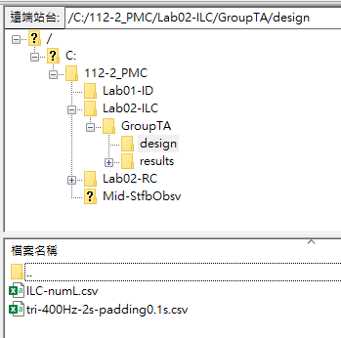
Step1. Generate the filter L,Q and reference r
Please design your L,Q filters in Lab2_ILC.m.
Record numQ, delayQ and delayL.
Drag and to C:\112-2_PMC\Lab02-ILC\<GroupName>\design

Slide 12
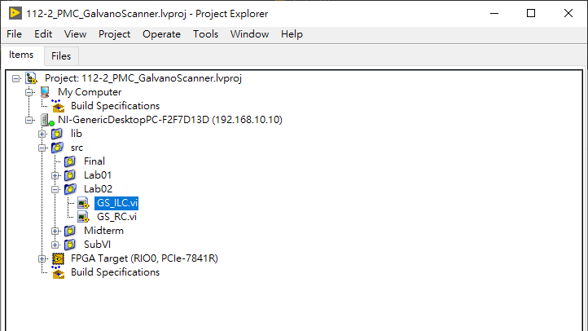
Step2. Find GS_ILC.vi

Slide 13
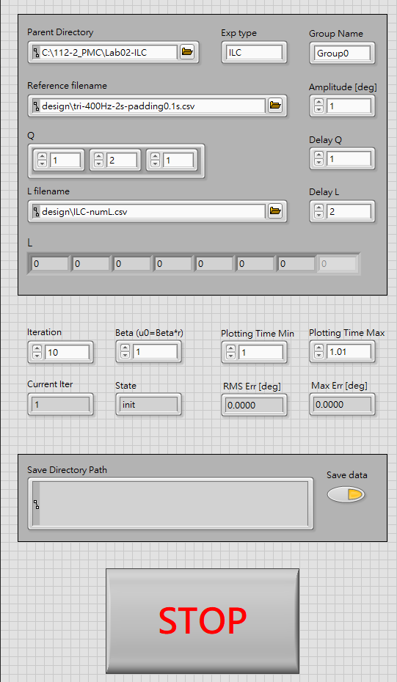
Step3. The GS_ILC.vi front panel
Group Name
Make sure the reference path and filename is correct.
numQ
(type it yourselves)
delayQ
(type it yourselves)
numL
(make sure the filename and the values are correct)
delayL
(type it yourselves)
You can change the iteration number here
You can change the range of time axis of the plots shown in the panel
Data is saved here

Slide 14
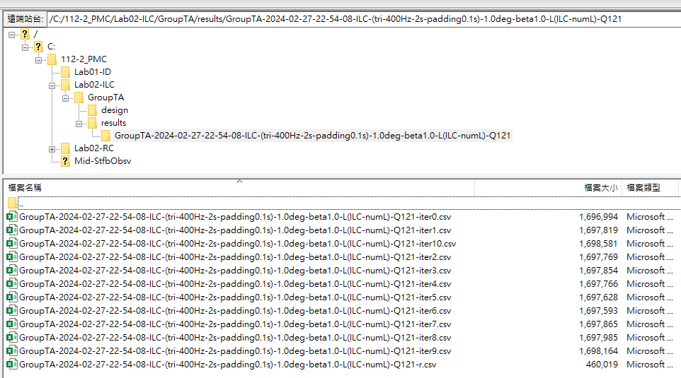
Step4. Data folder
Results of
each iteration
Reference

Slide 15
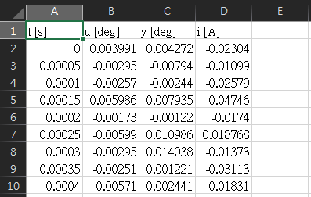
Step5. Find the saved Data of each iter
u [deg] : control input
y [deg] : output position
i [A] : current

Slide 16
Step6. Post-Processing the Data
Good luck.

Slide 17
“Oops! It’s not working!” Self-Checklist
Power blah, stop button blah, you know.
BTW the Q-filter in ILC will be normalized in the program. It will always be unit-gain.
If you got current issues in ILC, maybe you should reduce some other things first rather than the amplitude.
If all of the above failed, contact the TA.

Slide 18
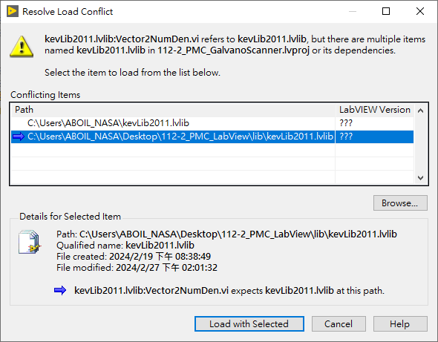
Appendix: Resolve Load Conflict
Yep, just click “Load with Selected”. You don’t need to do anything extra.

Slide 19
Thank you
Q&A

