Slide 1
Precision Motion Control
Final

Slide 2
Overview
Derive an FIR inverse filter
Data-based Feedforward control
Model-Free ILC
Model-Free RC

Slide 3
Derive an FIR inverse filter
In ref_imp.m file can generate the bandlimited impulse signal. (You don’t need to write this code.)
Apply this signal to GS_TR.vi to learning inverse filter. (This uses the TR ILC algorithm)
Get the data, write your code in FF.m
Save your data-based feedforward filter.
Tips: you can change the SimBandwidth, iterations, and alpha for better results.
Do not change the FIR filter order in ref_imp.m.

Slide 4
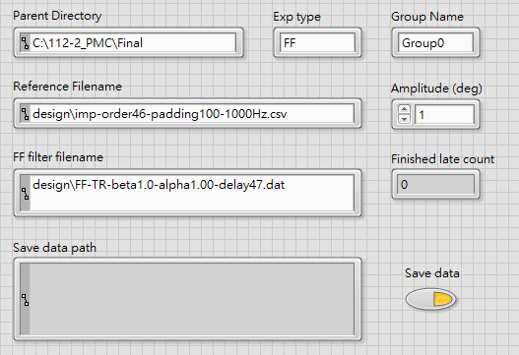
Data-based Feedforward control
Please find GS_FF.vi
Make sure the reference is correct.
Please load your designed data-based feedforward filter (generated by FF.m) here.

Slide 5
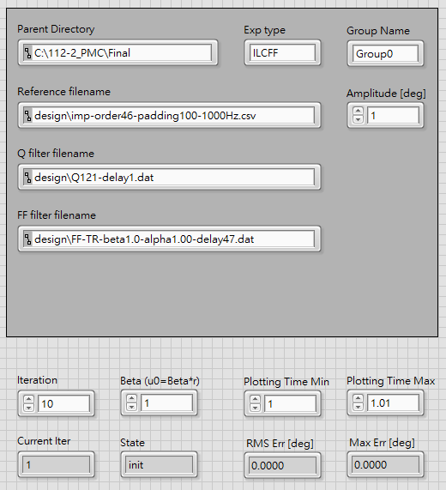
Model-Free ILC
Please find GS_ILCFF.vi
Make sure the reference is correct.
Import your Q filter.
Import your data-based feedforward filter.

Slide 6
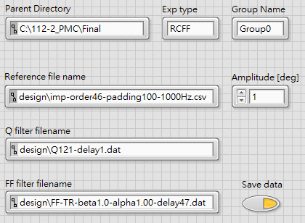
Model-Free RC
Please find GS_RCFF.vi
Make sure the reference is correct.
Import your Q filter.
Import your data-based feedforward filter.

Slide 7
Thank you
Q&A

