Slide 1
Lab01

Slide 2
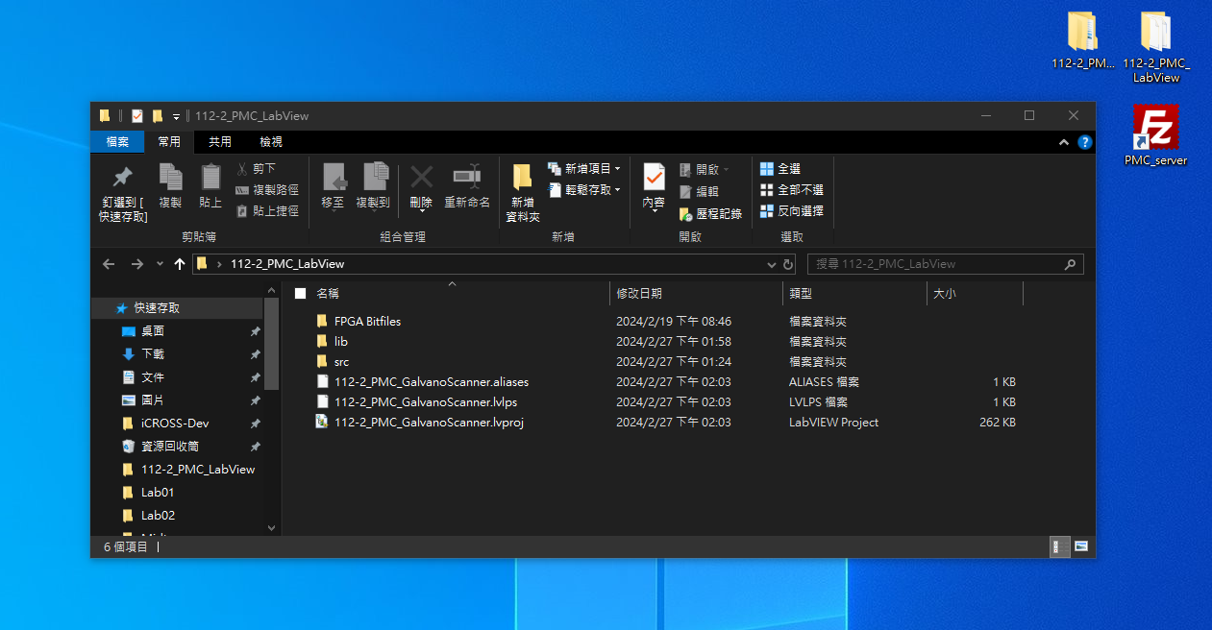
Step1. Open the Labview Project
Location of the LabVIEW Project:
C:\Users\user\Desktop\112-2_PMC_LabView\112-2_PMC_GalvanoScanner.lvproj
Click this folder
Double click to open it.

Slide 3
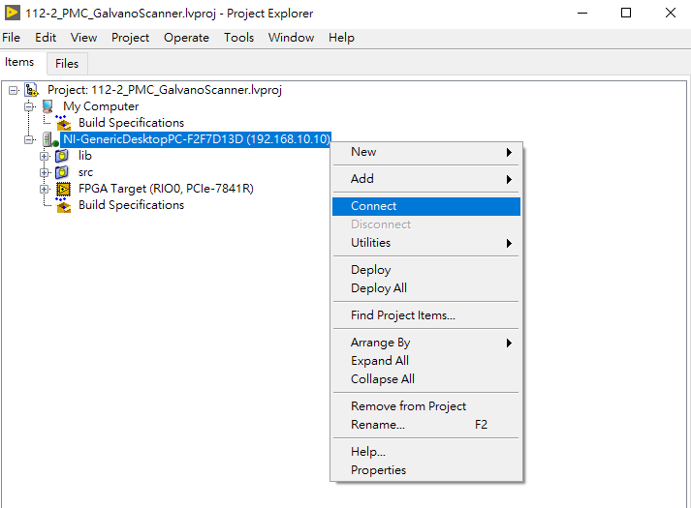
Step2. Connect to the RT Target
Right Click the target: NI-GenericDesktopPC-F2F7D13D (192.168.10.10)
Select “Connect”.
When the green indicator light is on, it means the target is connected successfully.
Connect successfully.

Slide 4
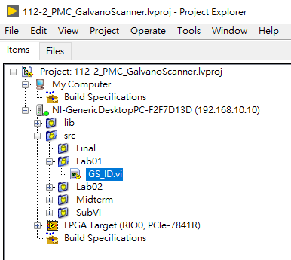
Step3. Find GS_ID.vi to do the First Experiment
Double click to open the GS_ID.vi file.

Slide 5
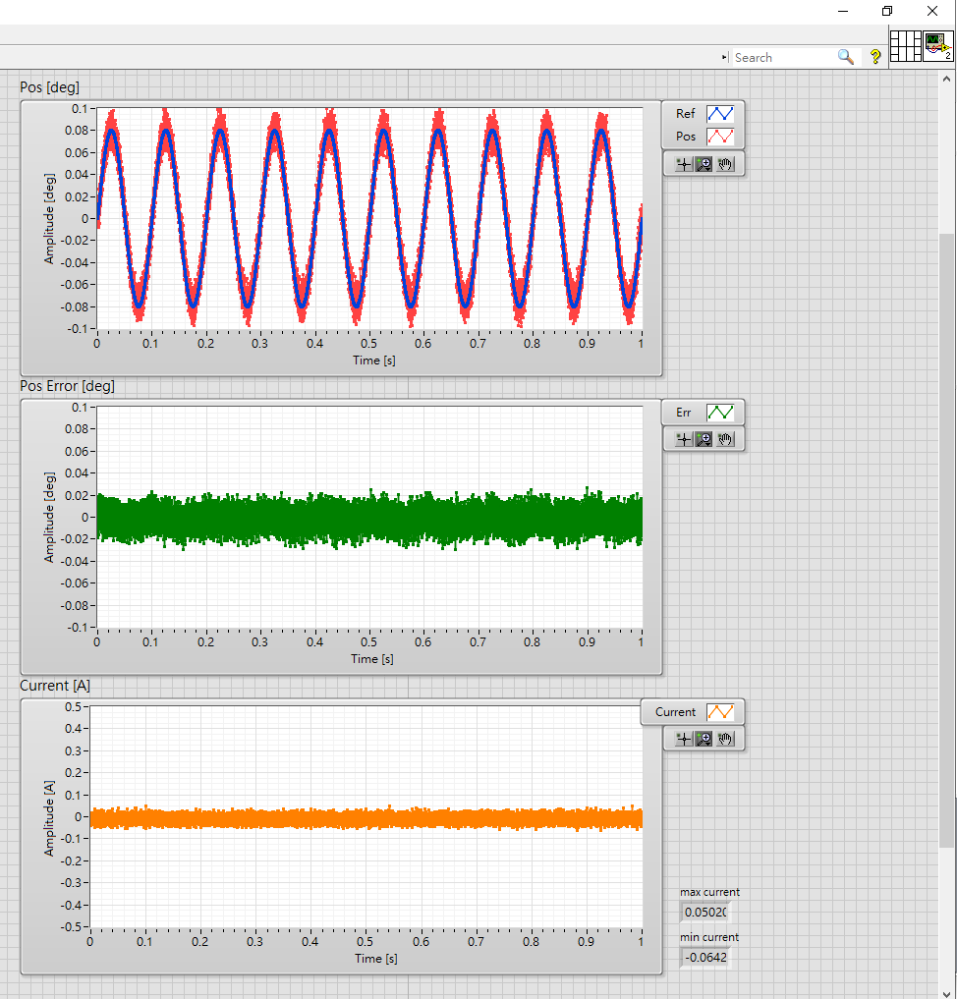
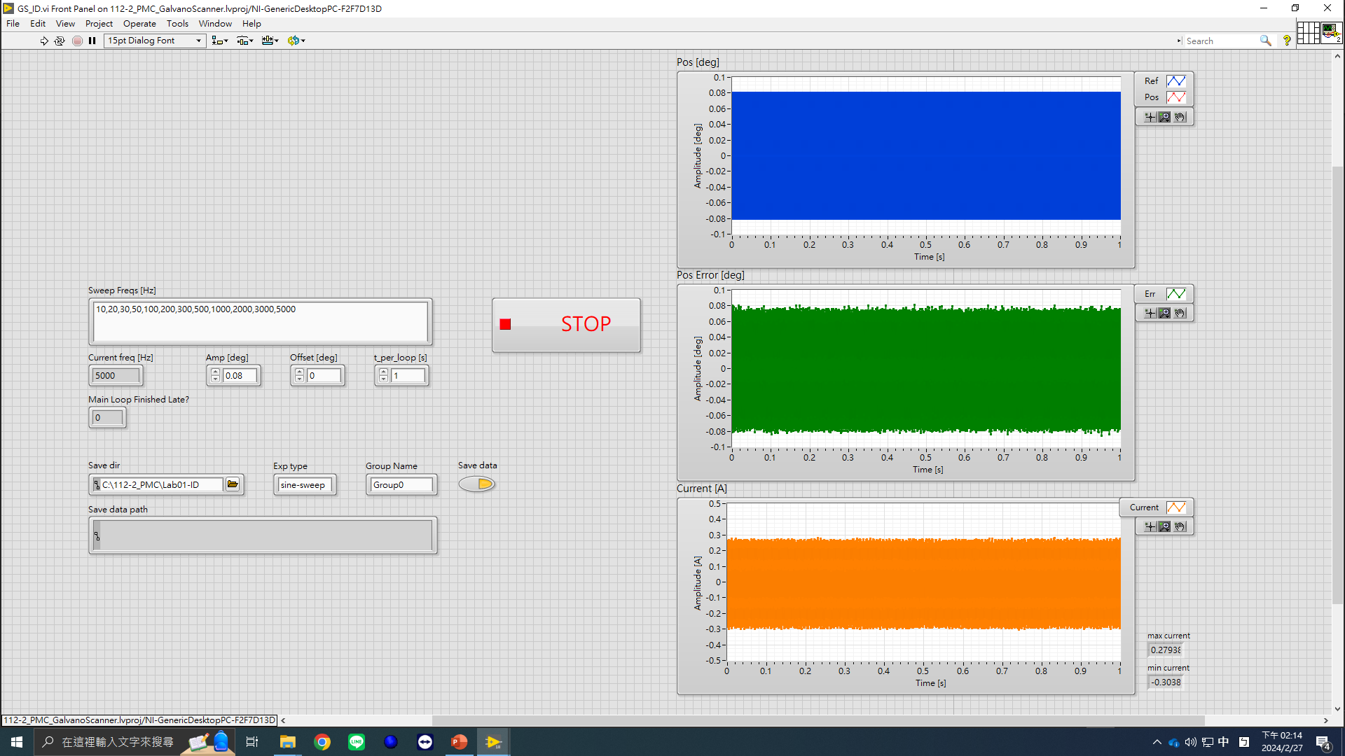
Step4. Do the Sine-Sweep Experiment
Emergency Stop
Run button
Response Plots
Sine-Sweep Frequency Values,
You are free to change it
Stop button
Sine-Sweep
Amplitude
Group Name
Save Data Button
(Default: True)
Saved data destination folder
(save on the controller’s disk)

Slide 6
Step5. Find the Data
Open the FileZilla link “PMC_server”.

Slide 7
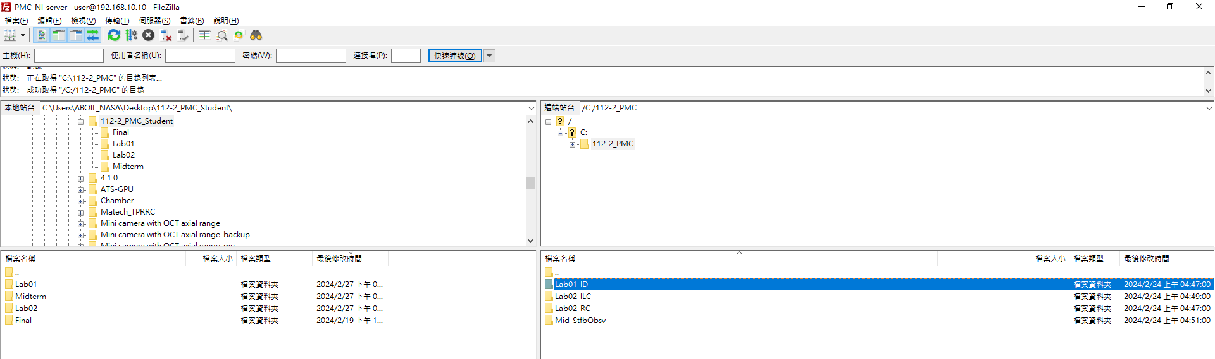
Step5. Find the Data
The data should be stored in the right hand side’s folders (in the controller).

Slide 8
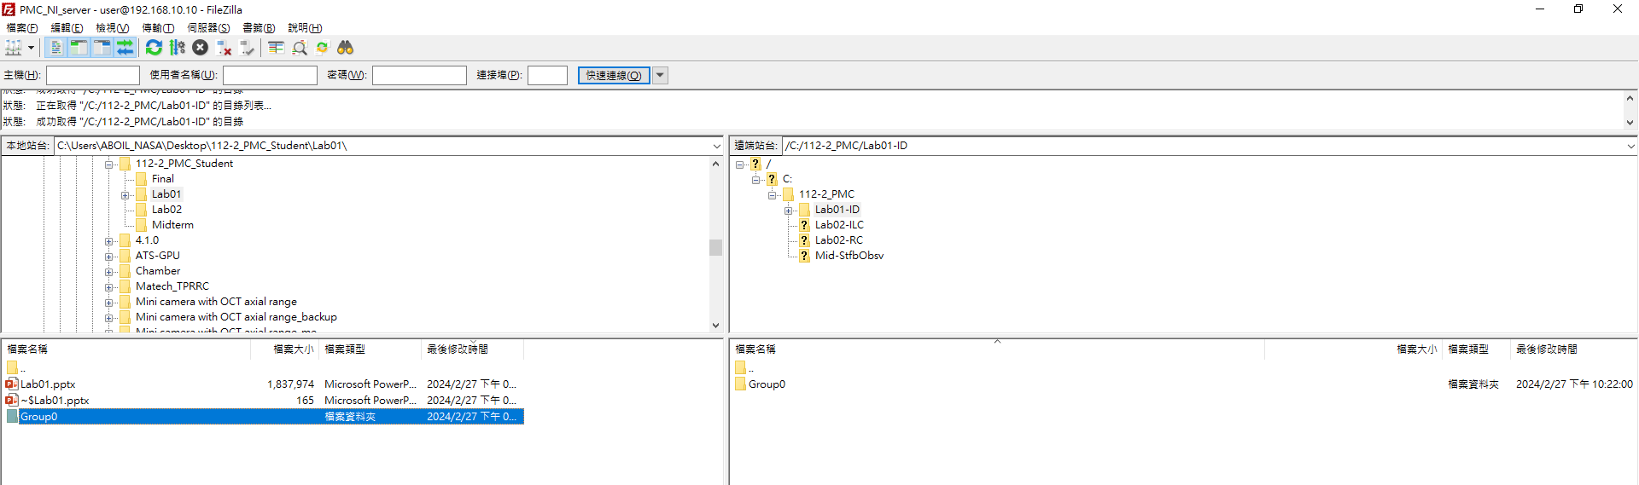
Step5. Find the Data
Build your own folders on the left hand side (current computer).
Drag the files in the right hand side to the left hand side.
Now the data is stored in this computer. Bring your data home and analyze it.

Slide 9
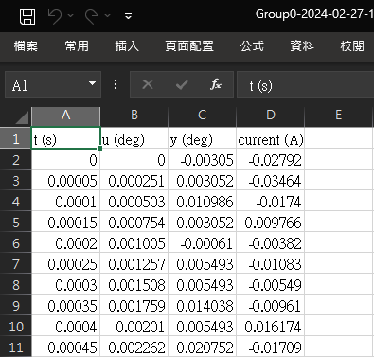
Step5. Find the Data
Store four data: Time (s), Input (deg), Output (deg), Current (A)

Slide 10
Step6. Post-Processing the Data to Get the Plant Model
Good luck.

Slide 11
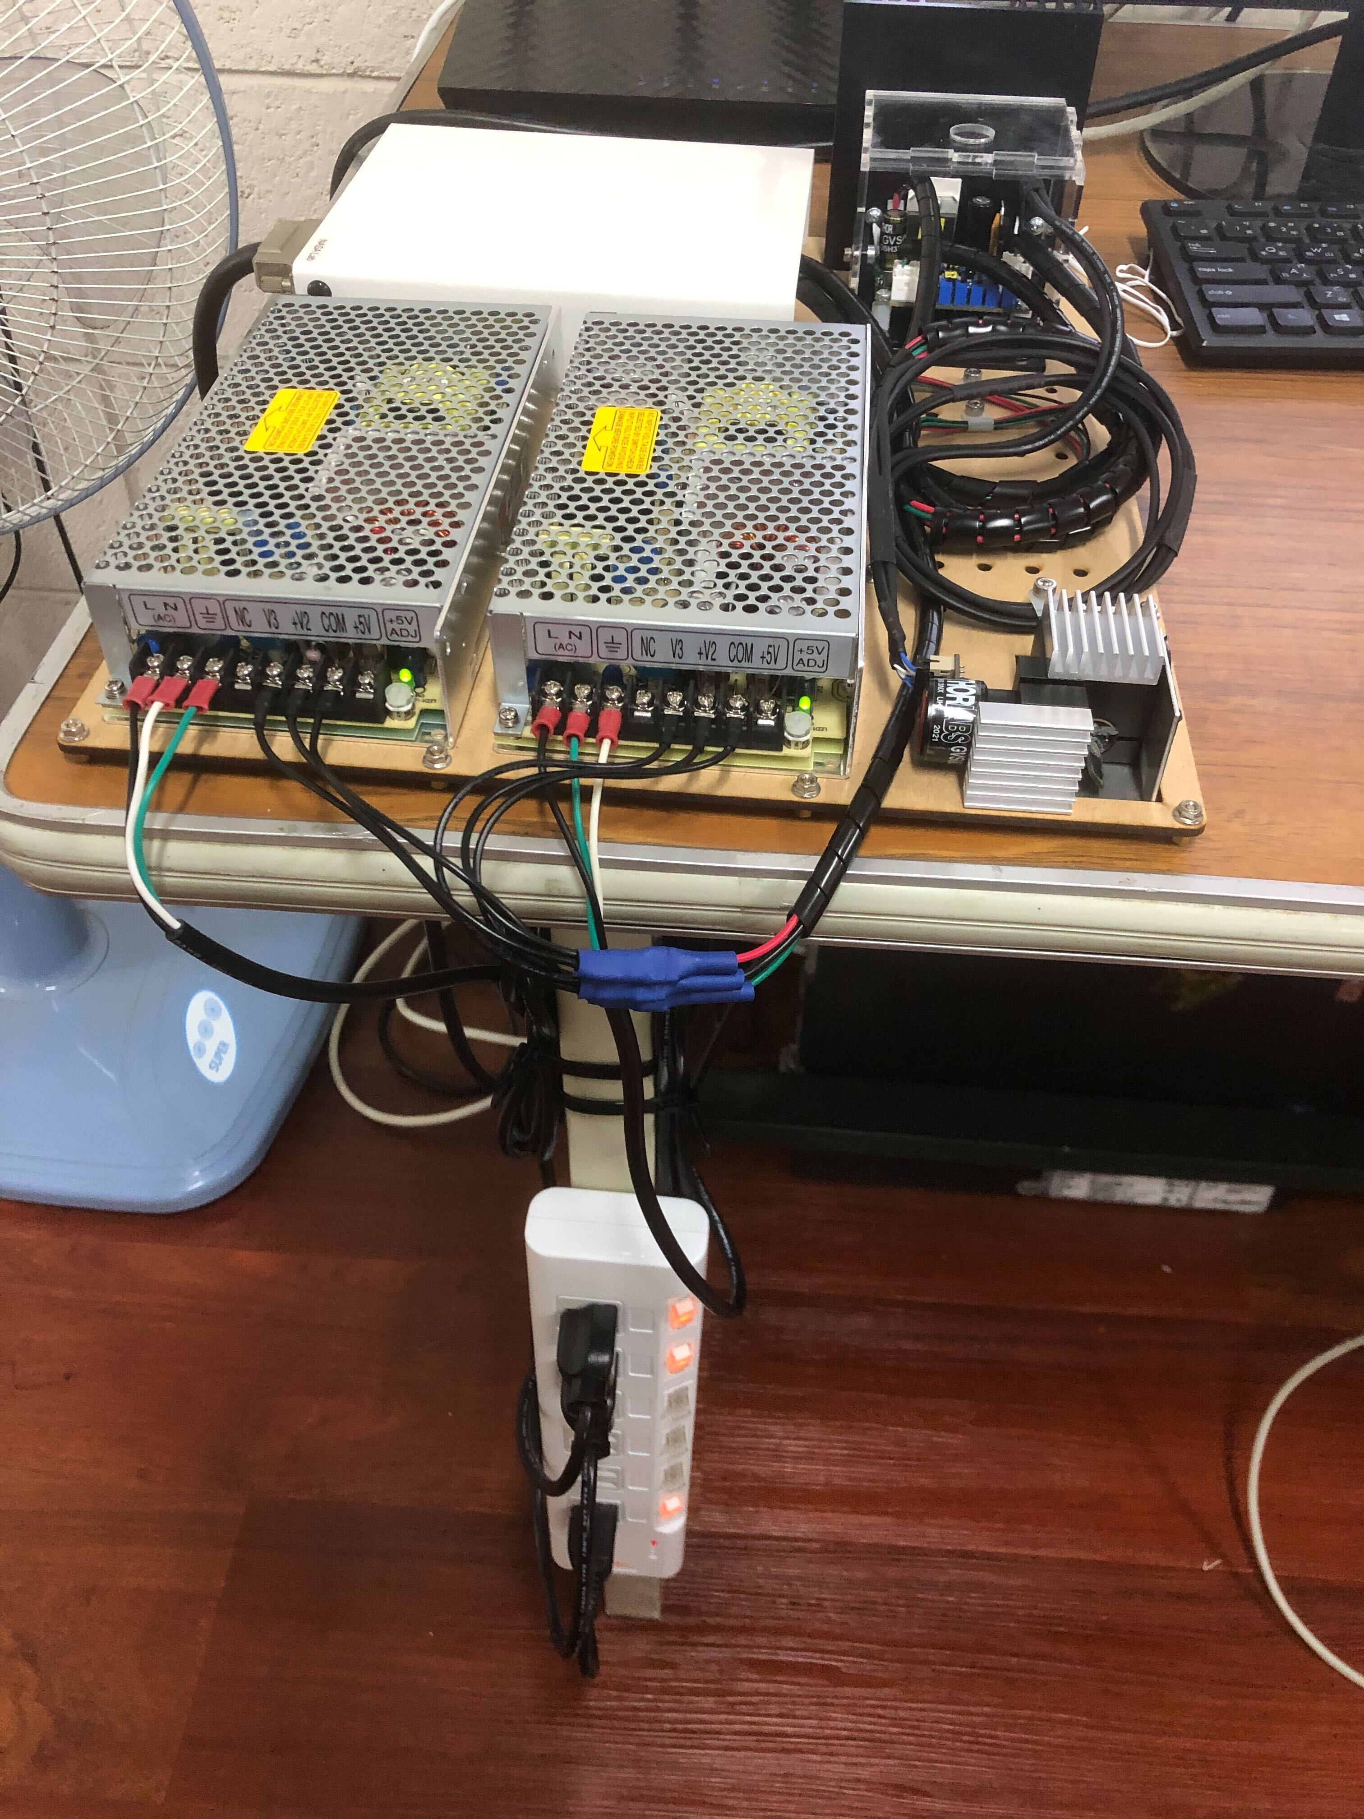
“Oops! It’s not working!” Self-Checklist
Is the power of the controller on?
Did you turn on the power supply? (Both of them?)
Are all the cables well-connected?
Did you “turn off” the stop button?
It is in fact, a switch, instead of a “button”.
Is the power supply halting due to high current?
Inspect the current plot. Over 1.5 [A] is risky.
Turn low the sine-sweep amplitude.
If all of the above failed, contact the TA.
LEDs will lit when turned on.
Power supply
Controller.
Do not turn off.

Slide 12
Thank You

