Slide 1
Precision Motion Control
Midterm

Slide 2

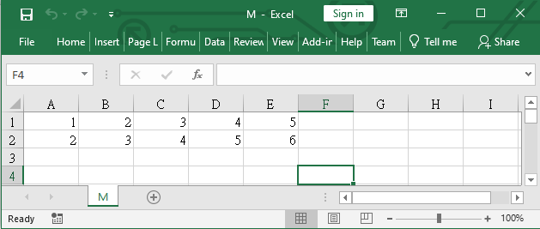

Step0: Controller Design
Find state-space $(A_{d}, B_{d}, C_{d})$ matrices from your discrete-time system P.mat (results from Lab01)
Do not use Pa.mat directly. Pa.mat is only for verification.
If you planned to use IMP, design $M_{a},M_{b},M_{c}$.
Design LQR controller $K_{d}$ and Kalman filter $L_{d}$.
Write them into csv files using command writematrix(A, filename)
Eg.

Slide 3
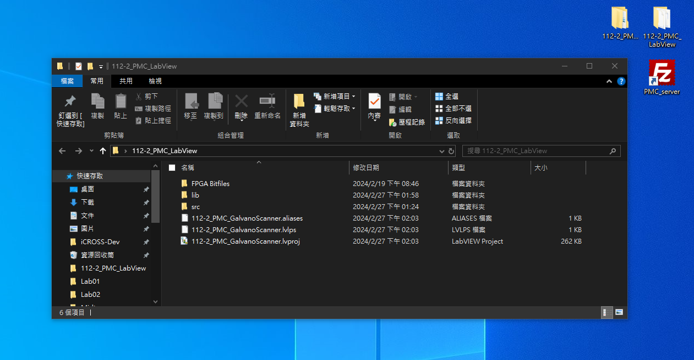
Step1. Open the Labview Project
Location of the LabVIEW Project:
C:\Users\user\Desktop\112-2_PMC_LabView\112-2_PMC_GalvanoScanner.lvproj
Click this folder
Double click to open it.

Slide 4
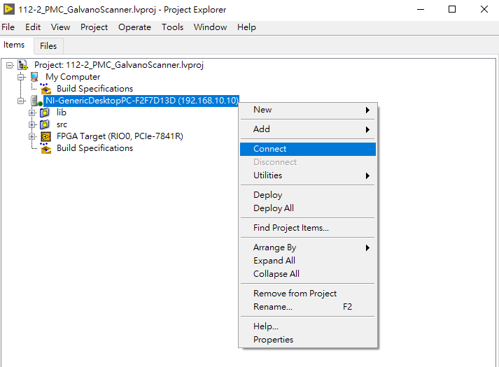
Step2. Connect to the RT Target
Right Click the target: NI-GenericDesktopPC-F2F7D13D (192.168.10.10)
Select “Connect”.
When the green indicator light is on, it means the target is connected successfully.
Connect successfully.

Slide 5
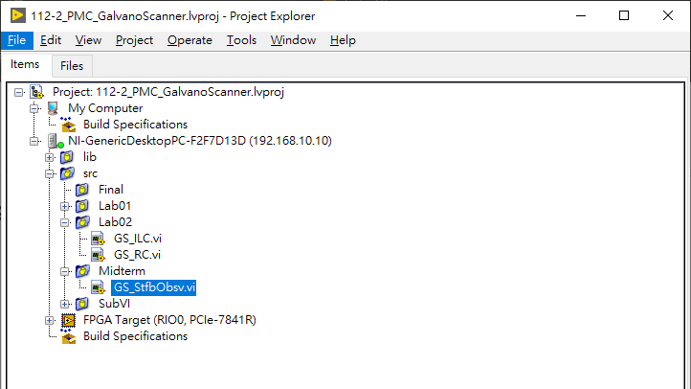
Step3. Find GS_StfbObsv.vi to do the experiment
Open the GS_StfbObsv.vi file.

Slide 6
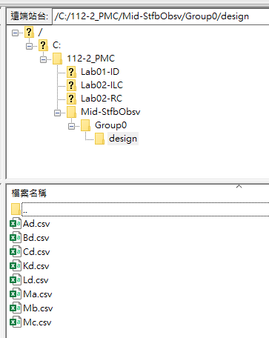
Step4. Put your matrices to target.
Open the FileZilla link on the top-right corner of the Desktop to browse the target’s disk space.
Create folder C:\112-2_PMC\Mid-StfbObsv\<GroupName>
Put your design in the folder.
You can temporarily store it at the 112-2_PMC_Student folder on the Desktop.

Slide 7
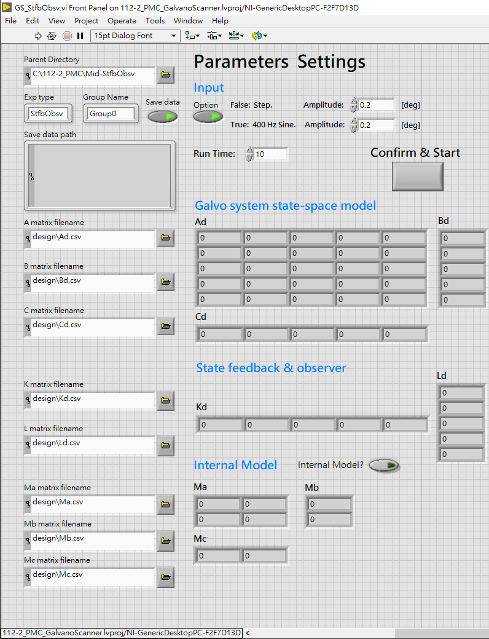
Step5. Do state observer feedback control experiment
Step 0: Enter your group name.
Step 1: Select your input type.
Step 2: If you plan on using an internal model, enable the "Internal Model?" setting.
Step 3: Enter the filename of you matrices.
For example, we saved our Ad.csv under C:\112-2_PMC\Mid-StfbObsv\GroupTA\design\Ad.csv Since the parent directory part and the group name is already stated in other fields, you just have to type in design\Ad.csv.
Step 4: Click the run button and see if the matrices are loaded correctly.
Yes: Click the confirm & start button to continue.
No: Click the STOP button to exit. (The bigger STOP button is suggested.)
Run button
Input Options: False: Step input
True: 400 Hz Sine
Confirm
Button
Internal Model?
(default off)

Slide 8
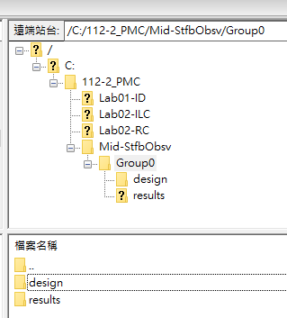
Step6. Find the Data
A folder called “results” should appear under <Parent Directory>/<Group Name>.
The data will be stored in this folder using csv format.

Slide 9
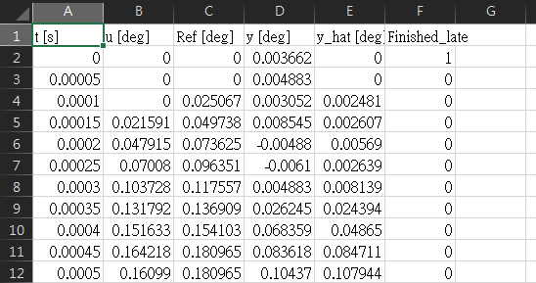
Step6. Find the Data
Six data stored in one csv (per experiment):
Time (s)
Input: u[k] (deg)
Reference: r[k] (deg)
Output: y[k] (deg)
Estimated Output by the Observer: y_hat[k] (deg)
LabView Finished late

Slide 10
Step7. Post-Processing the Data
Good luck.

Slide 11
“Oops! It’s not working!” Self-Checklist
Is the power of the controller on?
Did you turn on the power supply? (Both of them?)
Are all the cables well-connected?
Did you “turn off” the stop button?
It is in fact, a switch, instead of a “button”.
Is the power supply halting due to high current?
Inspect the current indicator under the big plot. Over 1.5 [A] is risky.
Turn low the amplitude. Usually 0.2 [deg] is good, which is the default value here.
If the files didn’t appear in the folders as you expected, try refresh (hit F5).
Did you type in the correct directories? E.g. group name, matrices filenames.
If you designed the controller with IMP, did you turn on the IMP switch?
Another direction: if you designed the controller without IMP, did your turn off the IMP switch?
Is your controller working in simulation?
If no, why are you here @_@ you got other different problems, mate.
If yes, is your simulation structure (e.g., the block diagram of Simulink) coincides with the structure that is upload on NTU COOL? (StateObserverFeedbackSimulink.PNG)
Did you forgot to click “Confirm & Start”?
If all of the above failed, contact the TA.

Slide 12
Thank You

