Slide 1
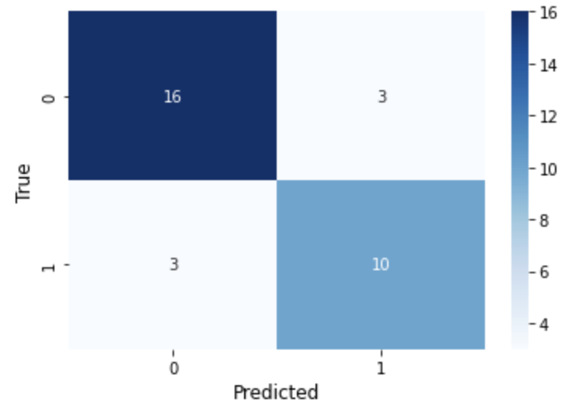
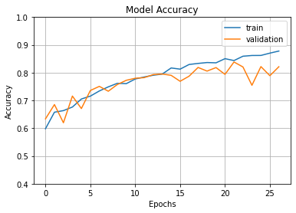
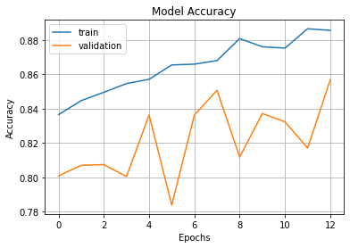
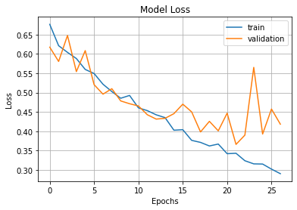
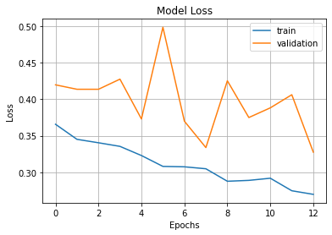
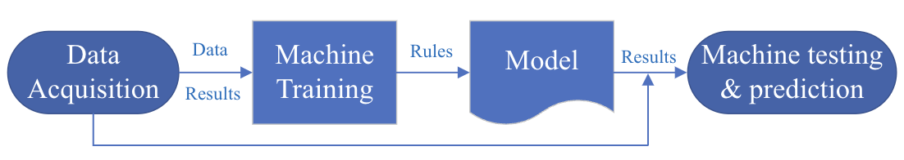
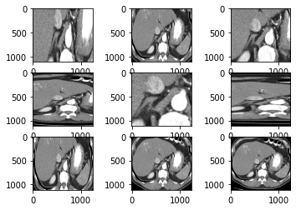
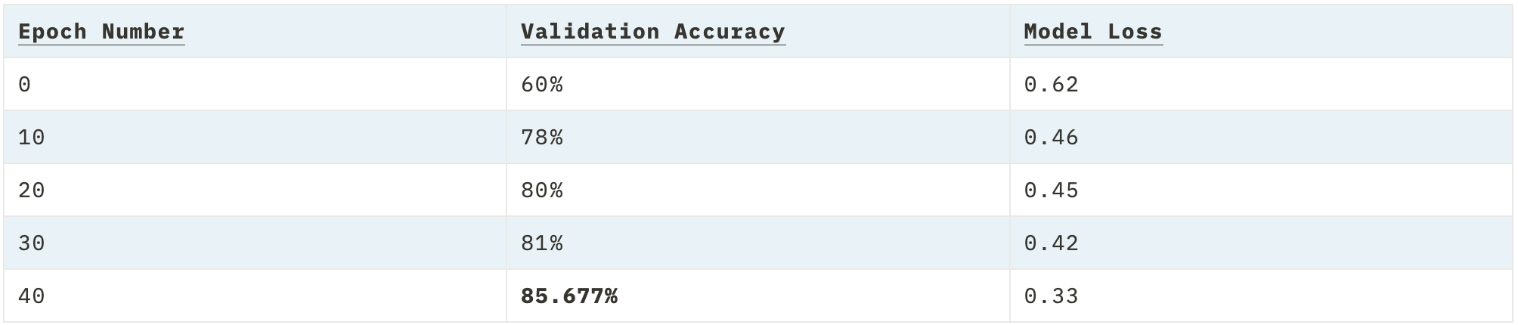


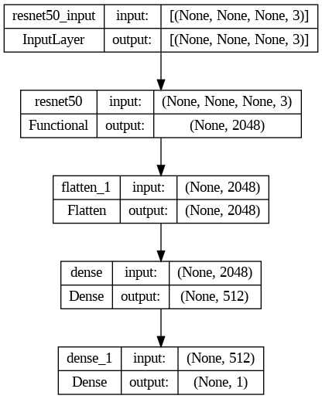
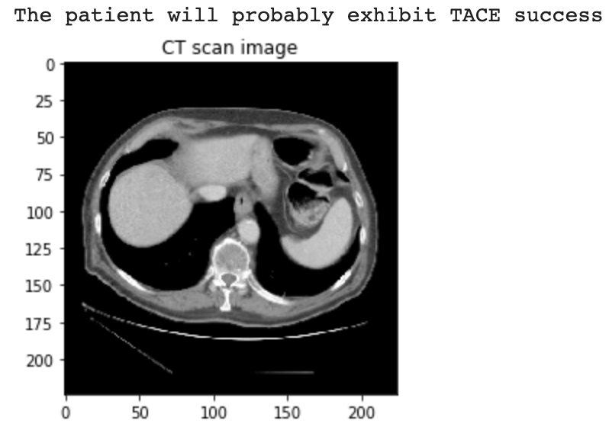
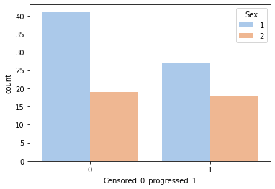
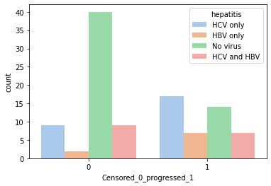
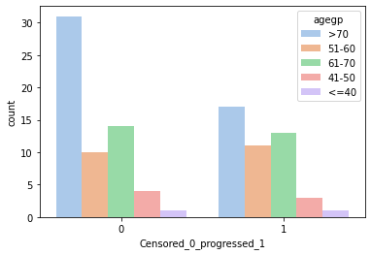
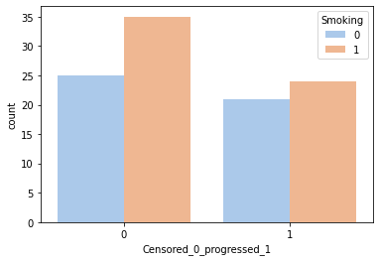
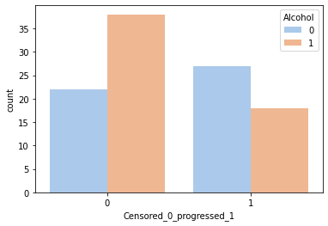
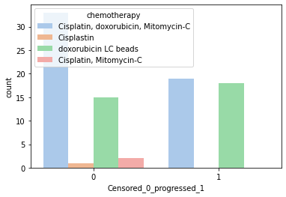
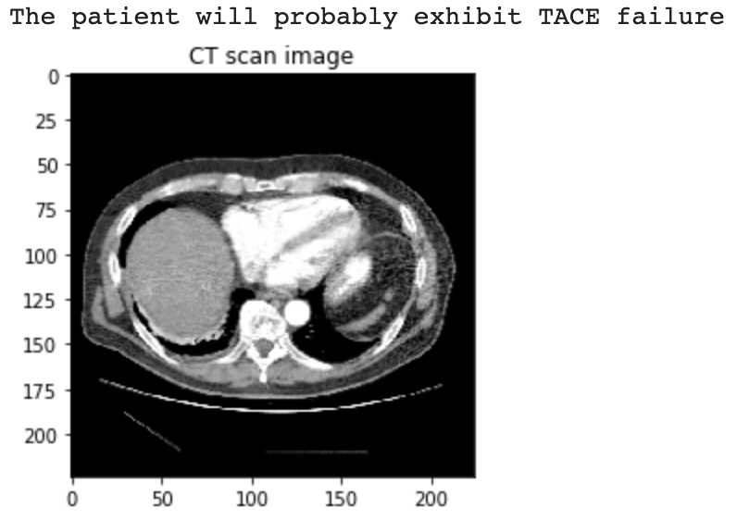
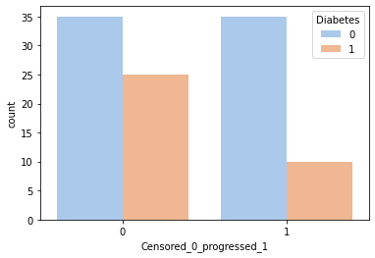
introduction
TAPS: A Novel Artificial Intelligence system for predicting Transarterial chemoembolization success on Hepatocellular Carcinoma
discussions
background
Logistic regression impact
Across the world, it is estimated that approximately 700,000 people die of liver cancer every year. Hepatocellular carcinoma (HCC) accounts for 90% of all liver cancers, primarily diagnosed in its late stages and a 5-year-survival rate of only 10%. With Transarterial chemoembolization (TACE) as the most common way to treat HCC, it fails to treat a staggering 60% of patients. TACE failure not only increases chances of fatality with delayed appropriate action, but also instills financial and emotional burdens on individuals. To prevent unexpected TACE failure and ensure medical professionals can prescribe correct treatment plans to HCC patients, it is crucial to determine pre-procedure if TACE is the right treatment plan for an individual. TAPS can aid medical professionals in correctly prescribing TACE therapy by using Machine learning with clinical and imaging factors to predict procedural outcomes. The system utilizes a Logistic Regression model to correlate external factors with TACE success, and a Convolutional Neural network to assess multiphasic contrast-enhanced CT scans and determine TACE outcomes. Using both models, better insight is provided on what factors should be examined before TACE prescription and a prediction system for medical professionals is developed. With models accessible through the Cloud, this project aims to provide a novel, cheap, efficient, and accurate way to determine TACE procedural outcomes and help prevent HCC fatalities around the world.
With the Logistic Regression model being able to predict TACE therapy outcomes with 81% accuracy over 105 patients, it provides insight into what clinical features correlate with the TACE procedure. Sex, Hepatitis, age group, smoking status, alcohol status, Chemotherapy type, and Diabetes all show evidence to play a role in TACE outcomes through the model. Hence, the model shows that these factors must be examined and considered by medical professionals when deciding to prescribe TACE therapy.
2. Model building & training
3. Limiting overfitting
The independent variables of the model were set as the clinical features and the dependent variable was set as the TACE outcome.
70% of the data was taken for training
A logistic regression function was created and trained with the training data
Using Model Checkpoint and Early Stopping, overfitting of the model was prevented. Overfitting results in a clinically inaccurate model which is specialized only for the data presented in the training set.
Convolutional neural network impact
4. Model training
The Convolutional Neural Network can predict TACE therapy outcomes on unseen images with 85.3339% accuracy. With the model built using 15,272 CT scans having minimal to no overfitting, it is suitable for use in a clinical setting. The 107.3 MB lightweight model can run on Python code processors available globally, netting a cost of $0. Utilizing optional external GPU hardware for mass batch image predicting and processing and a standard computer are the only potential costs of this novel Artificial intelligence system. This model provides high-accuracy predictions compared to the 40% accuracy of medical professionals when prescribing TACE therapy to patients today. In addition, predicting single CT scan images using the model takes only 0.326 seconds without a GPU hardware accelerator. Available through the Cloud, the model will help medical professionals globally including those in developing and underdeveloped countries, with fairly accurate, cheap, and efficient predictions regarding TACE therapy outcomes for their patients.
Testing & data analysis
Logistic regressions
Logistic regression algorithms in Machine Learning can predict an output based on various input features. The logistic function is a sigmoid function falling between the values of 0 and 1. Since the outputs of logistic regressions are always binary (0 or 1), it is used to address classification problems. Using data analysis through Python, features with correlations to TACE outcomes were selected for the model: gender, smoking, alcohol consumption, age group, Diabetes, Hepatitis, and type of chemotherapy used during the procedure. In the case of this project, a logistic regression model is created to predict TACE therapy outcomes of success (1), or failure (0) based on these clinical features for patients.
limitations
Convolutional neural networks
Figure 12: Model accuracy over epochs round 1
Figure 13: Model accuracy over epochs round 2
Data Size (Logistic Regression): The Logistic Regression model was trained on only 105 data points; therefore, it is overgeneralized to the sample and cannot be used in a clinical setting for predicting TACE outcomes.
Data type (CNN): The Convolutional Neural Network was only trained on multi-phasic contrast enhanced CT images of the liver, so CT scans lacking contrast and of other areas might fail to provide accurate predictions.
Model execution (CNN): The current CNN model can only predict a single image at a time.
Google Colaboratory GPU (CNN): On a free plan, Google Colab can only run GPU accelerated programs for 12 hours as a time.
Internet access: to run any of these models, internet access is required.
Accuracy: these models cannot guarantee TACE procedural outcomes, they can only predict with their respective accuracies.
Time: the models were created in a limited timeframe of 2 months.
Cloud: Amazon Web Services can only run for limited requests and time on a free tier.
Convolutional neural network (CNN) is an algorithm used for Computer vision. CNN takes input images, assigns weightage to various characteristics of an image, and can differentiate between them. CNNs are designed to function like the visual cortex of the human brain, connecting the weights between the characteristics in an image to output. This algorithm is used for classification problems. In the case of this project, a CNN was used to analyze training multiphasic pre-procedural CT imaging data with given classifications of success and failure to predict on unseen images.
Figure 9: Confusion Matrix for model testing (81% accuracy and 77% precision) using the remaining unseen dataset.
Neural network method
1. Image selection and preprocessing
Figure 14: Model loss over epochs round 1
Figure 15: Model loss over epochs round 2
Future extensions
Figure 1: CNN flowchart
Only multi-phasic CT scan images were selected from the dataset (15,272 images)
The images were converted from DICOM to PNG
Images were then matched with clinical outcomes and randomly split into Training (70%), Testing (15%), and Validation (15%) sets
Images were preprocessed to 224x224 sizes and Zoom and shear ranges of [0.2,1.0]
In the future, the TAPS website can be transferred to a better Cloud system and modified for a more functional design. In addition, the model can be expanded to take in multiple CT scan images per patient and give a prediction considering all CT scans. The accuracy of the model can also be attempted to be improved further through hyperparameter optimization techniques like Grid Search.
Materials
Data: “Multimodality annotated HCC cases with and without advanced imaging segmentation (HCC-TACE-Seg)” from the Cancer Imaging Archive (Open source)
Coding environments: Google Colaboratory and Visual Studio Code
Coding language: Python (and associated libraries)
Image Converter: DICOM Convertor
Open-source Machine Learning platform: TensorFlow
Neural Network library: Keras (in TensorFlow)
CNN Architecture: ResNet-50
Cloud Computing platform (for website): Amazon Web Services
Github repo CODE & TAPS WEBSITE ACCESS
Testing
The model was tested using the testing data of unseen images and yielded an accuracy of 85.3339% and 0.3153 loss when predicting TACE therapy outcomes.
Project goal
Figure 10: Zoom Range [0.2,1.0] image augmentation for a CT scan
To create a relatively accurate, efficient, accessible, and affordable Artificial Intelligence system to assist health professionals globally in predicting Transarterial Chemoembolization therapy success for individual patients.
2. Model building
Predictions on the TAPS website
Logistic regression method
Using Visual Studio code, the model was loaded to the TAPS website environment, and an unseen image for a patient with TACE success and for a patient with TACE failure were predicted using code designed and deployed to analyze the model’s predictions. Both images were accurately predicted by the model.
QR code to access GitHub repository for the project. Contains models and code for individual CT scan predictions. Scan for deeper look at the code and models.
QR code to access TAPS website (best used on a computer). Images to use on TAPS can be downloaded from the GitHub Repo.
Website URL: http://taps-hcc.duckdns.org:8080/
1. Data wrangling
conclusion
Figure 11: Final model architecture
An unseen CT scan with known TACE success was fed to the website using the finished model. TAPS was able to correctly predict TACE Success for the patient.
In conclusion, the project’s goal was met, and an accurate, efficient, accessible, and affordable TAPS Artificial Intelligence system was created using a Logistic Regression and Convolutional Neural Network to help medical professionals when prescribing TACE therapy. While there are limitations and extensions to this system, the current premise advances current prediction accuracies and provides insights into what clinical factors must be considered. This system has the potential to help patients globally in preventing TACE failure and receiving correct treatment prescriptions, saving numerous lives.
Figure 2: Sex vs. Outcome
Figure 3: Hepatitis vs. Outcome
Figure 4: Age group vs. Outcome
Works cited
Using Keras’ sequential model, a new model was created
Resnet 50 CNN architecture was utilized:
The fully connected layer of the network was removed (Dense layers)
Default imagenet weights and ‘avg’ pooling is applied (global average pooling is applied to output of last convolutional block, so model output will a 2D tensor)
Classes were set to 2 (Success and Failure of TACE therapy)
The pretrained layers for the Resnet model were made untrainable to preserve the architecture’s weight
A Flatten layer was added to the model to make the multidimensional inputs, one-dimensional
2 original Dense layers were also added:
The first dense layer utilizes the default ReLu activation function which allows the model to learn faster and preform better
On the first round, 128 neuron units were used in this layer
After an initial test, the neurons were incrementally increased to 512 neuron units for deeper and more optimal learning
The second Dense layer (the output layer) utilizes a sigmoid activation function used in binary classification to give a Failure or Success output.
The model was compiled with ‘adam’ optimizer and binary cross entropy loss function (standard for binary classification models), set to measure accuracy
Figure 16: TACE Success prediction
Key statistics about liver cancer. American Cancer Society. (n.d.). Retrieved February 5, 2023, from https://www.cancer.org/cancer/liver-cancer/about/what-is-key-statistics.html#:~:text=More%20than%20800%2C000%20people%20are,Center%20for%20more%20key%20statistics.
Konz, N. (2022, July 18). Train a neural network to detect breast MRI tumors with pytorch. Medium. Retrieved December 20, 2022, from https://towardsdatascience.com/train-a-neural-network-to-detect-breast-mri-tumors-with-pytorch-250a02be7777.
Li, S. (2019, February 27). Building a logistic regression in Python, step by step. Medium. Retrieved December 20, 2022, from https://towardsdatascience.com/building-a-logistic-regression-in-python-step-by-step-becd4d56c9c8.
Llovet, J. M., Kelley, R. K., Villanueva, A., Singal, A. G., Pikarsky, E., Roayaie, S., Lencioni, R., Koike, K., Zucman-Rossi, J., & Finn, R. S. (2021, January 21). Hepatocellular carcinoma. Nature reviews Disease primers. Retrieved February 5, 2023, from https://pubmed.ncbi.nlm.nih.gov/33479224/
Nolan, T. (2022). Multimodality annotated HCC cases with and without advanced imaging segmentation (HCC-TACE-SEG). Multimodality annotated HCC cases with and without advanced imaging segmentation (HCC-TACE-Seg) - The Cancer Imaging Archive (TCIA) Public Access - Cancer Imaging Archive Wiki. Retrieved February 5, 2023, from https://wiki.cancerimagingarchive.net/pages/viewpage.action?pageId=70230229.
Figure 5: Smoking vs. Outcome
Figure 6: Alcohol vs. Outcome
Figure 7: Chemotherapy type vs. Outcome
Similarly, an unseen CT scan with known TACE failure was fed to the TAPS website utilizing the model and it accurately predicted TACE failure for the patient based on the singular scan.
Out of 56 factors, only factors showing correlation with TACE outcomes were kept (non correlational data removed)
Figure 8: Diabetes vs. Outcome
Figure 17: TACE Failure prediction
All graphics were created by the student & CT scans were public data

