Slide 1
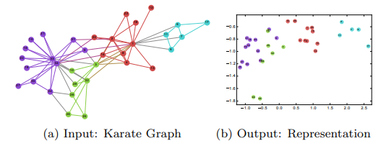
DeepWalk: Online Learning of Social Representations (2014)
1. INTRODUCTION
DeepWalk: Learn social representations by treating truncated random walks as the equivalent of sentences.
social representations: Latent features of the vertices that capture neighborhood similarity and community membership.
Feature of original network
encode
social relation
low-dimension vector
classification
truncated: 截断的.
The first one to introduce deep learning techniques into network analysis (or network embedding).
Significantly performance increased.
Scalable.

Slide 2



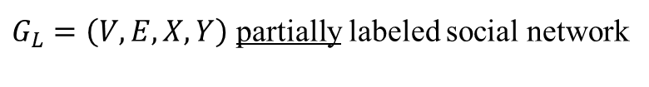

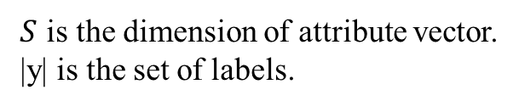


2. PROBLEM DEFINITION
Consider the problem of classifying members of a social network into one or more categories.
$S$ is the dimension of attribute vector.
|y| is the set of labels.
$G_{L}=\left(V,E,X,Y\right)$ partially labeled social network
$$S$$
attribute vector
goal
$$X$$
$$|V|$$
DeepWalk helps us to get the vector representation of each vertex.
Unsupervised feature learning, independent of the labels’ distribution.
classifier
|y|
Classify vertices into categories.
$$Y$$
$$|V|$$

Slide 3
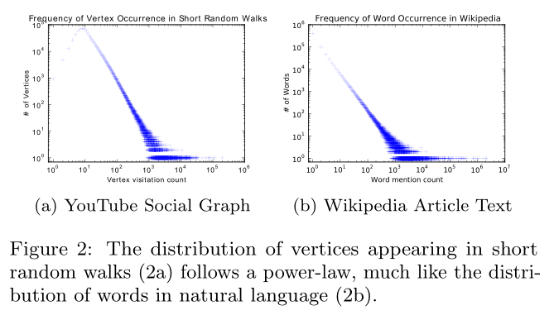





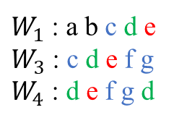
3. LEARNING SOCIAL REPRESENTATIONS
3.2 Connection: Power laws
Some characteristics:
Adaptability
Community aware
Low dimensional
Continuous
3.1 Random Walks
$$W_{v_{i}}^{1}$$
$$W_{v_{i}}^{2}$$
$$W_{v_{i}}^{3}$$
$$v_{i}$$
Visitation count | Of vertices
1 | 2: a b
2 | 2: c f
3 | 1: e
4 | 1: d
root
$W_{1}$ : a b c d e
$W_{3}$ : c d e f g
$W_{4}$ : d e f g d
random walk $W_{v_{i}}$
Capturing community information.
Easy to parallelize.
Accommodate small changes without computing globally.
Text is a sequence of words.
Random walk is a sequence of vertices.
Notes:
幂律分布: 某个随机变量分布密度函数是幂函数，表现在图上一条斜率为幂指数负数的直线.

Slide 4











3.3 Language Modeling
Give a sequence of words $W_{n}^{1}=\left(w_{0},w_{1},···,w_{n}\right)$.
Maximize $Pr⁡(w_{n}|w_{0},w_{1},···,w_{n−1})$ over all the training corpus, where $w_{i}∈V$ ($V$ is the vocabulary).
Ex. The cat is sitting on the fire.
?
$$Φ:v∈V ↦ ℝ^{\left|V\right|×d}$$
$Pr⁡(v_{i}|v_{1},v_{2},···,v_{i−1})$
$Pr⁡(v_{i}|Φ(v_{1}),{Φ(v}_{2}),···,{Φ(v}_{i−1}))$
relaxation
$$v_{2}$$
$$v_{4}$$
$Pr⁡({\{v}_{1},v_{2},v_{4},v_{5}\}|Φ\left(v_{3}\right))$
Independent vertex order, better capture the ‘nearness’ provided by random walks.
Training faster, given one vertex at a time.
$$v_{1}$$
$$v_{3}$$
$$v_{5}$$
$$w=2$$
$$w=2$$

Slide 5
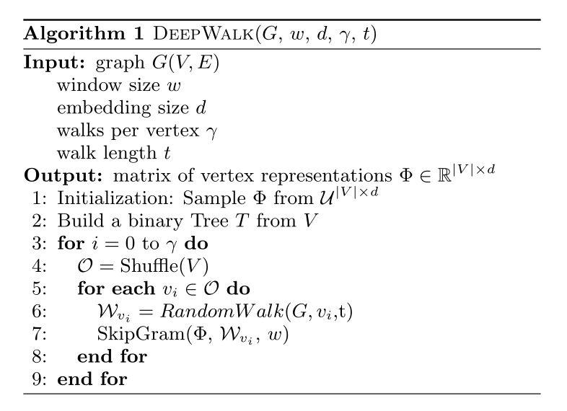
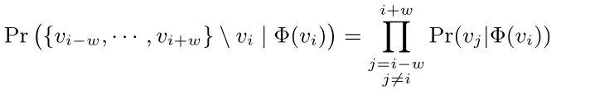
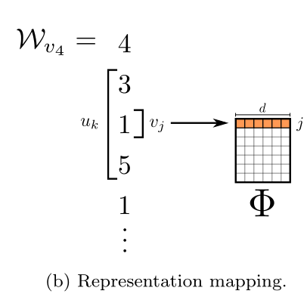
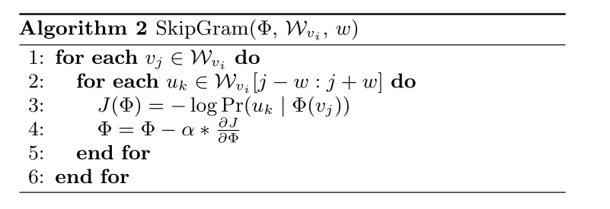
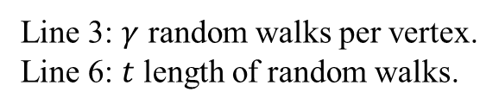


4. METHOD
SkipGram
Line 3: $γ$ random walks per vertex.
Line 6: $t$ length of random walks.
Independent assumption: regardless of the position
Iterate over all possible collocations.
$Pr⁡(v_{3}|Φ\left(v_{1}\right))$
$Pr⁡(v_{5}|Φ\left(v_{1}\right))$

Slide 6
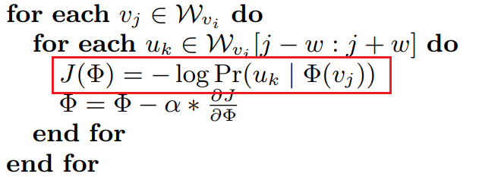

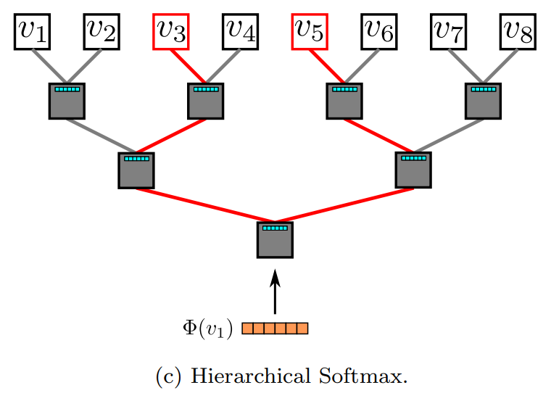




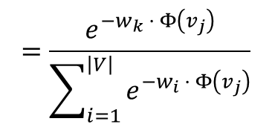










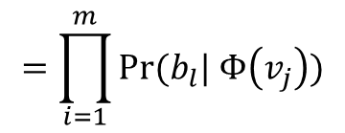


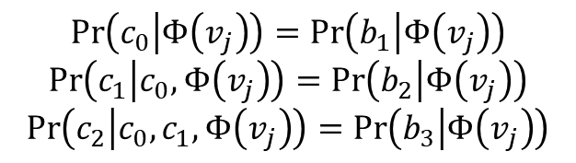


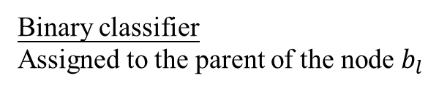



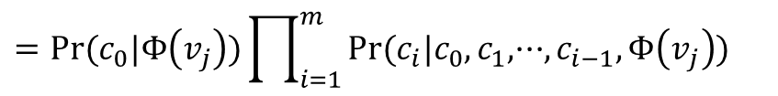
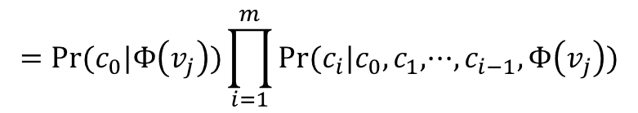

Hierarchical Softmax
Softmax Regression
$$=\frac{e^{−w_{k} · Φ\left(v_{j}\right)}}{\sum_{i=1}^{\left|V\right|}{e^{−w_{i} · Φ\left(v_{j}\right)}}}$$
$$w_{i}∈ ℝ^{d}$$
Encoding the vertices by $\left({c_{0},c}_{1},c_{2},···,c_{m}\right), c_{i}∈\left\{0,1\right\}, m=⌊log⁡|V|⌋$
$$b_{3}$$
$$\operatorname{Pr}\left(u_{k} | Φ\left(v_{j}\right)\right)=Pr⁡(c_{1},c_{2},···,c_{m}|Φ\left(v_{j}\right))$$
$=Pr⁡(c_{0}|Φ\left(v_{j}\right))\prod_{i=1}^{m}{Pr⁡(c_{i}|c_{0},c_{1},···,c_{i−1},Φ\left(v_{j}\right))}$
$$0$$
$$1$$
$$0$$
$$1$$
$$0$$
$$1$$
$$0$$
$$1$$
$$b_{2}$$
$$=Pr⁡(c_{0}|Φ\left(v_{j}\right))\prod_{i=1}^{m}{Pr⁡(c_{i}|c_{0},c_{1},···,c_{i−1},Φ\left(v_{j}\right))}$$
$$0$$
$$1$$
$$0$$
$$1$$
$$b_{1}$$
$$=\prod_{i=1}^{m}{Pr⁡(b_{l}| Φ\left(v_{j}\right))}$$
$$0$$
$$b_{0}$$
$$1$$
$$\operatorname{Pr}\left(c_{0} | Φ\left(v_{j}\right)\right)=\operatorname{Pr}\left(b_{1} | Φ\left(v_{j}\right)\right)$$
$$\operatorname{Pr}\left(c_{1} | c_{0},Φ\left(v_{j}\right)\right)=\operatorname{Pr}\left(b_{2} | Φ\left(v_{j}\right)\right)$$
$$\operatorname{Pr}\left(c_{2} | c_{0},c_{1},Φ\left(v_{j}\right)\right)=\operatorname{Pr}\left(b_{3} | Φ\left(v_{j}\right)\right)$$
Binary classifier
Assigned to the parent of the node $b_{l}$
$$\left({b_{0},b}_{1},b_{2},···,b_{m}\right)$$
$$···$$
$$\operatorname{Pr}\left(c_{m} | c_{0},c_{1},···,c_{m−1},Φ\left(v_{j}\right)\right)=\operatorname{Pr}\left(b_{m} | Φ\left(v_{j}\right)\right)$$

Slide 7
5. EXPERIMENTAL DESIGN
5.1 Datasets
5.2 Baseline Method
BLOGCATLOG
FLICKR
YOUTUBE
SpectralClustering
Modularity
EdgeCluster
wvRN
Majority

Slide 8
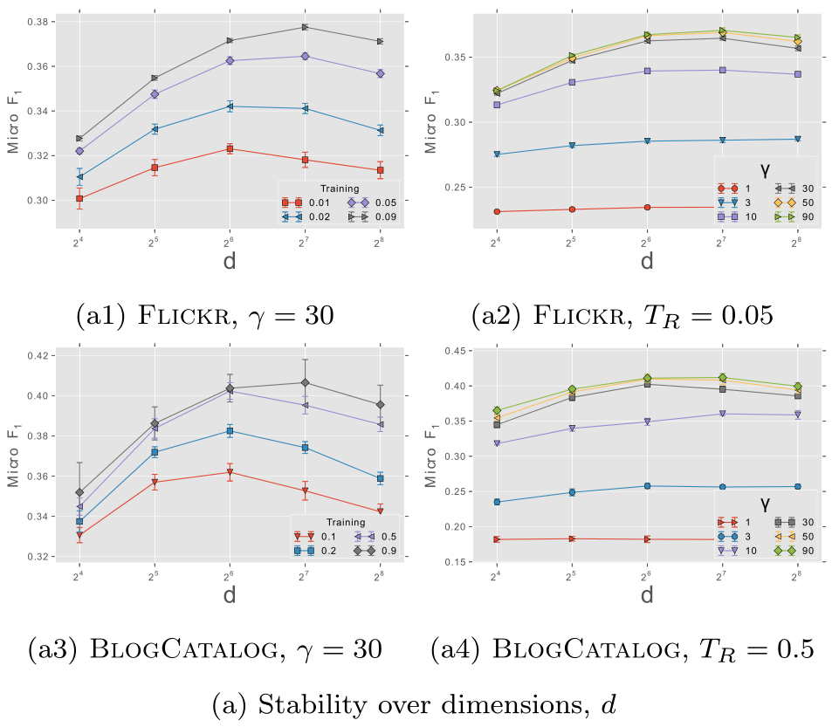

Slide 9
