Slide 1
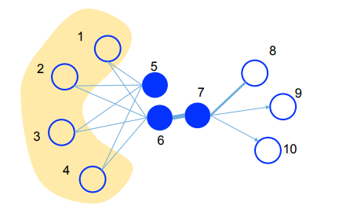
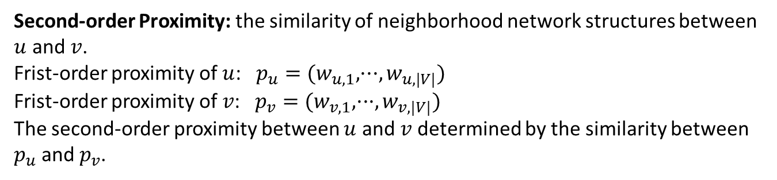
Definitions:
Information Networks: $G=(V,E,W)$, each edge $e=(u,v)∈E$ associated with a weight $w_{uv}>0$, which indicates the strength of the relation. Directed or Undirected.
Frist-order Proximity: $w_{uv}$, local pairwise proximity between two vertices.
Second-order Proximity: the similarity of neighborhood network structures between $u$ and $v$. Frist-order proximity of $u$: $p_{u}=(w_{u,1},···,w_{u,|V|})$
Frist-order proximity of $v$: $p_{v}=(w_{v,1},···,w_{v,|V|})$
The second-order proximity between $u$ and $v$ determined by the similarity between $p_{u}$ and $p_{v}$.
Notes:
信息网络：航线网络、出版网络、社会网络等，主要是在边上定义了权重。
Second-order proximity可解释为具有共享邻居结构的结点是相似的。

Slide 2
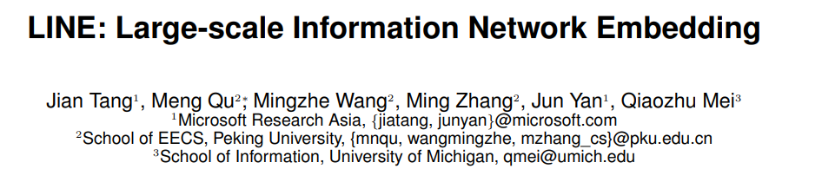
LINE is able to scale to very large, arbitrary types of networks:
Undirected, directed and/or weighted.
The model optimizes an objective which preserves both the local and global network structures.
Local: Frist-order proximity
Global: Second-order proximity
An edge-sampling algorithms for optimizing the objective.
Experiments shows the effectiveness and efficiency of LINE.
Notes:
Local就是网络中可见的边，通过Frist-order Proximity表示：边权
Global是看不见的边，但是能反映全局的玩咯结构，我们通过Second-order Proximity表示：结点之间共享
的邻居结构。

Slide 3


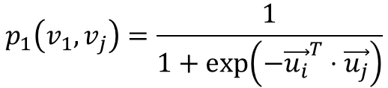
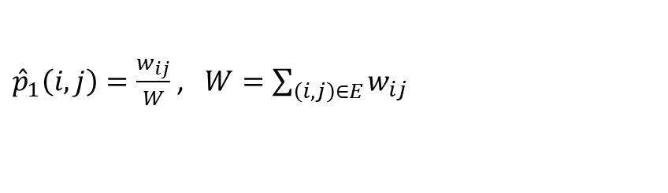
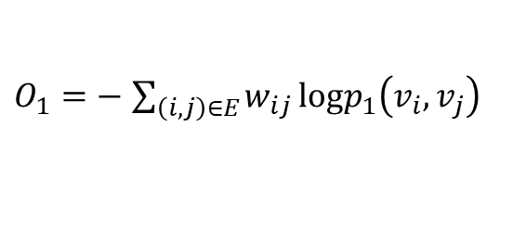
Model Description
1. LINE with Frist-order proximity
Model the first-order proximity after embedded, define the joint probability:
$$p_{1}\left(v_{1},v_{j}\right)=\frac{1}{1+\exp\left(−{\vec{u_{i}}}^{T}⋅\vec{u_{j}}\right)}$$
$\vec{u_{i}}∈R^{d}$ is the low-dimensional vector representation of vertex $v_{i}$.
empirical probability
${\hat{p}}_{1}\left(i,j\right)=\frac{w_{ij}}{W}$ , $W=\sum_{\left(i,j\right)∈E}{w_{ij}}$
Minimize the following objective function:
$$O_{1}=d({\hat{p}}_{1}\left(·,·\right),p_{1}\left(·,·\right))$$
$d$ is the distance between two distributions.
Replacing $d(·,·)$ with KL-divergence and omitting some constants,
$O_{1}=−$ $\sum_{\left(i,j\right)∈E}{w_{ij}}logp_{1}\left(v_{i},v_{j}\right)$
The first-order proximity is only applicable for undirected graphs, not for directed graphs.
Notes:
分别讨论保持1阶相似性和2阶相似性的LINE model，再结合两种相似性。
1阶相似性只适用于无向图、不适用于有向图。

Slide 4
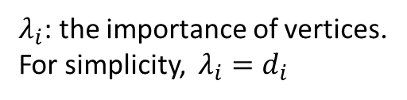
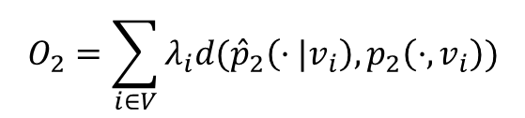
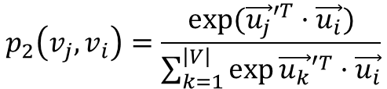
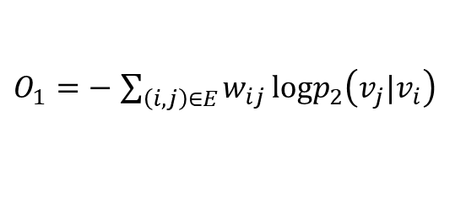
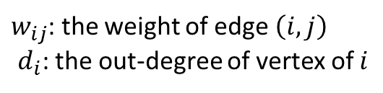
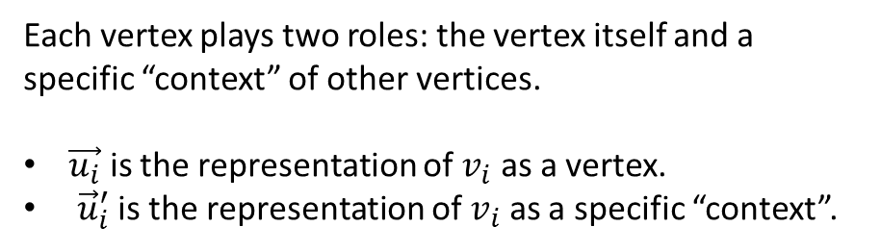
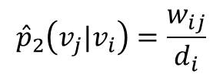
2. LINE with Second-order proximity
The second-order proximity is applicable for both directed and undirected graphs.
Each vertex plays two roles: the vertex itself and a specific “context” of other vertices.
$\vec{u_{i}}$ is the representation of $v_{i}$ as a vertex.
${\vec{u}}_{i}^{′}$ is the representation of $v_{i}$ as a specific “context”.
For each directed edge $\left(i,j\right)$, define the probability of “context” $v_{j}$ generated by $v_{i}$.
$$p_{2}\left(v_{j},v_{i}\right)=\frac{exp⁡({\vec{u_{j}}′}^{T}·\vec{u_{i}})}{\sum_{k=1}^{\left|V\right|}{\exp{{\vec{u_{k}}′}^{T}·\vec{u_{i}}}}}$$
Minimize the following objective function:
$$O_{2}=\sum_{ⅈ∈V}{λ_{i}d({\hat{p}}_{2}\left(·|v_{i}\right),p_{2}\left(·,v_{i}\right))}$$
$${\hat{p}}_{2}\left(v_{j}|v_{i}\right)=\frac{w_{ij}}{ⅆ_{i}}$$
$λ_{i}$: the importance of vertices.
For simplicity, $λ_{i}=d_{i}$
$w_{ij}$: the weight of edge $\left(i,j\right)$
$ⅆ_{i}$: the out-degree of vertex of $i$
$O_{1}=−$ $\sum_{\left(i,j\right)∈E}{w_{ij}}logp_{2}\left(v_{j}|v_{i}\right)$
Notes:
二阶相似性同时适用于有向图和无向图。
vi作为自己和上下文分别由不同的向量表示，上下文就是作为邻居结点。
结点i和结点vi对应，结点j和结点vj对应。

