Slide 1
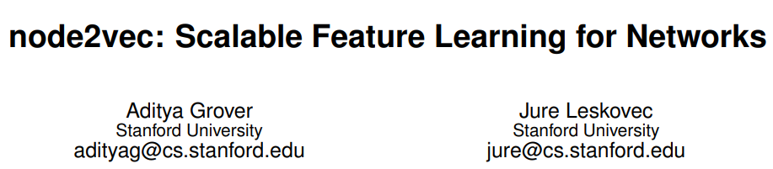

Slide 2
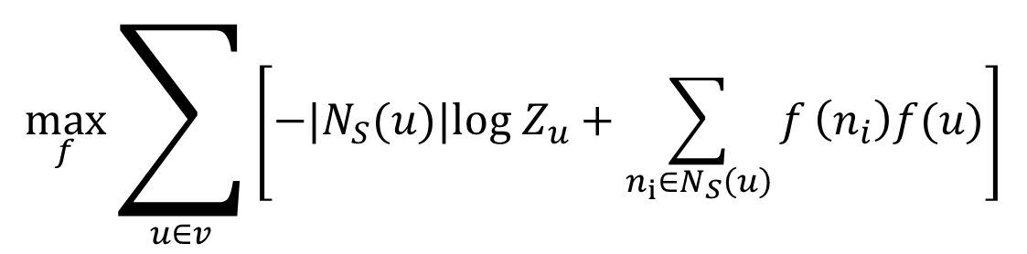
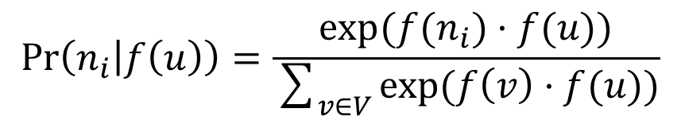
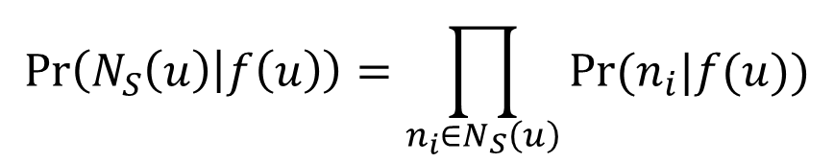
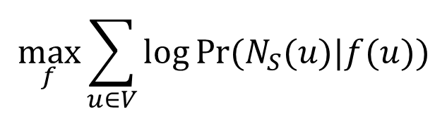
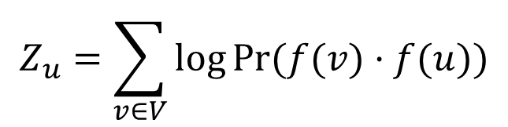
$f:V→ ℝ^{d}$, the mapping function from nodes to feature representations.
$N_{S}\left(u\right)⊂V$ as a network neighborhood of $u$ generated through a neighborhood sampling strategy $S$.
Maximize the log-probability:
Skip-Gram architecture
$$\max_{f}\sum_{u∈V}{log⁡Pr⁡(N_{S}(u)|f(u))}$$
(1)
two standard assumptions:
$$\operatorname{Pr}\left(N_{S}\left(u\right) | f\left(u\right)\right)=\prod_{n_{i}∈N_{S}\left(u\right)}{Pr⁡(n_{i}|f(u))}$$
Conditional independence
Symmetry in feature space
$$\operatorname{Pr}\left(n_{i} | f\left(u\right)\right)=\frac{exp⁡(f(n_{i})·f(u))}{\sum_{v∈V}{exp⁡(f\left(v\right)·f(u))}}$$
$$\max_{f}\sum_{u∈v}{\left[−|N_{S}(u)|log Z_{u}+\sum_{n_{i}∈N_{S}\left(u\right)}{f}\left(n_{i}\right)f(u)\right]}$$
(2)
SGD
$$Z_{u}=\sum_{v∈V}{log⁡Pr⁡(f(v)·f(u))}$$
negative sampling
Notes:
Part1：目标函数
对称是指一个node作为source node和neighbor node共享一个embedding vector.

Slide 3
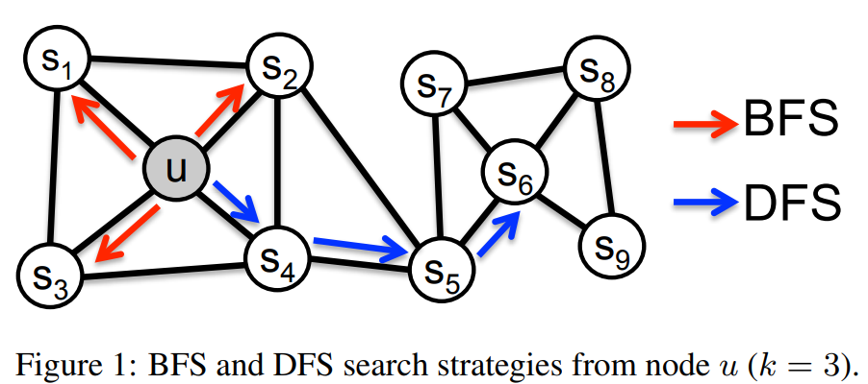
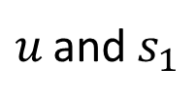
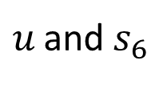
Two extreme sampling strategies for generating neighborhood set(s) $N_{S}$ of $k$ nodes:
Bread-Frist Sampling(BFS)
Depth-Frist Sampling(DFS)
Two kind of similarities:
Homophily
Nodes that highly interconnected and belong to similar network clustering or communities, embedded closely together.
DFS does, a macroscopic view of the neighborhood.
Drawback: Constrained sample size and a large neighborhood to explore,
Resulting in high variance.
greater depth → sample nodes far from source → complex dependencies
Structural equivalence
Nodes that have similar structural roles, embedded closely together.
BFS does, a microscopic view of the neighborhood.
Drawback: A very small portion of the graph is explored for any given k.
$u$ and $s_{1}$
$u$ and $s_{6}$
Notes:
Part2: 两种极端定点采样策略，BFS以及DFS
DFS表示同质性(homophily)，BFS表示结构等价性(structural equivalence)。
同质性跟之前的DeepWalk很像。
结构等价性通常不强调连通性。

Slide 4
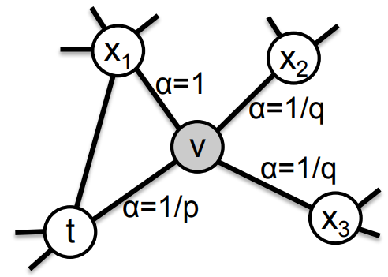
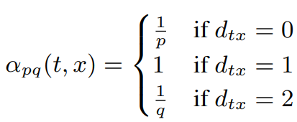
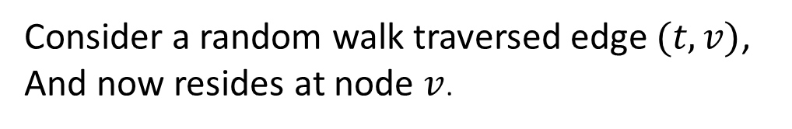
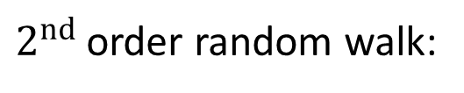
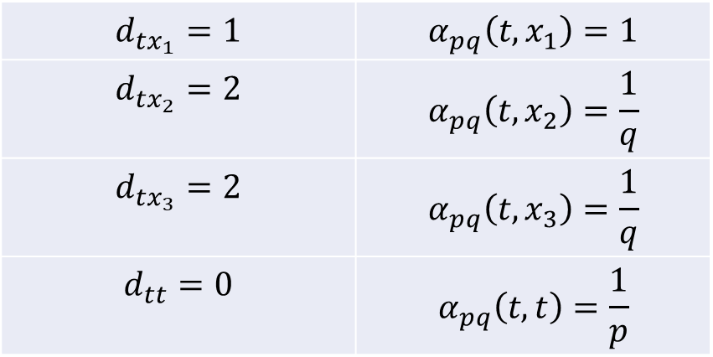
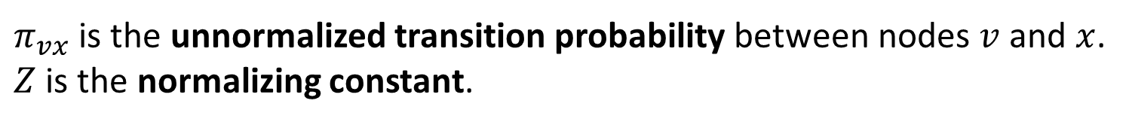
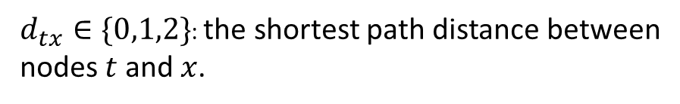
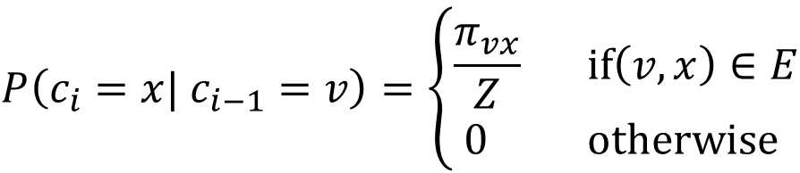

$2^{nd}$ order random walk:
$[c_{0},c_{1},···,c_{l}]$ : a random walk of fixed length $l$ from source node $u$. $c_{i}$ denote the $ith$ node in the walk, $c_{0}=u.$
$$P\left(c_{i}=x| c_{i−1}=v\right)=\left\{\begin{matrix}\frac{π_{vx}}{Z} if\left(v, x\right)∈E \\ 0 otherwise \end{matrix}\right.$$
$π_{vx}$ is the unnormalized transition probability between nodes $v$ and $x$.
$Z$ is the normalizing constant.
Consider a random walk traversed edge $(t,v)$,
And now resides at node $v$.
$$π_{vx}=α_{pq}\left(t,x\right)·w_{vx}$$
$$d_{tx_{1}}=1$$ | $$α_{pq}\left(t,x_{1}\right)=1$$
$$d_{tx_{2}}=2$$ | $$α_{pq}\left(t,x_{2}\right)=\frac{1}{q}$$
$$d_{tx_{3}}=2$$ | $$α_{pq}\left(t,x_{3}\right)=\frac{1}{q}$$
$$d_{tt}=0$$ | $$α_{pq}\left(t,t\right)=\frac{1}{p}$$
$d_{tx}∈\{0,1,2\}$: the shortest path distance between
nodes $t$ and $x$.
Notes:
Part3: node2vec顶点采样策略：2阶有偏随机游走
有偏的随机游走。

Slide 5
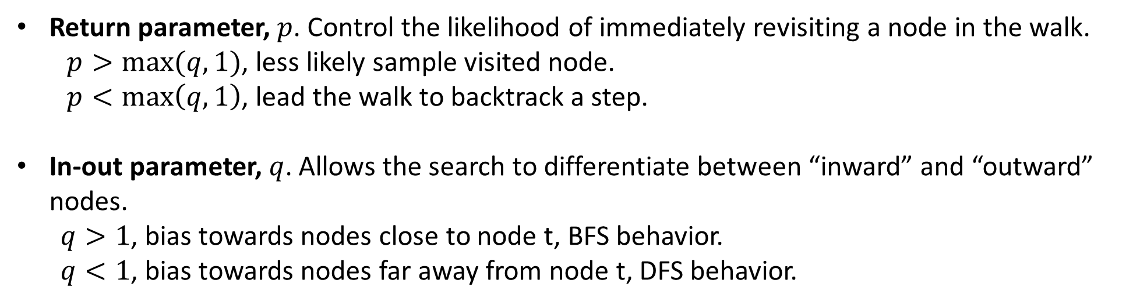
Return parameter, $p$. Control the likelihood of immediately revisiting a node in the walk.
$p>max⁡(q,1)$, less likely sample visited node.
$p<\max\left(q,1\right)$, lead the walk to backtrack a step.
In-out parameter, $q$. Allows the search to differentiate between “inward” and “outward” nodes.
$q>1$, bias towards nodes close to node t, BFS behavior.
$q<1$, bias towards nodes far away from node t, DFS behavior.
node2vec is not tied to a particular notion of equivalence.
参考链接：【Graph Embedding】node2vec：算法原理，实现和应用 - 知乎 (zhihu.com)
Notes:
p比较大，在下面两步取样到已经访问结点的可能性变低，这将会有一个适中的探索以及避免取样中的2-hop多余性。
P
比较小，随机游走可能会返回一步，这将会保持随机游走在源点u的附近。
q>1，随机游走偏向访问距离t近的点，更偏向BFS
q<1，随机游走偏向访问距离t远的点，更偏向DFS

