Slide 1
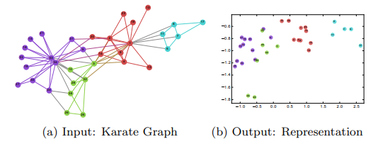
DeepWalk: Online Learning of Social Representations (2014)
1. INTRODUCTION
DeepWalk: Learn social representations by treating truncated random walks as the equivalent of sentences.
social representations: Latent features of the vertices that capture neighborhood similarity and community membership.
Feature of original network
encode
social relation
low-dimension vector
classification
truncated: 截断的.
The first one to introduce deep learning techniques into network analysis (or network embedding).
Significantly performance increased.
Scalable.

Slide 2



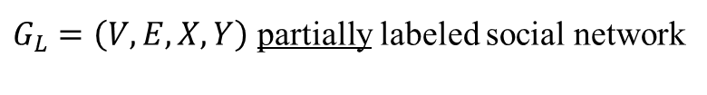

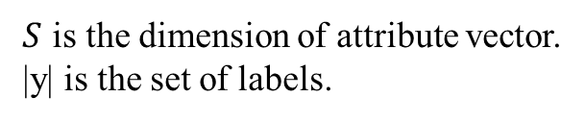


2. PROBLEM DEFINITION
Consider the problem of classifying members of a social network into one or more categories.
$S$ is the dimension of attribute vector.
|y| is the set of labels.
$G_{L}=\left(V,E,X,Y\right)$ partially labeled social network
$$S$$
attribute vector
goal
$$X$$
$$|V|$$
DeepWalk helps us to get the vector representation of each vertex.
Unsupervised feature learning, independent of the labels’ distribution.
classifier
|y|
Classify vertices into categories.
$$Y$$
$$|V|$$

Slide 3
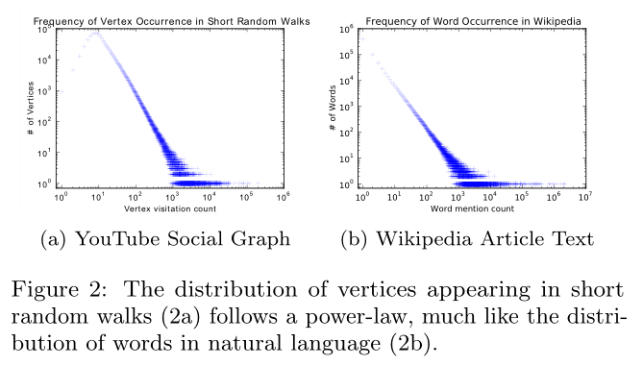
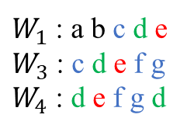





3. LEARNING SOCIAL REPRESENTATIONS
3.2 Connection: Power laws
Some characteristics:
Adaptability
Community aware
Low dimensional
Continuous
3.1 Random Walks
$$W_{v_{i}}^{1}$$
$$W_{v_{i}}^{2}$$
$$W_{v_{i}}^{3}$$
$$v_{i}$$
Visitation count | Of vertices
1 | 2: a b
2 | 2: c f
3 | 1: e
4 | 1: d
root
$W_{1}$ : a b c d e
$W_{3}$ : c d e f g
$W_{4}$ : d e f g d
random walk $W_{v_{i}}$
Capturing community information.
Easy to parallelize.
Accommodate small changes without computing globally.
Text is a sequence of words.
Random walk is a sequence of vertices.

Slide 4











3.3 Language Modeling
Give a sequence of words $W_{n}^{1}=\left(w_{0},w_{1},···,w_{n}\right)$.
Maximize $Pr⁡(w_{n}|w_{0},w_{1},···,w_{n−1})$ over all the training corpus, where $w_{i}∈V$ ($V$ is the vocabulary).
Ex. The cat is sitting on the fire.
?
$$Φ:v∈V ↦ ℝ^{\left|V\right|×d}$$
$Pr⁡(v_{i}|v_{1},v_{2},···,v_{i−1})$
$Pr⁡(v_{i}|Φ(v_{1}),{Φ(v}_{2}),···,{Φ(v}_{i−1}))$
relaxation
$$v_{2}$$
$$v_{4}$$
$Pr⁡({\{v}_{1},v_{2},v_{4},v_{5}\}|Φ\left(v_{3}\right))$
Independent vertex order, better capture the ‘nearness’ provided by random walks.
Training faster, given one vertex at a time.
$$v_{1}$$
$$v_{3}$$
$$v_{5}$$
$$w=2$$
$$w=2$$

Slide 5
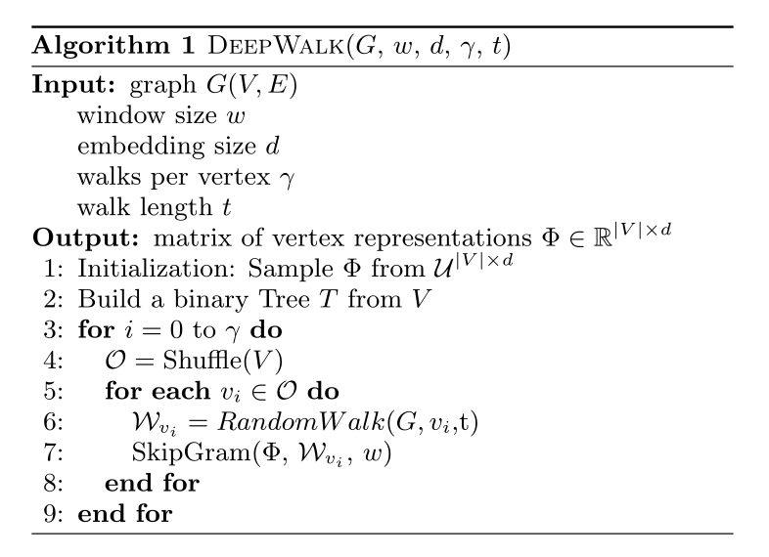
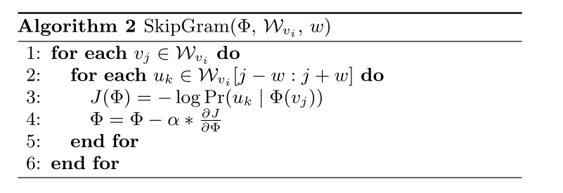
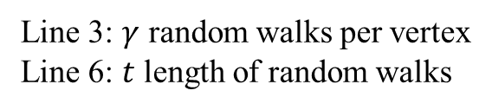
Line 3: $γ$ random walks per vertex
Line 6: $t$ length of random walks
Notes:
幂律分布: 某个随机变量分布密度函数是幂函数，表现在图上一条斜率为幂指数负数的直线.

Slide 6

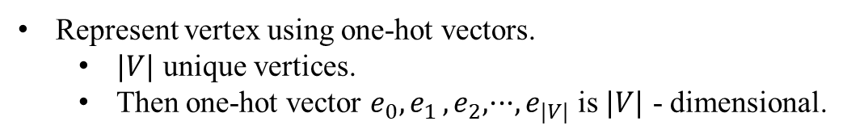

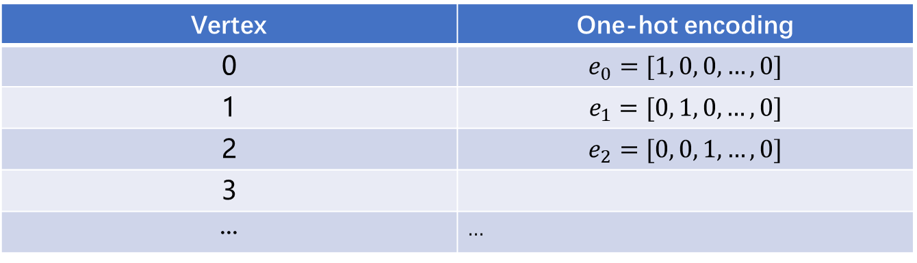



Represent vertex using one-hot vectors.
$|V|$ unique vertices.
Then one-hot vector $e_{0},e_{1 }, e_{2}, ···, e_{|V|}$ is $|V|$ - dimensional.
Vertex | One-hot encoding
0 | $$e_{0}=[1, 0, 0,…,0]$$
1 | $$e_{1}=[0, 1, 0,…,0]$$
2 | $$e_{2}=[0, 0, 1,…,0]$$
3
··· | ···
$$W_{v_{i}}^{1}$$
$$W_{v_{i}}^{2}$$
Capturing community information.
Easy to parallelize.
Accommodate small changes without computing globally.
$$W_{v_{i}}^{3}$$
$$v_{i}$$
root
random walk $W_{v_{i}}$

